Slide 1
HKCEM
JCM
OSCE
2 July 2025
United Christian Hospital

Slide 2
Case 1
M/3
Known Autism
Dry cough 2/12
  Seen by GP, told reactive airway and Ventolin was given
  Attended AED for no improvement
Vital signs
  BP 107/73 p 143/min
  SpO2 97% room air
  Temp 36.8°C

Slide 3
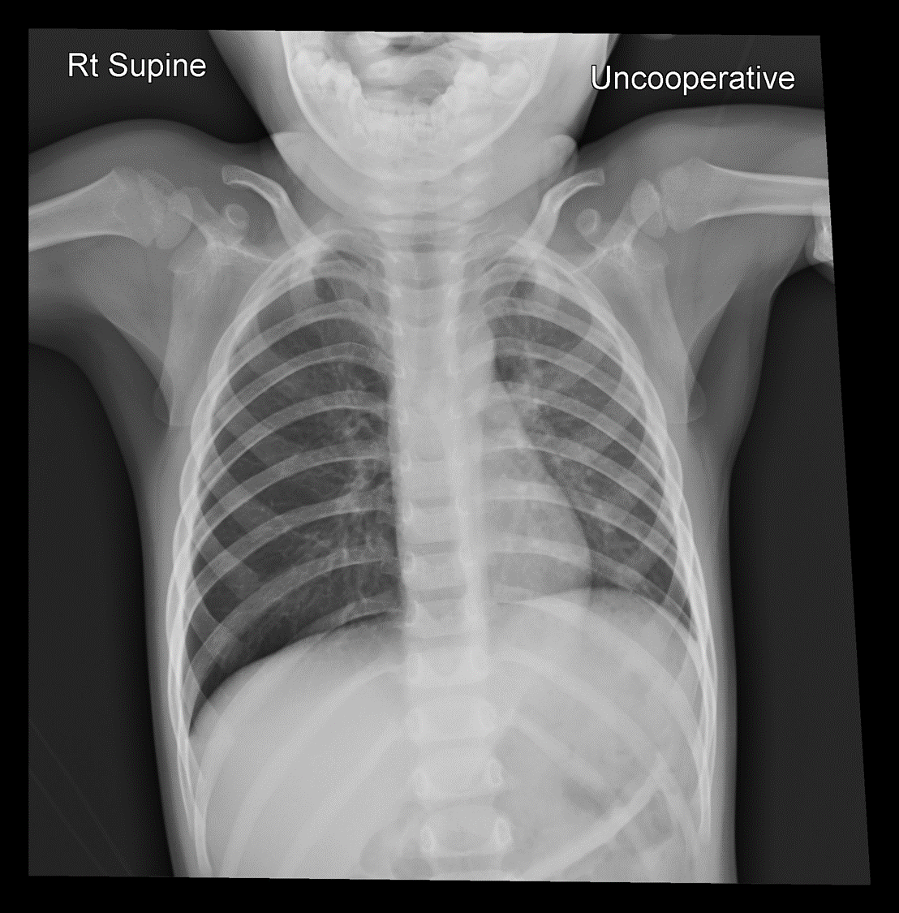
Case 1
1. What are the abnormal CXR findings? (2 points)

Slide 4
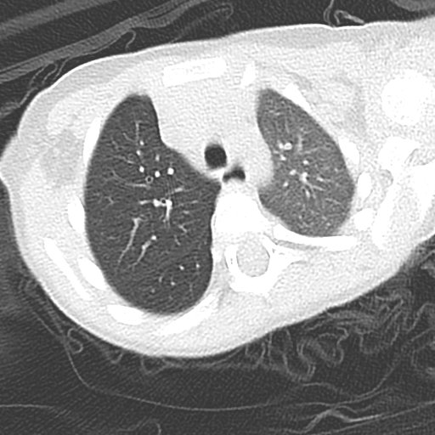
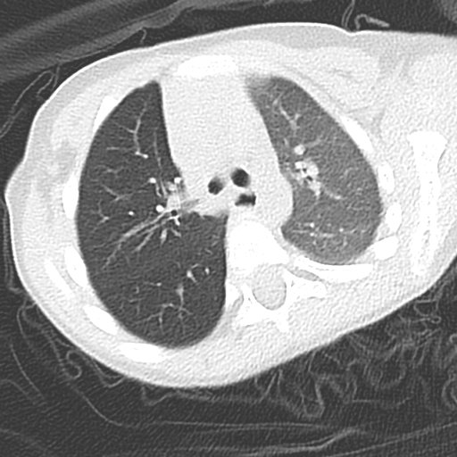
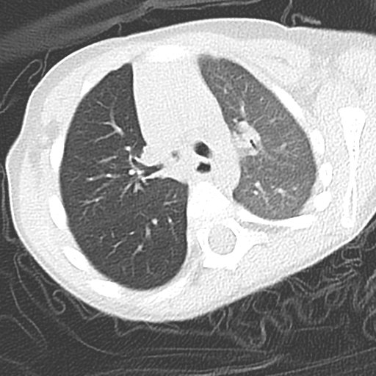
Case 1
2. What are the abnormal CT findings? (2 points)

Slide 5
Case 1
What are the abnormal CXR findings? (2 points)
  Relative lucency of right lung field
  Mild flattening of right hemidiaphragm
What are the abnormal CT findings? (2 points)
  Diffuse increase in lung attenuation and volume reduction of left lung
  Intraluminal density obstructing right distal main bronchus, suspected foreign body
What is the definitive management? (1 point)
  Bronchoscopy and retrieval of foreign body

Slide 6
Case 2
F/89
Known chronic rheumatic heart disease
Complains of SOB for three days
Vital signs
  BP 124/64, pulse 88/min
  SpO2 98% on 2L O2
  Afebrile

Slide 7
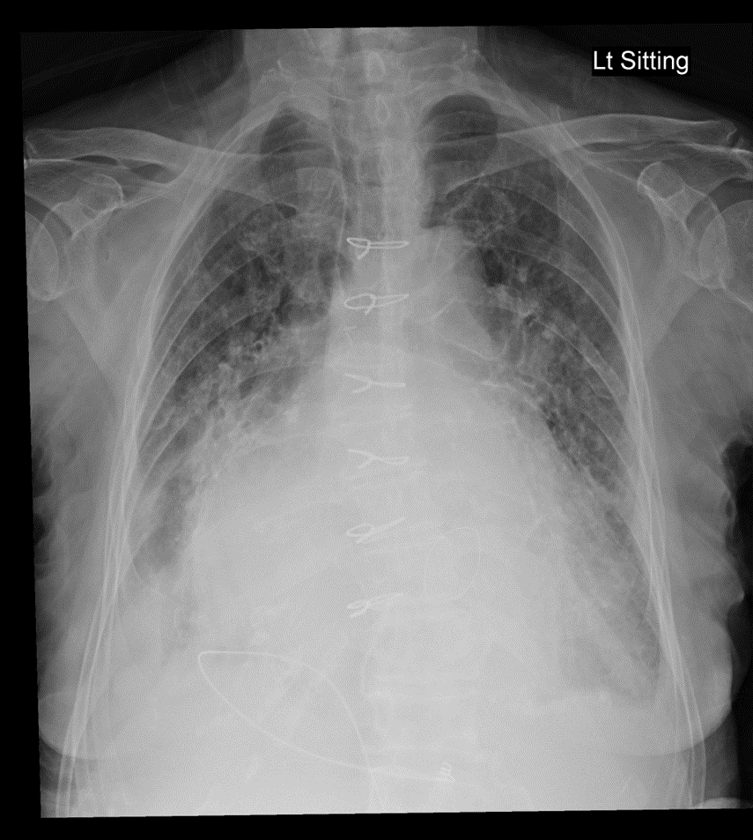
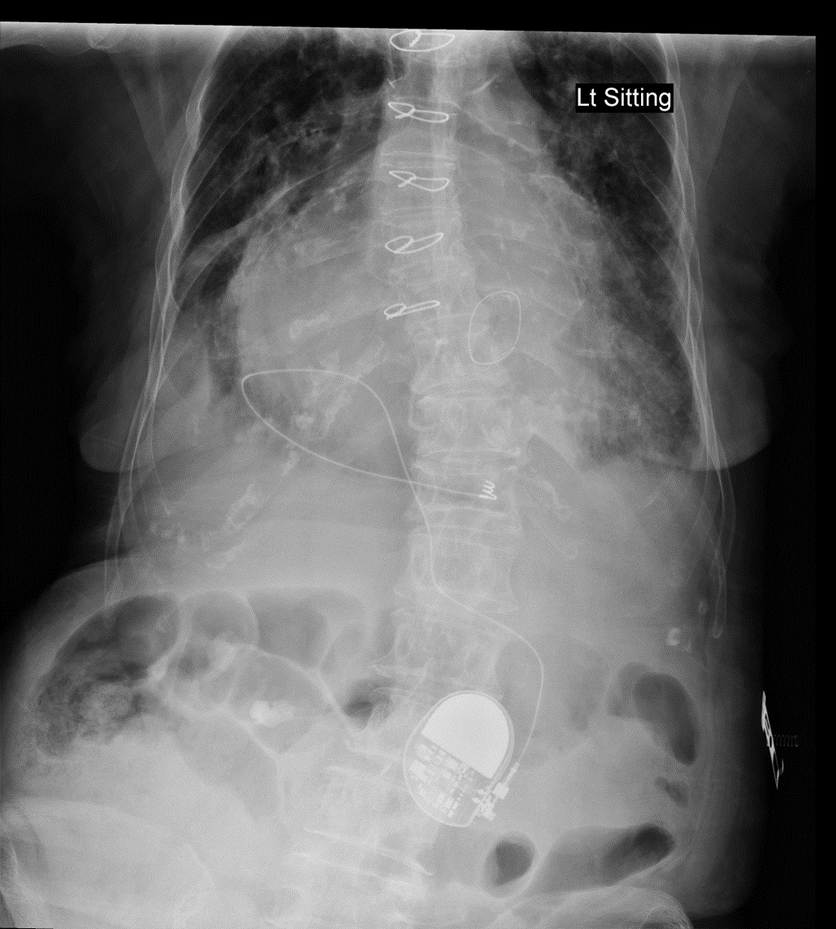
Case 2
1. What is the device shown from the X-ray?

Slide 8
Case 2
What is the device shown from the X-ray? (1 point)
  Epicardial lead pacemaker
Name two reasons for not using a transvenous device. (2 points)
  Abnormal anatomy/previous surgery
  Venous obstruction
Name two disadvantages of the device compared with a transvenous device. (Any 2)
  Higher incidence of lead failure
  Potential for increased thresholds
  Less durability

Slide 9
Case 3
M/32
Known substance abuser, vaping habit
Found confused and generalized weakness
Vital sings
  GSC 12 E3V4M5
  BP 110/60, pulse 120/min
  SpO2 100%
  Afebrile
  H’stix 5.1 mmol/L

Slide 10
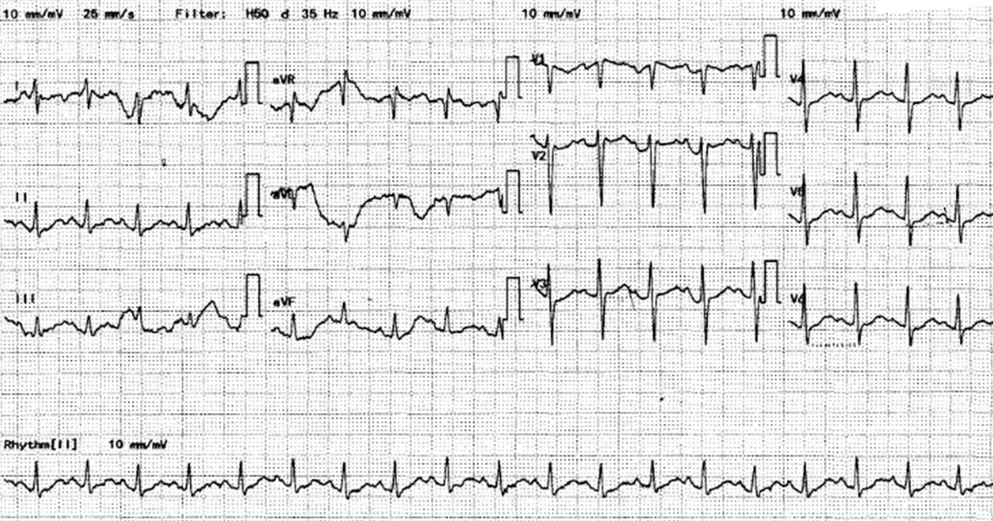
Case 3
1. What are the abnormal ECG findings? (2 points)

Slide 11
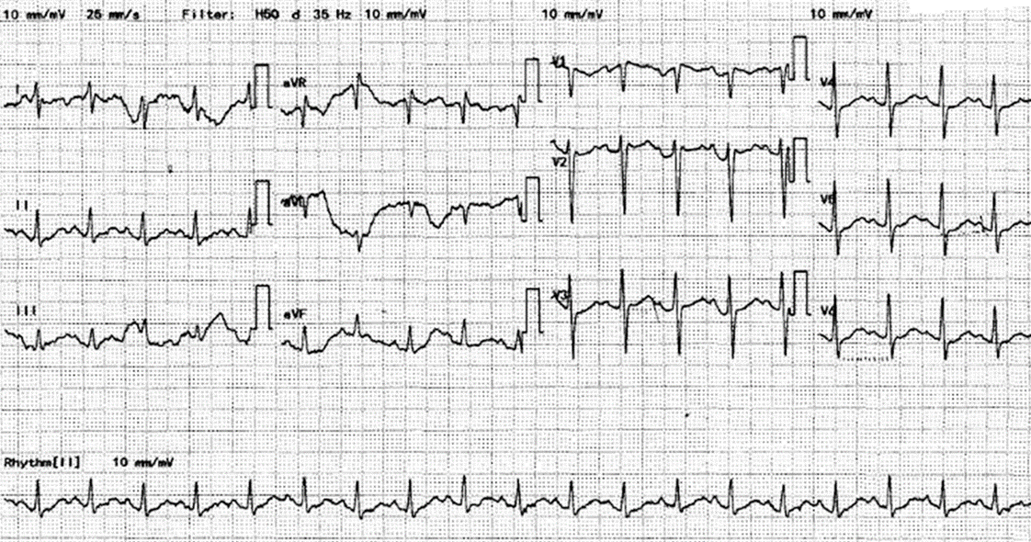
Bazett’s formula:
QTc = QT / √RR
520ms=9x0.04/√(12x0.04)

Slide 12
Case 3
What are the abnormal ECG findings? (2 points)
  Sinus tachycardia, prolonged QTc
What is the likely cause of the ECG findings and the underlying causative agent? (2 points)
  Hypokalemia
  Etomidate/Space Oil drug
What is another metabolic complication which can be caused by that agent? (1 point)
  Adrenal insufficiency

Slide 13
Case 4
M/63
Fell from a motorbike (static) with right hand landed
Tenderness over right palm

Slide 14
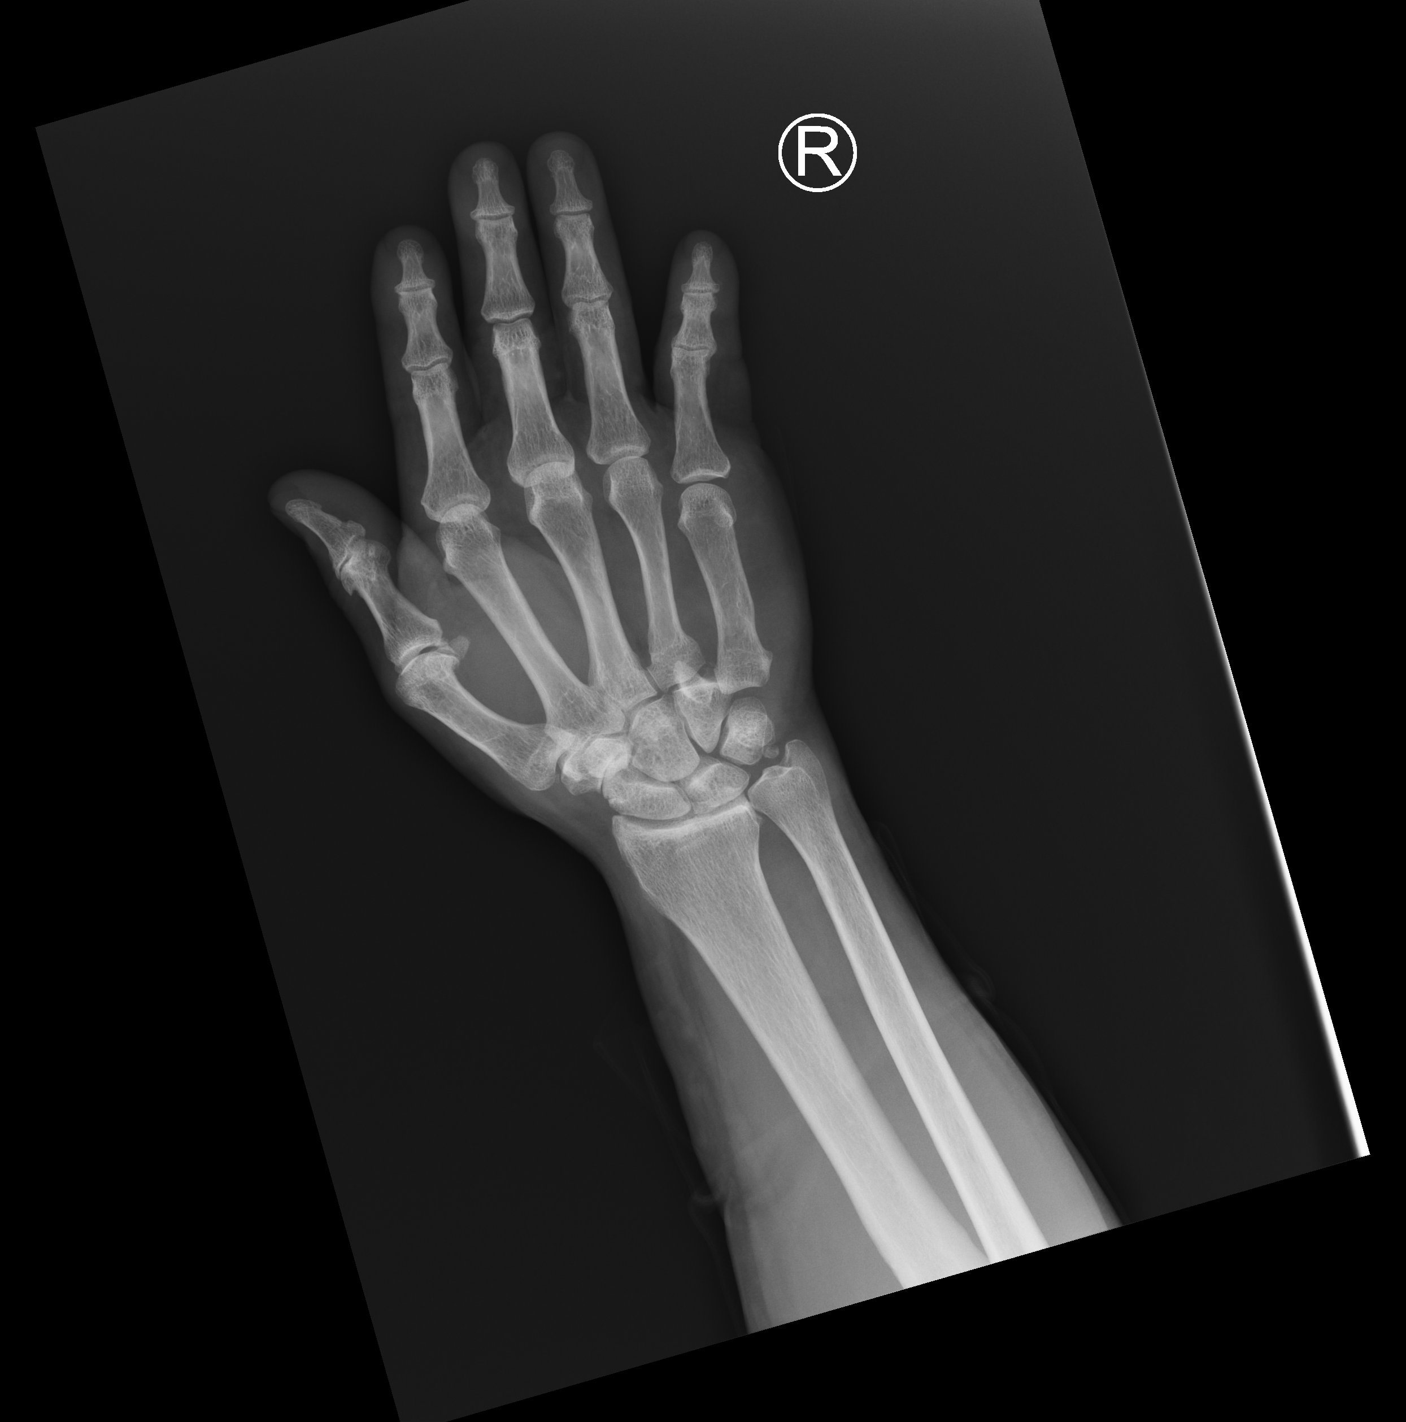

Slide 15
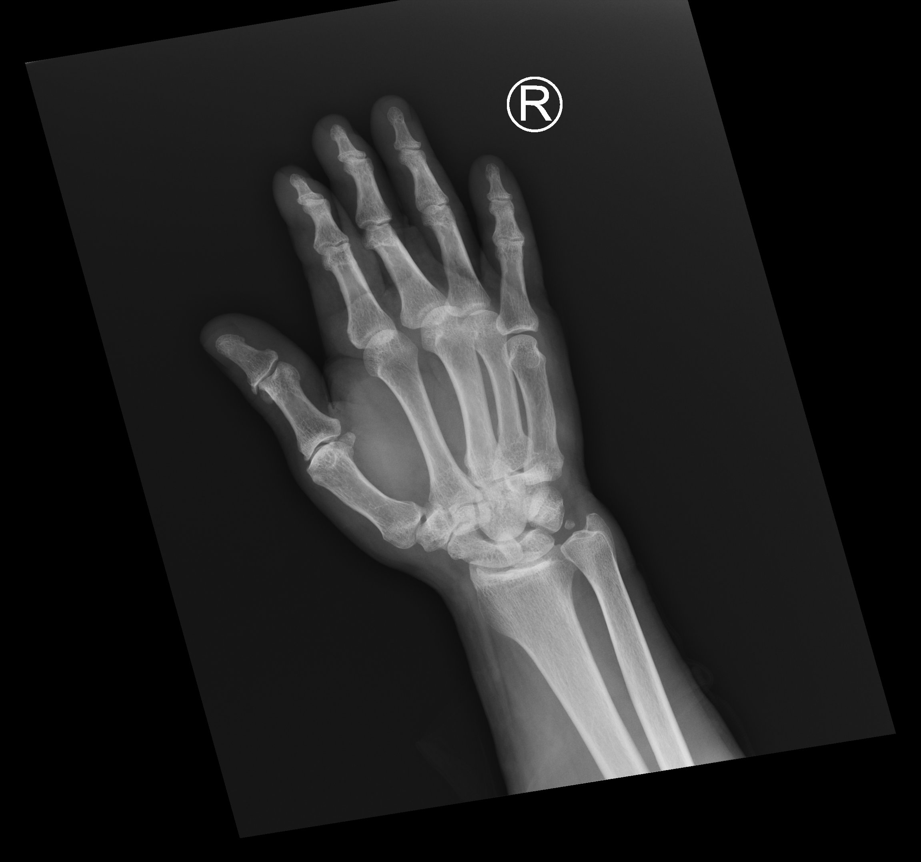

Slide 16
Case 4
What is the diagnosis? (2 points)
  Right 5th CMC dislocation
What is the usual mechanism of injury? (1 point)
  Direct force impact on the ulnar side of hand with clenched fist, or
  Axial loading force along the longitudinal axis of the fifth MC
What is the definitive treatment? (2 points)
  Close reduction and immobilization
  Open reduction (if CR failed) and surgical fixation (if the joint is unstable)

Slide 17
Case 5
F/92
Known suspected CA rectum
Found decreased GC
Vital signs
  BP 120/71, pulse 119/min
  SpO2 99%
  Temp 38.6°C
  H’stix 5.2mmol/L
Abdomen non-tender

Slide 18
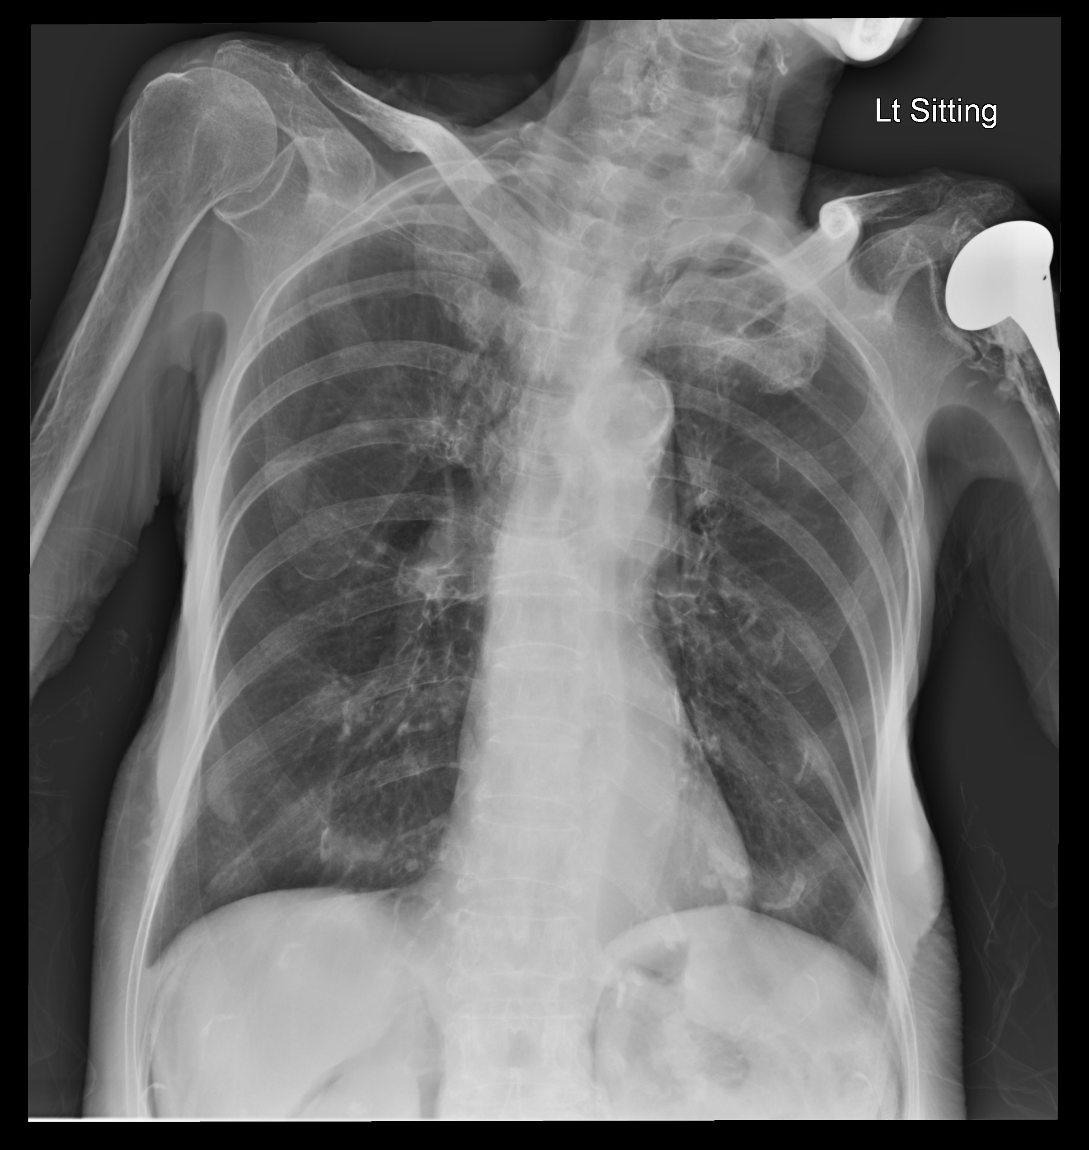

Slide 19
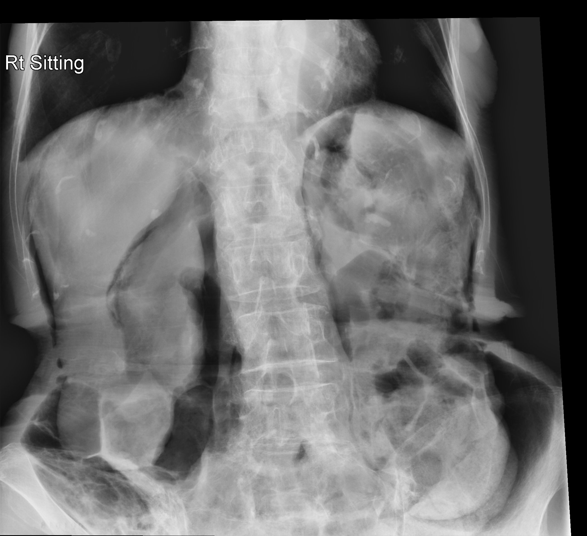

Slide 20
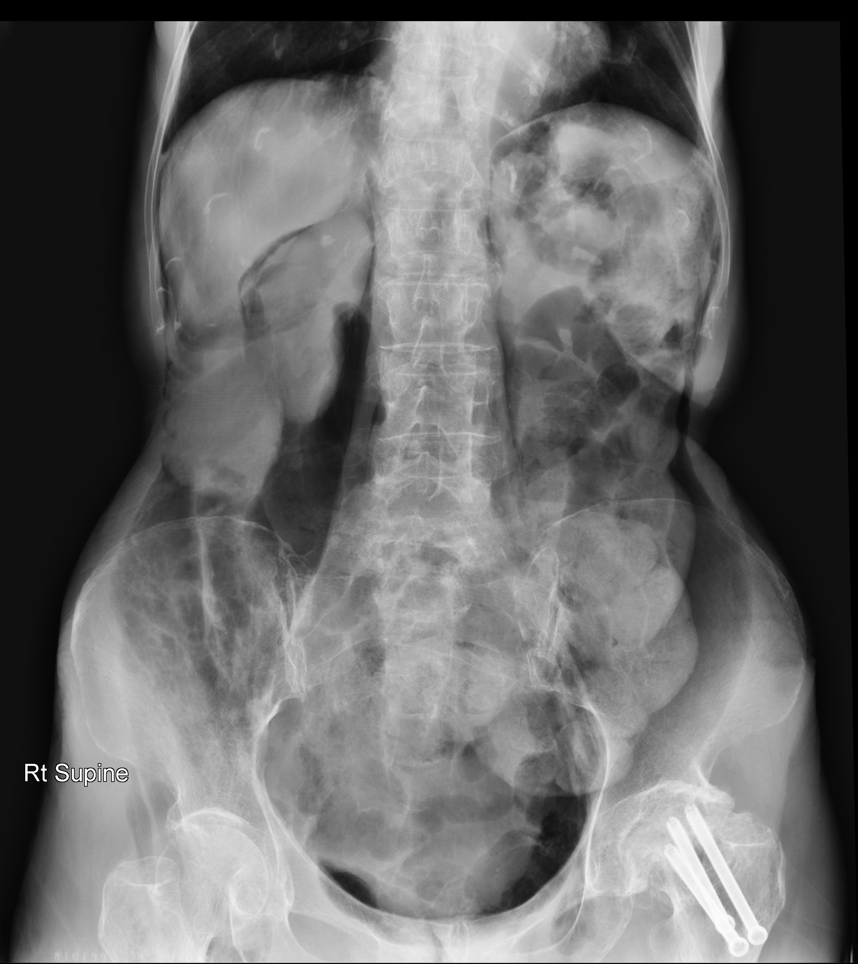

Slide 21
Case 5
What is the diagnosis? (2 points)
  Pneumoretroperitoneum
What are the X-ray findings support your diagnosis? (3 points)

Slide 22
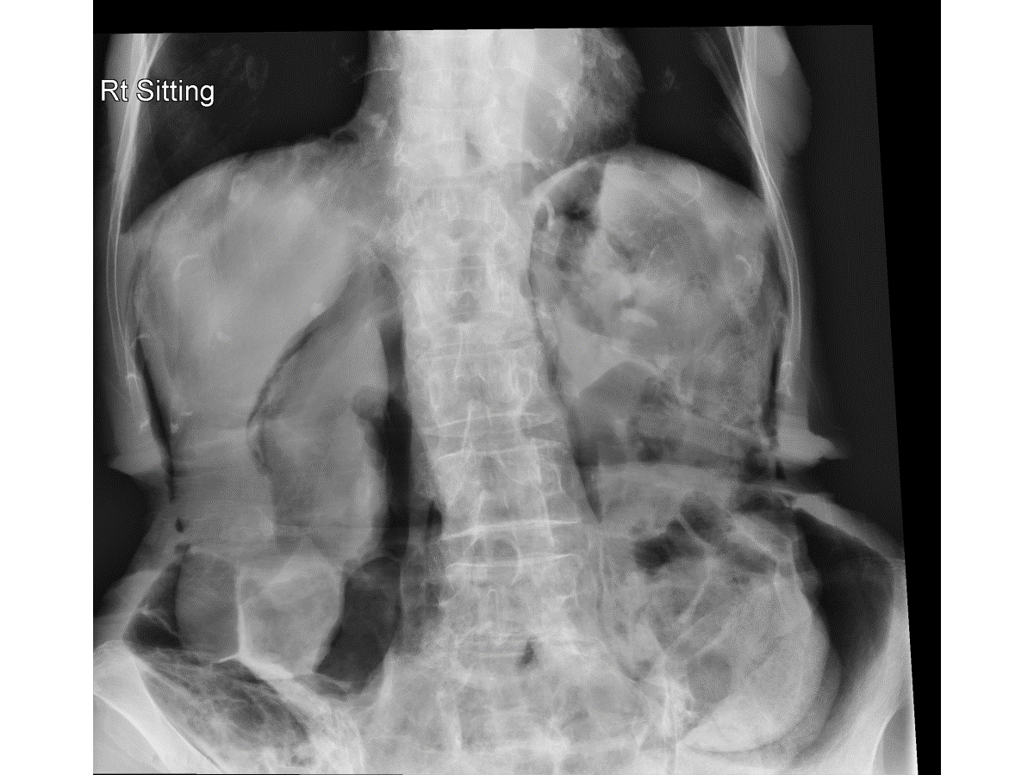
Case 5
2. What are the X-ray findings support your diagnosis?
Pneumoretroperitoneum
Free gas:
  outlining the borders of kidneys or iliopsoas muscle
  accumulates under the diaphragm either medially or laterally (vs crescent-shaped air under diaphragm in pneumoperitoneum)
  Lack of other features of pneumoperitoneum (such as continuous diaphragm sign, Cupola sign and Rigler sign)

Slide 23
Case 6
M/70
Smoker
Cough for months
SOB few days
Vital signs
  BP 198/100, pulse 126/min
  SpO2 97% on 2L O2
  afebrile

Slide 24
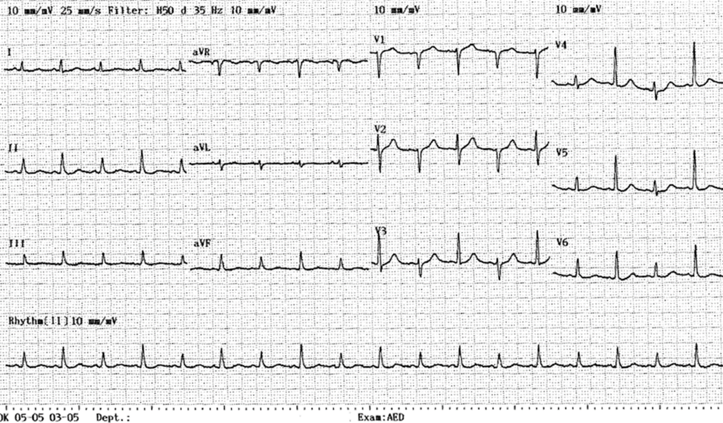
Case 6
What are the abnormal ECG findings? (2 points)
  Sinus tachycardia
  Electrical alternans

Slide 25
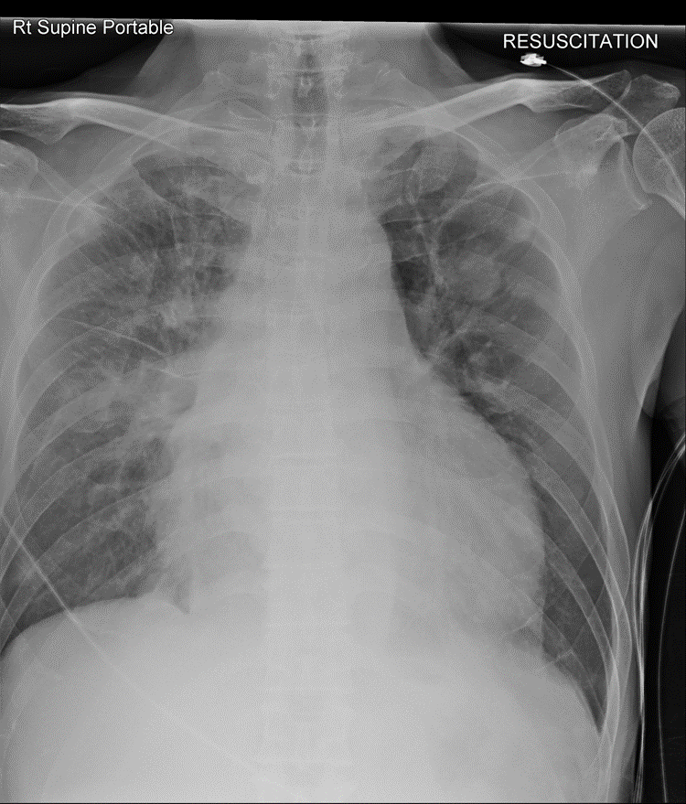
Case 6
2. State three abnormal CXR findings
Globular heart
Pulmonary congestion
LUZ mass with multiple lung shadows

Slide 26

Case 6
3. What is the likely diagnosis? (2 points)
Malignant Pericardial effusion with underlying metastatic CA lung

Slide 27
END

