Slide 1
20180103 JCM OCSE
Prepare by
A&E Department, QMH

Slide 2
Case 1
F/30, good past health
C/O severe right peri-orbital headache x 1/7 associated with repeated vomiting and mild blurring of vision
CT brain was ordered

Slide 3
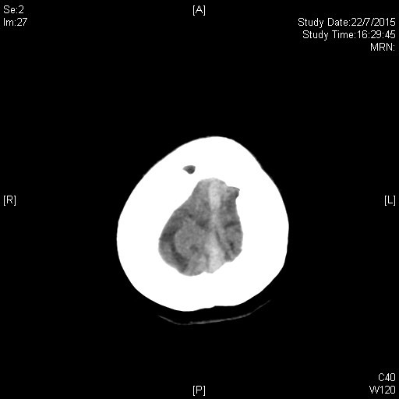
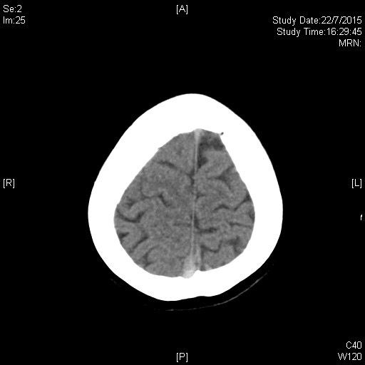
Case 1

Slide 4
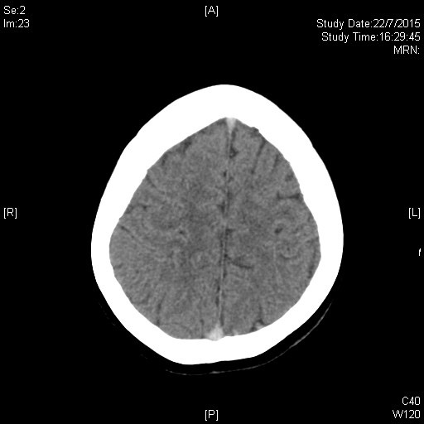
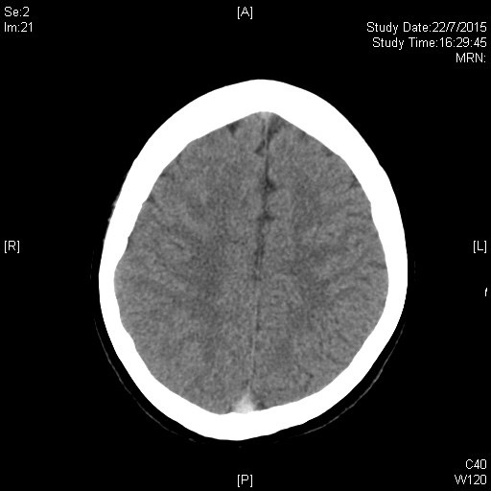
Case 1

Slide 5
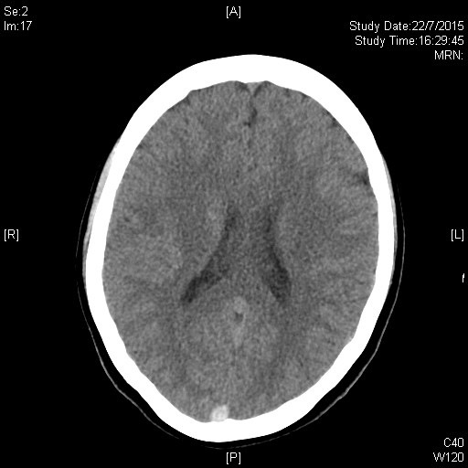
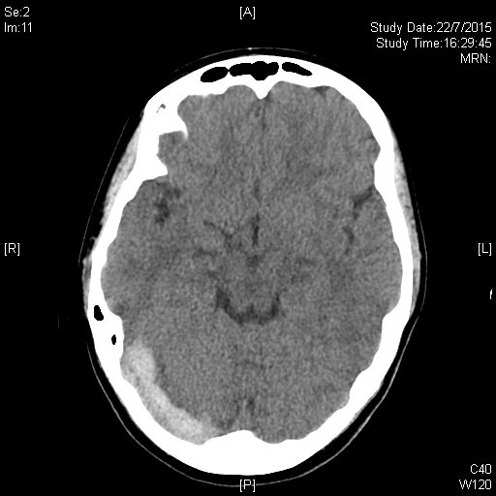
Case 1

Slide 6
Case 1
Q1. What are the differential diagnoses?

Slide 7
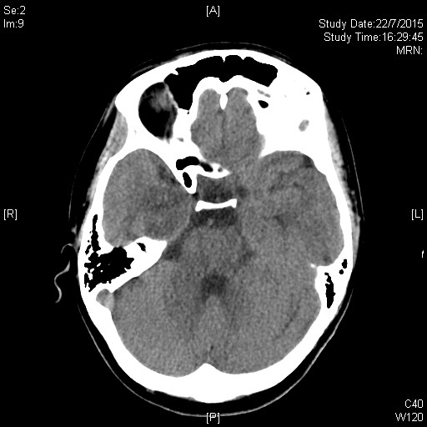
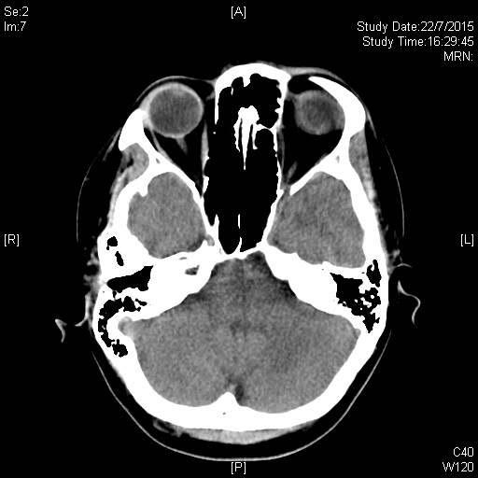
Case 1

Slide 8
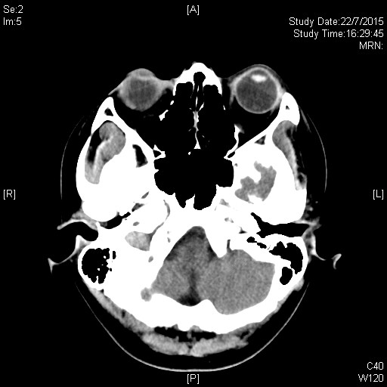
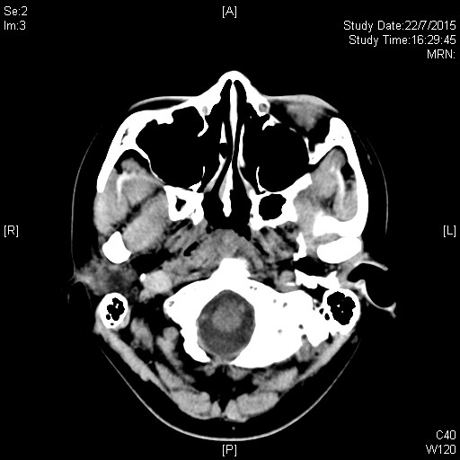
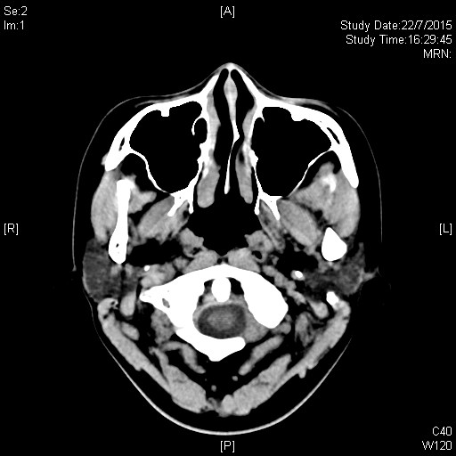
Case 1

Slide 9
Case 1
Q2. Name 2 sites involved on the CT brain shown.

Slide 10
Case 1
The patient has no history of HT
No recent head injury
On OC pills for 1 year

Slide 11
Case 1
Q3. What is the most likely diagnosis?
Q4. What further investigations would you order?
Q5. Name 4 precipitating factors for causing the above condition.
Q6. Name 3 treatment options.

Slide 12
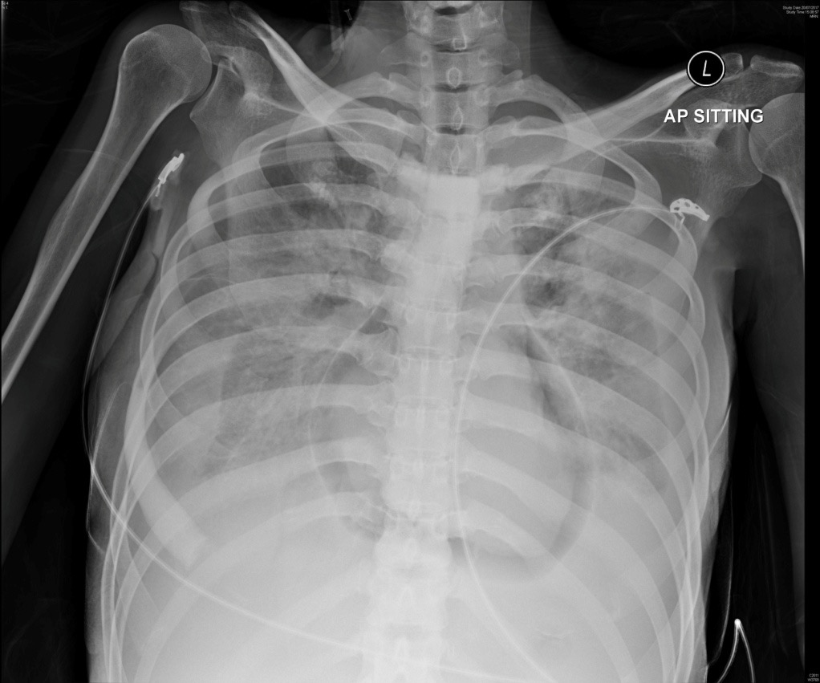
Case 2
F/32
Metastatic carcinoma of breast on palliative care
BP 79/48 P 109 Temp 37.2

Slide 13
Case 2
Q1. Name 3 radiological findings
Q2. What is the condition called?
Q3. Name 3 causes for the above condition.
Q4. What is the immediate treatment?

Slide 14
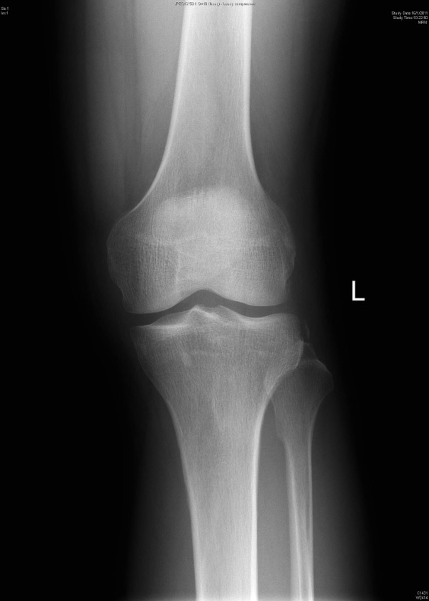
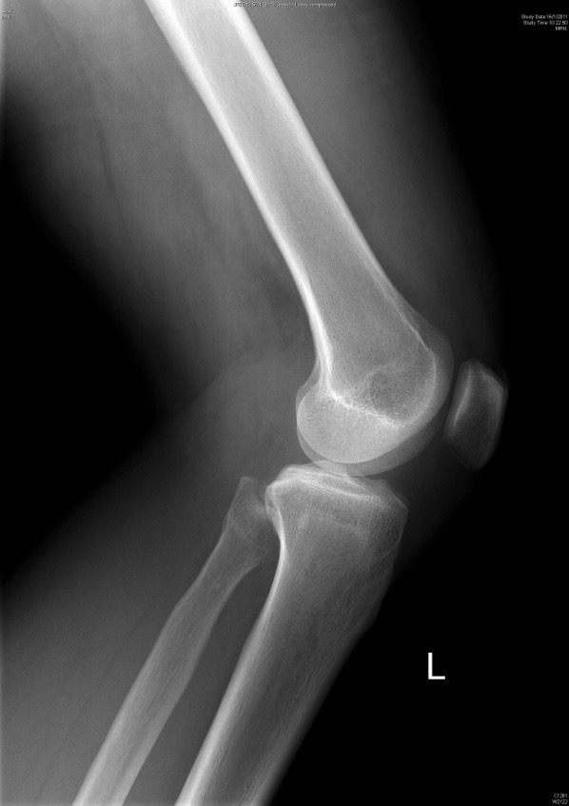
Case 3
M/50, left knee sprain while skiing, left knee effusion noted

Slide 15
Case 3
Q1. What is the X-ray finding?
Q2. What is the fracture called?
Q3. What are the mechanisms of injury?
Q4. Name 2 associated injuries at the knee.

Slide 16
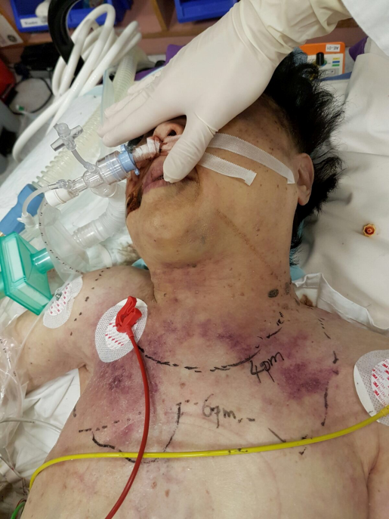
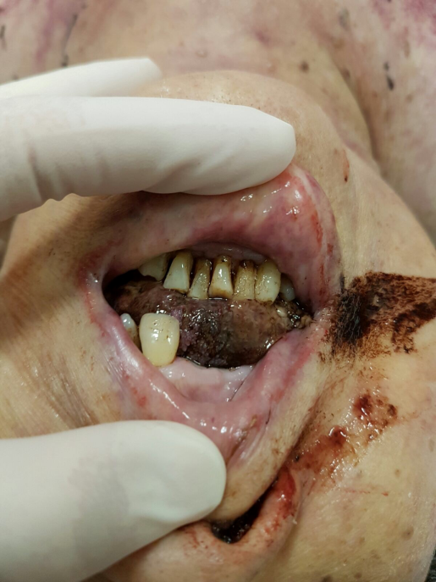
Case 4
F/84, past history of CA breast and HT, presented with tongue base blister for 3 days
Sepsis with septic shock on arrival

Slide 17
Case 4
Q1. Describe 2 clinical photo features.
Q2. What is the condition called?
Q3. Which structure of the neck is involved?

Slide 18
Case 4
Q4. Name the most likely causative agents.
Q5. What are the 4 types of Necrotizing fasciitis?
Q6. Name 3 treatment modalities for the above condition.

Slide 19
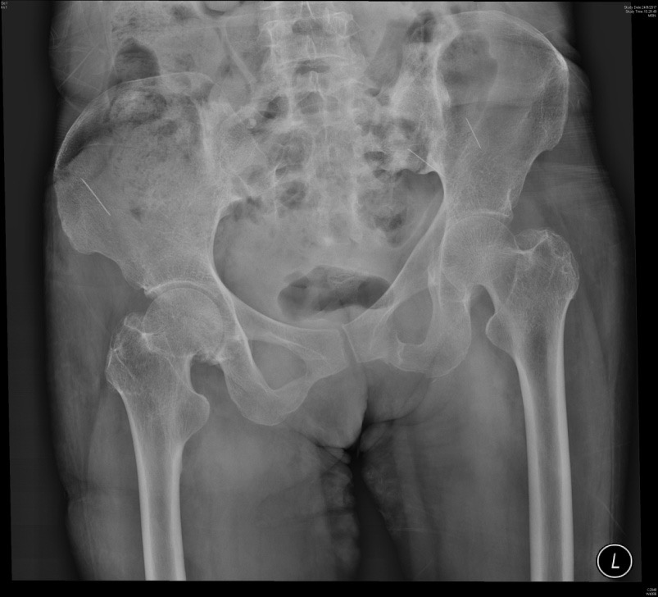
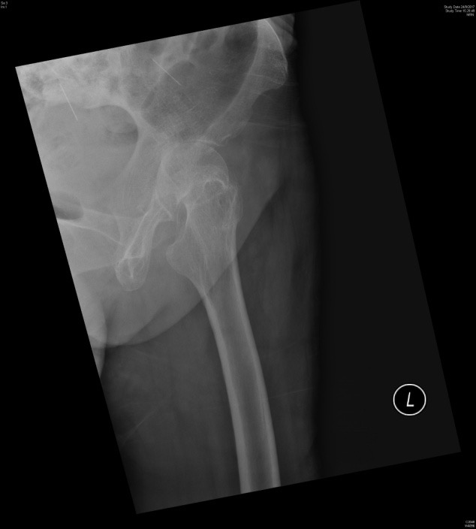
Case 5
F/50, known IVDA, presented with left hip pain

Slide 20
Case 5
Q1. Describe two XR features.
Q2. What is the most likely diagnosis?
Q3. Name two most common causative agents in this group of patients.
Q4. What are the antibiotics of choice?

Slide 21
Thank you

