Slide 1
20180103 Joint Clinical Meeting OSCE
Dr S YEUNG
A&E Department
Queen Mary Hospital

Slide 2
Case 1

Slide 3
Case 1
F/30, good past health
C/O severe right peri-orbital headache x 1/7 associated with repeated vomiting and mild blurring of vision
P/E vitals stable, GCS full, no neurology
CT brain was ordered

Slide 4
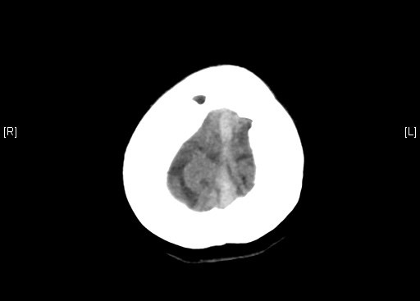
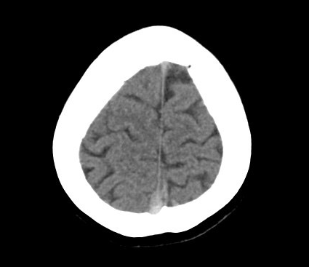
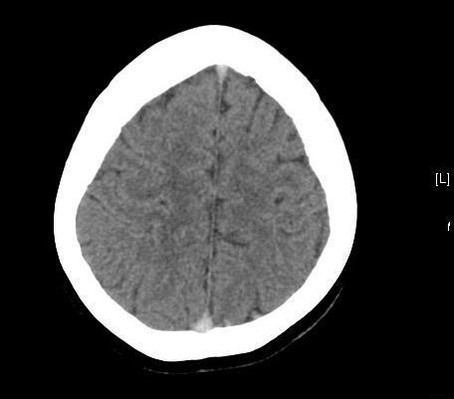
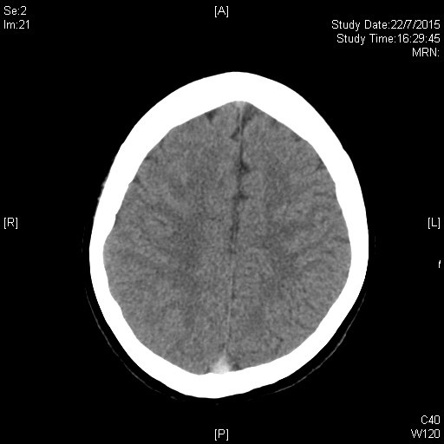
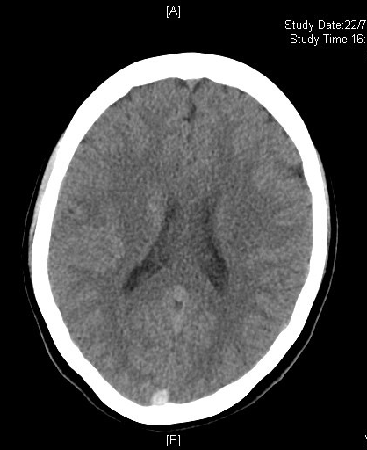
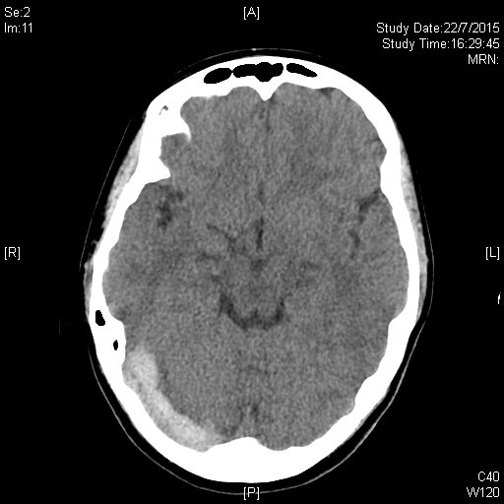

Slide 5
Case 1
Q1. What are the differential diagnoses?

Slide 6
Case 1
Q1. What are the differential diagnoses?
Answer
Intracerebral hemorrhage e.g. subdural hematoma
Intracerebral tumor with bleeding
Ischemic stroke with hemorrhagic transformation
Thrombotic event

Slide 7
Case 1
Q2. Name 2 sites involved on the CT brain.

Slide 9
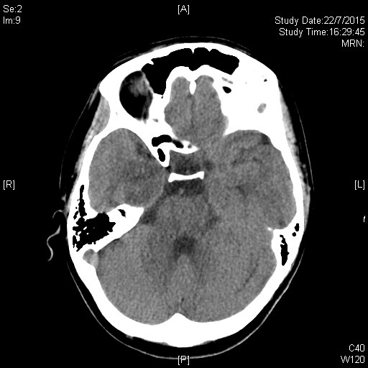
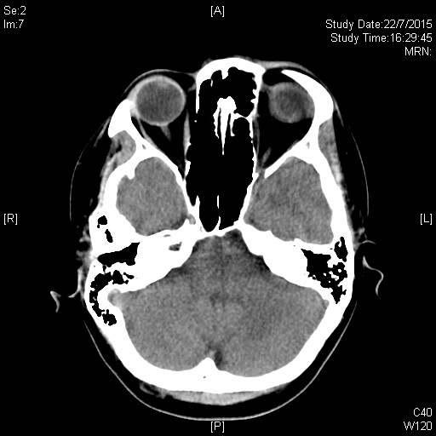
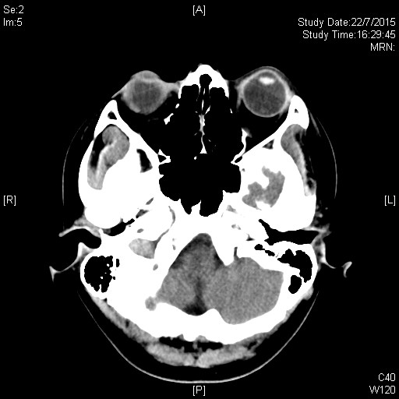
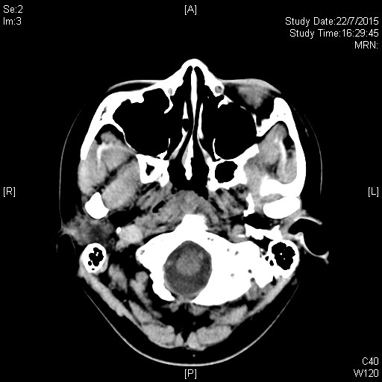
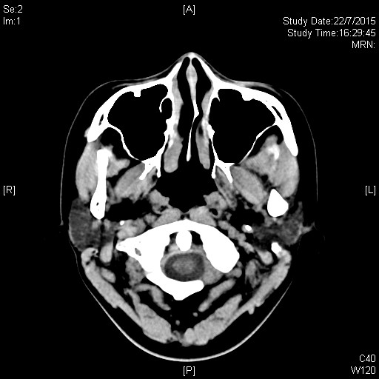

Slide 10
Case 1
Q2. Name 2 sites involved on the CT brain shown.
Answer
Superior sagittal sinus
Right sigmoid sinus
Right transverse sinus
Right internal jugular vein

Slide 11
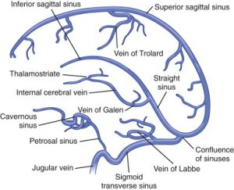

Slide 12
Case 1
On further history taking,
The patient has no history of HT
The patient has no recent head injury
The patient has been on OC pills for 1 year

Slide 13
Case 1
Q3. What is the most likely diagnosis for this patient?

Slide 14
Case 1
Q3. What is the most likely diagnosis for this patient?
Answer:
Cerebral venous sinus thrombosis

Slide 15
Case 1
Q4. What further investigations would you order?

Slide 16
Case 1
Q4. What further investigations would you order?
Answer
Contrast CT
CT angiogram/venogram brain and neck
MRI + MRA + MRV brain and neck

Slide 17
Case 1
Q5. Name 4 precipitating factors for causing the above condition.

Slide 18
Case 1
Q5. Name 4 precipitating factors for causing the above condition.
Answer
Neoplasm / Intracranial tumors / paraneoplastic
Pregnancy/ puerperium / Oral contraceptives
Coagulopathies
Surgeries / iatrogenic, head trauma
AVM
Infection
Autoimmune disease
30% idiopathic
Int J Stroke. 2009 Apr;
Cerebral venous sinus thrombosis risk factors.
Saadatnia M1, Fatehi F, Basiri K, Mousavi SA, Mehr GK.

Slide 19
Case 1
Q6. Name 3 treatment options.

Slide 20
Case 1
Q6. Name 3 treatment options.
Answer
Medical treatment
LMWH
Warfarin
+/- Anticonvulsants
+/- Antibiotics in cases of infection induced CVT
Local thrombolysis
Local +/- open thrombectomy
AHA/ASA Scientific Statement: Diagnosis and
management of cerebral venous thrombosis (Stroke
2011;42: 1158-1192)

Slide 21
Case 1
The patient has stable GCS throughout admission
Headache subsided on symptomatic treatment
Decided for conservative management
LMWH -> life long warfarin
Repeated CTB 1 month later showed no more CVT
Referred to O&G for pregnancy and contraception counselling

Slide 22
Case 2

Slide 23
Case 2
F/32
Metastatic carcinoma of breast on palliative care Known metastasis to lung, bone and brain Repeated long stay admissions
Presented with SOB, chest pain and hemoptysis
BP 79/48 P 109 Temp 37.2

Slide 24
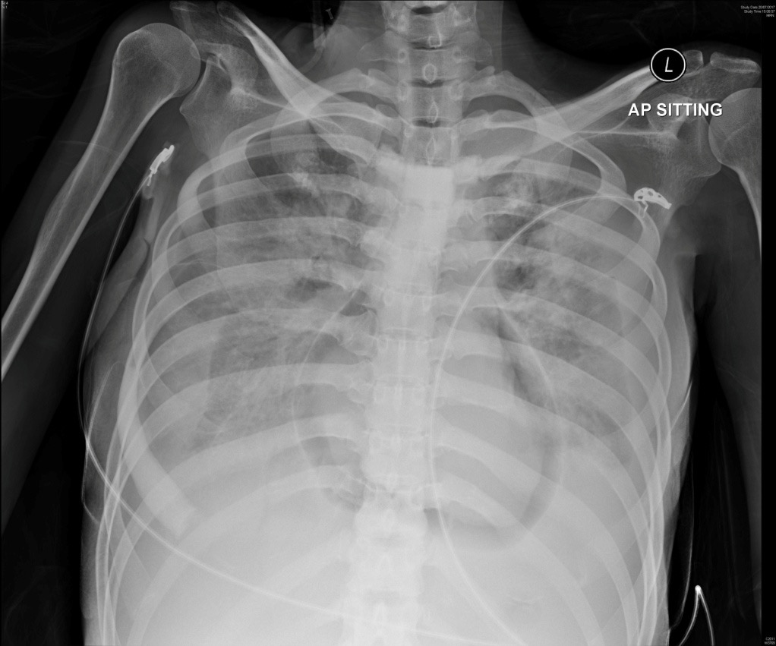

Slide 25
Case 2
Q1. Name 3 radiological findings.

Slide 26
Case 2
Q1. Name 3 radiological findings.
Answer
Bilateral pleural effusions
Lucent outline separating the pericardium from the heart
Right pneumothorax

Slide 27
Case 2
Q2. What is the condition called?

Slide 28
Case 2
Q2. What is the condition called?
Answer
Pneumopericardium

Slide 29
Case 2
Q3. Name 3 causes for the above condition.

Slide 30
Case 2
Q3. Name 3 causes for the above condition.
Answer
Penetrating / blunt chest trauma
Pericardial infections
Iatrogenic e.g. pericardiocentesis, external cardiac massage
Abnormal communications e.g. fistula between pericardium and trachea/lung parenchyma
Spontaneous

Slide 31
Case 2
Q4. What is the immediate treatment?

Slide 32
Case 2
Q4. What is the immediate treatment?
Answer
Conservative / observation in mild, stable and asymptomatic cases
Emergent pericardiocentesis
Pericardial fenestration and drainage

Slide 33
Case 2
Patient required increasing inotropic support
Recurrent pneumopericardium despite drainage
Succumbed same night of admission
Slama Iskander et al. Pneumopercardium: A rare
complication of pericardiocentesis. J Cardiovasc
Ultrasound 2016;24(1): 55-59.
Catalin-Iulian E et al. Sacre-Coeur: a torn sac. Emerg
Med J 2016;33:659

Slide 34
Case 3

Slide 35
Case 3
M/50
Good past health
Left knee sprain while skiing
P/E showed left knee effusion

Slide 36
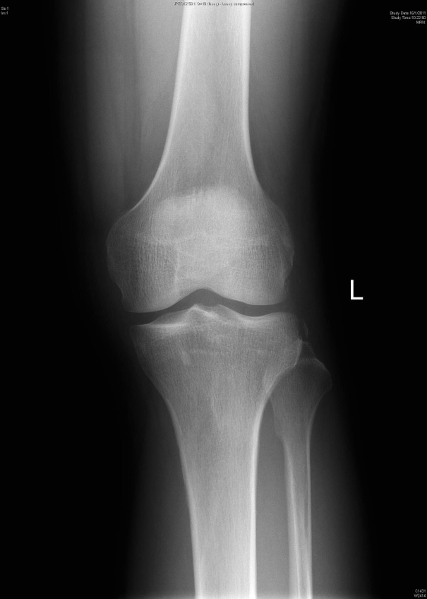
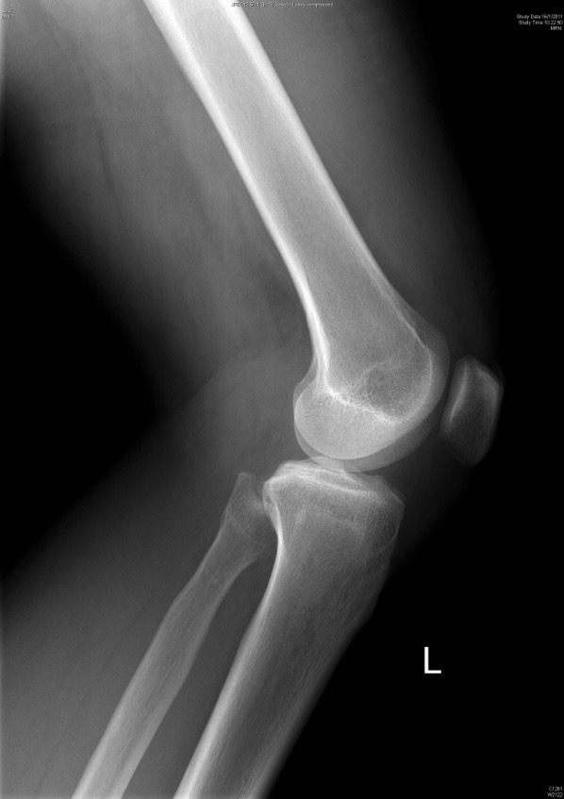

Slide 37
Case 3
Q1. Name the X-ray finding.

Slide 38
Case 3
Q1. Name the X-ray finding.
Answer
Lateral capsular sign
Proximal lateral tibial plateau avulsion fracture
Signify rupture from the lateral capsular ligament

Slide 39
Case 3
Q2. What is the fracture called?

Slide 40
Case 3
Q2. What is the fracture called?
Answer
Segond fracture

Slide 41
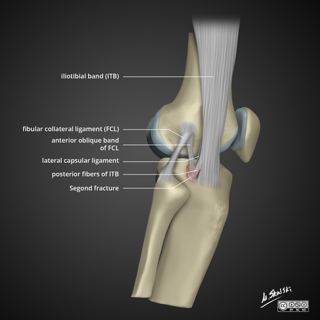

Slide 42
Case 3
Q3. What are the most common mechanisms of injury?

Slide 43
Case 3
Q3. What are the most common mechanisms of injury?
Answer
Internal rotation
Varus stress

Slide 44
Case 3
Q4. Name 2 associated injuries at the knee.

Slide 45
Case 3
Q4. Name 2 associated injuries at the knee.
Answers
ACL tears
Meniscal injury
Avulsion fractures of long head of biceps femoris and fibular collateral ligament (FCL)

Slide 46
Case 3
The patient has private MRI later confirmed ACL tear, along with other degenerative changes
Symptoms improved on conservative management with physiotherapy
No locking or giving way
Yearly follow up by Orthopedics
F. falciglia et al. Segond fracture with anterior cruciate
ligament tear in an adolescent. J Orthopaed Traumatol
(2008) 9: 167-169
Kristin Fay et al. Iliotibial band avulsion fracture: a case
report with differential diagnosis. Emery Radiol (2016)
23:93-96

Slide 47
Case 4

Slide 48
Case 4
F/84
History of CA breast and HT
Presented with tongue base blister for 3 days
Sepsis with septic shock on arrival

Slide 50
Case 4
Q1. Describe 2 clinical photo features.

Slide 51
Case 4
Q1. Describe 2 clinical photo features.
Answer
Necrosis of tongue
Bruising with evidence of quick spread over the anterior trunk

Slide 52
Case 4
Q2. What is the condition called?

Slide 53
Case 4
Q2. What is the condition called?
Answer
Necrotizing glossitis
Necrotizing fasciitis

Slide 54
Case 4
Q3. Which structure of the neck is involved?

Slide 55
Case 4
Q3. Which structure of the neck is involved?
Answer
By definition
NF is a rapidly progressive inflammatory infection of the fascia, with secondary necrosis of the subcutaneous tissues
Speed of spread is directly proportional to the thickness of the subcutaneous layer.
It moves along the fascial plane
Misiakos EP, Bagias G, Patapis P, Sotiropoulos D, Kanavidis P, Machairas A. Current concepts in the management of necrotizing fasciitis. Front Surg. 2014. 1:36.
Hakkarainen TW, Kopari NM, Pham TN, Evans HL. Necrotizing soft tissue infections: review and current concepts in treatment, systems of care, and outcomes. Curr Probl Surg. 2014 Aug. 51 (8):344-62.

Slide 56
Case 4
Q4. What are the 4 types of necrotizing fasciitis?

Slide 57
Case 4
Q4. What are the 4 types of necrotizing fasciitis?
Answer
Type 1: 70 to 80%, mixed bacterial involvement, at surgery/trauma site
Type 2: Group A strep, usually co-infected with staphylococcus aureus, most commonly affect head and neck region
Type 3: Vibrio vulnificus
Type 4: Fungal
Paz Maya, S; Dualde Beltrán, D; Lemercier, P; Leiva-Salinas, C (May 2014). "Necrotizing fasciitis: an urgent diagnosis". Skeletal radiology. 43 (5): 577–89.
Sarani, Babak; Strong, Michelle; Pascual, Jose; Schwab, C. William (2009). "Necrotizing Fasciitis: Current Concepts and Review of the Literature". Journal of the American College of Surgeons. 208 (2): 279–88.

Slide 58
Case 4
Q5. Name the most likely causative agents in this patient.

Slide 59
Case 4
Q5. Name the most likely causative agents in this patient.
Answer
Group A Streptococcus
Staphylococcus aureus

Slide 60
Case 4
Q6. Outline the mainstream of treatment for this condition.

Slide 61
Case 4
Q6. Outline the mainstream of treatment for this condition.
Answer
Prompt surgical consultation for debridement
Empirical antibiotics
Mixed infection: Tazocin + Vancomycin, Imipenem, Meropenem, Ertapenem, Cefotaxime + Metronidazole/ Clindamycin
Streptococcus: Penicillin + Clindamycin
Staphylococcus aureus: Nafcillin, Oxacillin, Cefazolin, Vancomycin (for resistant strains), Clindamycin
Vibrio vulnificus: Doxycycline + Ceftriaxone / Cefotaxime
Practice guidelines for diagnosis and management of SSTI 2014 from Infectious Diseases Society of America

Slide 62
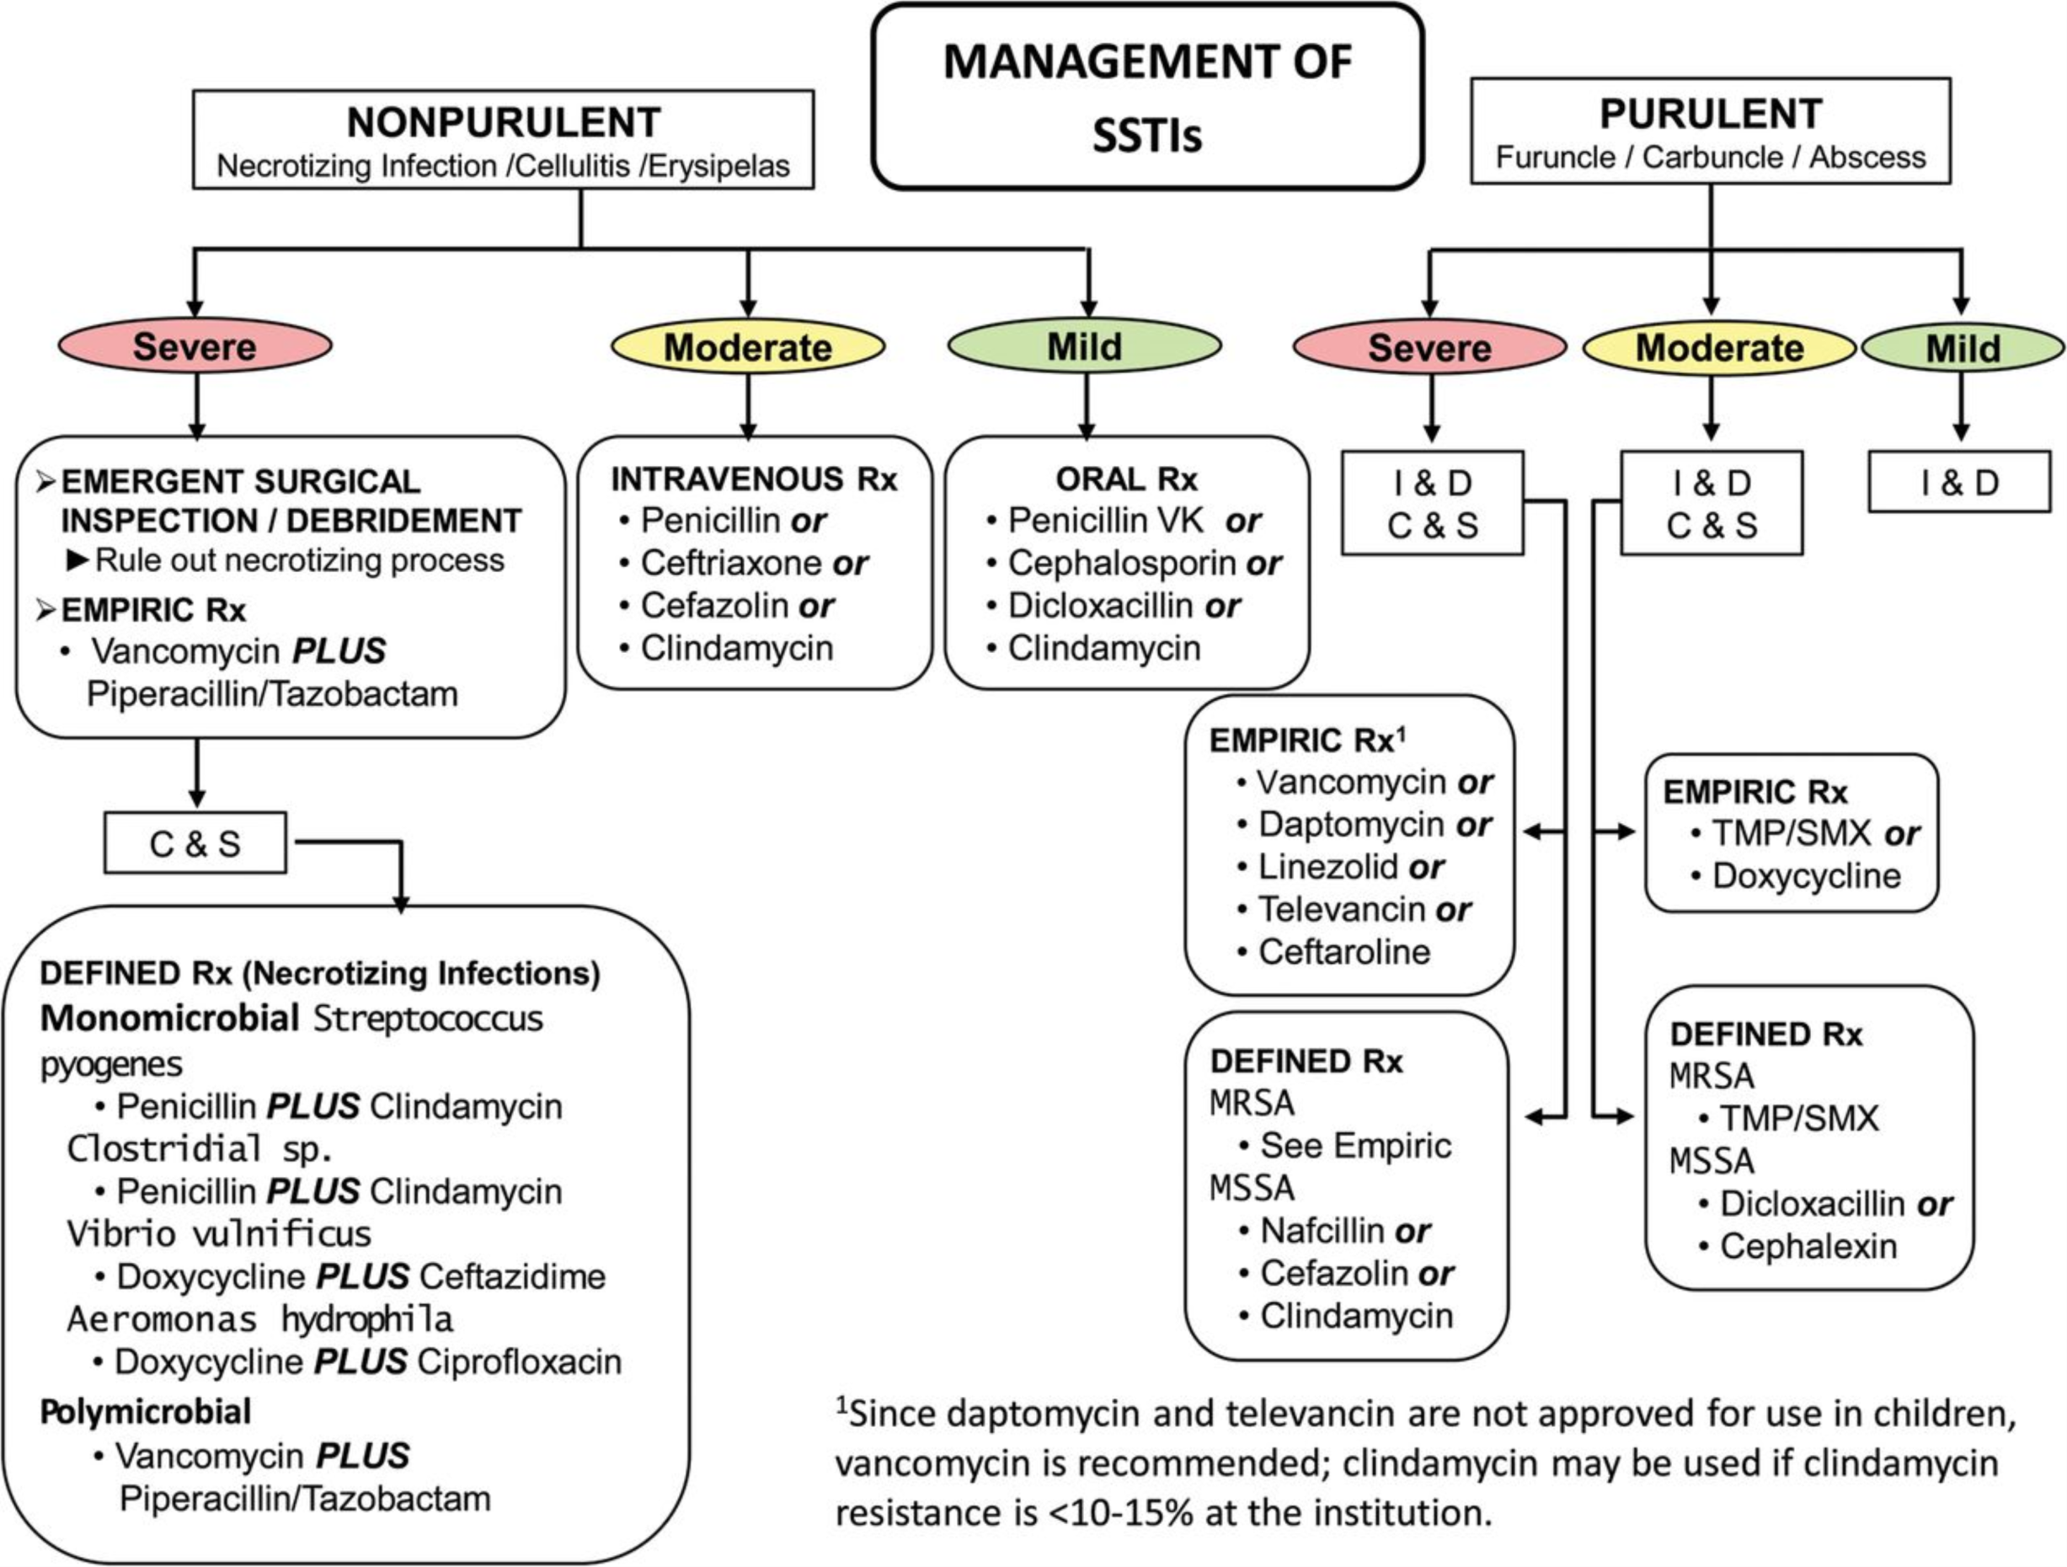
From: Practice Guidelines for the Diagnosis and Management of Skin and Soft Tissue Infections: 2014 Update by the Infectious Diseases Society of America
Clin Infect Dis. 2014;59(2):e10-e52. doi:10.1093/cid/ciu296
Clin Infect Dis | © The Author 2014. Published by Oxford University Press on behalf of the Infectious Diseases Society of America. All rights reserved. For Permissions, please e-mail: journals.permissions@oup.com.
Notes:
Table 1. Strength of Recommendations and Quality of the Evidence
62

Slide 63
Case 4
Patient could not maintain stable vitals during debridement
Succumbed shortly post op
Kristelle Chueng et al. An unusual presentation of Ludwig’s
angina complicated by cervical necrotizing fasciitis: A case
report and review of literature. Case Reports in Otolaryngology
2012 Article ID 93350
Chi-Woong Song et al. Cervical necrotizing fasciitis casued by
dental infection. Maxillofac Plast Reconstr Surg
2014;36(2):67-72
Ugur Gonlugur et al. Cervical necrotizing fasciitis associated
with descending necrotising mediastinitis. Multidisciplinary
Respiratory Medicine 2011;6(6):387-389

Slide 64
Case 5

Slide 65
Case 5
F/50
Unknown past health
Presented with left hip pain for a few days
P/E febrile Left hip pain on axial loading and all ROM

Slide 66
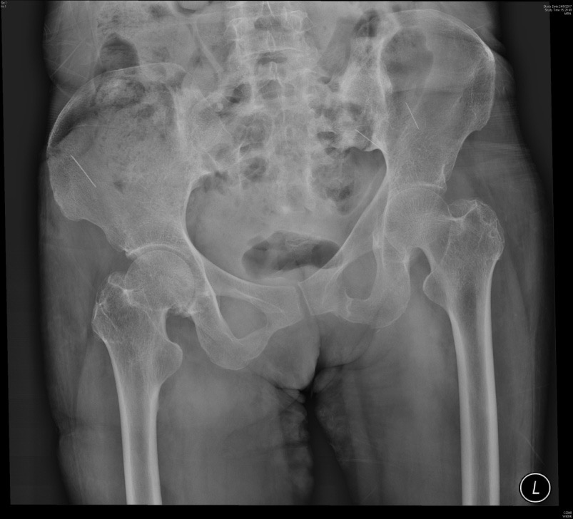
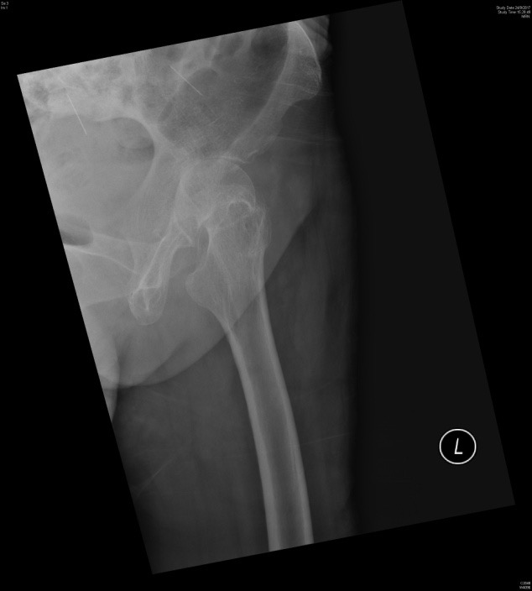

Slide 67
Case 5
Q1. Describe two XR features.

Slide 68
Case 5
Q1. Describe two XR features.
Answer
Multiple radio-opaque foreign bodies at bilateral pelvis
Decreased joint space between left femoral head and left acetabulum tures

Slide 69
Case 5
Q2. What is the most likely diagnosis?

Slide 70
Case 5
Q2. What is the most likely diagnosis?
Answer
Left hip septic arthritis with evidence of self IV drug use with retained needles

Slide 71
Case 5
Q3. Name two most common causative agents in this group of patients

Slide 72
Case 5
Q3. Name two most common causative agents in this group of patients
Answer
Staphylococcus aureus (MRSA or MSSA)
Pseudomonas aeruginosa (IVDA)

Slide 73
Case 5
Q4. Outline the mainstream of treatment.

Slide 74
Case 5
Q4. Outline the mainstream of treatment.
Answer
Surgery is indicated when
The appropriate choice of antibiotic and vigorous percutaneous drainage fails to clear the infection after 5-7 days
The infected joints are difficult to aspirate (e.g. hip)
Adjacent soft tissue is infected
Long course of antibiotics
Sharff KA, Richards EP, Townes JM. Clinical management of septic arthritis. Curr Rheumatol Rep. 2013 Jun. 15(6):332

Slide 75
Case 5
The patient has two arthrotomies in total with frank pus inside the hip joint intra-op
Still receiving oral antibiotics
Close FU by Orthopedics

Slide 76
Thank you

