Slide 1
JCM OSCE Answers CMC AED
7 Feb 2018

Slide 2
Case 1
An 86-year-old man fell forward with head injury in toilet at home. He attended ED complaining of immediate neck pain. He was able to walk afterwards and there was no limb numbness or weakness.
Physical exam showed tenderness over the neck region. Upper and lower limb power were full, sensation intact, normoflexia with normal tone.

Slide 3
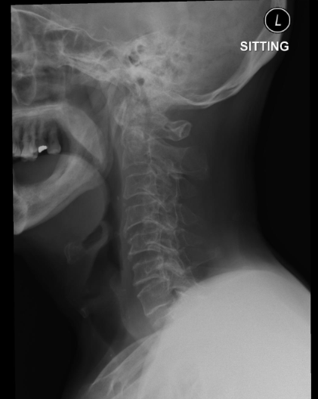
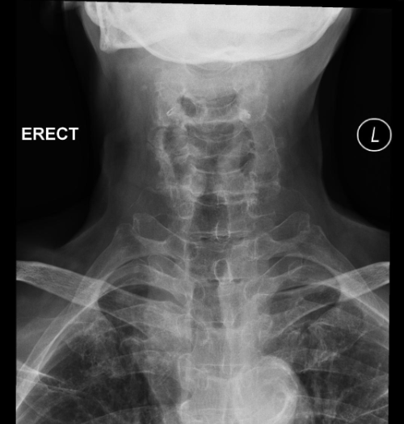

Slide 4
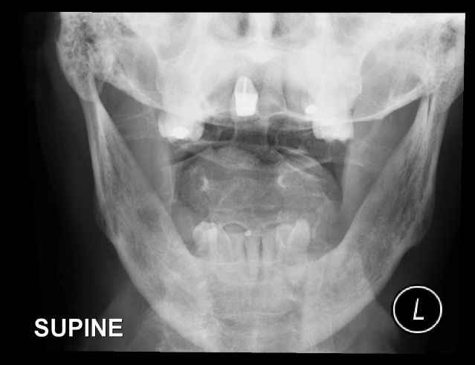

Slide 5
Case 1
Q 1: Name the abnormality in the X-ray C spine. (2 marks)
Fracture line on base of odontoid process of C2 and extends into the body of the axis.

Slide 6
Case 1
Q2: What is the diagnosis? (2 marks)
Odontoid fracture (type III)

Slide 7
Case 1
Q3: What is the most commonly used classification for this injury and how to classify? (2 marks)
Anderson and D’Alonzo classification
Type I: avulsion fracture of the apex (rare, stable)
Type II: fracture through the base of the dens, at the junction of the odontoid base and the body of C2 – (most common ~2/3 cases, often unstable)
Type III: fracture extends into the body of the axis. Usually stable (~1/3 cases, usually stable)

Slide 8
Case 1
Q4: What is the common etiology in young and elderly patients respectively? (2 marks)
Young- high-energy trauma (e.g. a motor vehicle accident), multi-trauma; Elderly- low-energy trauma (e.g. a fall), isolated injury

Slide 9
Case 1
Q5. What are the treatment options for this patient? (2 marks)
Sterno-occipito mandibular immobiliser (SOMI) brace, Halo Vest, semi-rigid cervical collar

Slide 10
Case 2
A 25 months old child fell from 20cm height while playing on a gym-machine for “rotating exercise”. He landed on the ground with left foot and then fell down due to imbalance. He was unable to walk afterwards. No other injury was noted.
Physical examination showed no external wound and mild tenderness was noted at distal left tibia. Examination on left hip, knee and ankle were unremarkable.

Slide 11
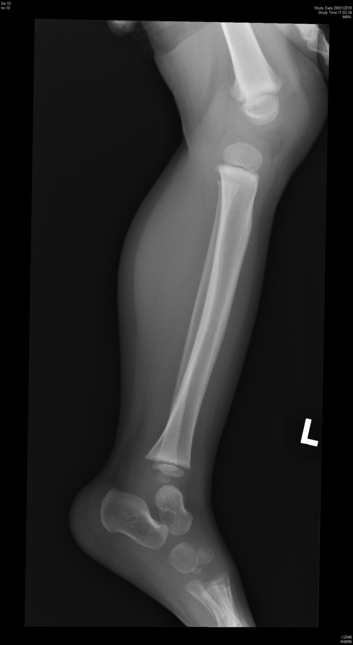
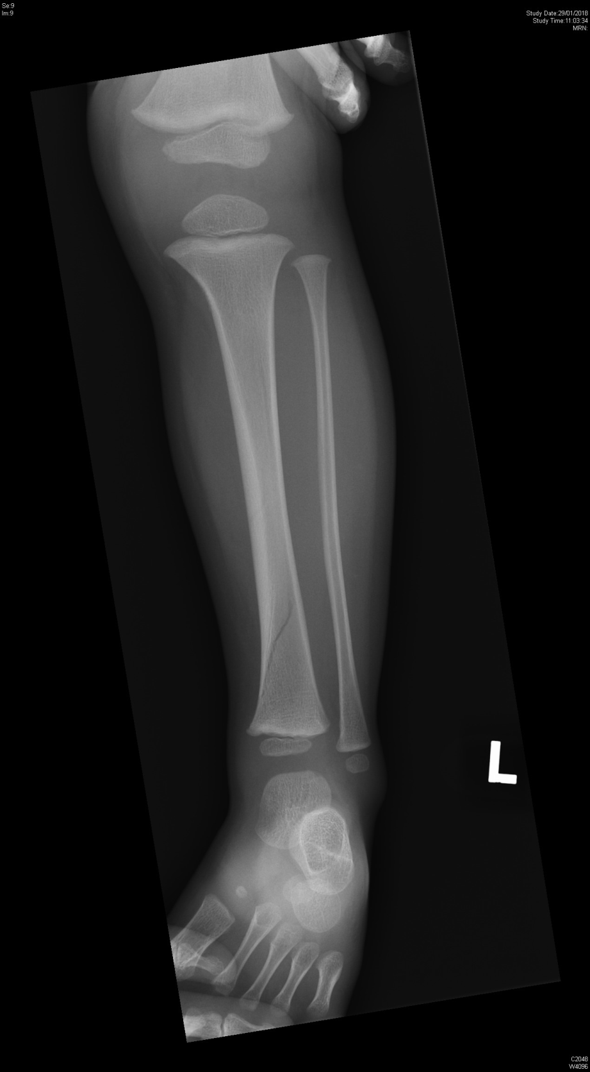

Slide 12
Case 2
Q1: Here are the x-rays of this child, what is the finding? (1 mark)
Non-displaced spiral fracture of left distal tibia or Toddler fracture

Slide 13
Case 2
Q2: Name one differential diagnosis of the above finding (1 mark)
The radiolucent line could be a nutrient vessel

Slide 14
Case 2
Q3: Name two complications of the above condition (2 marks)
Acute compartment syndrome
Growth disturbance (Leg length discrepancy)

Slide 15
Case 2
Q4: How would you manage this child? (2 marks)
Short leg cast, non-weight bear and refers to Orthopedic SOPD

Slide 16
Case 2
Q5: Name one associated condition you would consider. (1 mark)
Child abuse / non-accidental injury

Slide 17
Case 2
Q6: How you manage the child if the condition mentioned in question 5 is suspected? (2 marks)
Search for other injury (including fundi examination for retinal hemorrhage and skeletal survey)
Admit into Pediatric Unit

Slide 18
Case 3
55-year-old female presented with cough and whitish sputum for half month. She has good past health and is a non-smoker, non-drinker. There was no recent travel history. Her temperature was 38ºC. Other physical findings were essentially normal.
Below is her Chest X-ray taken on day of presentation.

Slide 19
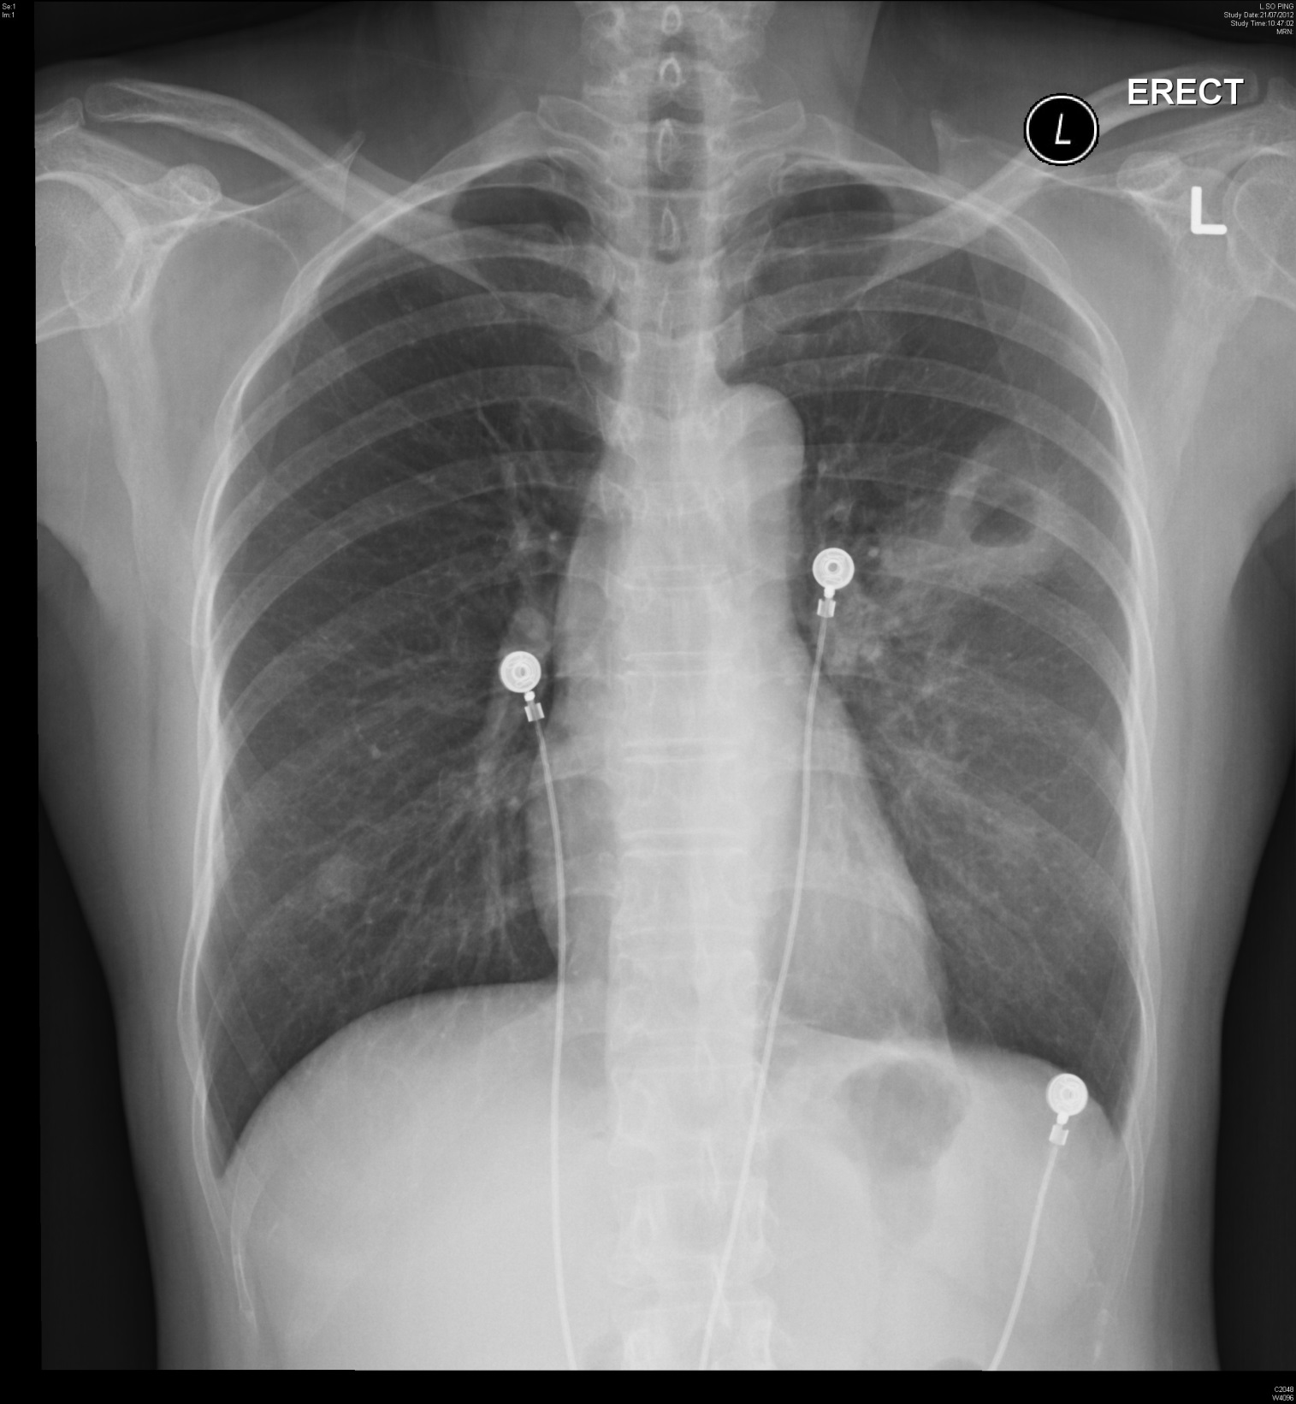

Slide 20
Case 3
Q1: Name the radiological findings. (3 marks)
Cavitating lesion (1 mark) with fluid level (1 mark) at left middle zone
Roundish shadow at right lower zone likely nipple shadow (1 mark)

Slide 21
Case 3
Q2: Name 3 types of lung infections and one corresponding causative organism for each type that may present with this XR finding. (3 marks)
Pulmonary tuberculosis, Mycobacterium tuberculosis
Bacterial pulmonary abscess, Streptococcus p., Staph.aureus, Klebsiella p., H. influenzae
Fungal infection, Aspergillus fumigatus
Non-tuberculous Mycobacterial infection, M. avium-intracelluare and M. kansaii

Slide 22
Case 3
Q3: Name 3 other causes for such XR finding. (3 marks)
Primary bronchogenic carcinoma of lung, esp squamous cell carcinoma
Granulomatosis with Polyangiitis
Rheumatic Nodules
Sarcoidosis
Pulmonary metastasis from squamous cell carcinomas, mainly from GI tract and breast, sarcomas, and adenocarcinomas.
Pulmonary infarct
Entities that overlap with cystic diseases like Langerhans cell histiocytosis

Slide 23
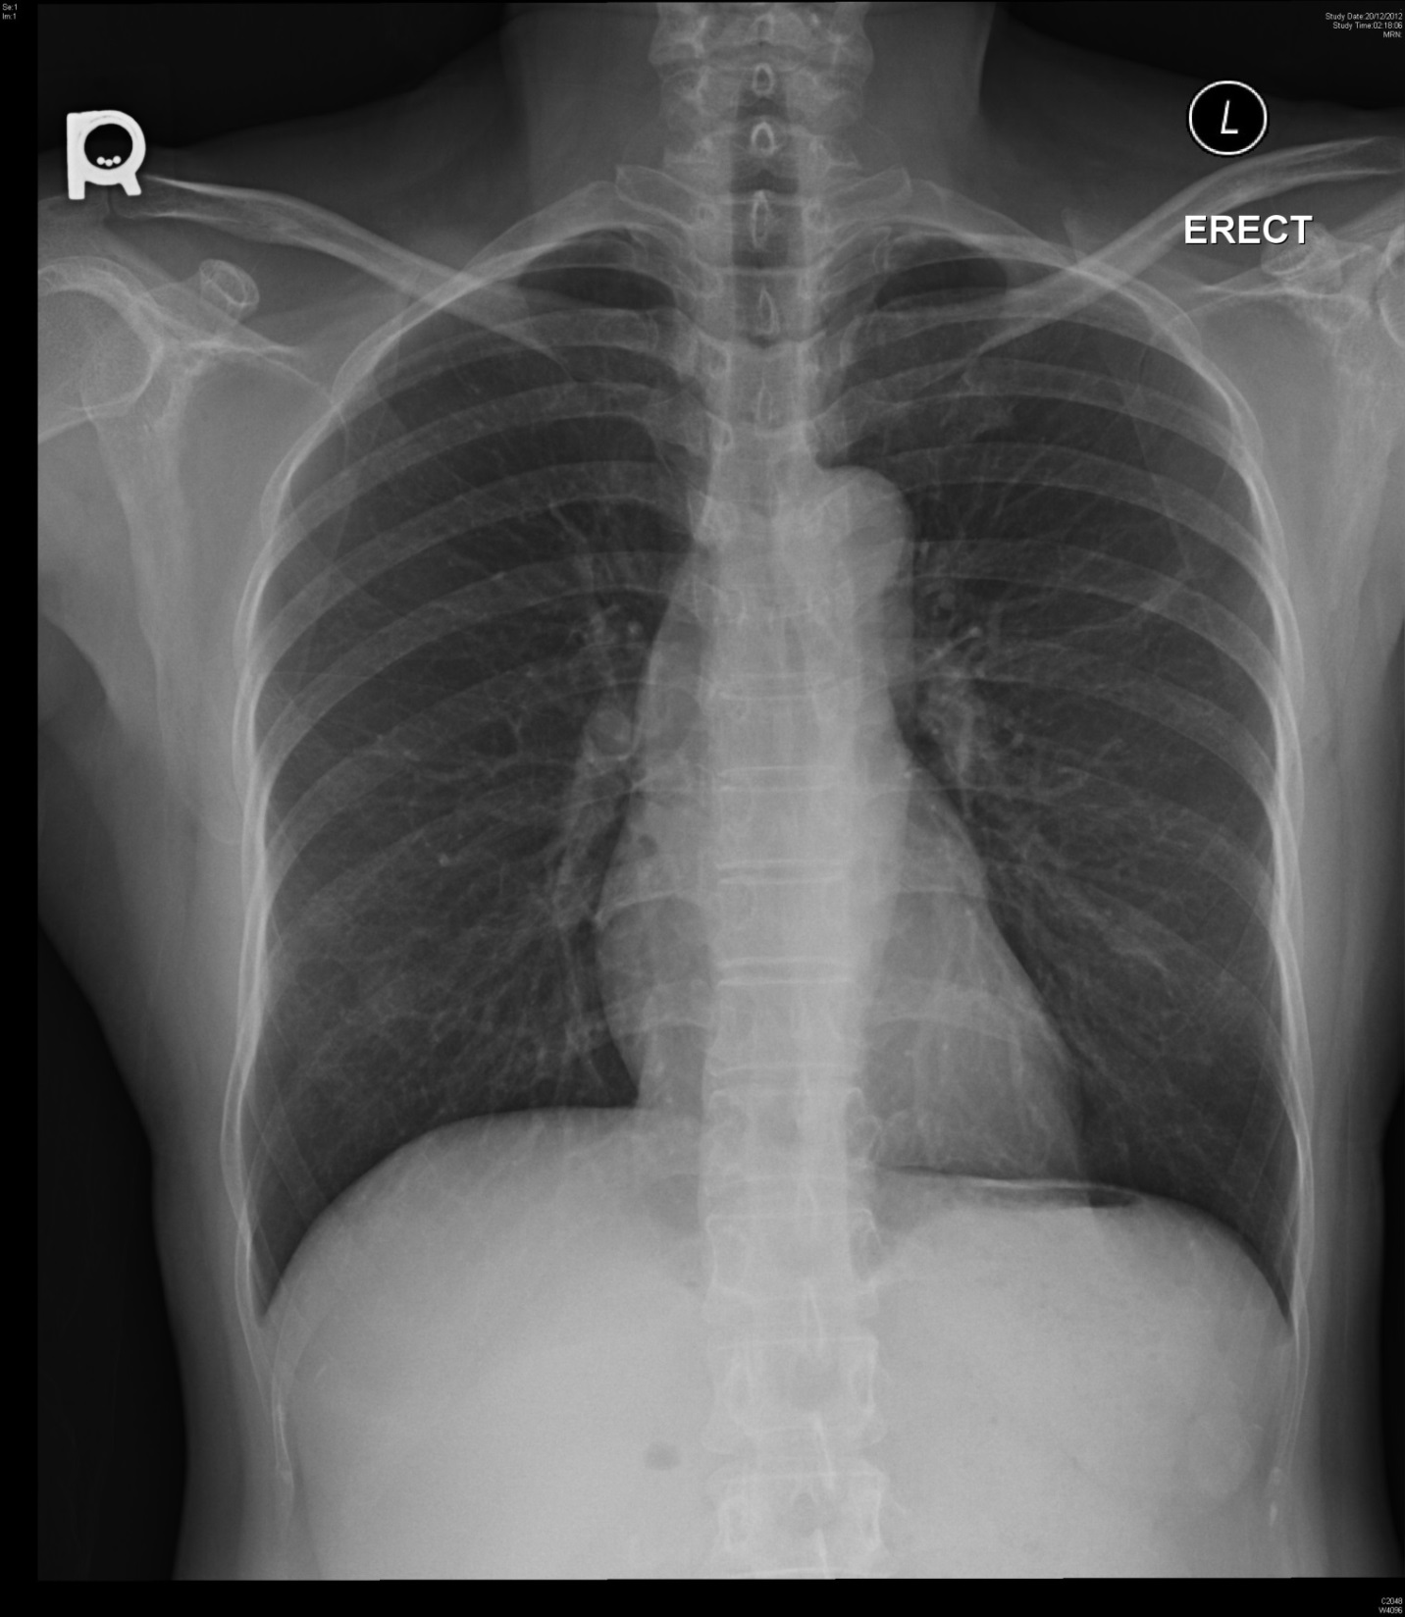

Slide 24
Case 3
Q4: Below is her chest X-ray after 5 months. What treatment is likely received by her? (1 mark)
anti-TB treatment

Slide 25
Case 4
39-year-old female had a nap when she was home after work at 5pm. She woke up with dizziness, headache and repeated vomiting of undigested food at 6pm. When her husband went home at 7pm she was sent to A&E Department by ambulance. She was fully conscious on arrival and was put in sitting position (which she preferred) in a trolley. Her blood pressure was 129/90 mmHg, pulse 73/min regular. No focal neurological deficits were found. She had good past health.

Slide 26
Case 4
Q1. Name three categories of important differential diagnosis you have to think of. (2 marks)
SAH
CNS infection
arterial dissection, cerebral venous sinus thrombosis, head injury, etc (but not HT encephalopathy)
(1 mark for SAH and half mark for the other two)

Slide 27
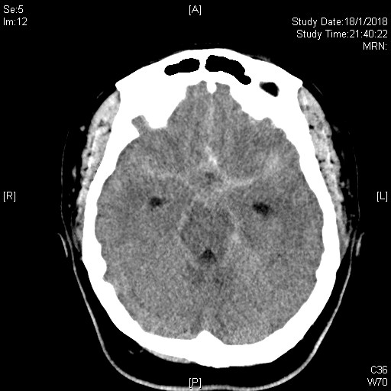

Slide 28
Case 4
Q2. Below is one of her CT brain cut. What is the diagnosis. (2 marks)
Subarachnoid hemorrhage with distended ventricles

Slide 29
Case 4
Q3. Name three more clues to your above diagnosis, not given to you in the history and physical examination mentioned above. (3 marks)
Neck pain or neck stiffness
Character of the headache – thunderclap headache, worst ever headache, pulsatile
Any history of seizure
Any history of LOC
Intraocular hemorrhage on P/E (subhyaloid hemorrhage on fundi exam)
Cranial nerve lesions on P/E

Slide 30
Case 4
Q4. If the first CT brain (plain) was normal, name three differential diagnoses now in descending order of possibility. (2 marks)
SAH
CNS infection
Migraine
Cluster headache and others
(1 mark for SAH as 1st diagnosis, half mark for the other possible two)
(no marks for ICH, head injury etc that are likely to have CT abnormalities)

Slide 31
Case 4
Q5: Name two further investigations that may be done on this patient. (1 mark)
digital subtraction angiography, multi-detector CT or MR angiography.

Slide 32
Case 4
Q6: Name two possible interventions this patient may receive for definitive care to prevent recurrence. (1 mark)
clipping through craniotomy; coiling through endovascular technique

Slide 33
Case 5
A 52-year-old gentleman took around 60 gram of mothballs for suicide. He grounded the mothballs into powder before ingestion. He complained of malaise and passed dark brown urine 20 hours after ingestion.

Slide 34
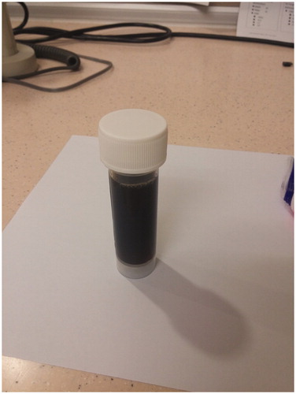
Dark urine of our patient 20 h after mothballs ingestion.

Slide 35
Case 5
Q1. Name 3 common ingredients of mothballs. (3 marks)
naphthalene
paradichlorobenzene
camphor

Slide 36
Case 5
Q2. What is the most likely diagnosis in this patient? (2 marks)
hemoglobinuria with intravascular hemolysis after naphthalene mothball poisoning

Slide 37
Case 5
Q3. Why were his symptoms occurred at 20 hours after ingestion? (2 marks)
It is because of the time necessary for the metabolism of naphthalene. The hepatic metabolites of naphthalene, primarily α-naphthol, are responsible for the oxidant stress causing hemolysis and methemoglobinemia

Slide 38
Case 5
Q4. The patient brought along the ‘mothball powder’ of unknown ingredient. How will you identify the ingredient in AED? What physical property of the mothball ingredient do you test for? (2 marks)
Melting point tests. The melting points of paradichlorobenzene and naphthalene are 53°C and 80°C. In a water bath with temperature between 53°C and 80°C, paradichlorobenzene powder will melt while naphthalene powder will not.
The mothball powder and tiny fragment forms tend to float more easily than intact mothballs, thus float test is less accurate than melting point test in identification of mothball powder.

Slide 39
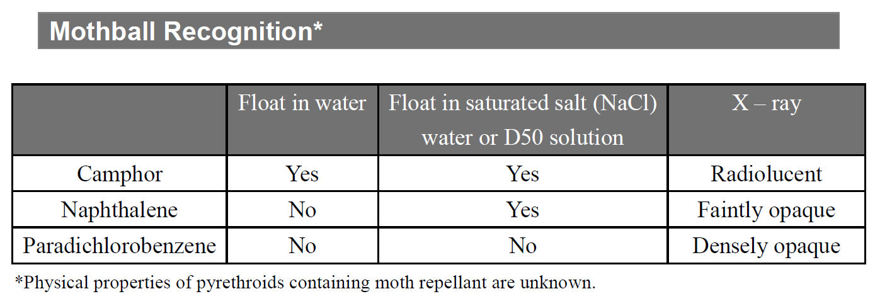

Slide 40
Thank you!

