Slide 1
OSCE Feb 2013
A &E QEH

Slide 2
Question 1
A 73 years old gentleman had a medical history of DM and CVA. He presented with fever and decrease in general condition. CXR was performed

Slide 3
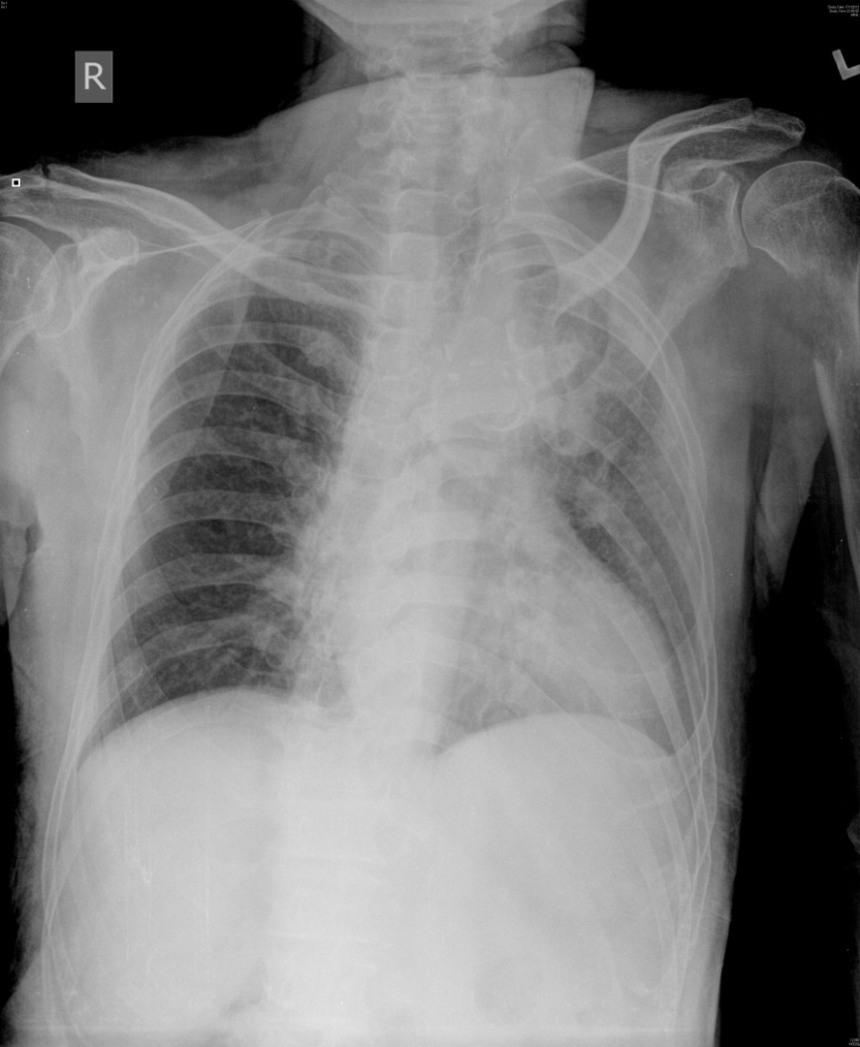

Slide 4
Name 3 abnormalities on CXR
Lung shadow at Lt upper zone
Erosion of Lt 5 th posterior rib
Osteolytic lesion at Lt proximal humerus

Slide 5
What is the likely provisional diagnosis?
Ca lung with bone metastasis

Slide 6
How do you calculate the adjusted calcium level?
measured total Ca (mmol/L) + 0.02 (40 - serum albumin [g/L])

Slide 7
Name 5 treatments for malignant associated hypercalcaemia
Rehydration
Biphosphate e.g. Pamidronate
Calcitonin ( fast acting)
Steroid ( in case of hematological malignancy)
Haemodialysis for severe case

Slide 8
Question 2
A woman slipped and fell in the street and sustained a “ Rt knee sprain “ during a fall.

Slide 9
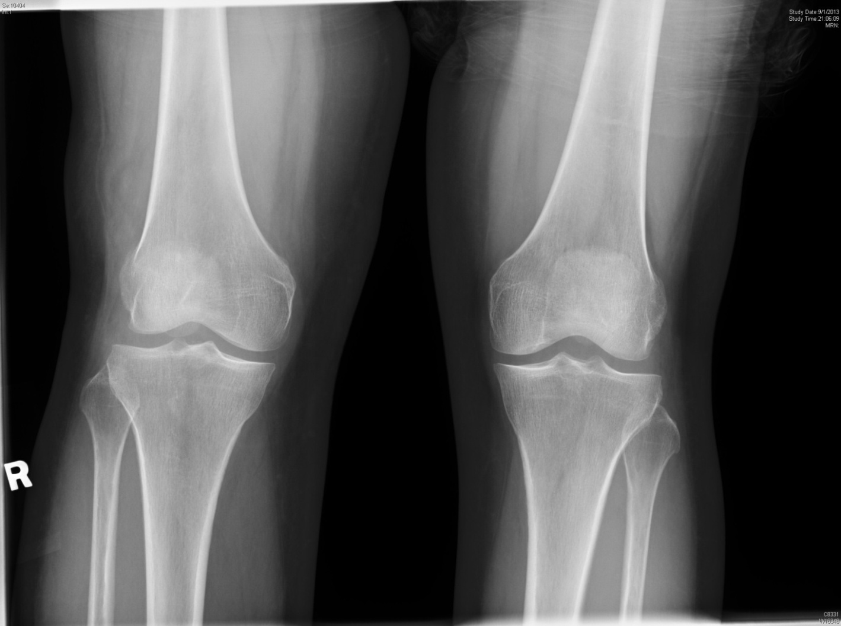

Slide 10
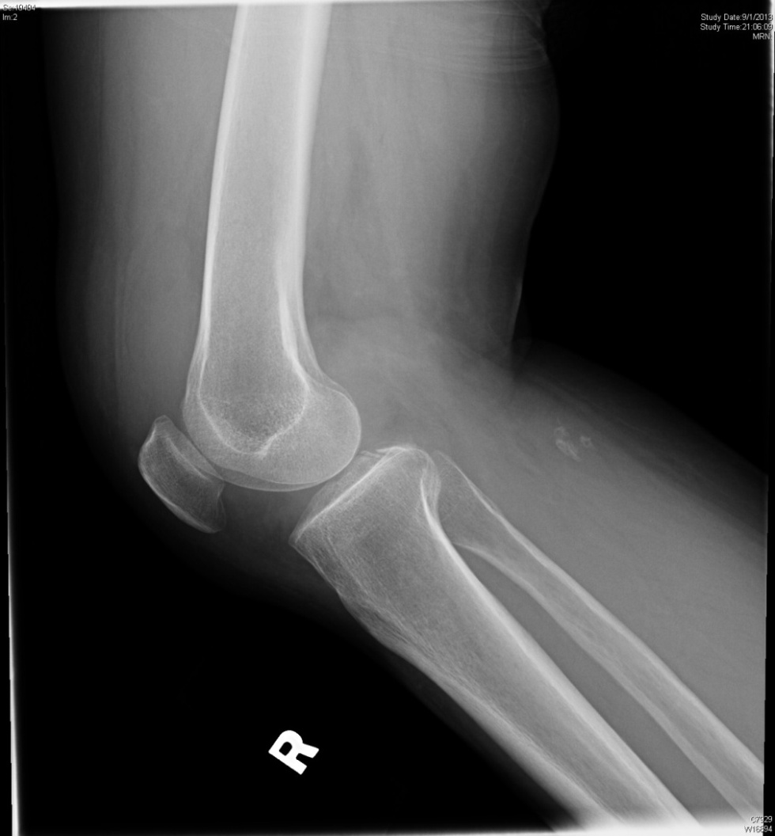

Slide 11
Name 2 prediction rules on XR utilization for knee injury
Age 55 years or older
Tenderness at head of fibula
Isolated tenderness of patella
Inability to flex to 90°
Inability to bear weight both immediately and in the emergency department
Ottawa Knee Rule

Slide 12
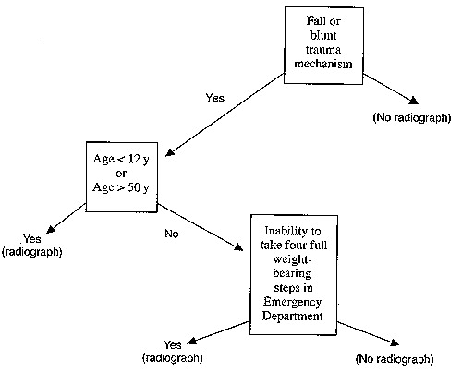
Pittsburgh knee rules

Slide 13
How do you compare the two rules in term of sensitivity and specificity
Sensitivity : no difference
Ottawa 97% (90 to 99%);
Pittsburgh 99% (95% CI 94% to 100%).
Specificity: Pittsburgh rule significantly more specific
Ottawa 27% (23 to 30%), Pittsburgh 60% (56 to 64%).
Seaberg D, Yealy D, Lukens T, et al. Multicenter comparison of two clinical decision rules for the use of radiography in acute, high risk knee injuries. Ann Emerg Med 1998;32:8e13

Slide 14
What is the diagnosis?
Avulsion fracture at the insertion site of PCL

Slide 15
How to test the ACL
Anterior drawer test
Lachman test
Pivot shift

Slide 16
Question 3
A young man presented with Rt wrist injury during a fall on outstretched hand.

Slide 17
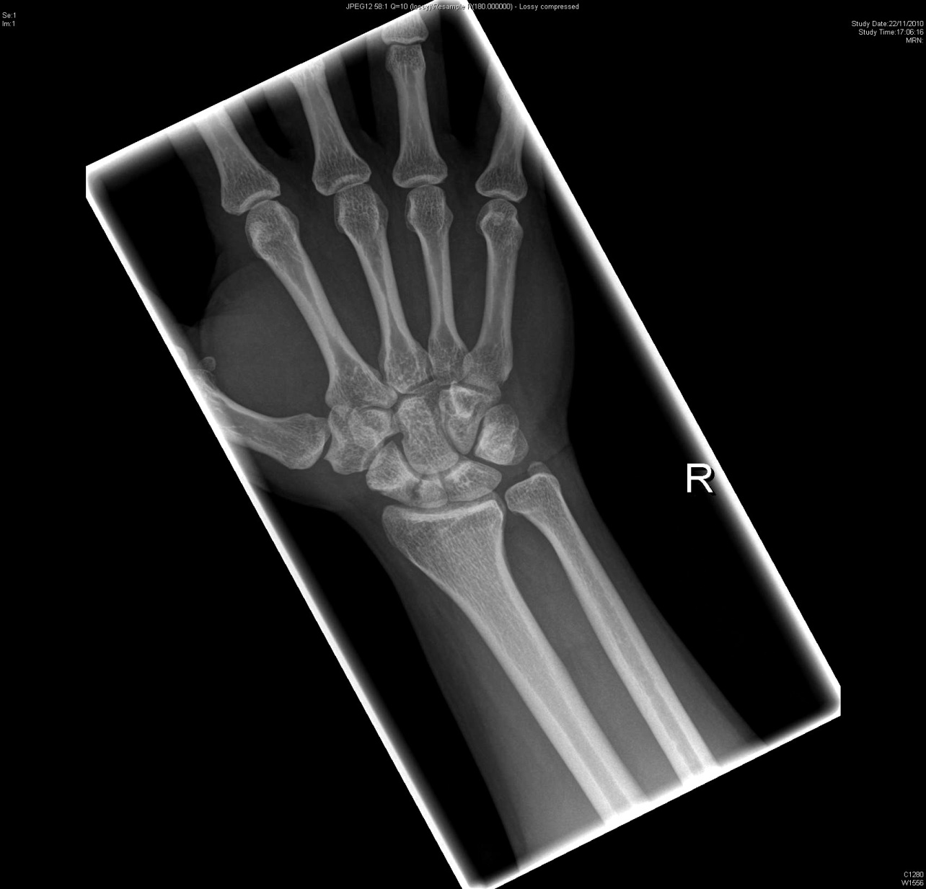

Slide 18
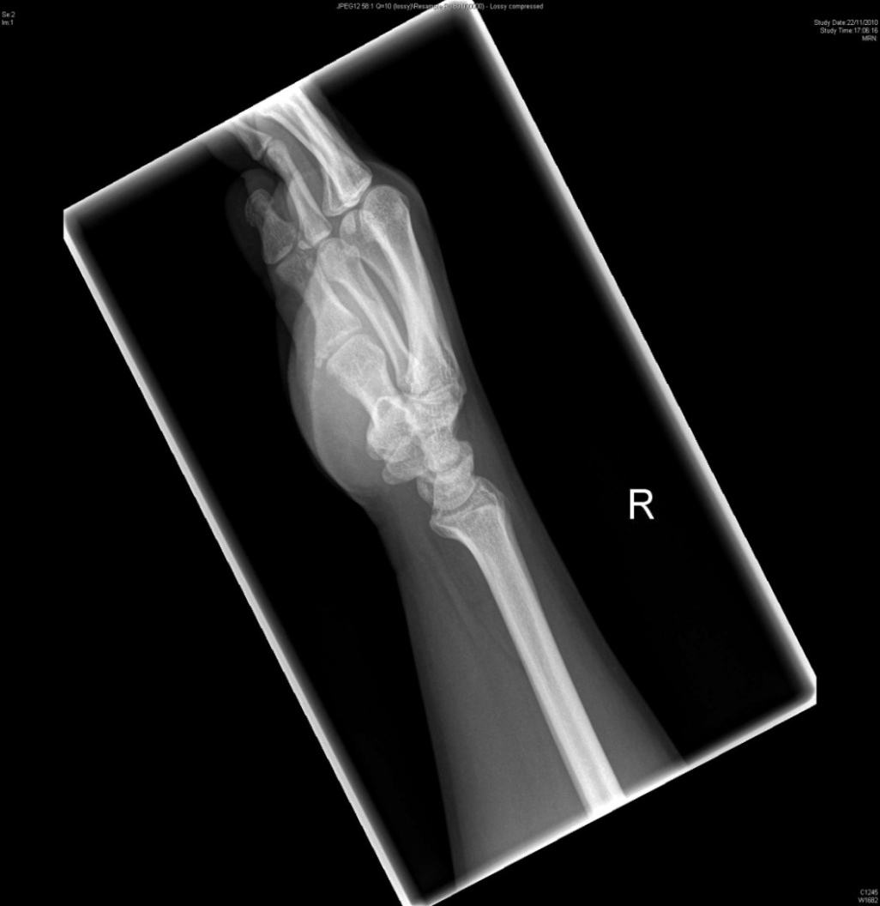

Slide 19
What is the diagnosis?
Scaphoid fracture ( waist )

Slide 20
Name three physical examination for this orthopedic condition
Tenderness at anatomic snuffbox
Tenderness at scaphoid tubercle
Pain elicited with axial compression of thumb

Slide 21
Name three potential complications
1. Avascular necrosis
2. Non-union/ Malunion
3. Radiocarpal arthritis with chronic pain and stiffness

Slide 22
When to consider operative treatment?
Unstable/Displaced / Comminuted fracture
Proximal fracture
Nonunion

Slide 23
Question 4
A 53 year old male psychiatric in-patient was transferred for assessment of fever and back pain.

Slide 24
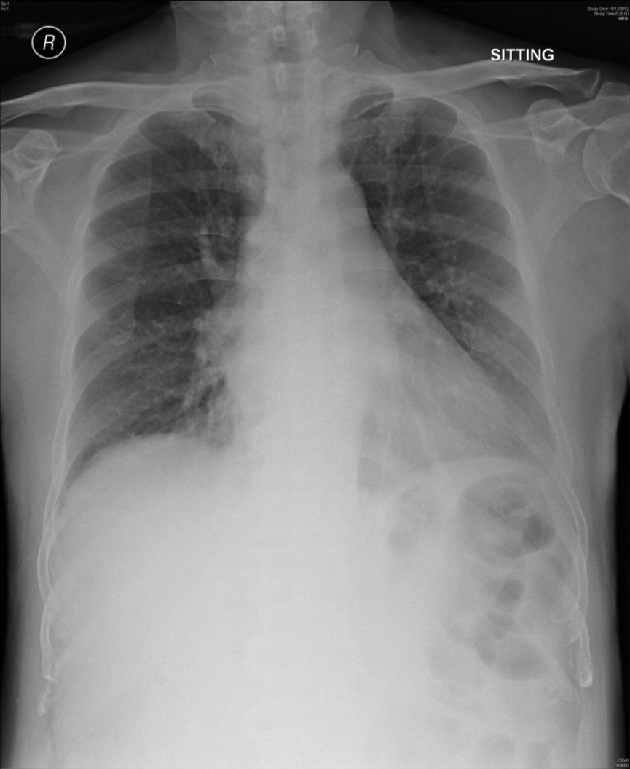

Slide 25
Please suggest some DDx
Uncomplicated viral illness
Spinal infection
Pyelonephritis
Psoas abscess
Pneumonia
Epidural abscess
Spinal Malignancy

Slide 26
.

Slide 27
The CXR abnormalities are probably too subtle. After more physical examination, the medical officer decided to take further XR for investigation.

Slide 28
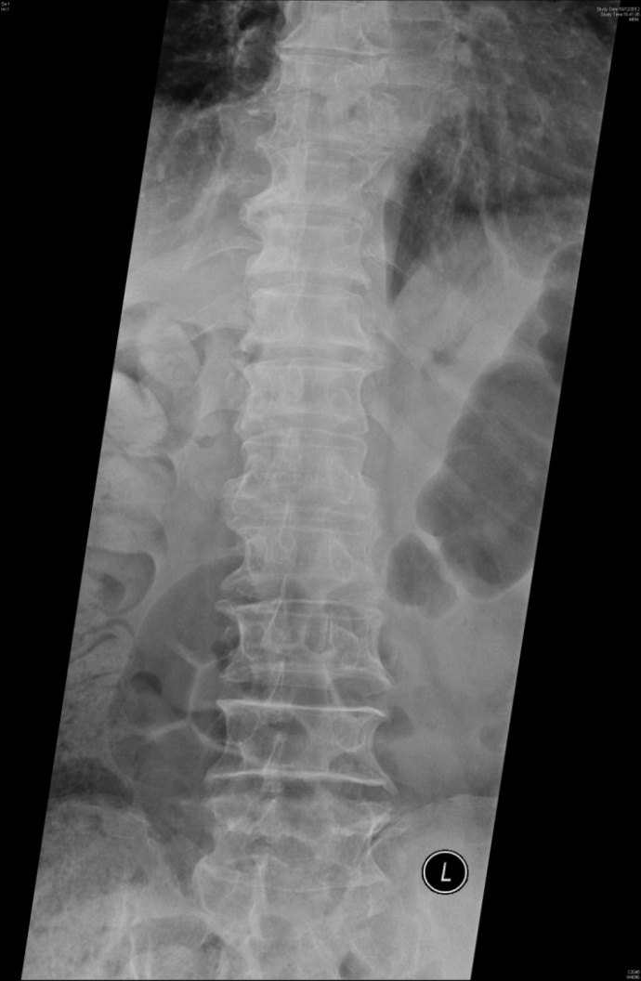

Slide 29
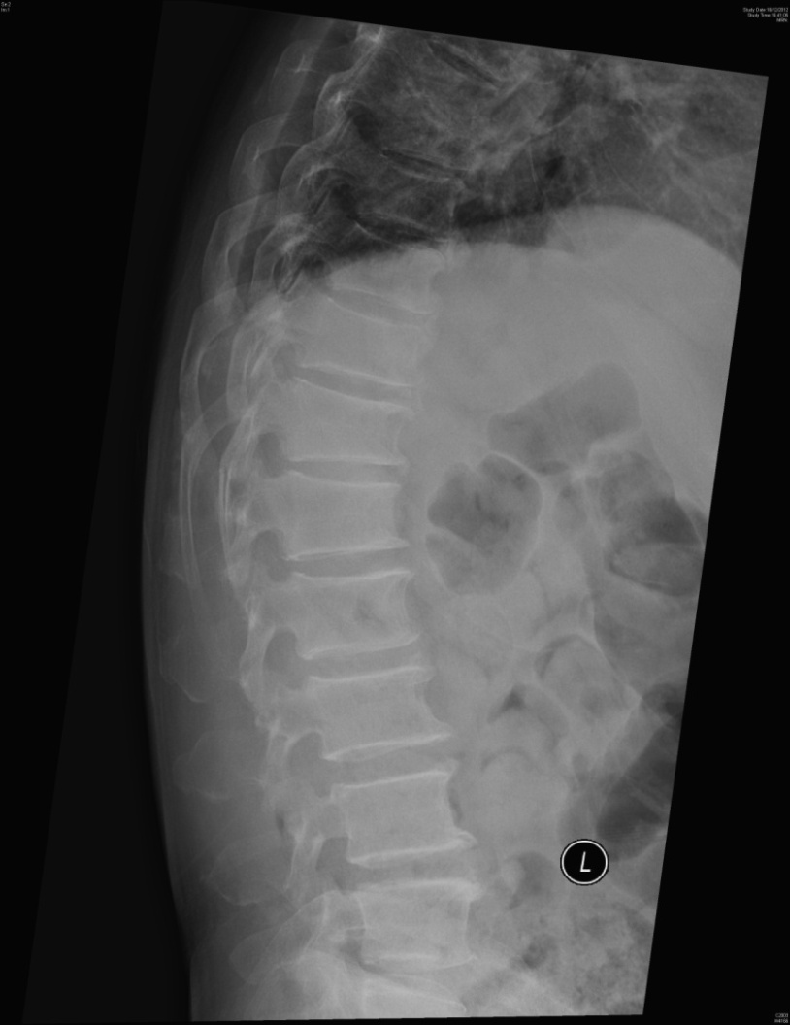

Slide 30
What is the abnormality and diagnosis?
XR T spine: destroyed endplate at T7-T8
CXR: Bulging of the Lt paraspinal line
Infectious sponylitis

Slide 31
What are the common causes in such a condition?
Tuberculosis
Staphylococcus aureus

Slide 32
Question 5
A 22 months baby presented with abdominal pain and passing blood stained stool.

Slide 33
Name four DDX for this age group
Intussusception
Meckle diveticulum
Hench-Schonlein purpura
Gastroenteritis

Slide 34
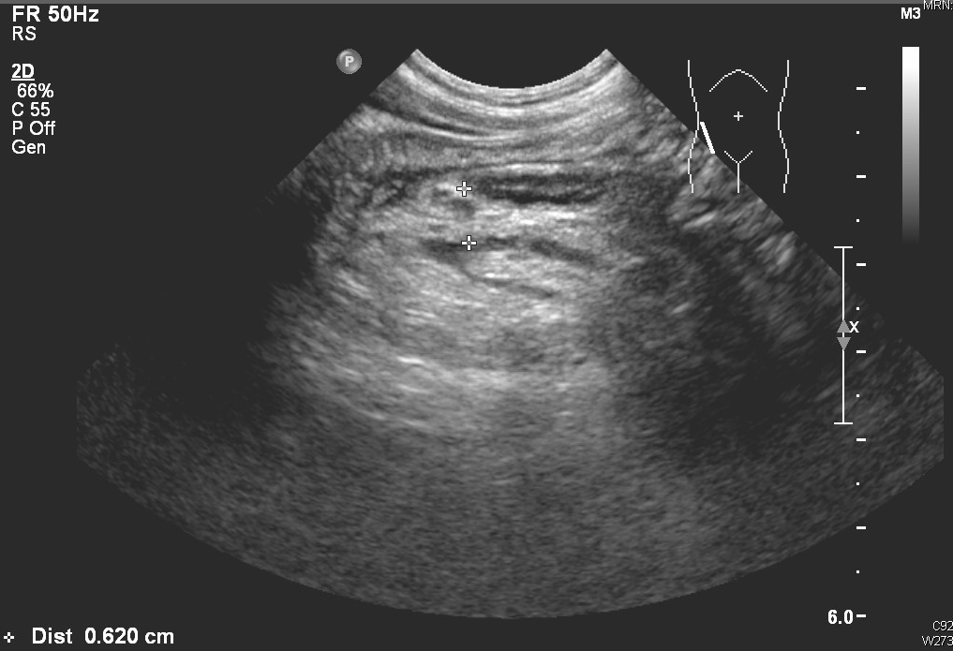
Abdominal mass was found at RUQ during USG

Slide 35
What is the diagnosis?
Intussusception

Slide 36
What is the classical USG appearance?
Pseudokidney sign ( longitudinal view )
Bull’s eye sign ( transverse view)

Slide 37
Suggestion the initial treatment. What is the success rate?
Air reduction
Success rate 80-90%

Slide 38
What are the indications for surgery?
Failed non operative treatment
Bowel perforation or bowel necrosis
The presence of lead point requiring resection

Slide 39
Question 6
A 79 year old elderly, living alone, was found collapse at home by relatives. She was unconscious on arrival. ECG was performed.

Slide 40
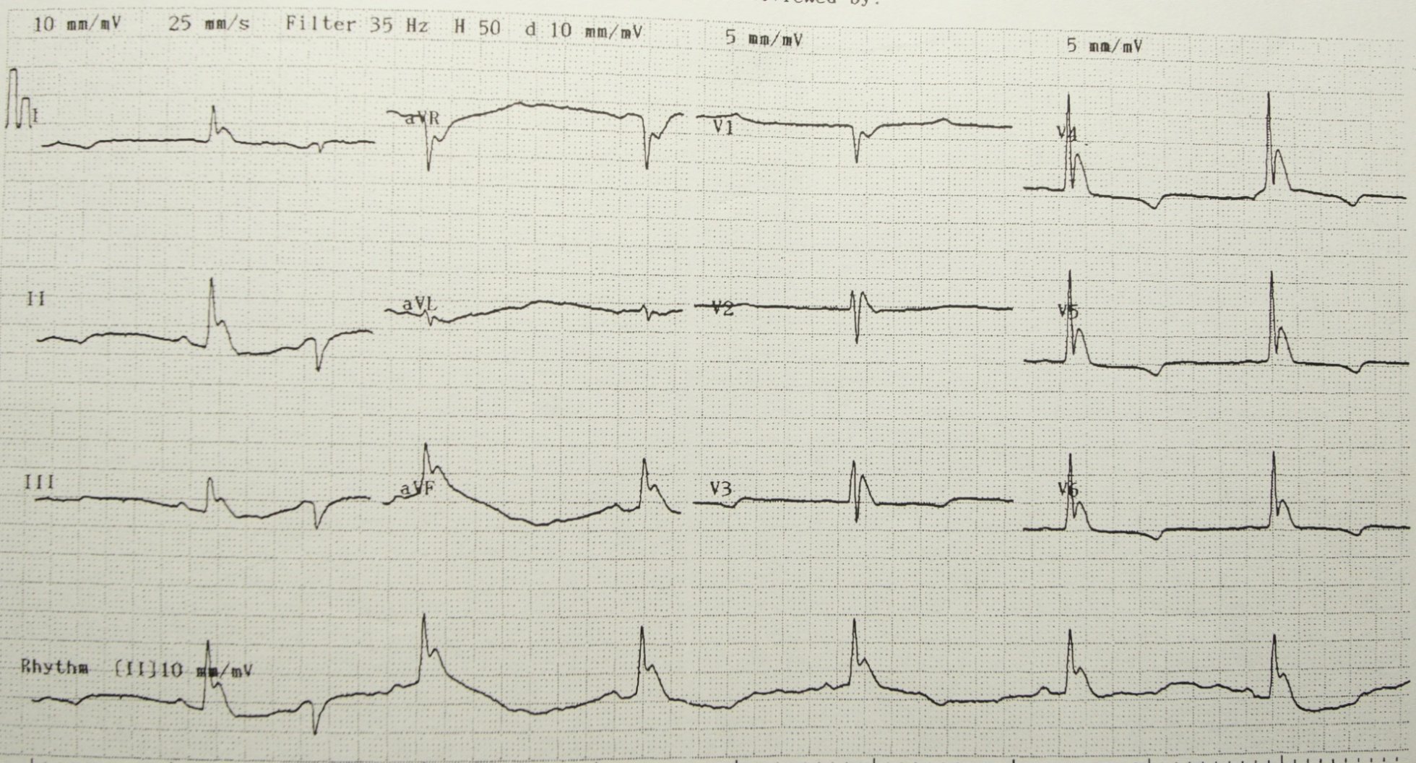

Slide 41
List three abnormalities on ECG
sinus bradycardia
Osborn ( or J wave)
TWI V3 –V6

Slide 42
Based on ECG, what medical conditions may the patient suffer from?
Causes of Osborn wave
Hypothermia
Acute ischemic event
Cocaine use
Haloperidol overdose
Hypercalcemia
Brugada’s syndrome
CNS injury
After resuscitation of cardiac arrest
Ref: Indian Heart J 2007; 59: 80-82

Slide 43
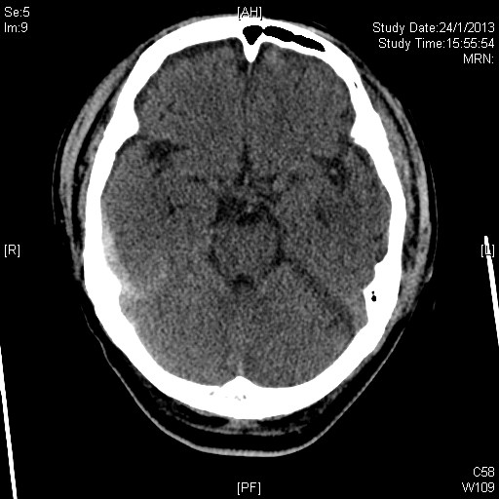
CT brain was performed in view of the reduced consciousness level.

Slide 44
Please comment on CT
Subdural hemorrhage over Rt parietal region and tentorium

Slide 45
Medical record showed that showed that she has a past medical history of HT, AF, CHF on warfarin. What specific immediate treatment will you give her?

Slide 46
Prothrombin complex concentrates

