Slide 1
HKCEM JCM OSCE
06 March 3013
AED POH

Slide 2
Case 1
M/52
Walk unaided to AED
c/o left foot sprain few days ago during working
P/E swelling, tender over dorsum of foot

Slide 3
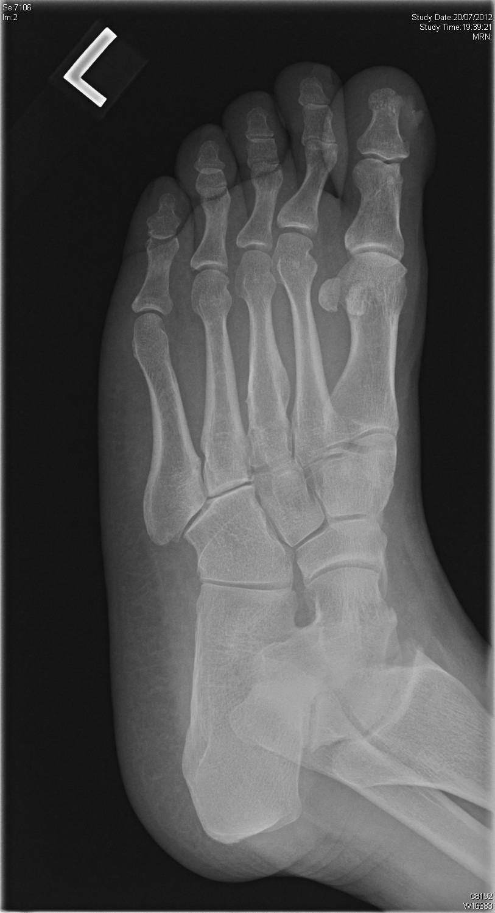

Slide 4
Questions
What were the X ray findings
What was the name of the sign showed in X-ray?
What was this injury call?
What was the classification of this injury
What was the optimal management
What were the important complications
Notes:
D. D. Brown and R. V. Gumbs. Lisfranc fracture-dislocations: report of two cases. National Med Assoc. 1991 April; 83(4): 366–369.

Slide 5
Case 2
M/42
Hx of stepping to nail
Left sole wound unhealed for 6 months
P/E: 4mm size ulcer in left sole, discharge +ve
X ray left foot was taken

Slide 6
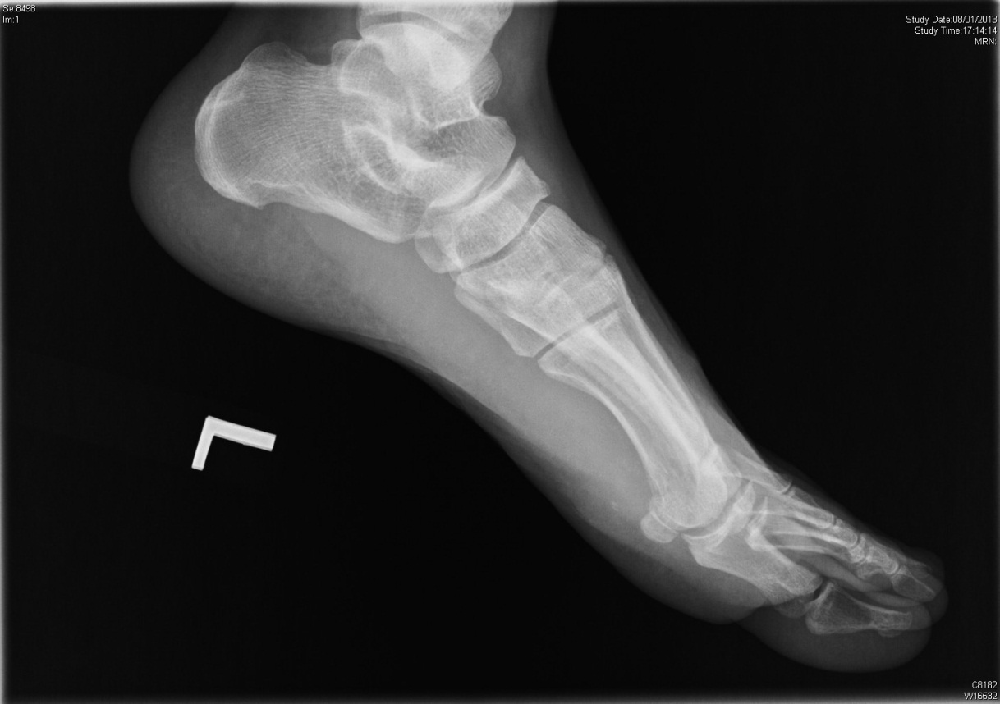

Slide 7
Questions
What was the X ray finding
What you were suspected?
What further investigations you would like to do to confirm the diagnosis?

Slide 8
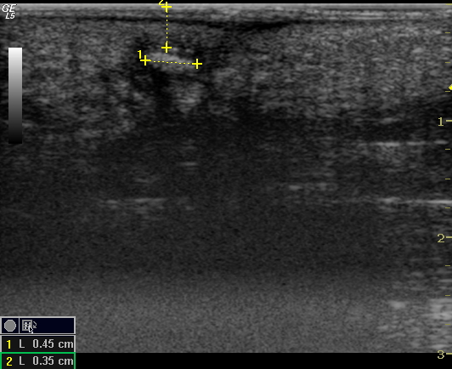

Slide 9
Questions
Describe the ultrasound finding

Slide 10
What did you think about the nature of material that caused the problem? (Metal, glass, plastic or wood) Why?

Slide 11
What other investigation you would consider?

Slide 12
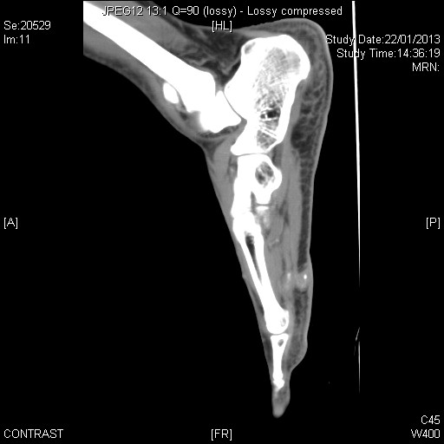
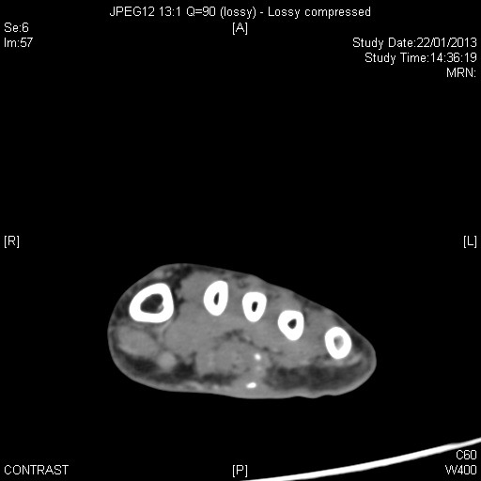

Slide 13
What is your management?

Slide 14
Case 3
F/59
c/o: abd pain, vomiting and diarrhea x 1/7
T 36
Abd.:
Soft,
tender over lower abd., Gº/Rº
Mass -ve

Slide 15
Questions
What bedside investigations you would consider?

Slide 17
What were the ultrasound findings?
What was the diagnosis?
What were the ultrasonic features of acute appendicitis?
Name 3 clinical signs of acute appendicitis
Name one scoring system for acute appendicitis

Slide 18
Case 4
M/40
IVDA
Personality disorder
c/o LBP for 3 days
No injury
Could not walk

Slide 19
Questions
What were the red flags of LBP?

Slide 20
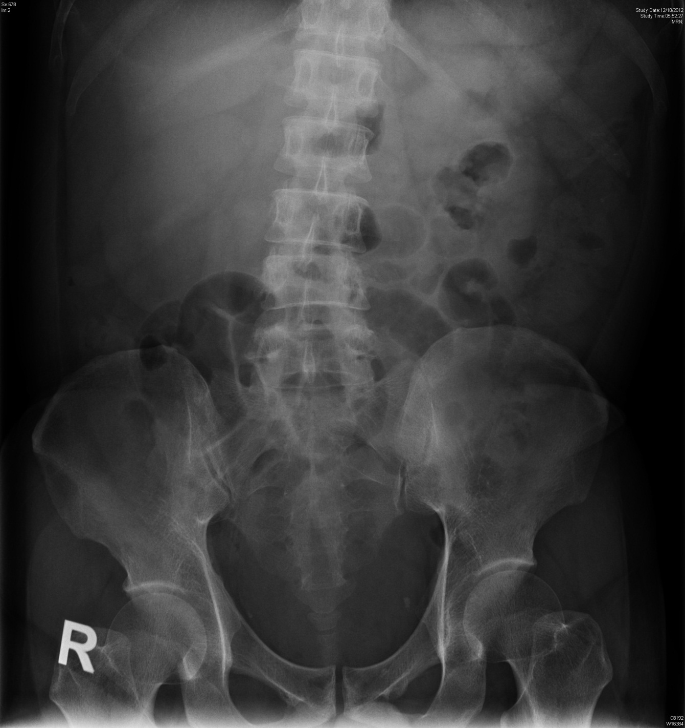

Slide 21
What were the X ray findings?
What were the differential diagnosis?
What other imaging Ix you would consider?

Slide 22
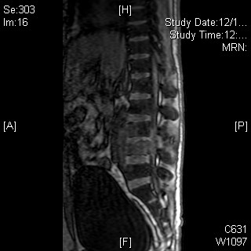
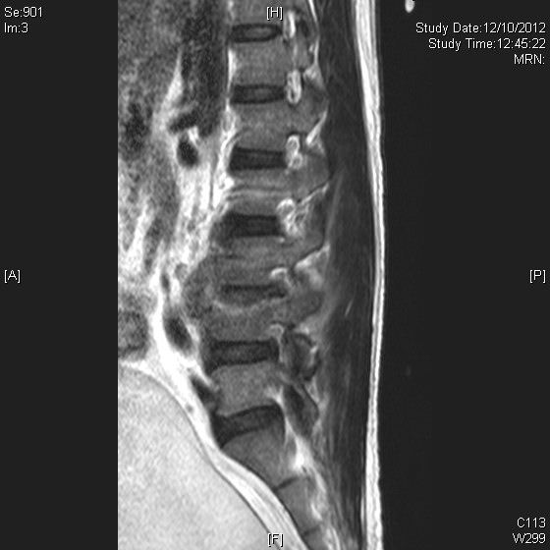
Notes:
Infective spondylolitis involving L3 and L4 with left intra-spinal epidural extension and a small left para-central posterior disc protrusion, marked compression on the corresponding cauda equina and thecal sac.

Slide 23
How to manage this patient?

Slide 24
Case 5
M/35
Amateur body builder
c/o sudden sharp pain in left upper arm while practicing weight lifting

Slide 26
Questions
Describe the abnormality showed in the clinical photo
What was the sign called?
What bedside investigation would help in diagnosis in ED?

Slide 27
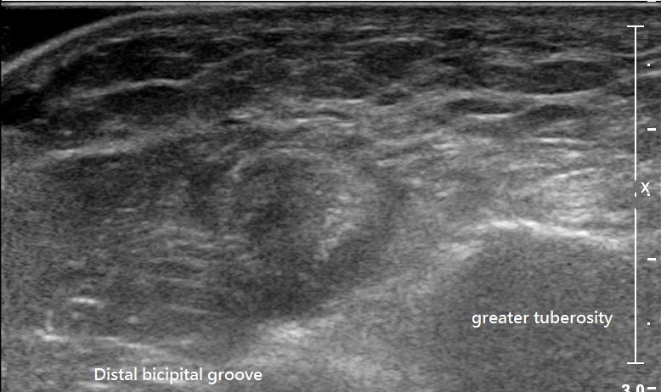
Figure 1
Figure 2

Slide 28
Figure 3

Slide 29
Describe the ultrasound findings

Slide 30
What was the diagnosis?
What were the management options for the patient?

