Slide 1
JCM OSCE
QMH A&E
7.11.2012

Slide 2
Case 1
M/29
Good past health
Recurrent skin rash over limbs x 6 months
Multiple medical consultations including dermatologists without improvement

Slide 4
What are the important points in the history?
Name 2 differential diagnoses.
What is the plan of management?

Slide 5
Case 2
M/37
PMH: Schizophrenia
Brought in by mother for decrease GC in recent few days
Poor appetite with vomiting

Slide 6
BP 137/76, P 102
T 36.9 °C
SpO2 100% (2L O₂)
H’stix Hi
ABG:
pH 6.9
Na 152
K 2.2
Cl 124
HCO₃ 16
BE -28

Slide 7
What is the diagnosis?
If Glucose is 52, what is the corrected Na? Why is that important?
He was recently started on Olanzapine for schizophrenia, what is the significance?

Slide 8
Case 3
M/55
Good past health
SOB x 2 months
Dry cough

Slide 10
What are the 2 clinical signs?
Name 3 differential diagnoses

Slide 11
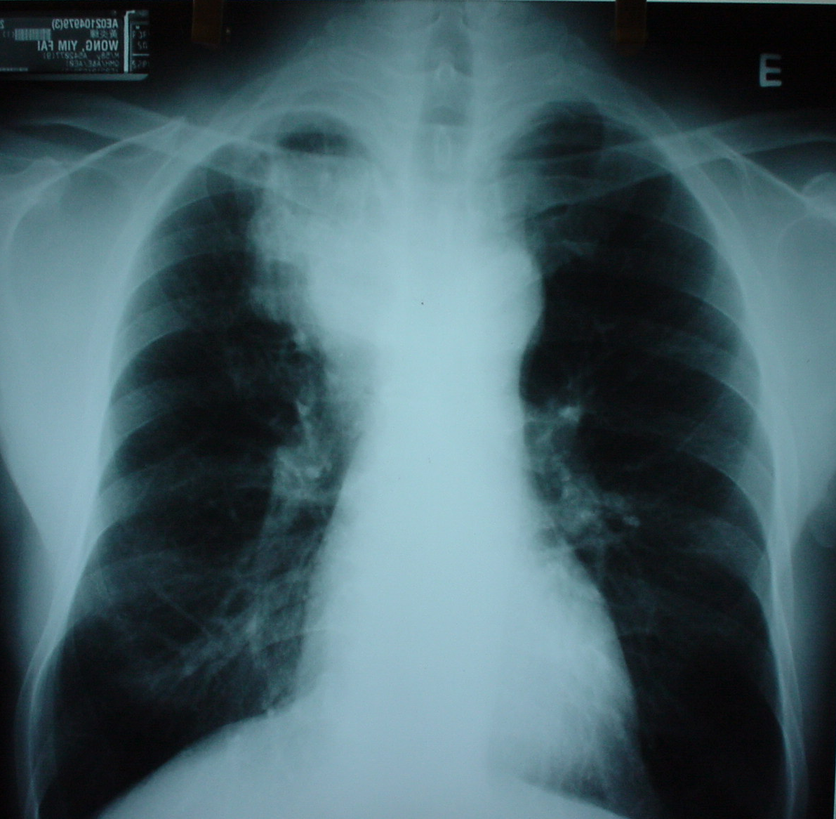

Slide 12
What are the CXR findings?
What is the diagnosis?

Slide 13
Case 4
F/4
Good past health
Vaccinations up to date
Irritable and refused oral feeding for 2 days

Slide 14
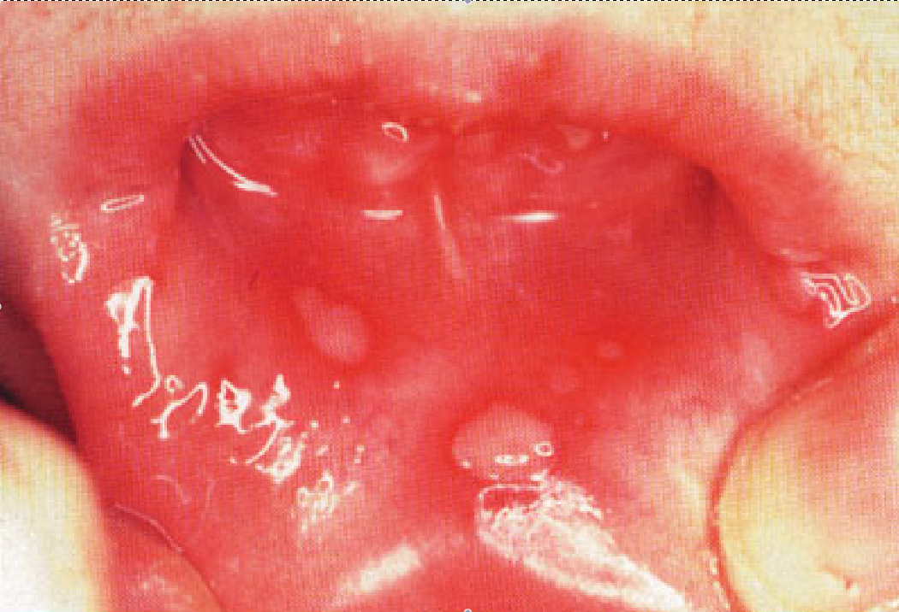

Slide 15
What is the most common causative agent?
What is the incubation period?
Name 3 locations where lesions can occur.
Name 3 systemic symptoms.
What is the appropriate treatment?

Slide 16
Case 5
M/24
PMH: Chronic solvent abuse
Dizziness for 2 days
Nausea but no vomiting
Mild SOB, no cough or fever
Denied recent drug use

Slide 17
BP 102/59, P 110
T 37.2 °C
SpO2 98% (2L O₂)
RR 24
Urine pH 7.2

Slide 18
ABG / RFT:
pH 6.94
FiO₂ 0.4
pO₂ 18
pCO₂ 2.3
BE -28
HCO₃ 10
Na 125
K 2.9
Cl 113

Slide 19
Interpret the ABG results.
What are the common causes?
What is the possible agent of abuse?
What is the cause of the current presentation?

