Slide 1
JCM--OSCE
KWH
3 August 2011

Slide 2
Question 1
A 45 years old man with good past health complained of severe sore throat and odynophagia for 2 days. He had low grade fever. He had no stridor. Physical examination showed mild tenderness over the anterior neck region. No cervical lymph node was noted. He was not in respiratory distress. His vital signs were stable. X-ray of the neck was taken.

Slide 3
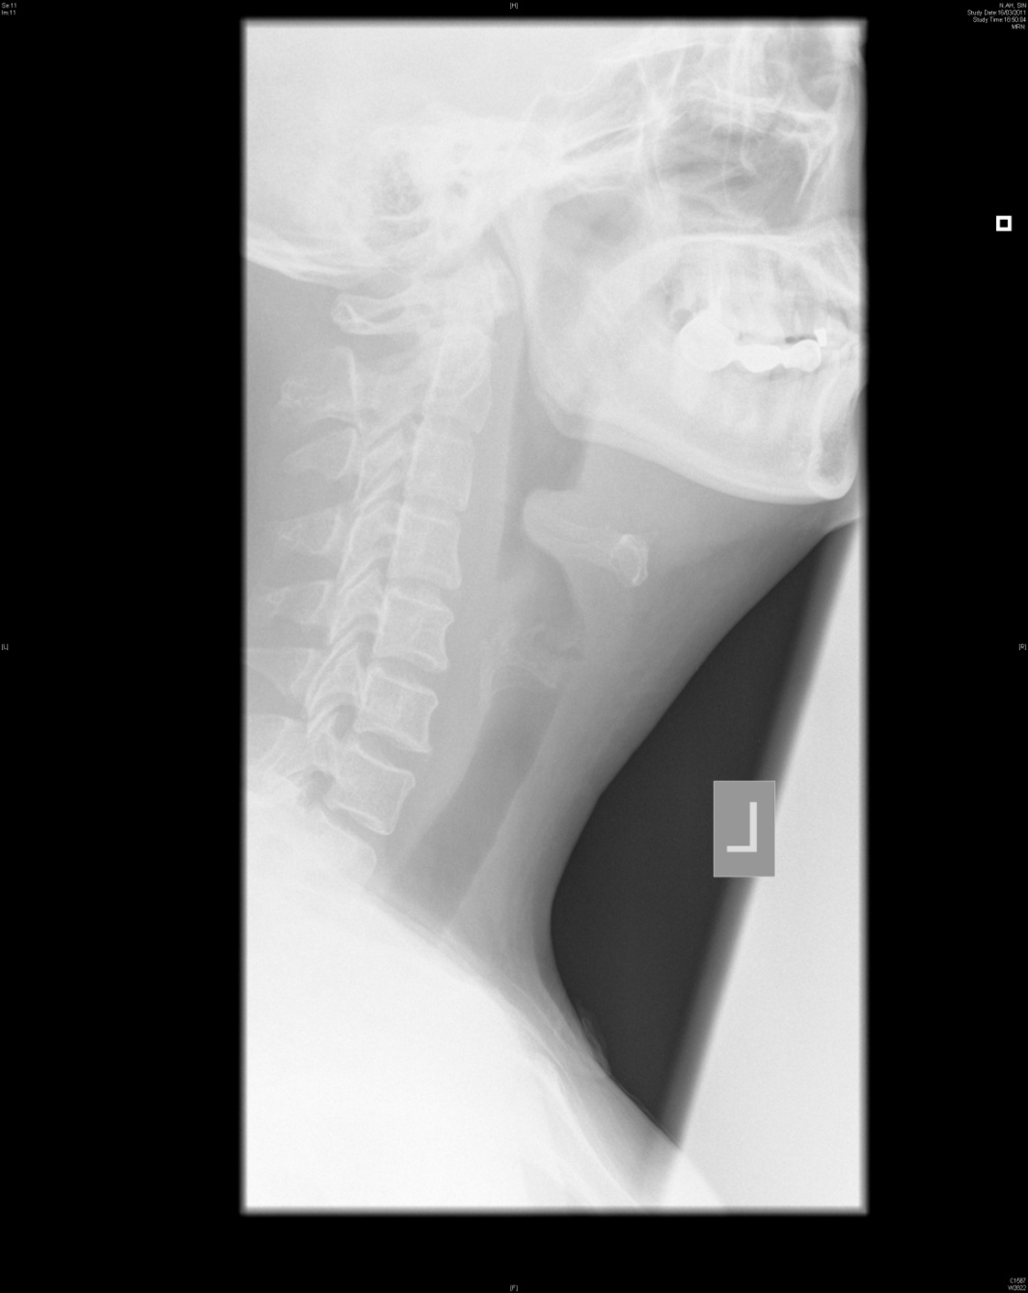
Question 1

Slide 4
Question 1
Describe the x-ray findings.
What is the diagnosis?
What are the common organisms that cause the above condition?
Why do adults usually present less acutely than children?
What is your management?

Slide 5
Question 2
A 55-year-old man complained of retrosternal chest pain while walking on the street. The pain was constricting in nature with radiation to the left shoulder. He had associated sweating and nausea. On arrival, his chest pain subsided. He had no shortness of breath and was not in distress. His BP was 148/87, pulse 76bpm, Sa02 97% on room air. The chest was clear and the heart sounds were dual with no murmur. The ECG was shown below.

Slide 6
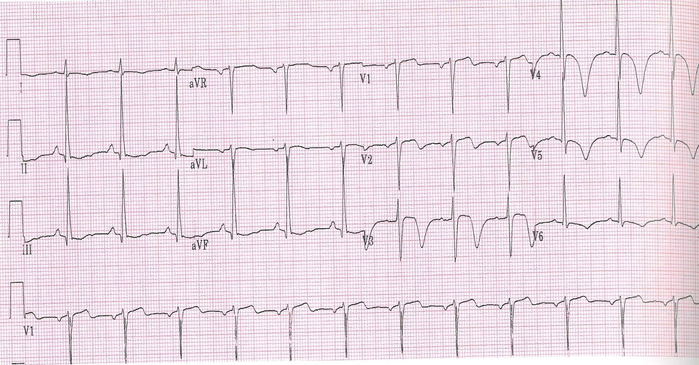
Question 2

Slide 7
Question 2
Describe the ECG findings
What is the syndrome called?
Which coronary artery is affected?
Why is it so important to recognize the above condition as early as possible?

Slide 8
Question 3
A 48-year-old man complained of right thumb pain, swelling and redness for 1 week. He had no fever. He revealed that his thumb was stung by fins of a sea-water fish while preparing food for dinner 1 week ago.

Slide 9
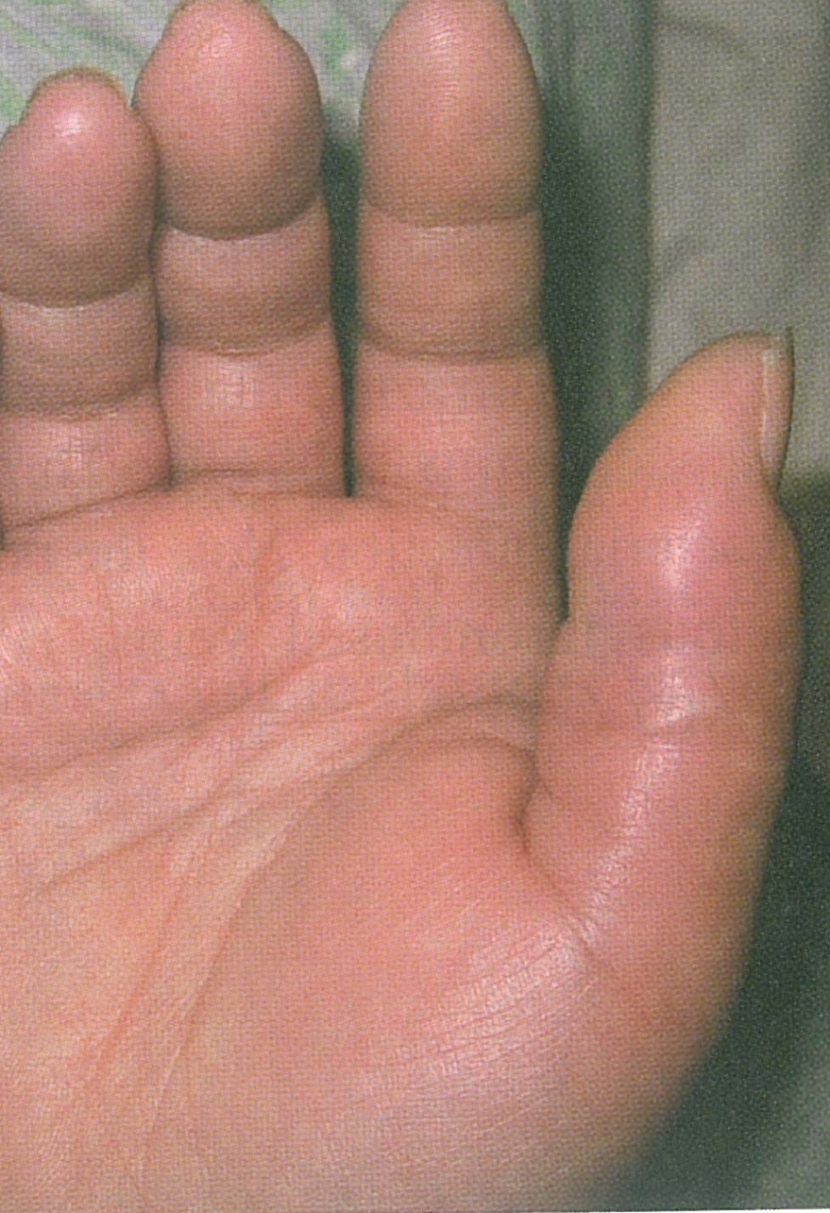
Question 3

Slide 10
Question 3
What physical signs would you expect?
What is the diagnosis?
What are the common causes of the above condition?
What is the most common causative organism for the above condition?
Which specific organism(s) is responsible for the condition caused by sting from marine animals?
What is your management?
What are the complications?

Slide 11
Question 4
A 25 years old man with good past health complained of palpitation for 4 hours. He denied any chest pain, shortness of breathing, dizziness. His blood pressure was 100/51, pulse 128, SaO2 100% on 2L/min O2. His chest was clear. The heart sounds were dual with no murmur.

Slide 12
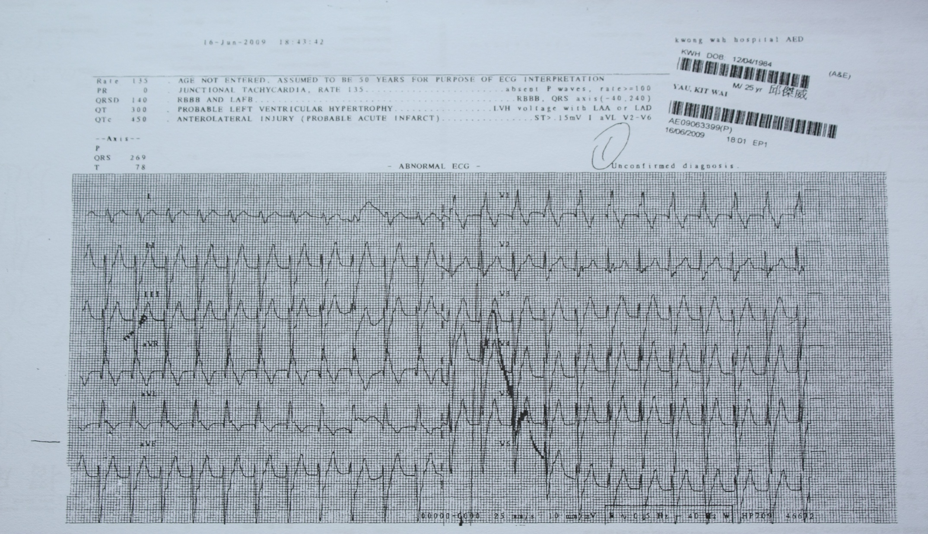
Question 4

Slide 13
Question 4
Describe the ECG findings.
What is the diagnosis?
What is the drug of choice in treating this condition?
What is the definite treatment?

Slide 14
Question 5
A 16 years old boy complained of left testicular pain that woke him up from sleep for 3 hours before attending the AED. He denied any urinary symptoms, history of injury or sexual activity. His vital signs were stable on arrival. He was afebrile. Urine multi-stix was negative for RBC, WCC and nitrite.

Slide 15
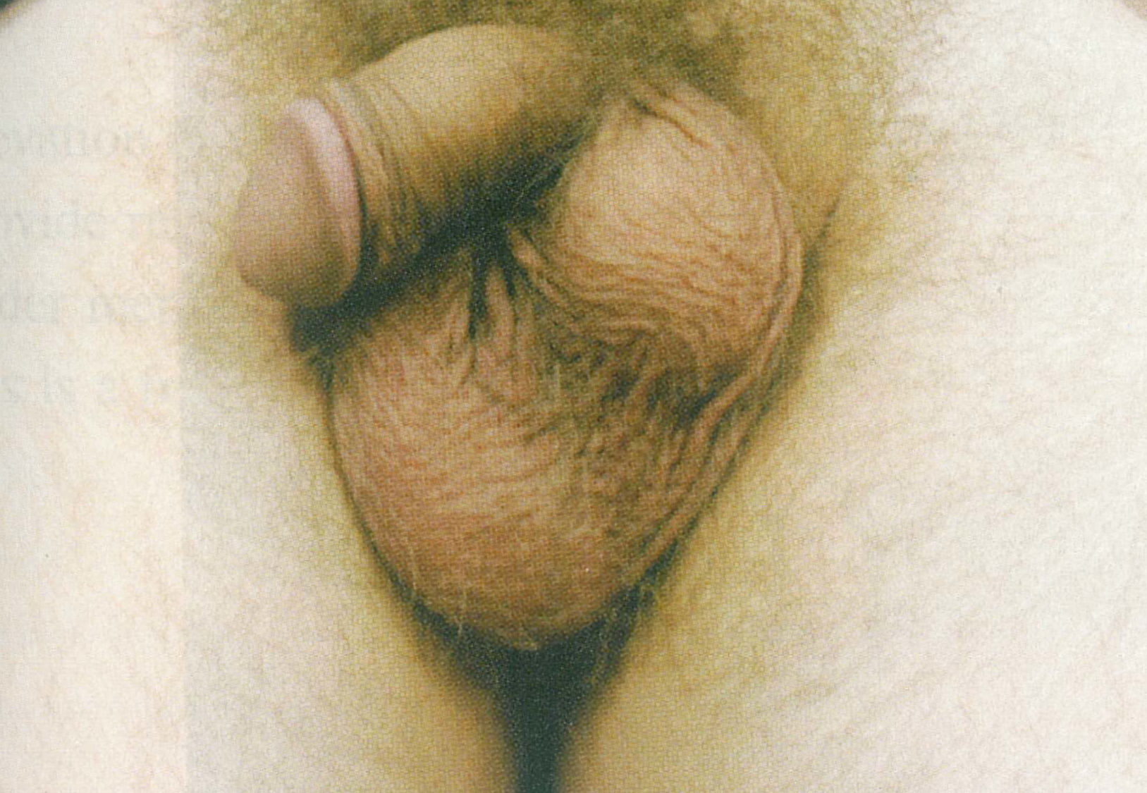
Question 5

Slide 16
Question 5
Describe the physical findings
What is the sign called?
What is the immediate treatment if the patient presents within a few hours of onset?
What is the definite treatment?
What is the salvage rate of the testis if operation is done
A) within 6 hours of onset of pain?
B) after 24 hours of onset of pain?

Slide 17
The End
Thank you

