Slide 1
OSCE
RHTSK A&E
4th September 2013

Slide 2
Case 1
F/81
PHx: Dementia/ Parkinsonism/ HT
Decrease GC for few days
Vital signs stable
ECG done

Slide 3
ECG

Slide 4
Questions
The doctor considers the rhythm as VT. Do you agree? Give 1 reason.
NO. Presence of regular, normal looking QRS on anterior leads ➔ unlikely VT
What is your diagnosis and what can be done to confirm this?
Motion artefact. Repeat the ECG with limb restraint

Slide 5
Suggest 3 ECG features that suggest VT as the cause of wide-complex tachycardia.
Other ECG features suggestive of VT:
Capture beats
Fusion beats
AV dissociation
Very broad QRS complexes (>0.16 second)
Brugada’s sign
Josephson’s sign

Slide 6
ECG after the “maneuver”

Slide 7
“WCT” – differential diagnosis
VT
SVT with aberrant conduction due to BBB
SVT with abnormal accessory pathway (e.g. WPW)

Slide 8
Brugada Algorithm

Slide 9
DDx of WCT origin – Wellen’s Criteria
 | VT | SVT plus aberrancy
Clinical Features | Age >50 Hx of MI, CHF, CABG or ASHD Previous Hx of VT | Age < 30 None Previous Hx of SVT
P/E | Cannon A wave Variation in arterial pulse Variable 1st HS | All absent
ECG | Fusion beats; AV dissociation QRS >0.14 sec; Extreme LAD (< -30 degree) No response to vagal maneuvers | No fusion, P preceding QRS; QRS usu < 0.14 sec; axis normal Slow or terminate with vagal maneuvers
Specific QRS pattern | V1 : R, qR or RS V6 : S, rS or qR Identical to previous VT tracing Concordance of positivity or negativity | V1 : rSR’ V6 : qRs Identical to previous SVT tracing

Slide 10
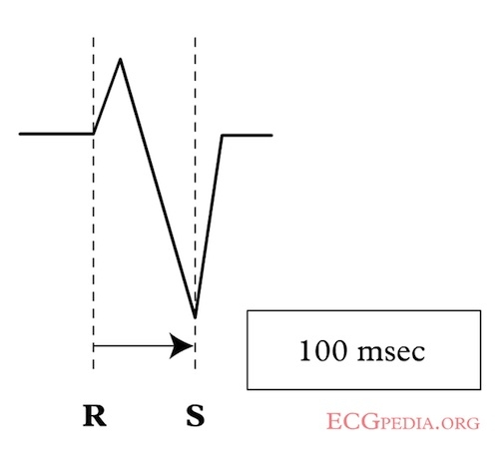
Brugada’s sign

Slide 11
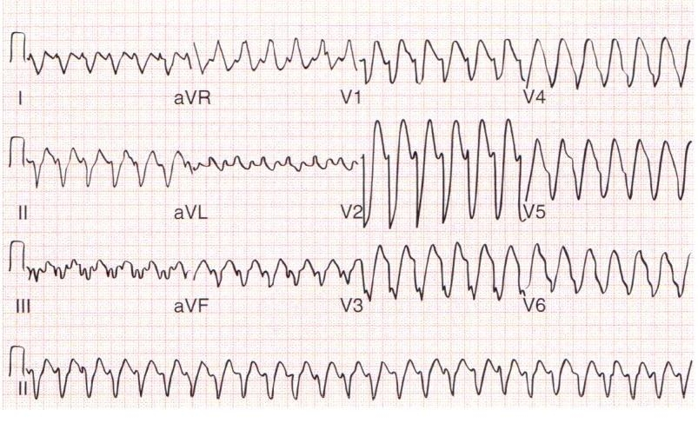
Josephson’s sign

Slide 12
Case 2
F/53
PHx: Good
S/F resulting in left wrist painful swelling
X-ray left wrist done

Slide 13
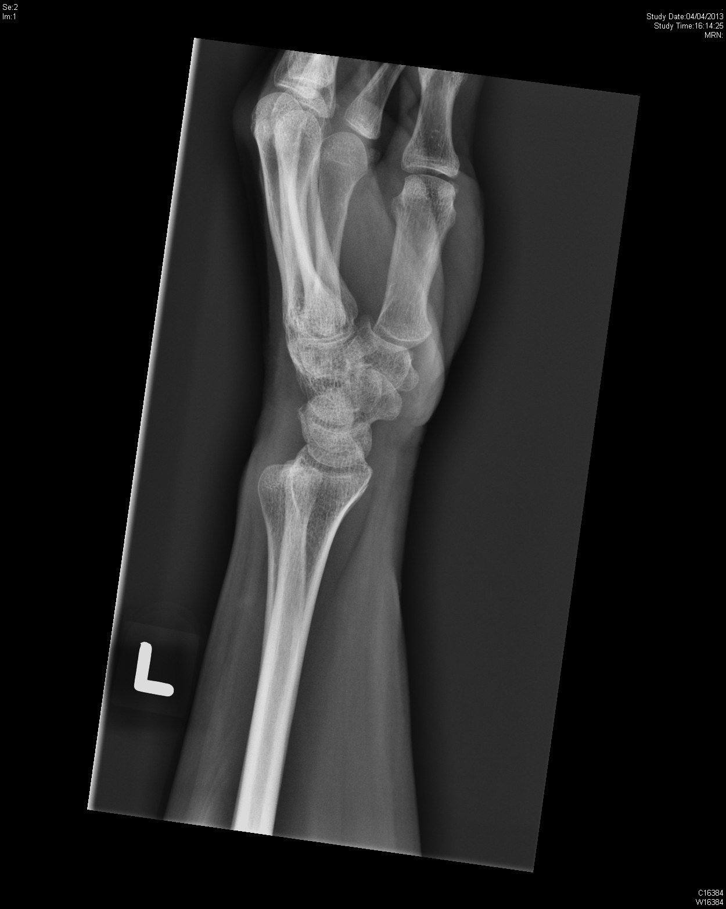

Slide 15
Question
Suggest 2 x-ray abnormalities.
Dorsal distal RUJ dislocation, fracture left distal radius
What is the major pathophysiology of the deformity shown on the x-ray?
Damage to TFCC (triangular fibrocartilage complex)

Slide 16
Suggest 1 image modality helpful to further delineate the injury
CT (to evaluate suspected fracture, degenerative change, DRUJ subluxation)
What is the management?
CR with digital pressure on ulnar head and supination, followed by long arm splint if position is stable; ORIF if unstable or irreducible

Slide 17
Case 3
M/22
PHx: Good
c/o palpitation
Vital signs stable except tachycardia
ECG done

Slide 18
ECG

Slide 19
Question
What are the ECG findings?
Regular WCT with QRS 0.14s, RBBB, LAD
What is the diagnosis?
Fascicular VT
Which class of drug should be used to terminate the rhythm?
Calcium channel blocker (e.g. Verapamil, Herbesser)

Slide 20
What is the underlying pathophysiology of the rhythm?
Calcium-dependent re-entry circuit at Purkinje fibers within LV
Suggest 3 more investigations helpful to delineate the diagnosis
Cardiac MRI, Echo, Electrophysiology Study
What is the definitive treatment?
Radio-frequency ablation

Slide 21
After Herbesser

Slide 22
Fascicular VT
The 2nd most common idiopathic VT
Due to re-entry circuit within left ventricle
Most episodes occur at rest, but may be triggered by stress or exercise
May be misdiagnosed as SVT with RBBB
Treatment: Calcium channel blocker (ATP/ vagal maneuver ineffective)

Slide 23
Case 4
F/41
Good past health, on OCP
Brought to AED after 1 episode of convulsion
Regained consciousness few minutes later
c/o headache in the past few days
P/E: Fully conscious, no focal neurological sign, vital signs stable, h’stix 6.8
No scalp wound
Another episode of convulsion at AED, lasting for 1 minute

Slide 24
Case 4

Slide 25
Question
Name 2 differential diagnosis.
ICH/ Cerebral sinus thrombosis
Name 1 investigation to confirm the diagnosis
CT venogram/ MRI

Slide 26
Suggest 2 risk factors.
Risk factors include: thrombophilia, nephrotic syndrome, pregnancy, OCP, infection (e.g. meningitis/ mastoiditis), chronic inflammatory diseases
What is the treatment?
Anticoagulation/ (Thrombolytic therapy may be considered if anticoagulation fails + deteriorating condition)

Slide 27
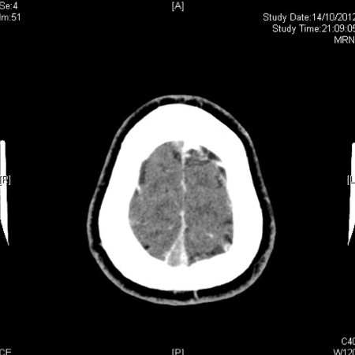
CT venogram

Slide 28
Cerebral vein thrombosis
Thrombosis of the dural sinuses
 Frequently involving: Sup. Sagittal sinus, transverse/sigmoid sinus and cavernous sinus
 Symptoms: Headache, visual loss, convulsion, weakness/focal deficits

Slide 29
Cord Sign
homogeneous, hyperattenuating, cordlike appearance on a unenhanced transverse computed tomographic (CT) scan of the brain.

Slide 30
Dense Triangular Sign

Slide 31
Empty Delta Sign

Slide 32
Case 5
F/83
PHx: Dementia
Found painful swelling and bruise at left foot for 2 days, after falling from bed
X-ray done

Slide 33
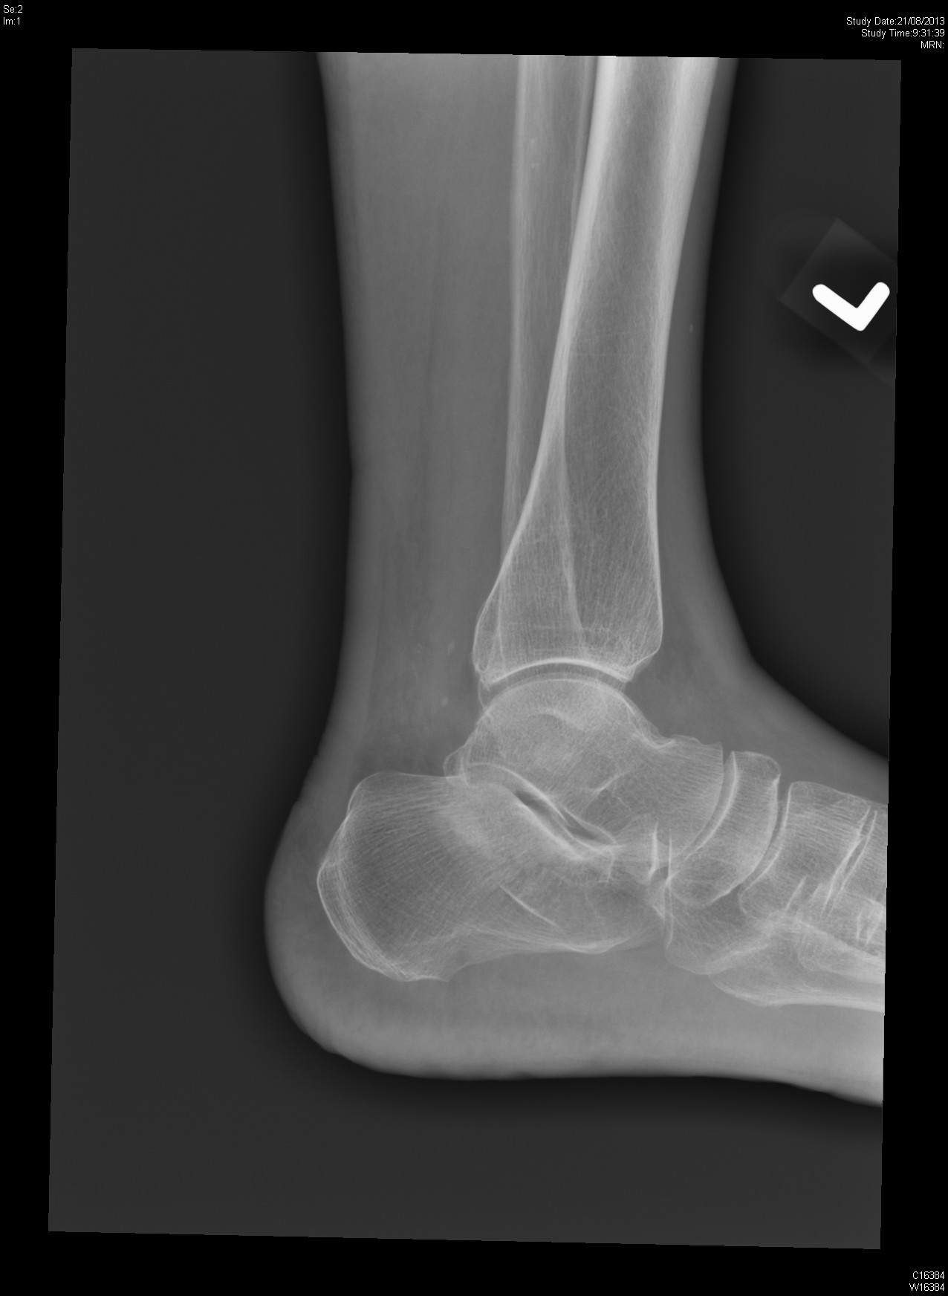

Slide 34
Question
Suggest 2 radiological abnormalities.
Fracture calcaneum/ Depressed Bohler angle/ Widened Gissane angle
What other x-ray view can be done to confirm diagnosis?
Axial view of calcaneum
Suggest 1 investigation that helps confirming diagnosis and guiding management
Plain CT scan

Slide 35
Name 1 classification based on this imaging modality.
Sanders classification
Suggest 3 indications of operative management of this injury
Displaced or comminuted intra-articular fracture/ displaced posterior avulsion fracture/ open fracture/ fracture-dislocation/ displaced fracture of calcaneal tuberosity

Slide 36
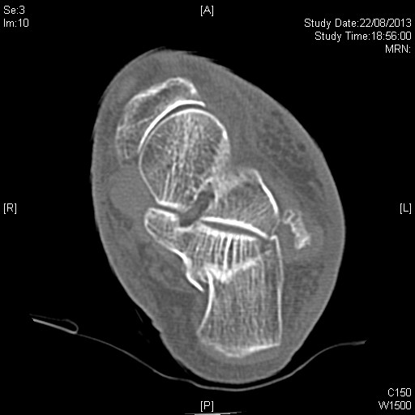
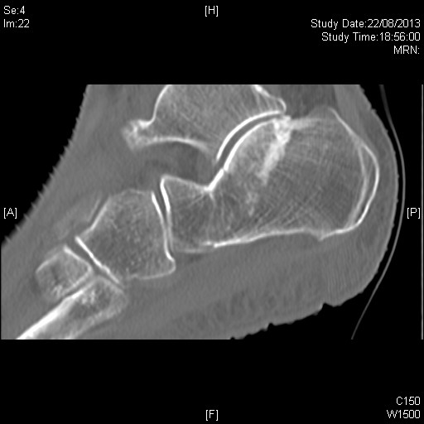

Slide 37
THE END

