Slide 1
JCM OSCE
AHNH
2 Oct 2013

Slide 2
Case 1
M/20
Walk-in case
Chest discomfort for 1 hour
BP 114/89 P77

Slide 4
What are the differential diagnoses?

Slide 5
Differential diagnoses
STEMI
Pericarditis
LV aneurysm
BER

Slide 6
BER
Concave ST elevation
Diffuse ST elevation
Typically seen in leads V2 to V5
Notching at J point
Relative temporal stability

Slide 7
Pericarditis
Sinus tachycardia
Diffuse concave ST elevation
PR segment depression
Best seen in inferior leads and V6
PR segment elevation in aVR

Slide 8
Notes:
Emergency Medicine: Avoiding the Pitfalls and Improving the Outcomes

Slide 9
HsTnT 293ng/L
Echo: normal
Viral titer negative

Slide 11
Case 2
M/15
SOB and throat obstruction for few hours

Slide 14
Pneumomediastinum

Slide 15
What are the possible causes?

Slide 16
Notes:
Mason: Murray and Nadel's Textbook of Respiratory Medicine, 5th ed.

Slide 17
Notes:
Mason: Murray and Nadel's Textbook of Respiratory Medicine, 5th ed.

Slide 18
Case 3
M/60
Fell on outstretched hand

Slide 21
Fracture of triquetrum
Dorsal chip fracture
Cast for 4 weeks
Good prognosis

Slide 22
Case 4
F/29
Abdominal distension and NBO for 3 days
No vomiting
Similar episodes before

Slide 23
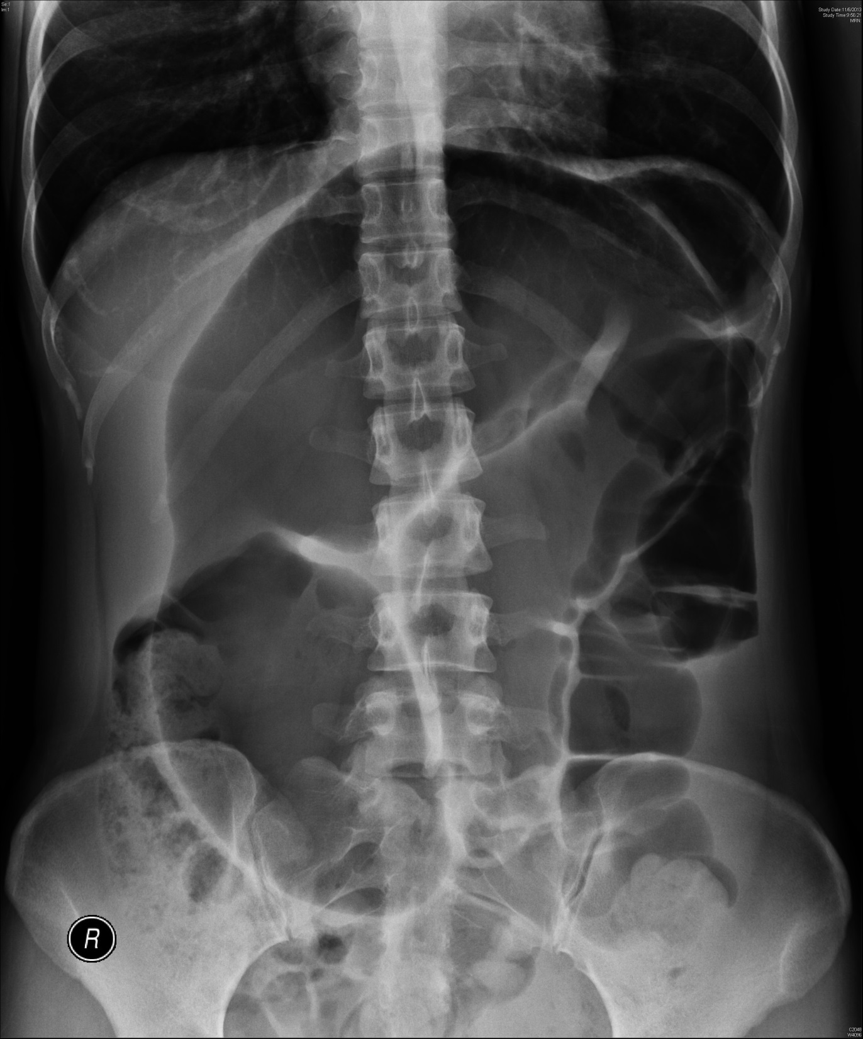

Slide 24
Sigmoid volvulus

Slide 25
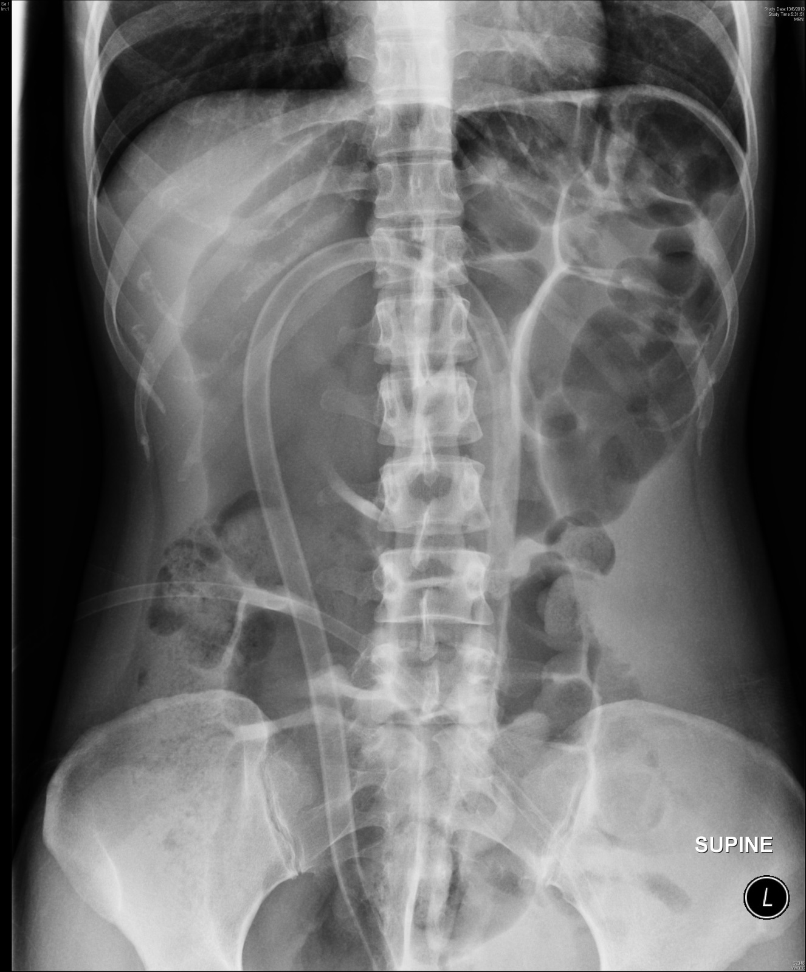

Slide 26
Emergency
Endoscopic decompression
Elective
Colectomy for recurrent cases

Slide 27
Case 5
F/80
Abdominal distension for 1 day

Slide 29
Abdominal aortic aneurysm

Slide 30
Resuscitation
USG/CT
Operation

Slide 31
Case 6
M/13
Twisted right leg while chasing others at school

Slide 34
What is the diagnosis?
Posterior hip dislocation
position of modesty

Slide 35
What is the commoner mechanism of injury?
MVA dashboard injury

Slide 36
What are the potential complications?
Sciatic palsy
Femoral vessels injury
Acetabular and femoral head fracture
Joint instability
AVN
Traumatic arthritis

Slide 37
What is the management at A&E?
Reduction within 6 hours under procedural sedation or general anesthesia

Slide 38
Notes:
Roberts: Roberts and Hedges' Clinical Procedures in Emergency Medicine, 6th ed.

Slide 39
The end

