Slide 1
JCM OSCE
AHNH
2 Oct 2013

Slide 2
Case 1
M/20
Walk-in case
Chest discomfort for 1 day
BP 114/89 P70

Slide 4
What are the differential diagnoses?
How to distinguish between them?

Slide 5
Case 2
M/15
SOB and throat obstruction for few hours

Slide 8
What is the diagnosis?
What are the possible causes?
What is the management?

Slide 9
Case 3
M/60
Fell on outstretched hand

Slide 12
What is the diagnosis?
What is the treatment?
What is the prognosis?

Slide 13
Case 4
F/29
Abdominal distension and NBO for 3 days
No vomiting
Similar episodes before

Slide 14
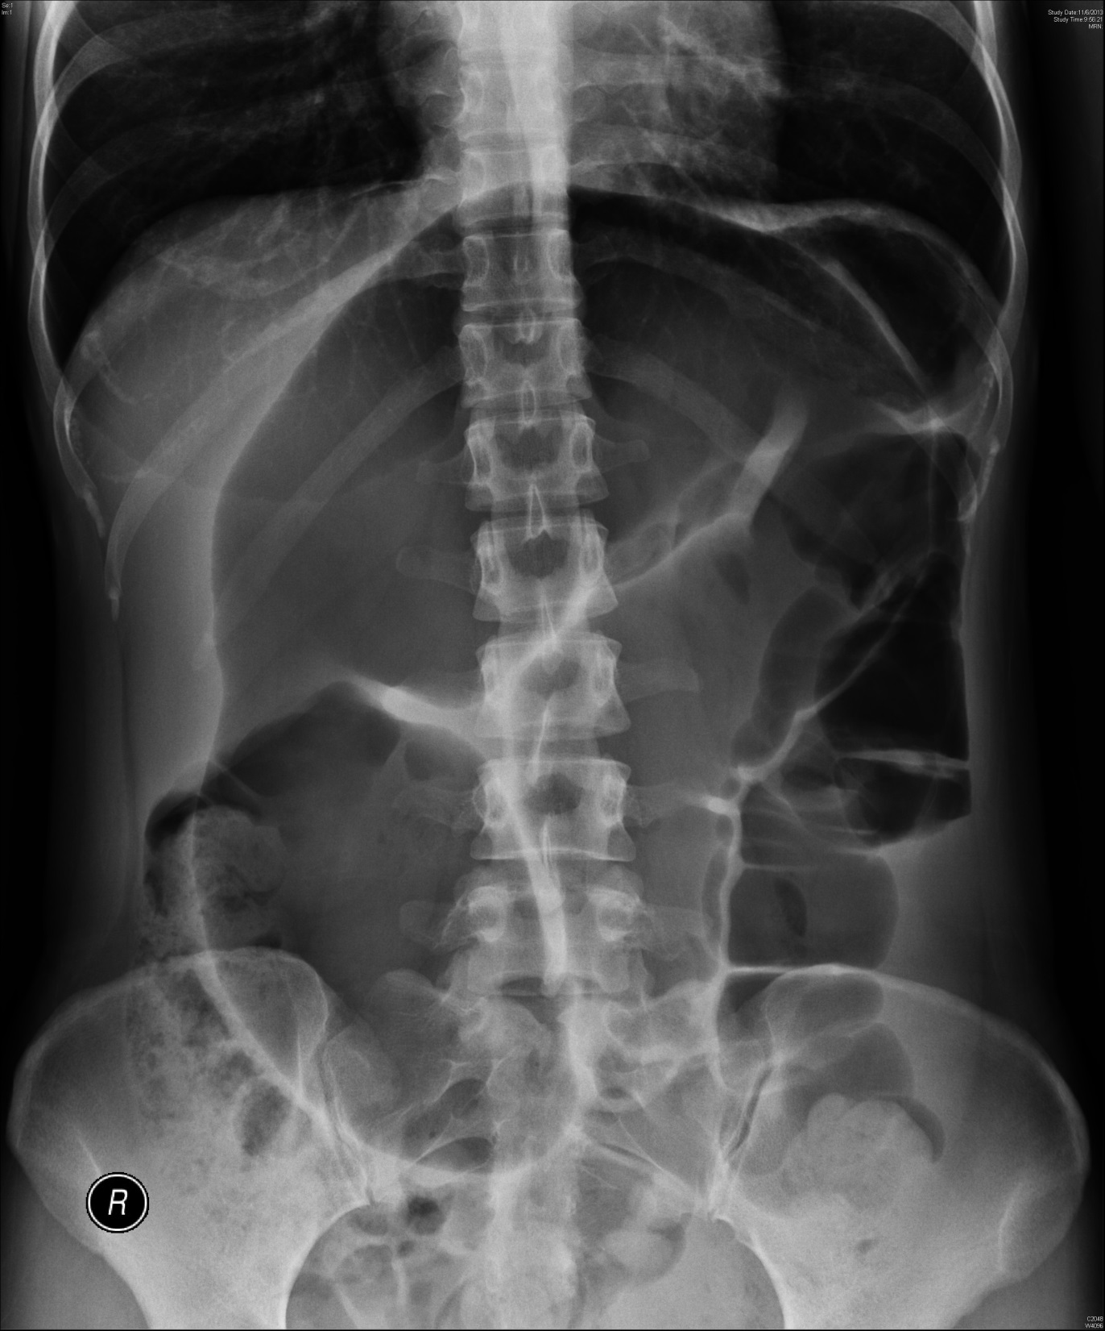

Slide 15
What is the likely diagnosis?
What is the management?

Slide 16
Case 5
F/80
Abdominal distension for 1 day

Slide 18
What is the diagnosis?
What is the management at A&E?

Slide 19
Case 6
M/13
Twisted right leg while chasing others at school

Slide 21
What is the diagnosis?
What is the commoner mechanism of injury for this condition?
What are the potential complications?
What is the management at A&E?

Slide 22
The end

