Slide 1
OSCE
Dr KM Poon
POH A&E
10/2015

Slide 2
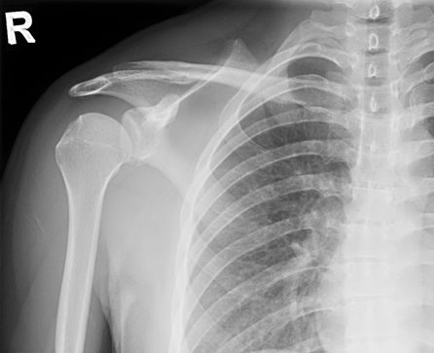
X ray R shoulder

Slide 3
Questions
a. What did you see on the X ray ?
b. What did it suggest?
c. What nerves and vessels are at risk of the condition in b ?
d. What is the advice for patient to help avoid further episode of condition in b?

Slide 4
Case 2
17/M, GPH
c/o SOB in the morning
Associated with central pleuritic chest discomfort & odynopagia +
Cough, sputum -ve
Recalled carried 2 boxes of water (24 bottles of 600ml H2O) the previous night

Slide 5
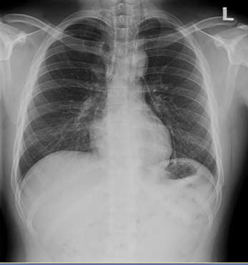
CXR

Slide 6
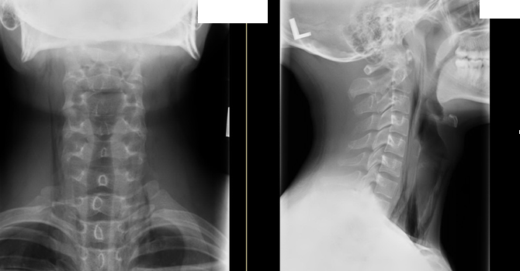
Neck X ray

Slide 7
Questions
a. What are the X rays findings.
b. What is the diagnosis?
c. What specific physical sign would you look for?
d. What should be the ED treatment?

Slide 8
Case 3
12 boy,
c/o left hip pain for 1 month
Injury –ve
Walk with left limping gait

Slide 9
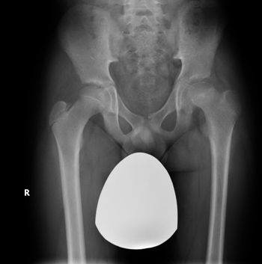
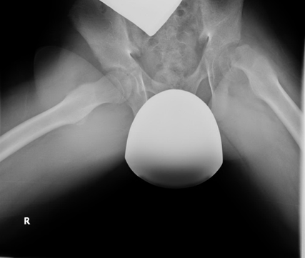
X ray hip

Slide 10
Questions
a. What are the X ray finding?
b. What is the clinical diagnosis?
c. What are the signs in physical examination?
d. What are the complications?
e. What type of epiphyseal injury (Salter Harris classification) does this patient belong to?

Slide 11
Case 4
45/M, smoker
c/o central chest pain for 20 mins
Radiation –ve
Sweating+
ECG done

Slide 12
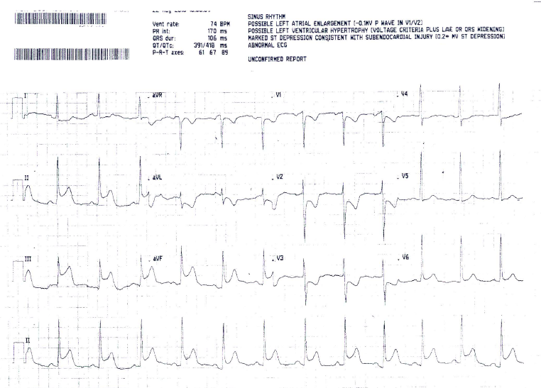
ECG

Slide 13
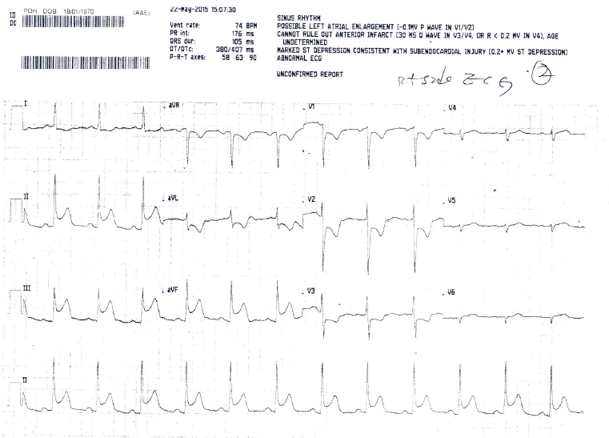
Right sided ECG

Slide 14
Questions
a. What are the ECG findings?
b. What is your diagnosis?
c. What are possible complications?
d. What drug should be avoided if there is RV involvement?
e. Patient eventually received the TNK thrombolytic therapy. What is the expected door-to-needle time ?

Slide 15
Case 5
63/F
CA ovary with TAHBSO done in 2012
C/O dizziness & headache
CT brain was done

Slide 16
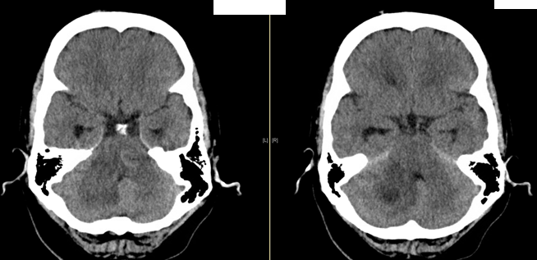
CT brain

Slide 17
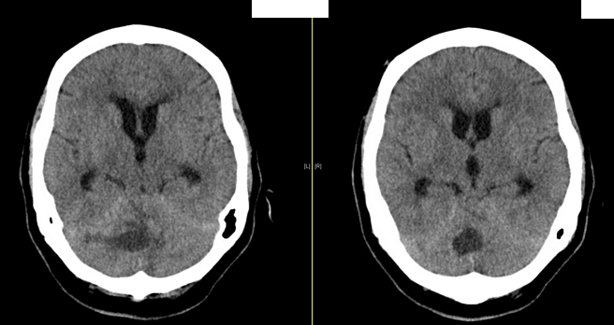
CT brain

Slide 18
Questions
a. What are the CT findings.
b. What are possible diagnosis.
c. What physical signs you would expect in this patient.
d. What are ED treatments.

Slide 19
That’s all Any questions ?
Thank you

