Slide 1
OSCE
Dr KM Poon
POH A&E
10/2015

Slide 2
Case 1
18/M
C/O right shoulder pain after lift up his right arm
Fail to move his arm afterward
Noted some “deformity” over right shoulder
Spontaneous recovery by patient before present to you

Slide 3
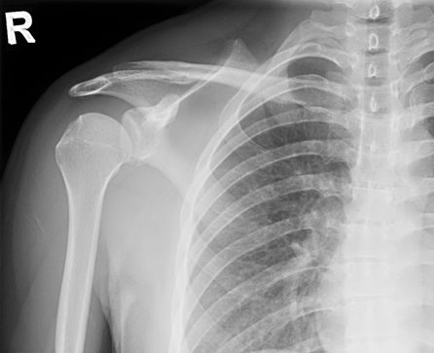
X ray R shoulder

Slide 4
X ray R shoulder
Notes:
Hill-Sachs lesions are a posterolateral humeral head compression fracture, typically secondary to recurrent anterior shoulder dislocations, as the humeral head comes to rest against the anteroinferior part of the glenoid.

Slide 5
Questions
a. What did you see on the X ray ?
b. What did it suggest?
c. What nerves and vessels are at risk of the condition in b ?
d. What is the advice for patient to help avoid further episode of condition in b?

Slide 6
Answer
a. Fracture over the right glenoid lip (Bony Bankart lesion) & compression fracture of the posterolateral aspect of right humeral head (Hill Scahs lesion)
b. Recurrent right shoulder dislocation
c. Right axillary & musculocutaneous nerves & vessel (axillary artery)
d. He is advised to avoid the throwing position (abduction and external rotation of the arm). This is the basis of the ‘apprehension test’. In this test the arm is put in the vulnerable position of abduction and external position. This will cause pain or discomfort and the patient becomes apprehensive that the shoulder will re-dislocate.

Slide 7
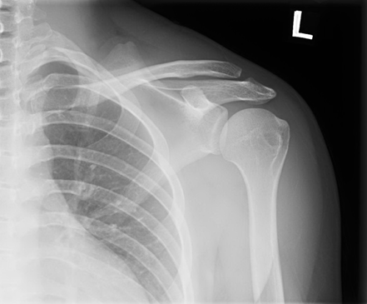
X ray Left shoulder for comparison

Slide 8
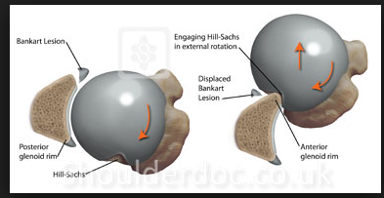
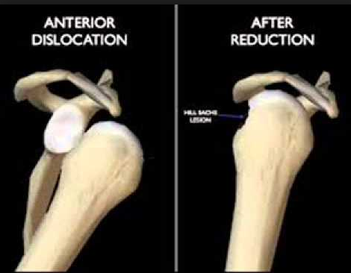
Picture from google search

Slide 9
Case 2
17/M, GPH
c/o SOB in the morning
Associated with central pleuritic chest discomfort & odynopagia +
Cough, sputum -ve
Recalled carried 2 boxes of water (24 bottles of 600ml H2O) the previous night

Slide 10
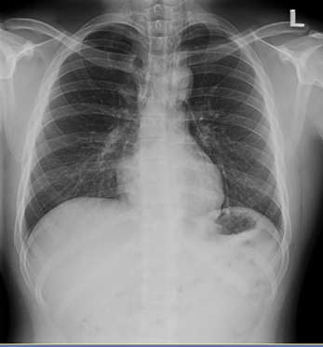
CXR

Slide 11
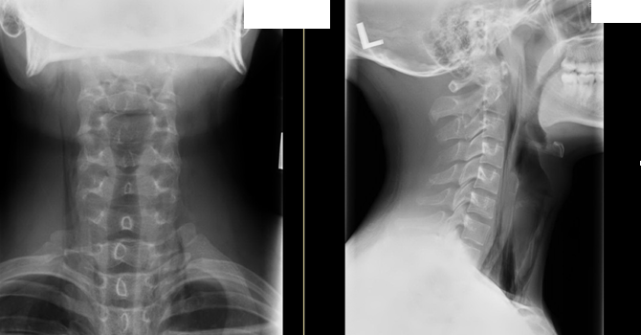
Neck X ray

Slide 12
Questions
a. What are the X rays findings.
b. What is the diagnosis?
c. What specific physical sign would you look for?
d. What should be the ED treatment?

Slide 13
Answer
a. There are lucent streaks of air over both sides of mediastinum and extends to the neck.
b. Spontaneous pneumomediastinum.
c. Surgical emphysema and Hamman’s crunch (a crepitance sound occurring with the heartbeat on auscultation of the precordium)
d. Conservative Management (bed rest, analgesics, oxygen therapy and avoidance of Valsalva type maneuvers)

Slide 14
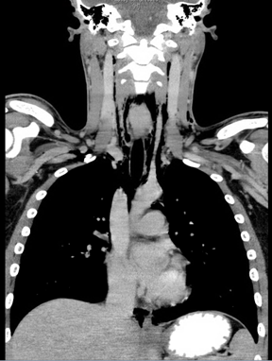
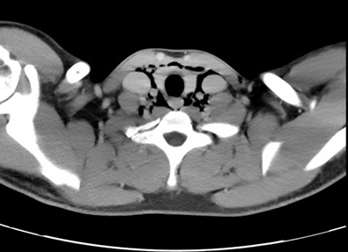
CT thorax

Slide 15
Case 3
12 boy,
c/o left hip pain for 1 month
Injury –ve
Walk with left limping gait

Slide 16
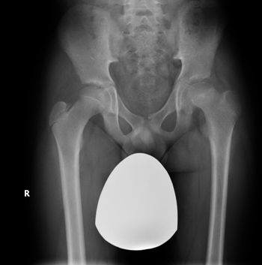
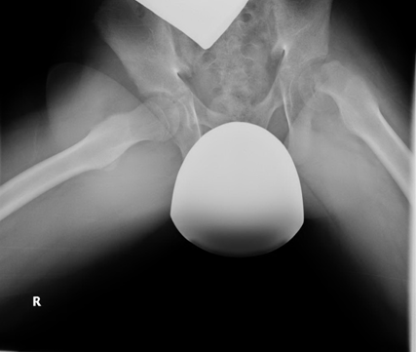
X ray hip

Slide 17
Questions
a. What are the X ray finding?
b. What is the clinical diagnosis?
c. What are the signs in physical examination?
d. What are the complications?
e. What type of epiphyseal injury (Salter Harris classification) does this patient belong to?

Slide 18
Answer
a. Abnormal Trethowan sign over left hip. A line (line of Klein) drawn along the superior border or the femoral neck should normally cut through the epiphysis. Shenton’s line on left side is disrupted.
Flog view reveals postero-medial slip of the epiphysis as well as a Bloomber’s sign (widening & blurring of the physis)
b. Slipped left capital femoral epiphysis

Slide 19
Answer
c. left hip is externally rotated & there is pain & decreased range of movement to internal rotation, abduction & flexion.
d. Complications are avascular necrosis (early), chrondrolysis & osteomyelitis (late)
e. Type I (slipped)

Slide 20
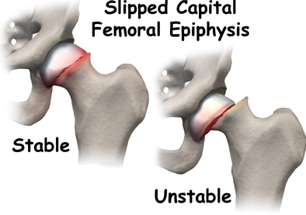
Picture from google search

Slide 21
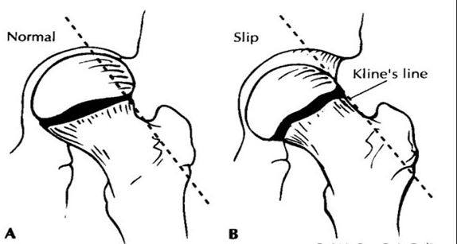
Trethowan sign
Picture from google search

Slide 22
Salter Harris Epiphyseal Injury
Picture from google search

Slide 23
Case 4
45/M, smoker
c/o central chest pain for 20 mins
Radiation –ve
Sweating+
ECG done

Slide 24
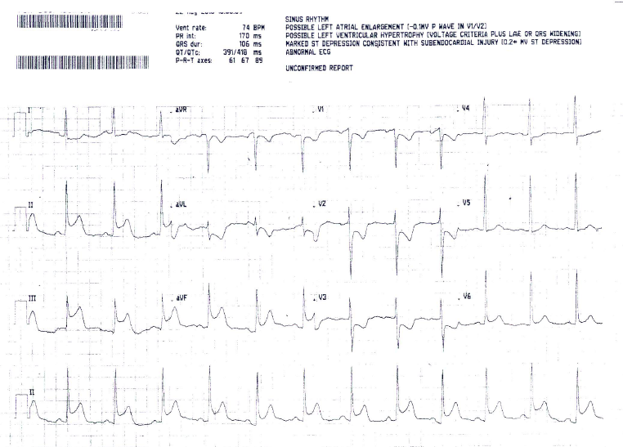
ECG

Slide 25
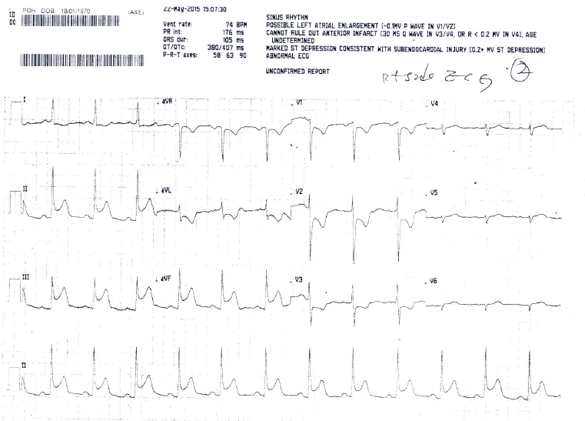
Right sided ECG

Slide 26
Questions
a. What are the ECG findings?
b. What is your diagnosis?
c. What are possible complications?
d. What drug should be avoided if there is RV involvement?
e. Patient eventually received the TNK thrombolytic therapy. What is the expected door-to-needle time ?

Slide 27
Answer
a. ST segment elevation over leads II, III & aVF with reciprocal ST segment depression over V1-V3
There is no right ventricle involvement
b. Inferior myocardial infarction with no RV involvement.
c. Variable degrees of heart block, malignant arrhythmia, right ventricular infarction, congestive heart failure
d. vaso-dilating agent e.g. TNG
e. Door-to-needle time should be within 30 mins

Slide 28
Progress
ECG elevation resolved after TNK
Trop I - 25
Echo : satifactory LVEF ~70%. No RWMA.
Coro: - LAD : proximal LAD 20% lesions
- RCA dominant, mid RCA aneurysmal dilatation with turbulance
- Medical treatment with dual anti-platelet for 3 months

Slide 29
Case 5
63/F
CA ovary with TAHBSO done in 2012
C/O dizziness & headache
CT brain was done

Slide 30
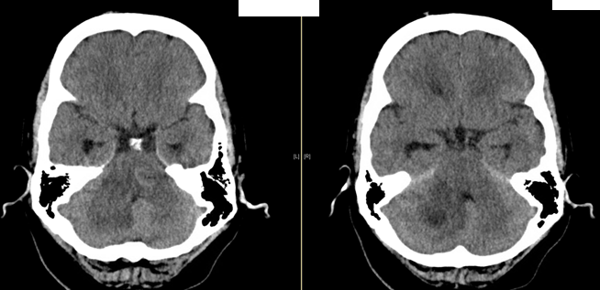
CT brain

Slide 31
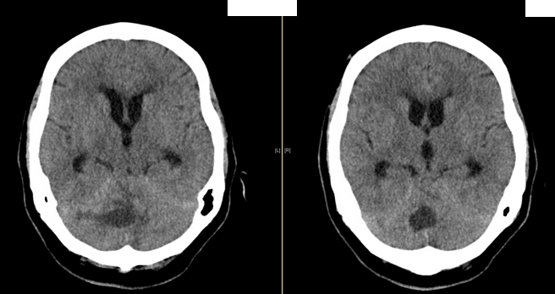
CT brain

Slide 32
Questions
a. What are the CT findings.
b. What are possible diagnosis.
c. What physical signs you would expect in this patient.
d. What are ED treatments.

Slide 33
Answer
a. Heterogeneous lesion with associated odema was noted over the cerebellum. Dilated ventricles with temporal horn seen. Ballooning of the 3rd ventricle. Hydrocephalus +
b. Brain metastasis. Tumour bleeding. Brain abscess.
c. Cerebellar signs ( truncal ataxia, failed heel to toe walking, dysdiadochokinesia, intention tremor or pass pointing in finger-to-nose test)
Signs of increased ICP (Cushing reflex, papilloedmea on fundoscopy)
Notes:
Test for dysdiadochokinesis by showing the patient how to clap by alternating the palmar and dorsal surfaces of the hand. Ask them to do this as fast as possible and repeat the test with the other hand. - See more at: http://www.osceskills.com/e-learning/subjects/cerebellar-examination/#sthash.yuXl1N1C.dpuf

Slide 34
Answer
d. Analgesics, control ICP (sit upright, head neutral position, use of mannitol), prevent seizures, multidisciplinary approach with neurosurgeon and clinical oncologist.

Slide 35
That’s all Any questions ?
Thank you

Slide 36
Acknowledgement
Thanks to
Dr MM Lee (POH A&E) &
Dr CL Tsui (POH A&E)
of cases selection

