Slide 1
OSCE Suggested answer
4 May 2016

Slide 2
Q1
A) Abdominal aortic aneurysm
B) Abdominal mass/bruit
Flank ecchymosis
LL circulation
C) Resuscitation
Pain control
Emergency surgical consultation

Slide 3
Q2
Purple urine bag syndrome
Indwelling urinary catheter
Chronic constipation
Female
Alleviation of constipation
Catheter replacement
+/- Antibiotic

Slide 4
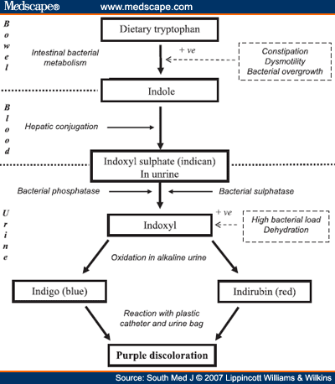

Slide 5
Q3
Well circumscribed CSF lesion at left middle cranial fossa
Arachnoid cyst
Epidermoid cyst
C) Refer to neurosurgeon

Slide 6
Q4
Opioid overdose
CNS depression
Respiratory depression
Miosis

Slide 7
Anticholinergic overdose
Flushing
Mydriasis
Tachycardisa
Urinary retention
Confusion

Slide 8
ECG
Observation for 6 hours

Slide 9
Q5
Left lung collapse
Massive left pleural effusion
Mediastinal shift
Boerhaave Syndrome
Aortic dissection
Emphyema

Slide 10
Resuscitation
Broad spectrum antibiotic
NG tube
Tube thoracostomy
Urgent surgical consultation

Slide 11
The end

