Slide 1
Quiz with answer
5 Apr 2017
PYNEH

Slide 2
Q1. A 6-year-old girl had a fall on level ground. She complained of pain over left forearms.
X-rays of both forearms were taken.
What are the injuries identified in this set of X-ray?
1. Dislocation of radial head (left)
2. Plastic Bowing of ulna (left)
What treatment will you recommend?
CR + POP

Slide 3
Q1 Fig 1e: POP

Slide 4
Q2: M/51 back seat passenger of a car injured in RTA. He complained of abdominal and back pain.
1.What injury is present in the LS spine X-ray?
- Chance #
2.What is the mechanism of injury?
- Flexion-distraction of the spine
3.What intra-abdominal injuries will you consider?
- mesenteric tear or small bowel perforation

Slide 5
Q2 Fig 2c: CT

Slide 6
Q3: This 80-year-old woman has chest discomfort for 2 days. She has hypertension with treatment.
1. What are your ECG findings?
- Diffuse STD i.e. I, II, III, aVf, V2-6; STE aVr, aVL; atrial fib
2. Which is the likely culprit vessel?
- either LMCA or 3VD with severe obstruction
3. Which ECG feature is important for prognosis?
-STE in aVR ≥ 0.5mm was associated with a 4-fold increase in mortality
-STE in aVR ≥ 1mm was associated with a 6- to 7-fold increase in mortality
-STE in aVR ≥ 1.5mm has been associated with mortalities ranging from 20-75%

Slide 8
Q4: M/36 with ankle sprain
Refer to the ankle X-ray:
1. point out the abnormal findings
- Oblique # of distal fibular with no displacement above the tibio-fibular syndesmosis.
- Widening of space between medial malleulus and talus
What might be the likely mechanism of injury
- External rotation + eversion
Which ligaments are involved?
- Deltoid ligament and anterior tibio-fibular ligament

Slide 9
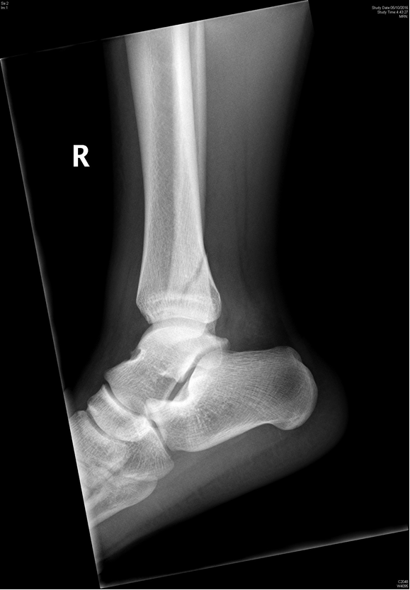
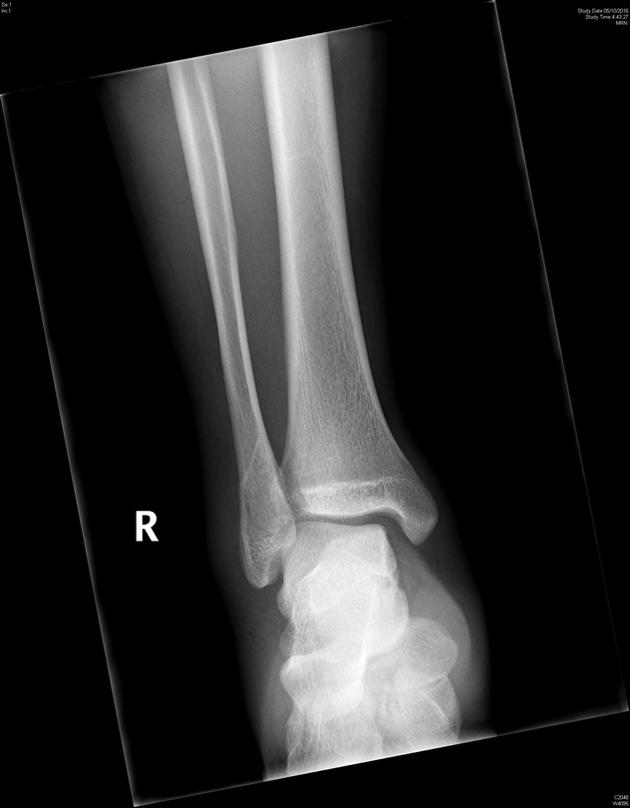
Fig. 8

