Slide 1
OSCE
May 2017
NLTH

Slide 2
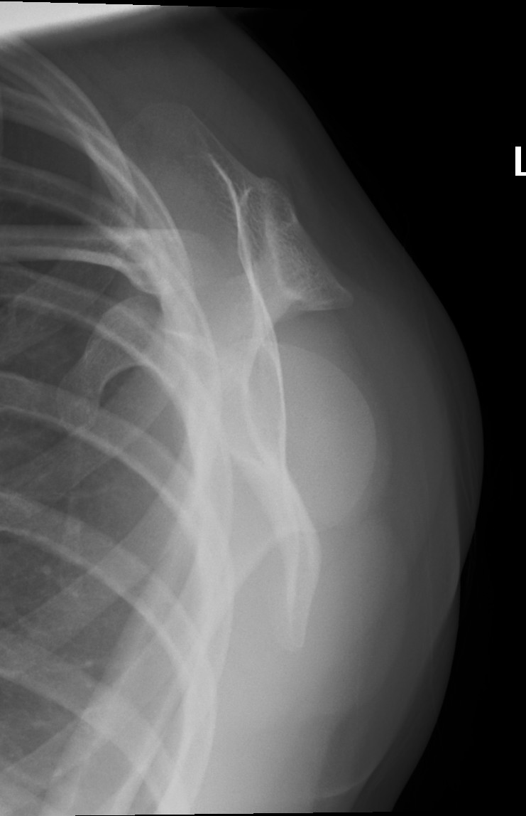
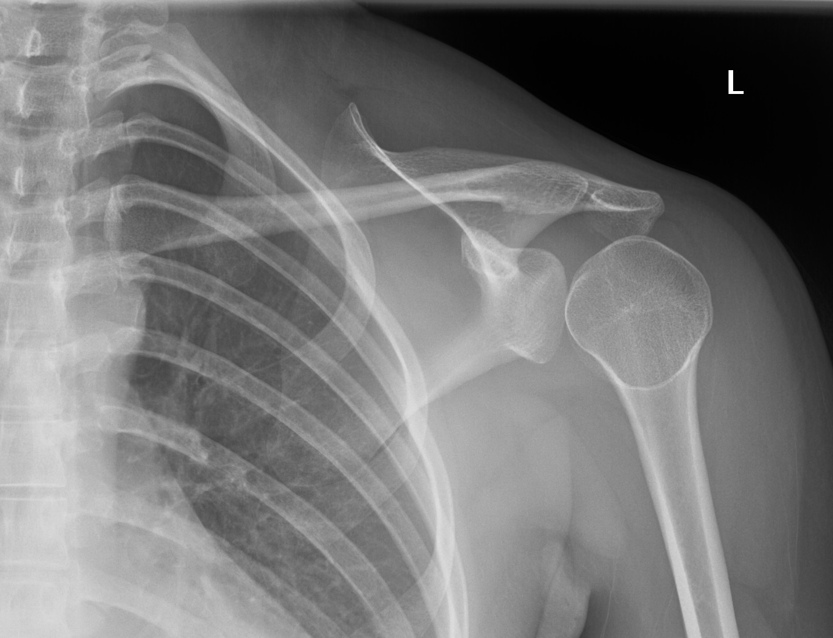

Slide 3
What are the X-ray findings and diagnosis?
a
Q1
b
How will you manage this patient?
Q1
c
What are the associate injuries?
Q1
A 25-year-old lady presented with left shoulder pain after sustained left shoulder contusion

Slide 4
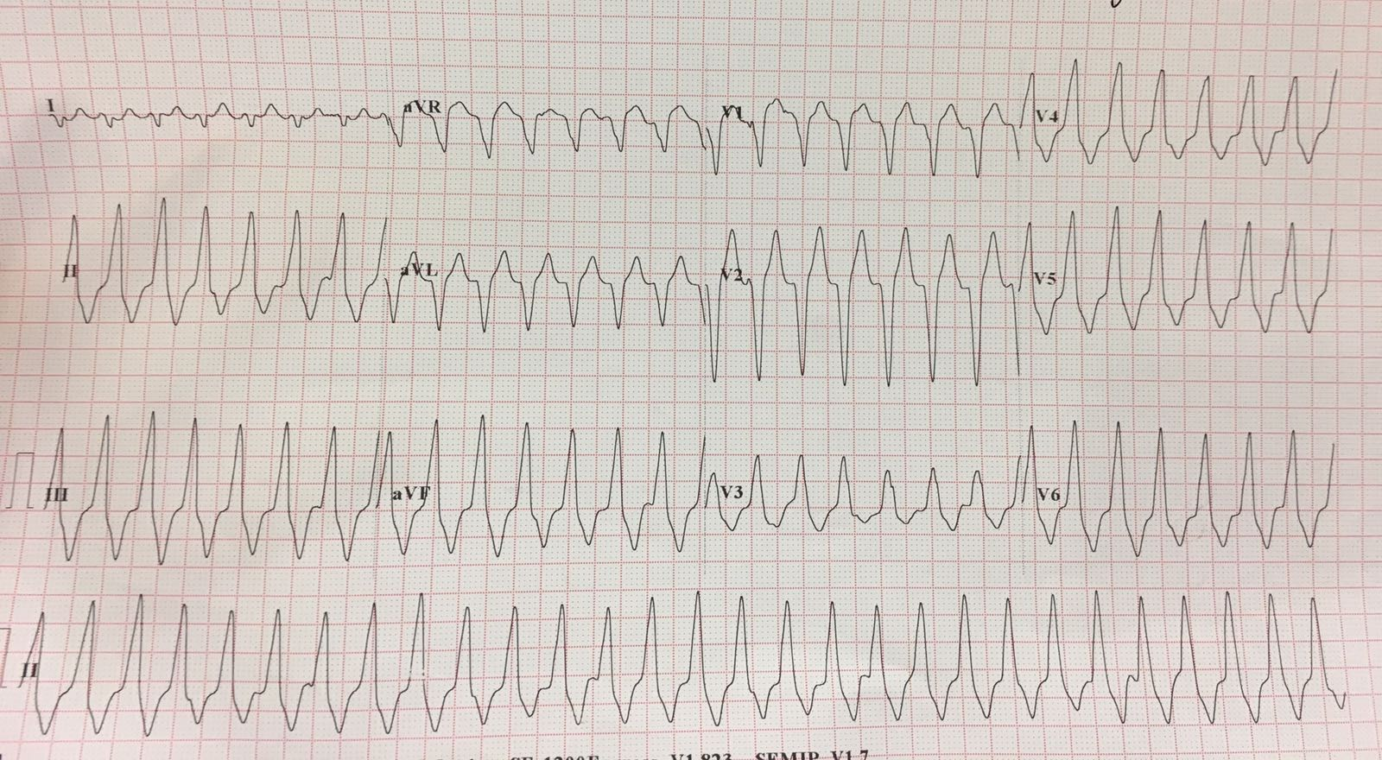

Slide 5
What are the ECG findings and diagnosis?
a
Q2
b
How will you manage this patient?
Q2
c
What is the definite treatment?
Q2
A 20-year-old man complained of palpitation
BP 110/70 mmHg

Slide 6
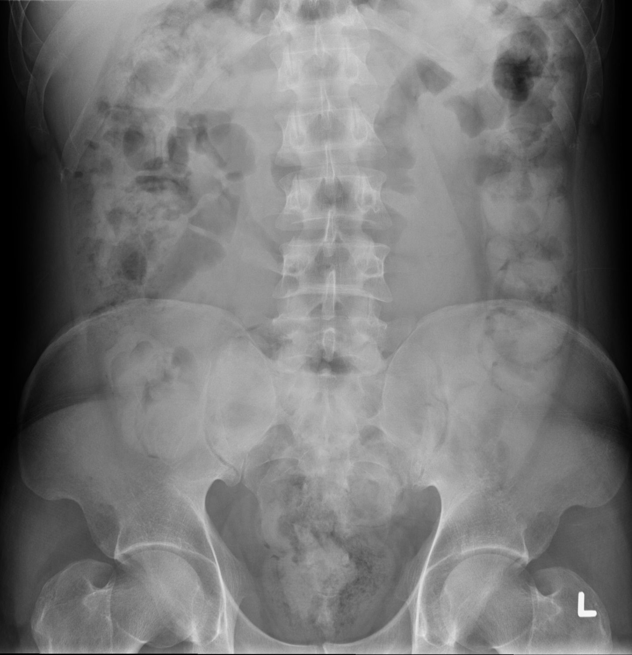

Slide 7
What are the X-ray findings and diagnosis?
a
Q3
What other investigations can help to confirm the diagnosis?
b
Q3
What will you do if the patient refuses further investigations?
c
Q3
A 38-year old Venezuelan lady was brought in by custom for physical examination

Slide 8
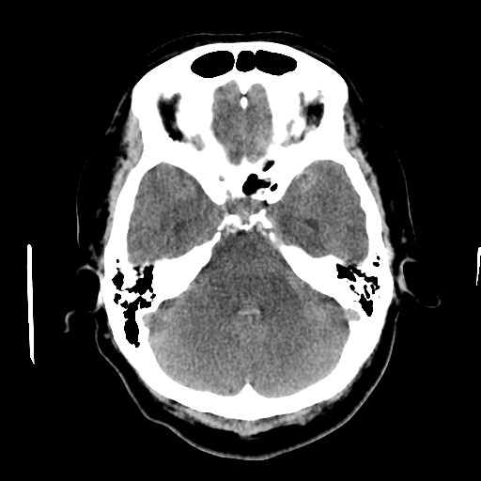
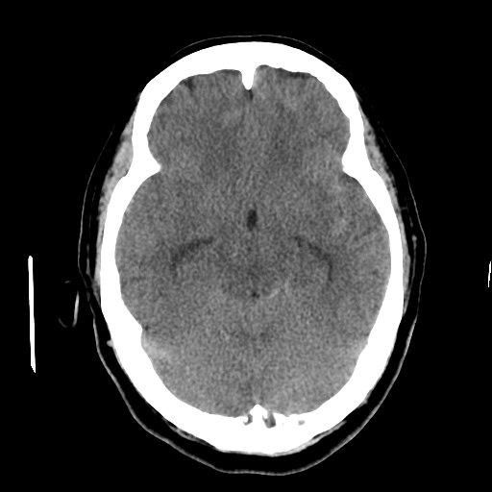

Slide 9
What are the CT findings and diagnosis?
a
Q4
What other investigations can help to confirm the diagnosis?
b
Q4
c
What is the commonest underlying cause?
Q4
Referred by GP for management of a 64-year old lady with one month history of headache

Slide 10
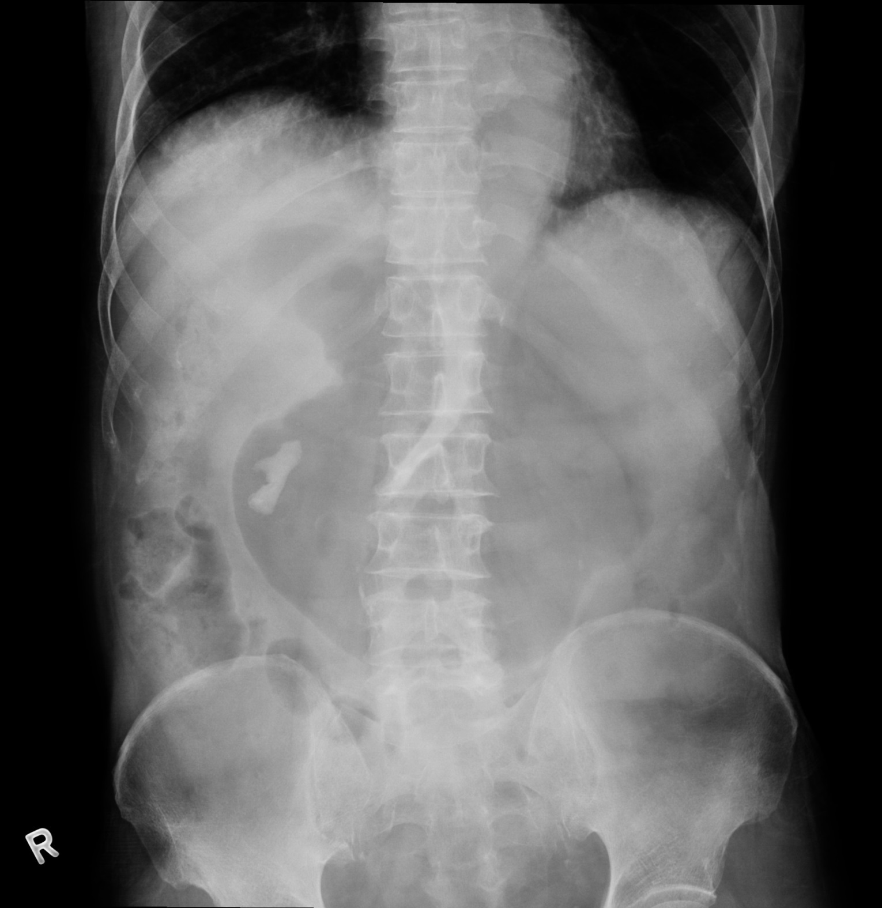

Slide 11
What are x-ray findings and possible common causes?
a
Q5
What other investigation can help to confirm the diagnosis?
b
Q5
c
How will you manage this patient?
Q5
Nurse reported to you that a 80-year-old gentleman got repeat vomiting during EMW stay

