Slide 1
JCM 08/2017 OSCE
RTSKH

Slide 2
Question 1
M/53, Hx of DM
S/F when going down-stair 3/7 ago
Cannot recall mechanism of injury but denied LOC
Self ambulatory, with mild neck discomfort
c/o persistent neck pain, no weakness / numbness / SOB
On arrival, GCS 15/15, BP 128/62, P75. Afebrile.
Pain over upper cervical region, 4 limbs power 5/5, no sensory deficit, reflex normal.

Slide 3
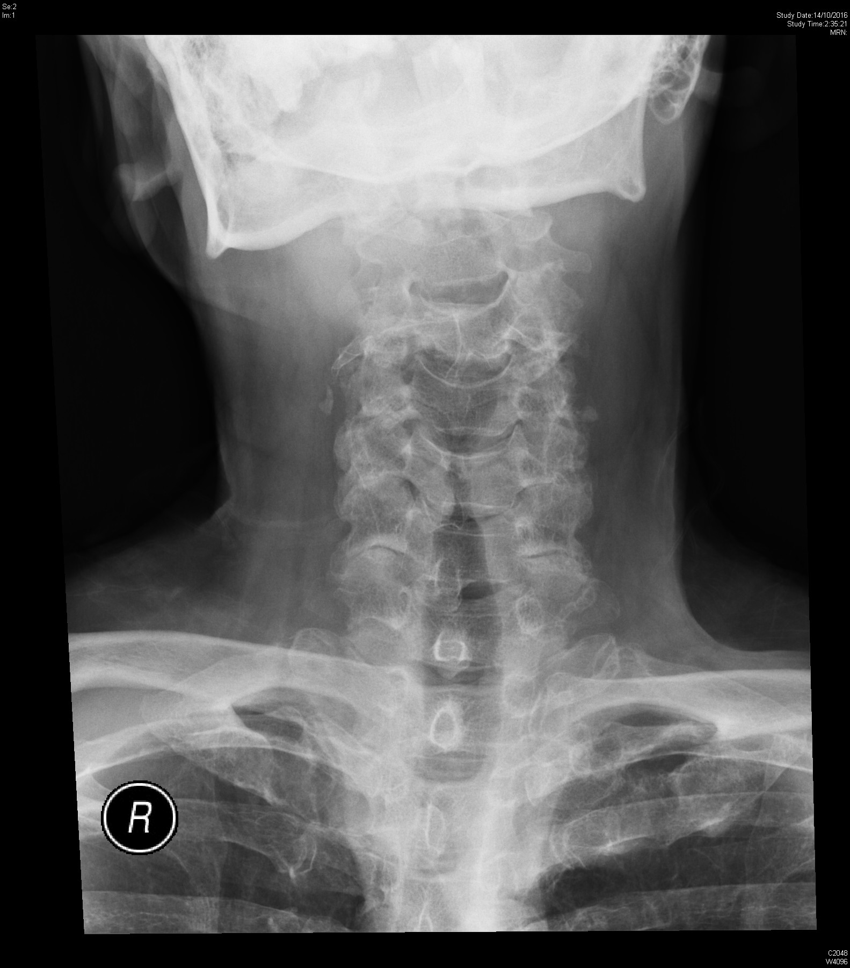

Slide 4
a. List 3 important X-ray findings
Radiolucent line over base of odontoid process
Posterior displacement of C2 body
Gross disruption of anterior vertebral line, posterior vertebral line, spino-laminar line and posterior spinous line over C2
Asymmetry of articular spaces between dens and lateral masses of C1
No significant soft tissue swelling
Dx: # C2 odontoid process

Slide 5
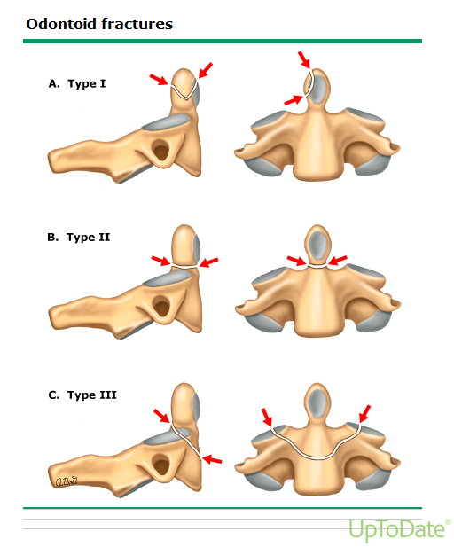
b. How to classify the pathology
Anderson and D’Alonzo classification
Classify according to level of fracture line
Type I: stable
Type II / III: unstable
Type II: high chance of non-union on conservative Mx

Slide 6
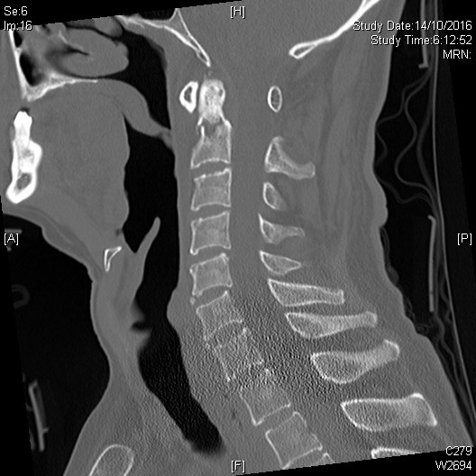
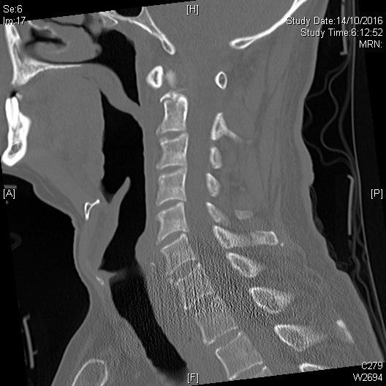
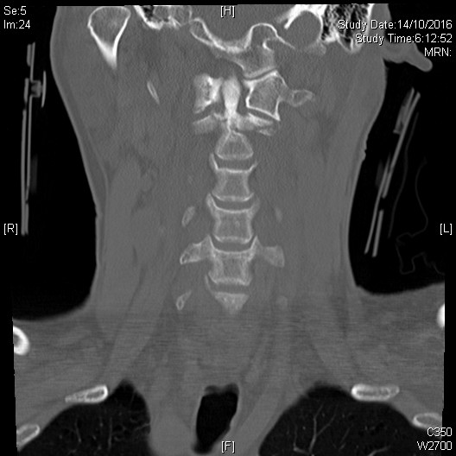
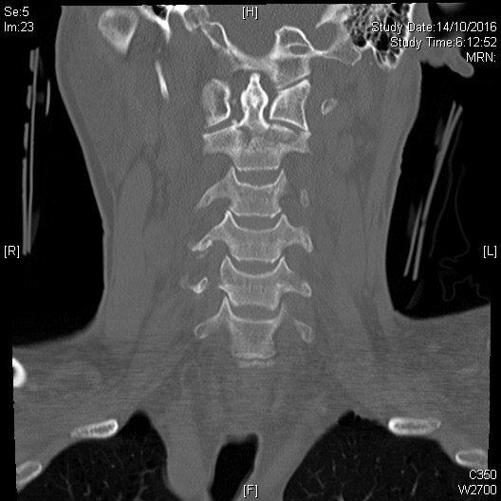
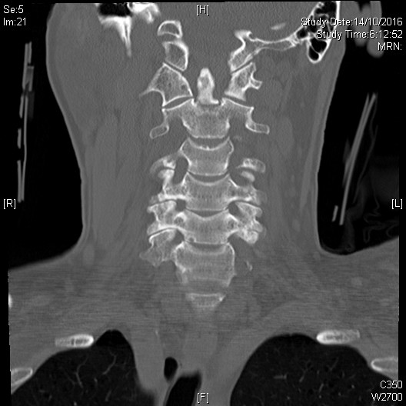

Slide 7
C. His BP drop to 80/50. What will you do?
Haemorrhagic vs Neurogenic shock
Pulse rate is not always slow in trauma patients with neurogenic shock!
IVF
Blood transfusion
Pharmacologic vasopressor
Bradycardia: external pacing, atropine
Monitor urine output to avoid fluid overload

Slide 8
Question 2
F/72, no significant PMHx
just travelled back to Hong Kong from the United Kingdom
had applied a soft brace to her left knee for a sprain
c/o left lower leg swelling and pain
No fever / chest pain / SOB
P/E vital stable, BP 154/78, P88, RR 14, SpO2 100% RA. Afebrile.

Slide 9
A. Identify structure A, B, C
A
B
Left Groin
C
B
A
Compressed
C
B

Slide 10
A: Great Saphenous Vein (GSV)
B: Common Femoral Artery (CFA)
C: Common Femoral Vein (CFV)

Slide 11
b. Describe the USG finding C. What is the Diagnosis
Compressed
Non-Compressive

Slide 12
B:
Echogenic thrombus in Left common femoral vein
CFV non-compressible
C: Left lower limb deep vein thrombosis (DVT)

Slide 13
d. What are the sonographic signs of DVT?
non-compressible venous segment
echogenic thrombus in venous lumen
loss of phasic flow with respiration in colour Doppler
absent colour flow if completely occlusive
lack of flow augmentation of calf squeeze

Slide 14
e. What are the pitfalls of venous USG in DVT?
Isolated iliac vein thrombus
CFV can be fully compressible
Acute on chronic / recurrent DVT
At 3 months post DVT, 80% proximal USG studies are abnormal
At 1 year post DVT, 25-50% studies are still abnormal
Difficult to determine if the clot is old or new
Previous USG to compare
Increase in Residual venous diameter (RVD) >=4mm

Slide 15
Question 3
M/26, Good past health
sustained a facial injury after being assaulted by someone's fist
No LOC, nausea or vomiting
Noted left face swelling after expelled blood in nostril

Slide 16
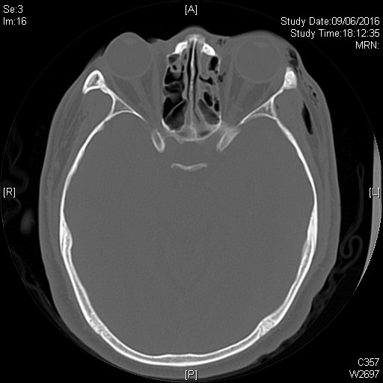

Slide 17
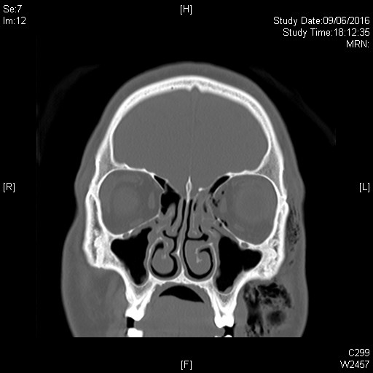

Slide 18
a. List 3 Ct abnormalities
Surgical emphysema over left orbital and facial region
Fracture Left medial orbital wall
Fracture Left ethmoid sinus

Slide 19
b. He c/o double vision after injury. Which muscle is most likely involved?
Left Medial rectus muscle
Herniation of medial rectus causing diplopia on horizontal gaze

Slide 20
c. He c/o blurring of Left eye vision. List 5 DDx
Conreal abrasion
Traumatic Hyphaema
Viterous Hemorrhage
Retinal detachment
Commontio retinae
Optic nerve injury
Rupture globe
Orbital compartment syndrome

Slide 21
d. What is the diagnosis?
D. Traumatic hyphaema
www.aao.org

Slide 22
e. hOw would you manage this patient in ED?
Patient should remain upright
Oral analgesia
Topical cycloplegics
Consider antiemetics
Apply eye shield
Check drug Hx: avoid agents that may contribute to bleeding diathesis
Identify and Treat associated injuries
Consult Ophthalmologist

Slide 23
Question 4
M/4
c/o fever x 3/7
Vomiting x 5, no diarrhoea
Reduced oral feeding, increase drowsiness recent 1/7
no TOCC
Noted rashes on body on day of attending A&E

Slide 24
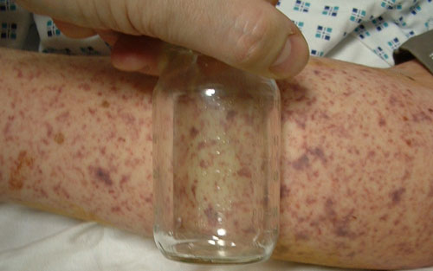
a. Describe the skin rash b. List 4 DDx
http://www.rch.org.au
http://www.mrfpaediatricguide.info

Slide 25
A: diffuse non-blanchable purpuric rash
B:
Purpura fluminans / Meningococcal meningitis
Henoch-Schonlein purpura (IgA vasculitis)
Thrombotic thrombocytopenic purpura
Immune thrombocytopenic purpura
Haemolytic uremic syndrome
Disseminated intravascular coagulation
Drug induced thrombocytopenia

Slide 26
c. What are the common causative bacteria in meningitis?
Neisseria meningitidis
Streptococcus pneumoniae
Haemophilus influenzae type B (Hib)
Group B streptococcus (more common in neonate)
Listeria monocytogenes

Slide 27
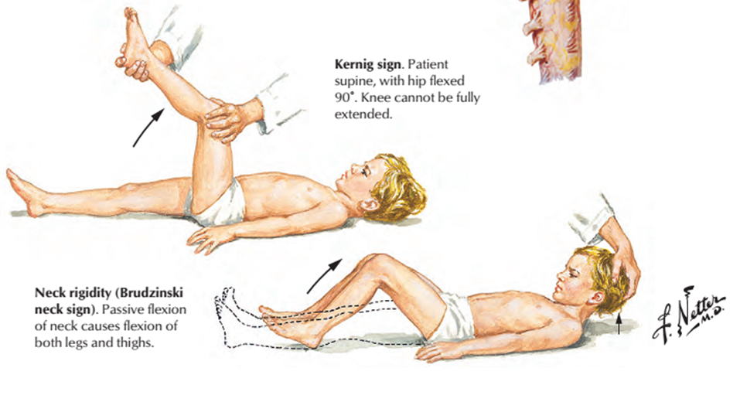
d. What clinical signs are suggestive of meningeal irritation?
Kernig sign
Hip and knee flexed at 90º on a supine patient, attempt to extend leg at knee
+ve: resistance to knee extension
Brudzinski sign
Head passively flexed towards chest on a supine patient
+ve: flexion of knees and hips
www.netterimages.com

Slide 28
E. What are the drugs of choice In empirical treatment of bacterial meningitis?
Ceftriaxone (Rocephin) 2gm IV stat, or
Cefotaxime (Claforan) 2gm IV stat
Consider Dexamethasone 0.15mg/kg IV Q6H x 2-4/7
Reduce risk of hearing loss in children with HiB meningitis
Affect CSF penetration of Vancomycin (for penicillin resistant S. pneumoniae)
Should be given before or concurrently with 1st dose of antibiotics

Slide 29
f. What is your advice on chemoprophylaxis to his mother, a 8 weeks pregnant lady?
Chemo-prophylaxis is indicated in all household contacts who have been exposed to index case within 10 days of onset
Drug of choice:
Ceftriaxone 250mg IM once
Ciprofloxacin 500mg po once (animal study and case report of fetal arthropathy)
Rifampin 600mg Q12H x 2/7 (should not be used in pregnancy)

Slide 30
Question 5
M/21, good past health
Brought in by ambulance due to syncope while walking on street
Spontaneous regain consciousness but duration unknown
P/E GCS 15/15, BP 110/55, P 88, afebrile, H’stix 5.2 mmol/L
No focal neurological deficit, CVS HS dual, no murmur, not in HF

Slide 32
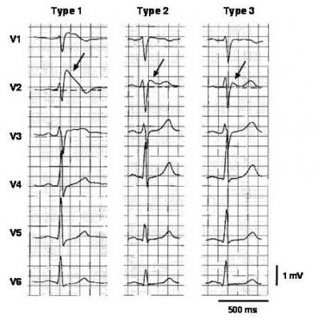
a. Describe the ECG finding b. What is the diagnosis
A. Coved type ST segment with J point elevation over V1-V2
B. Brugada syndrome (Type I)

Slide 33
c. What other important Hx will you ask?
Any preceding symptoms
No preceding chest pain / dizzy / SOB / discomfort before syncope
Any previous Hx of syncope
1 episode of syncope after exercise 1 year ago, didn’t consult doctor
Drug Hx
Denied substance abuse / recreational drug use / use of medication / herbs
Family Hx
No FHx of sudden cardiac death (SCD), with a healthy 19 years old younger brother

Slide 34
D. What are the provoking factors?
Fever
Na channel blocker (flecainide, ajmaline, procainamide)
Beta blocker
Local anaesthesia
TCA
Alcohol
Cocaine

Slide 35
E. What are the indications for Implantable cardiac defibrillator (ICD)?
Prior cardiac arrest :ICD recommended
Hx of sustained VT :ICD recommended
Hx of syncope judged to be caused by ventricular arrhythmia :ICD can be useful
Inducible VF on EP study :ICD may be considered
Consider anti-arrhythmic drugs in patients with frequent firing of ICD
Asymptomatic (Brugada pattern ECG only): not indicated for ICD

Slide 36
The END

