Slide 1
JCM 08/2017 OSCE
RTSKH

Slide 2
Question 1
M/53, Hx of DM
S/F when going down-stair 3/7 ago
Cannot recall mechanism of injury but denied LOC
Self ambulatory, with mild neck discomfort
c/o persistent neck pain, no weakness / numbness / SOB
On arrival, GCS 15/15, BP 128/62, P75. Afebrile.
Pain over upper cervical region, 4 limbs power 5/5, no sensory deficit, reflex normal.

Slide 3
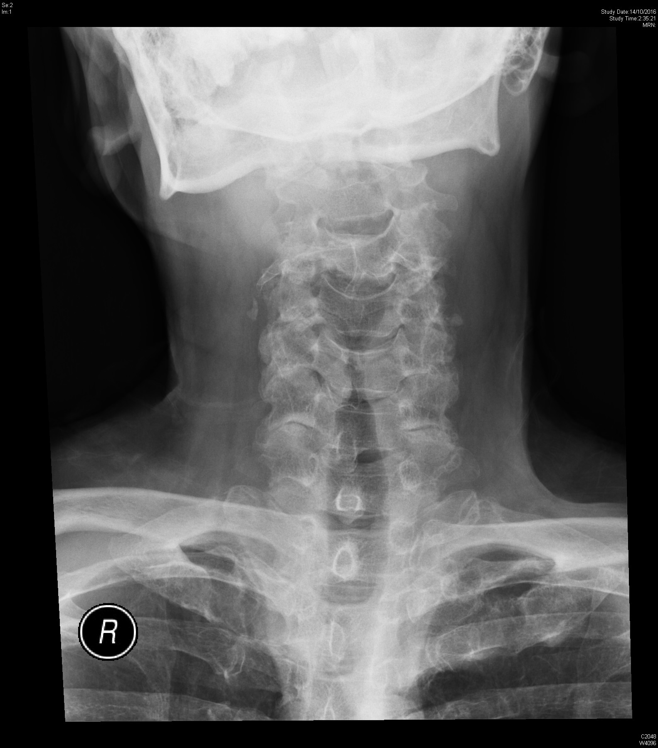

Slide 4
a. List 3 important X-ray findings
b. How to classify the pathology
c. His BP drop to 80/50. What will you do?

Slide 5
Question 2
F/72, no significant PMHx
just travelled back to Hong Kong from the United Kingdom
had applied a soft brace to her left knee for a sprain
c/o left lower leg swelling and pain
No fever / chest pain / SOB
P/E vital stable, BP 154/78, P88, RR 14, SpO2 100% RA. Afebrile.

Slide 6
A. Identify structure A, B, C
A
B
Left Groin
C
B
A
Compressed
C
B

Slide 7
b. Describe the USG finding C. What is the Diagnosis
Compressed
Not Compressed

Slide 8
d. What are the sonographic signs of DVT?
e. What are the pitfalls of venous USG in DVT?

Slide 9
Question 3
M/26, Good past health
sustained a facial injury after being assaulted by someone's fist
No LOC, nausea or vomiting
Noted left face swelling after expelled blood in nostril

Slide 10
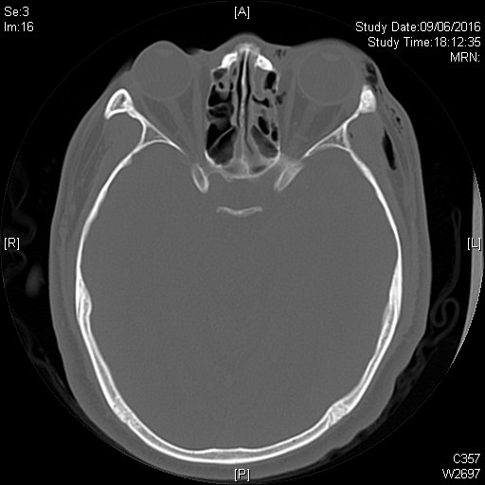

Slide 11
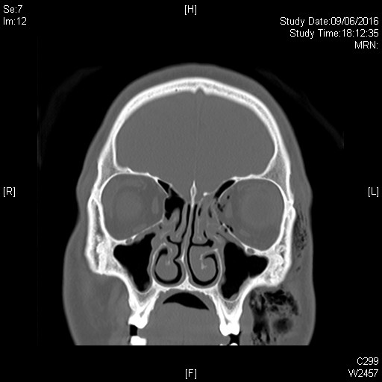

Slide 12
a. List 3 Ct abnormalities
b. He c/o double vision after injury. Which muscle is most likely involved?
c. He c/o blurring of Left eye vision. List 5 DDx

Slide 13
D. What is the diagnosis?
E. hOw would you manage this patient in ED?
www.aao.org

Slide 14
Question 4
M/4
c/o fever x 3/7
Vomiting x 5, no diarrhoea
Reduced oral feeding, increase drowsiness recent 1/7
no TOCC
Noted rashes on body on day of attending A&E

Slide 15
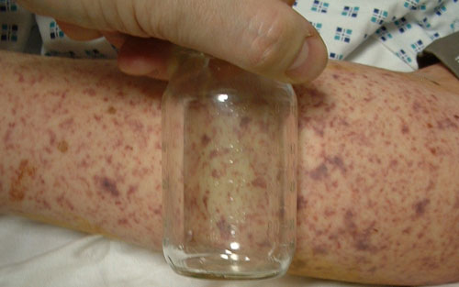
a. Describe the skin rash b. List 4 DDx
http://www.rch.org.au
http://www.mrfpaediatricguide.info

Slide 16
c. What are the common causative bacteria in meningitis?
d. What clinical signs are suggestive of meningeal irritation?
E. What are the drugs of choice In empirical treatment of bacterial meningitis?
f. What is your advice on chemoprophylaxis to his mother, a 8 weeks pregnant lady?

Slide 17
Question 5
M/21, good past health
Brought in by ambulance due to syncope while walking on street
Spontaneous regain consciousness but duration unknown
P/E GCS 15/15, BP 110/55, P 88, afebrile, H’stix 5.2 mmol/L
No focal neurological deficit, CVS HS dual, no murmur, not in HF

Slide 19
C. What other important Hx will you ask?
A. Describe the ECG finding
B. What is the diagnosis

Slide 20
D. What are the provoking factors?
E. What are the indications for Implantable cardiac defibrillator (ICD)?

Slide 21
The END

