Slide 1
JCM OSCE
AHNH AED
6 September 2017

Slide 2
Case 1
F/72
Sudden headache, chest and back pain
BP 152/87 P 69
ECG SR No ischaemic changes

Slide 3
CXR

Slide 4
Describe the CXR.

Slide 5
CT with contrast

Slide 10
Describe the CT.
What is the diagnosis?
What are the other entities in this spectrum of disease?
What is the definitive treatment for this patient?

Slide 11
Case 2
M/9
Swallowed a piece of magnet toy 1 hour ago
Currently asymptomatic and well

Slide 12
CXR

Slide 13
AXR

Slide 14
Why other x ray view may be needed?
How would you manage the boy?
What advice would you give?

Slide 15
Case 3
F/75
Fell from escalator
Head injury without LOC
BP 132/84 P 107
GCS 15/15
3cm laceration on occiput

Slide 16
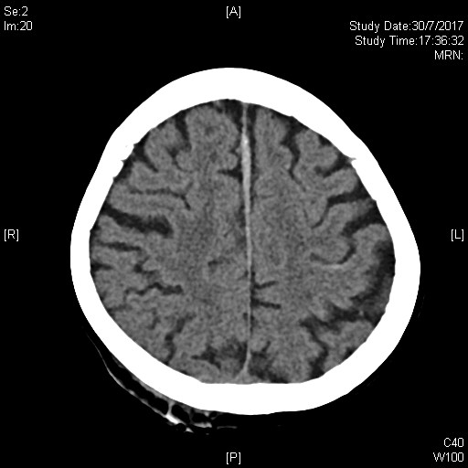

Slide 20
Describe the CT.
What neurologic symptoms and signs would you look for?

Slide 21
Case 4
M/76
Dizziness, epigastric pain and LOC few minutes
BP 117/53 P44
GCS 15/15
T 36C
SpO2 99%

Slide 23
Describe the ECG.
What is the diagnosis?
What are the potential complications?

Slide 24
Case 5
F/78
Palpitations for 2 hours
BP 120/69 P174
SpO2 100% (2L/min O2)
GCS 15/15

Slide 26
Describe the ECG.
Name 2 possibilities.
How to differentiate between them on ECG?

Slide 27
The end

