Slide 1
HKCEM JCM OSCE
Friday 8 December 2017
TKOH

Slide 2
Case 1
A 53-year-old construction site worker with past history of HT presented to ED with chest discomfort, palpitations and dizziness for 4 hours.
On presentation his BP was 103/52 mmHg, HR 75/min, SpO2 94% on RA. He was afebrile.
ECG was performed at triage.

Slide 3
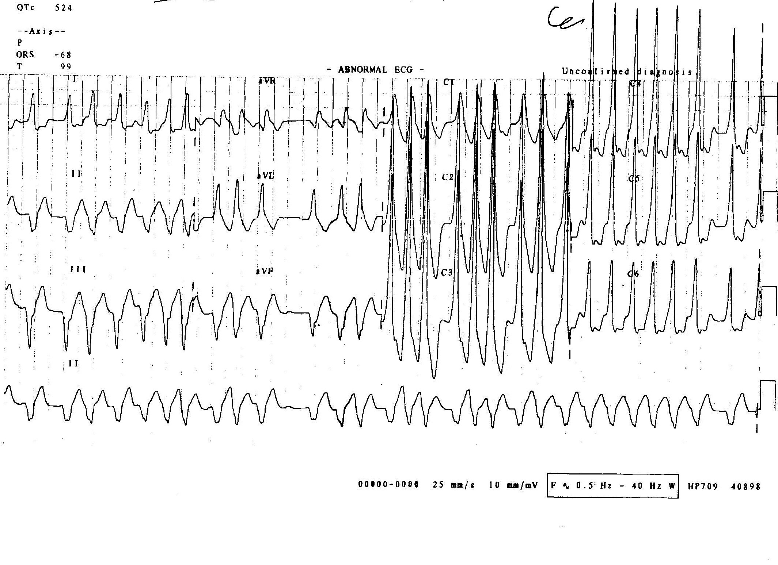

Slide 4
Case 1
List 2 positive findings of the ECG.

Slide 5
Case 1
List 2 positive findings of the ECG.
Tachycardia
Irregular rhythm
Broad QRS complexes with variable width
Slurred upstroke in the QRS complex compatible with delta wave

Slide 6
Case 1
Give two differential diagnosis.

Slide 7
Case 1
Give two differential diagnosis.
Atrial fibrillation with Wolff-Parkinson-White syndrome
Polymorphic ventricular tachycardia

Slide 8
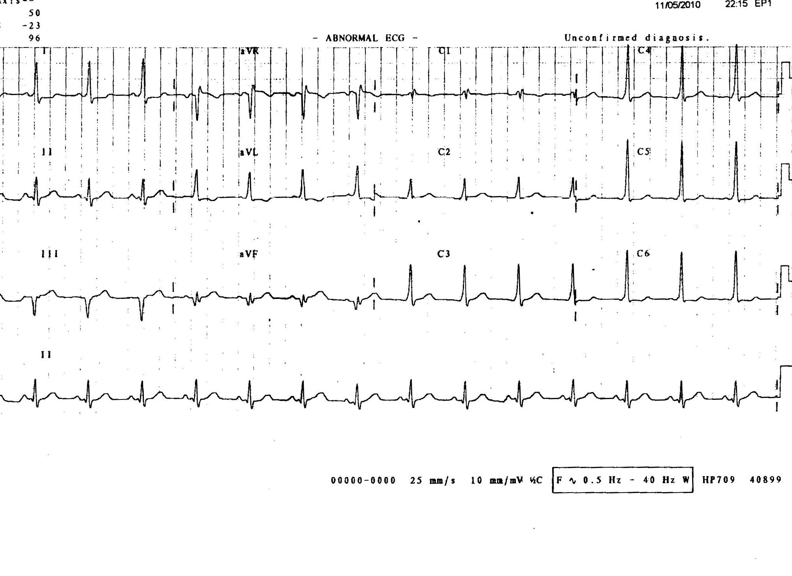
This his ECG repeated 20 minutes after the first ECG.

Slide 9
Case 1
Name two drugs that could be used to treat this condition.
Notes:
2014 AHA/ACC/HRS Guideline for the Management of Patients With Atrial Fibrillation
7.8. WPW and Pre-Excitation Syndromes: Recommendations
Class I
Prompt direct-current cardioversion is recommended for patients with AF, WPW syndrome, and rapid ventricular response who are hemodynamically compromised. (Level of Evidence: C)
Intravenous procainamide or ibutilide to restore sinus rhythm or slow the ventricular rate is recommended for patients with pre-excited AF and rapid ventricular response who are not hemodynamically compromised. (Level of Evidence: C)

Slide 10
Case 1
Name two drugs that could be used to treat this condition. 2014 AHA/ACC/HRS Guideline for the Management of Patients With Atrial Fibrillation
Procainamide (class Ia)
Ibutilide (class III)
are recommended for patients with pre-excited AF and rapid ventricular response who are not haemodynamically compromised.
Notes:
2014 AHA/ACC/HRS Guideline for the Management of Patients With Atrial Fibrillation
7.8. WPW and Pre-Excitation Syndromes: Recommendations
Class I
Prompt direct-current cardioversion is recommended for patients with AF, WPW syndrome, and rapid ventricular response who are hemodynamically compromised. (Level of Evidence: C)
Intravenous procainamide or ibutilide to restore sinus rhythm or slow the ventricular rate is recommended for patients with pre-excited AF and rapid ventricular response who are not hemodynamically compromised. (Level of Evidence: C)

Slide 11
Case 1
Name four drugs that are contraindicated in treating the condition.
Notes:
2014 AHA/ACC/HRS Guideline for the Management of Patients With Atrial Fibrillation
Class III: Harm
Administration of intravenous amiodarone, adenosine, digoxin (oral or intravenous), or nondihydropyridine calcium channel antagonists (oral or intravenous) in patients with WPW syndrome who have pre-excited AF is potentially harmful because these drugs accelerate the ventricular rate. (Level of Evidence: B)

Slide 12
Case 1
Name four drugs that are contraindicated in treating the condition. 2014 AHA/ACC/HRS Guideline for the Management of Patients With Atrial Fibrillation
Adenosine
Amiodarone
(Beta-blockers)
Ca channel blockers
Digoxin
Lignocaine
Notes:
2014 AHA/ACC/HRS Guideline for the Management of Patients With Atrial Fibrillation
Class III: Harm
Administration of intravenous amiodarone, adenosine, digoxin (oral or intravenous), or nondihydropyridine calcium channel antagonists (oral or intravenous) in patients with WPW syndrome who have pre-excited AF is potentially harmful because these drugs accelerate the ventricular rate. (Level of Evidence: B)

Slide 13
Case 2
A 43-year-old construction site worker presented to ED after falling from 2 metres of height
He complained of severe pain over left hip and was unable to bear weight
Physical exam showed left hip in abnormal posture with limited range of movement.

Slide 14
Case 2

Slide 15
Case 2
Describe the abnormal hip posture

Slide 16
Case 2
Describe the abnormal hip posture
Flexed
Abducted
Externally rotated

Slide 17
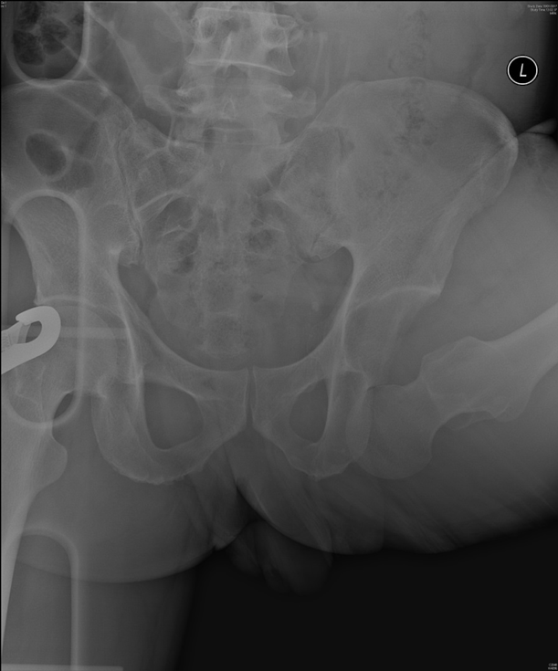

Slide 18
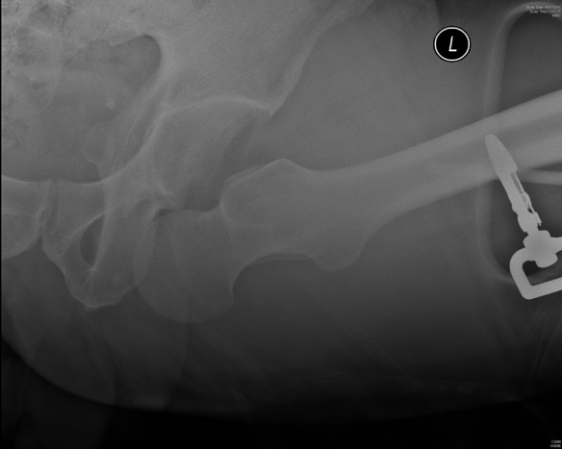

Slide 19
Case 2
Name three abnormalities in the X-ray pelvis and left hip.
Left femoral head out of acetabulum in inferior position
Hip abducted
Shenton’s line disrupted
Other features
Lesser tuberosity more prominent due to external rotation
Femoral head appear larger due to geometric magnification

Slide 20
Case 2
Name three abnormalities in the X-ray pelvis and left hip.

Slide 21
Case 2
What is your diagnosis?

Slide 22
Case 2
What is your diagnosis?
Left anterior hip dislocation, inferior subtype

Slide 23
Case 2
Classify hip dislocation and describe the mechanisms of injury

Slide 24
Case 2
Classify hip dislocation and describe the mechanisms of injury
MOI: Usually high energy trauma: dashboard injury, fall from height, MVA, sports.
Classification
Posterior (90%)
Anterior (5-10%)

Slide 25
Case 2
Classification
Posterior (90%)
Axial loading applied to femur while hip is flexed and adducted (e.g. dashboard injury)
Anterior (5-10%)
Superior (pubic)
Hip abduction, hyperextension and external rotation
Inferior (obturator)
Extreme abduction of hip, which is then flexed and externally rotated

Slide 26
Case 2
How to reduce the hip dislocation in this patient?

Slide 27
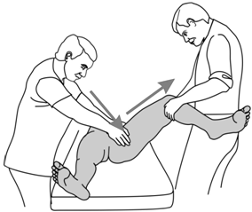
Case 2
How to reduce the hip dislocation in this patient?
Close reduction (under procedural sedation)
Assistant applying a lateral force to the hip to disimpact the femur from the obturator fossa
In-line traction of the partially flexed hip
Then internally rotate and adduct the femur

Slide 28
Case 2
What are the complications of hip dislocation?

Slide 29
Case 2
What are the complications of hip dislocation?
Sciatic nerve injury
Femoral artery, vein thrombosis and nerve injury
Associated fractures: acetabulum, femoral head or neck, transchondral, indentation fractures
Avascular necrosis
Post-traumatic osteoarthritis
Recurrent hip dislocations

Slide 30
Case 2
What are the signs of sciatic and femoral nerve injury?

Slide 31
Case 2
What are the signs of sciatic and femoral nerve injury?
Sciatic:
Loss of sensation in posterior leg and foot
Loss of dorsiflexion (peroneal branch) or plantar flexion (tibial branch)
Loss of deep tendon reflex at ankle S1,2
Femoral:
Loss of sensation in thigh
Weakness of quadriceps muscles
Loss of deep tendon reflex at knee L3,4

Slide 32
Case 3
An 88-year-old lady attended ED complaining of inability to walk in the past two days due to exacerbation of bilateral knee pain. The pain was more severe on left side.
There was no history trauma.

Slide 33
Case 3
Her past medical history include HT DM hyperlipidaemia old CVA gastritis and raised ALP
On examination she was on wheelchair. Bilateral knee non-tender with AROM 0-90 degrees with crepitation.

Slide 34
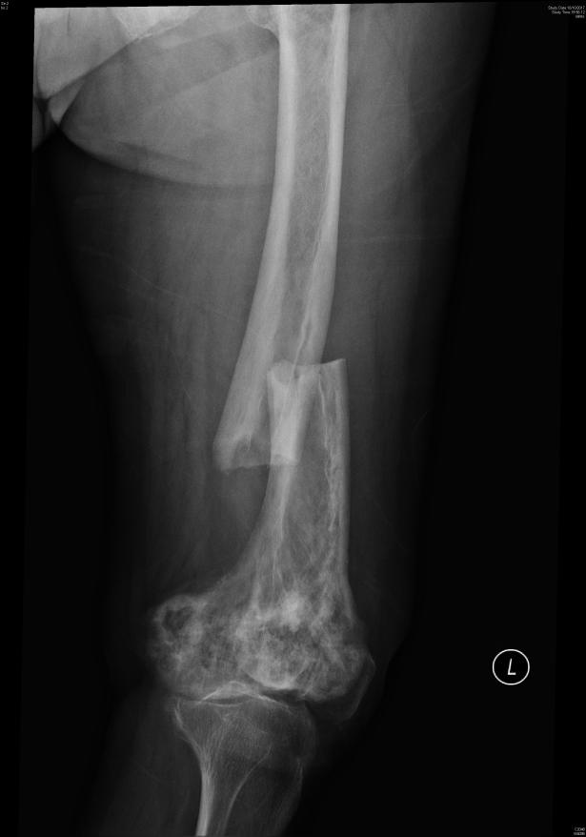
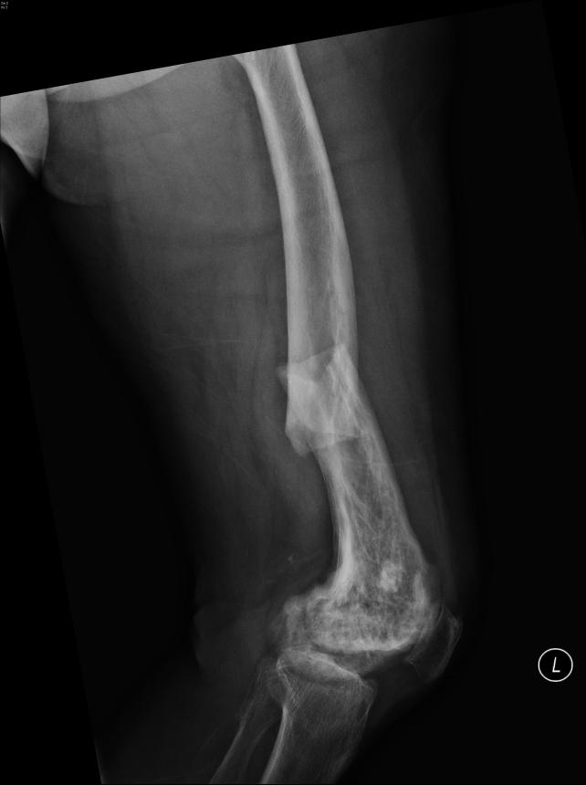

Slide 35
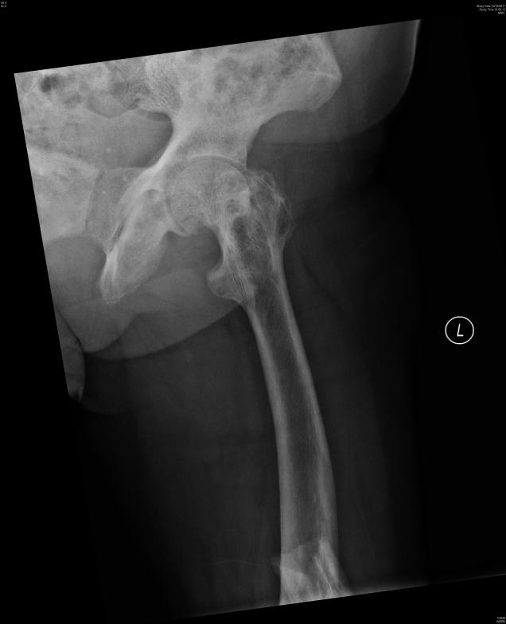

Slide 36
Case 3
Describe two abnormal findings in the X-rays

Slide 37
Case 3
Describe two abnormal findings in the X-rays
Transverse fracture over left femoral shaft
Patchy cortical thickening with mixed osteosclerotic and osteolytic changes over left femur
Degenerative changes over bilateral knee joints

Slide 38
Case 3
What is your diagnosis?
Name two possible causes for the diagnosis.

Slide 39
Case 3
What is your diagnosis?
Pathological fracture of left femoral shaft
Name two possible causes for the diagnosis.

Slide 40
Case 3
What is your diagnosis?
Pathological fracture of left femoral shaft
Name two possible causes for the diagnosis.
Paget’s disease of bone
Bone tumour (primary or secondary)

Slide 41
Case 3
Given her past medical history, which item may be related to her condition?

Slide 42
Case 3
Given her past medical history, which item may be related to her condition?
Raised Alkaline phosphatase (ALP)

Slide 43
Case 3
What are the possible causes for this condition?

Slide 44
Case 3
What are the possible causes for this condition?
Causes of elevated ALP
liver origin: cholestasis, cirrhosis, hepatitis, malignancy
bone origin (reflects osteoblast activities): Paget’s disease, [growing children], healing fracture, bone metastasis, osteomalacia, osteomyelitis, hyperparathyroidism
Congestive heart failure
[Pregnancy]

Slide 45
Case 3
What other investigations would you request?

Slide 46
Case 3
What other investigations would you request?
Blood test for CBC, RLFT, Ca and PO₄, ALP heat stable index
X-ray skeletal survey to delineate any other bony involvement
PET-CT to rule out malignancy

Slide 47
Case 4
A 6-year old boy with history of recent URTI 1 week ago presented to ED with skin rash.

Slide 49
Case 4
Describe the rash and state the most likely diagnosis.

Slide 50
Case 4
Describe the rash and state the most likely diagnosis.
Symmetrically distributed erythematous purpura over bilateral lower limbs
Henoch Schonlein purpura

Slide 51
Case 4
Name three other presentations of this condition other than skin rash.

Slide 52
Case 4
Name three other presentations of this condition other than skin rash.
Abdominal pain
Arthralgia/arthritis
Renal disease e.g. microscopic haematuria

Slide 53
Case 4
Suggest three ED investigations.

Slide 54
Case 4
Suggest three ED investigations.
Blood for CBP, RFT and clotting
Urine multistix for haematuria and proteinuria
USG abdomen to exclude intussusception

Slide 55
Case 4
Name four complications of this condition.

Slide 56
Case 4
Name four complications of this condition.
Intussusception
Acute kidney injury
GI bleeding
Intracerebral haemorrhage

Slide 57
Case 5
A 4-month boy presented to ED after fell from bed and he refused to move his right arm.

Slide 59
Case 5
Describe the X-ray and state one condition which you need to suspect.
Name two differential diagnosis of underlying cause the X-ray finding?

Slide 60
Case 5
Describe the X-ray and state one condition which you need to suspect.
Spiral fracture of the shaft of the right humerus
Non-accidental injury
Name two differential diagnosis of underlying cause the X-ray finding?

Slide 61
Case 5
Describe the X-ray and state one condition which you need to suspect.
Spiral fracture of the shaft of the right humerus
Non-accidental injury
Name two differential diagnosis of underlying cause the X-ray finding?
Ricket
Osteogenesis Imperfecta

Slide 62
Case 5
Name four radiological features and four physical findings suggestive of the suspected condition

Slide 63
Case 5
Name four radiological features and four physical findings suggestive of the suspected condition
Radiological findings
Metaphyseal (bucket handle) fracture
Scapular fracture
Multiple fractures
Rib fracture especially posterior rib fracture
Sternal fracture
Spinal process fracture

Slide 64
Case 5
Physical findings
Bruises in babies and infants who are not independently mobile
Multiple bruises in cluster
Multiple bruises in uniform shape
Bruises away from bony prominence
Bruises at usual sites (e.g. buttock, genitalia)
Bruises of different ages

Slide 65
Case 5
Physical findings (continued)
Torn frenulum
Bite marks
Retinal haemorrhage (shaken baby syndrome)
Scald with glove and stocking distribution (immersion injury)
Circular burns (cigarette burns)
Physical findings incompatible with history

Slide 66
Case 5
How would you manage the child in the ED?

Slide 67
Case 5
How would you manage the child in the ED?
Immobilisation with splintage and/or U-slab
Pain control with analgesic
Consult Paediatrician for suspected NAI
(Consult Orthopaedic Surgeon for fracture of right humerus)

Slide 68
Case 6
A 60 years old man with history of HT presented to ED for severe chest pain for one hour with radiation to the back.
On presentation his BP was 210/100 mmHg, HR 90/min, SpO2 99% on RA. He was sweating and yelling because of the pain.
ECG showed normal sinus rhythm.

Slide 69
Case 6
What is the most important differential diagnosis to consider?
Notes:
Acute aortic syndrome (AAS) refers to the acute presentation of closely related life-threatening entities having similar clinical features and challenges, including the aortic dissection, intramural hematoma, and penetrating atheromatous ulcer

Slide 70
Case 6
What is the most important differential diagnosis to consider?
Acute aortic syndrome
Notes:
Acute aortic syndrome (AAS) refers to the acute presentation of closely related life-threatening entities having similar clinical features and challenges, including the aortic dissection, intramural hematoma, and penetrating atheromatous ulcer

Slide 71
Case 6
Name two physical signs that may related to this condition.

Slide 72
Case 6
Name two physical signs that may related to this condition.
Radial-radial delay
Signs of acute lower limbs ischemia
Signs of aortic regurgitation
Signs of acute heart failure
Signs of pleural effusion
Signs of pericardial effusion/tamponade

Slide 74
Case 6
Name two findings in the CT thorax

Slide 75
Case 6
Name two findings in the CT thorax
Aortic intramural hematoma over descending aorta
Bilateral pleural effusion

Slide 76
Case 6
What are the initial management in the ED?

Slide 77
Case 6
What are the initial management in the ED?
BP control with iv beta-blockers +/- vasodilators (nitrates) aiming for SBP 100-120 mmHg
Pain control with analgesics (opiates)
Consult CTS if progression to Type A

