Slide 1
HKCEM JCM OSCE
Friday 8 December 2017
TKOH

Slide 2
Case 1
A 53-year-old construction site worker with past history of HT presented to ED with chest discomfort, palpitations and dizziness for 4 hours.
On presentation his BP was 103/52 mmHg, HR 75/min, SpO2 94% on RA. He was afebrile.
ECG was performed at triage.

Slide 3
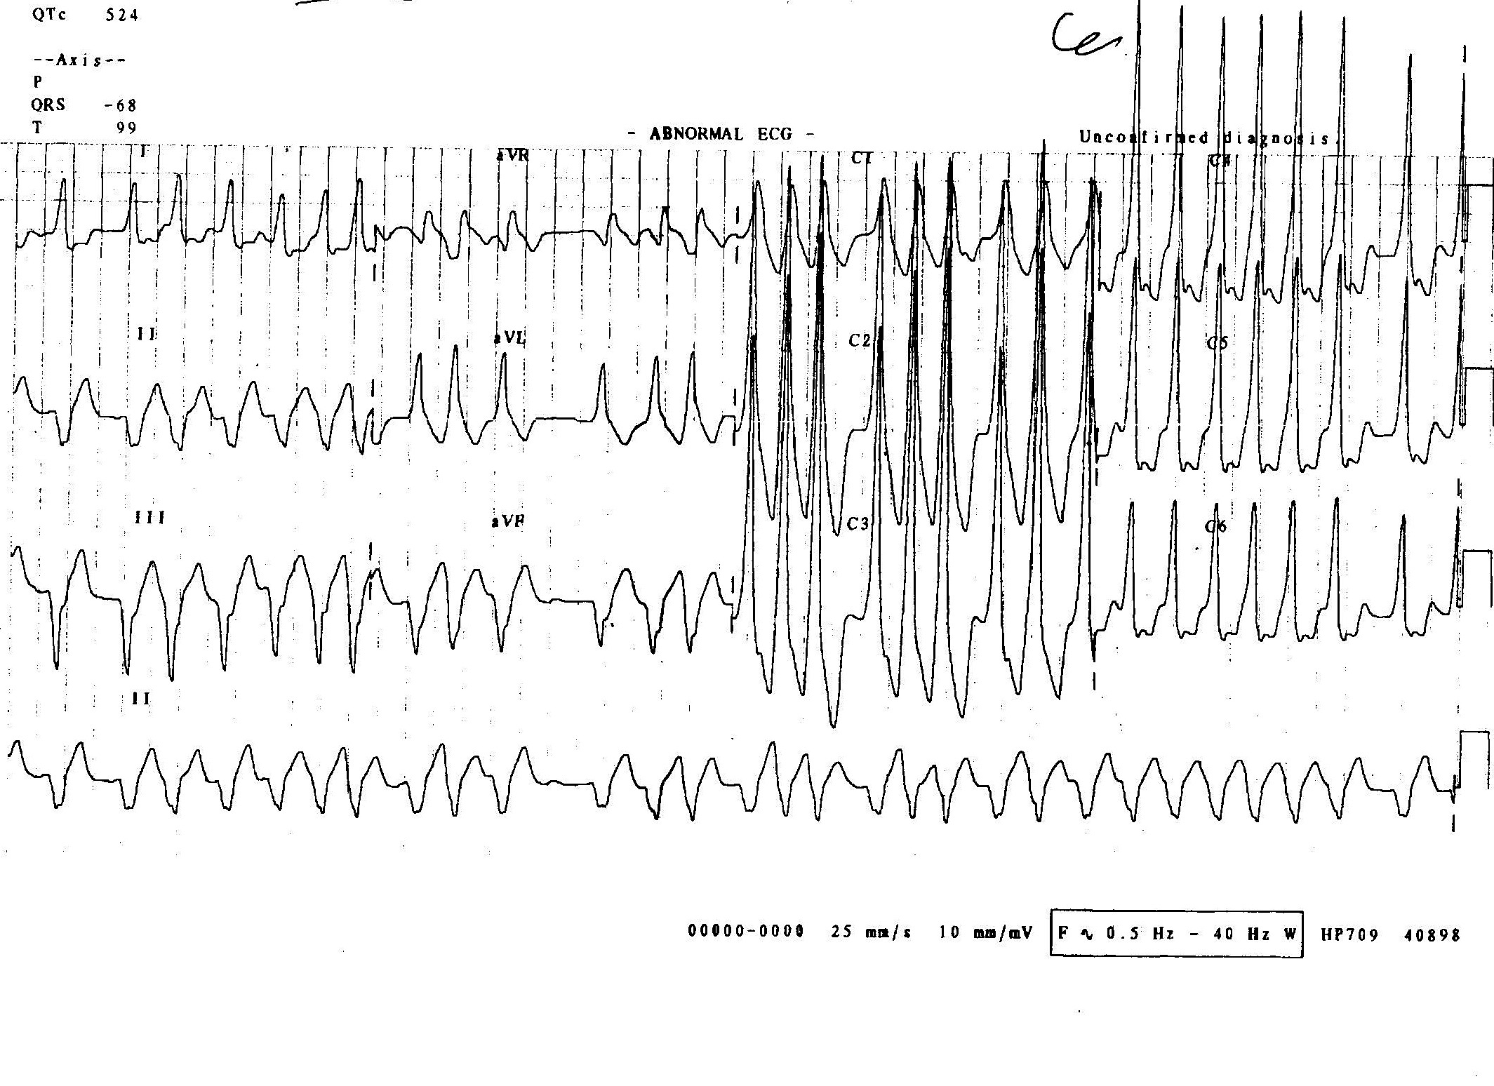

Slide 4
Case 1
List 2 positive findings of the ECG.
Give two differential diagnosis.
Name two drugs that could be used to treat this condition.
Name four drugs that are contraindicated in treating the condition.

Slide 5
Case 2
A 43-year-old construction site worker presented to ED after falling from 2 metres of height
He complained of severe pain over left hip and was unable to bear weight
Physical exam showed left hip in abnormal posture with limited range of movement.

Slide 6
Case 2

Slide 7
Case 2
Describe the abnormal hip posture

Slide 8
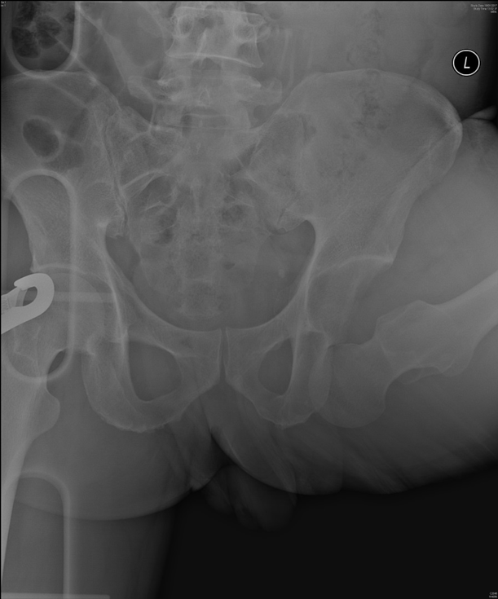

Slide 9
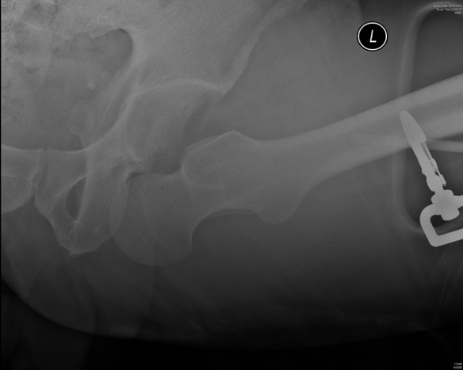

Slide 10
Case 2
Name three abnormalities in the X-ray pelvis and left hip.
What is your diagnosis?
Classify the condition and describe the mechanisms of injury.
How would you to treat the condition of this patient?
What are the complications of this condition?
What are the signs of sciatic and femoral nerve injury?

Slide 11
Case 3
An 88-year-old lady attended ED complaining of inability to walk in the past two days due to exacerbation of bilateral knee pain. The pain was more severe on left side.
There was no history trauma.

Slide 12
Case 3
Her past medical history include HT DM hyperlipidaemia old CVA gastritis and raised ALP
On examination she was on wheelchair. Bilateral knee non-tender with AROM 0-90 degrees with crepitation.

Slide 13
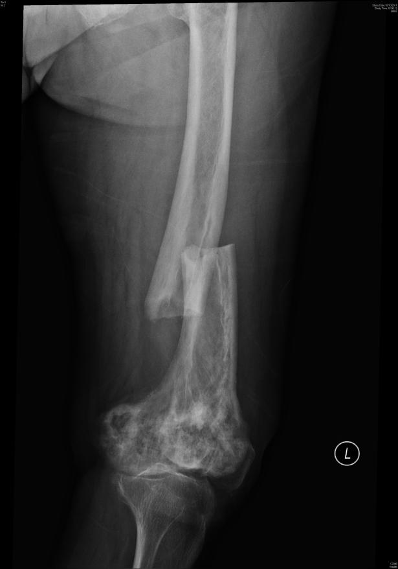
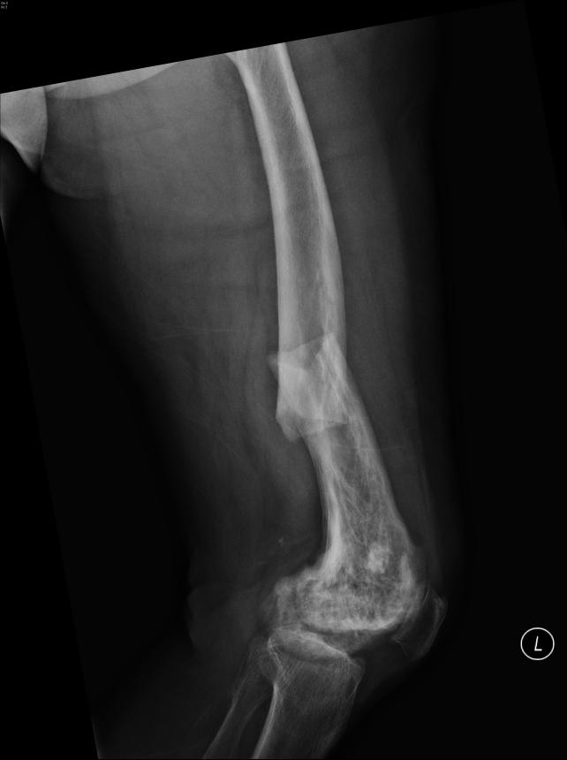

Slide 14
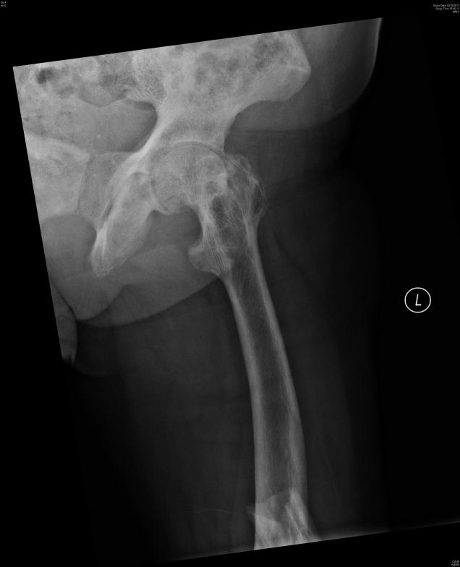

Slide 15
Case 3
Give two abnormal findings in the X-rays.
What is your diagnosis?
Name two possible causes for the diagnosis
Given her past medical history, which item may be related to her diagnosis? What are the possible causes for this condition?
What other investigations would you request?

Slide 16
Case 4
A 6-year old boy with history of recent URTI 1 week ago presented to ED with skin rash.

Slide 18
Case 4
Describe the rash and state the most likely diagnosis.
Name three other presentations of this condition other than skin rash.
Suggest three ED investigations.
Name four complications of this condition.

Slide 19
Case 5
A 4-month boy presented to ED after fell from bed and he refused to move his right arm.

Slide 21
Case 5
Describe the X-ray and state one condition which you need to suspect.
Name two differential diagnosis of underlying cause the X-ray finding?
Name four radiological features and four physical findings suggestive of the suspected condition.
How would you manage the child in the ED?

Slide 22
Case 6
A 60 years old man with history of HT presented to ED for severe chest pain for one hour with radiation to the back.
On presentation his BP was 210/100 mmHg, HR 90/min, SpO2 99% on RA. He was sweating and yelling because of the pain.
ECG showed normal sinus rhythm.

Slide 23
Case 6
What is the most important differential diagnosis to consider?
Name two physical signs that may related to this condition.
Notes:
Acute aortic syndrome (AAS) refers to the acute presentation of closely related life-threatening entities having similar clinical features and challenges, including the aortic dissection, intramural hematoma, and penetrating atheromatous ulcer

Slide 25
Case 6
Name two findings in the CT thorax
What are the initial management in the ED?

