Slide 1
OSCE
By QEH
JCM – 4 April 2018

Slide 2
Q1
F/47
Ca cervix, depression
Allergic to Flagyl, flu medication, Transamine, Clindamycin
Attended at 0210 for headache
On & off for 3 months but get worse that night
Vomited 10 times
CTB

Slide 3
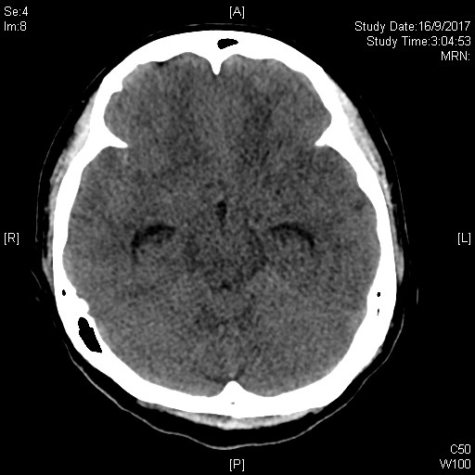
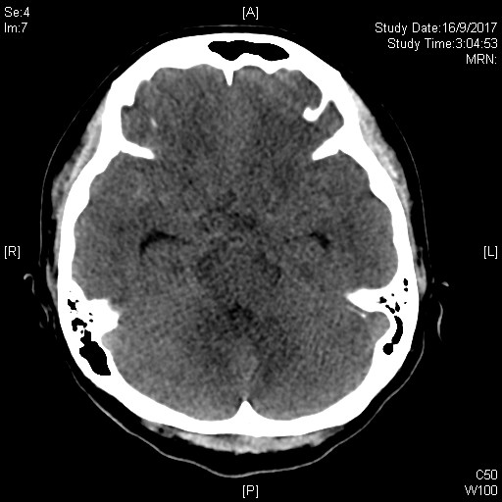
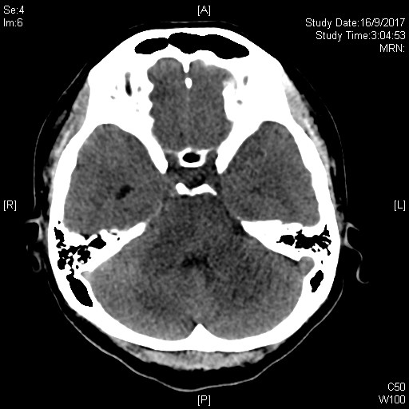
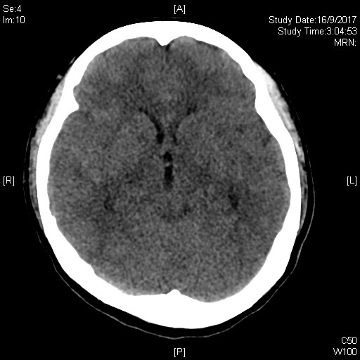
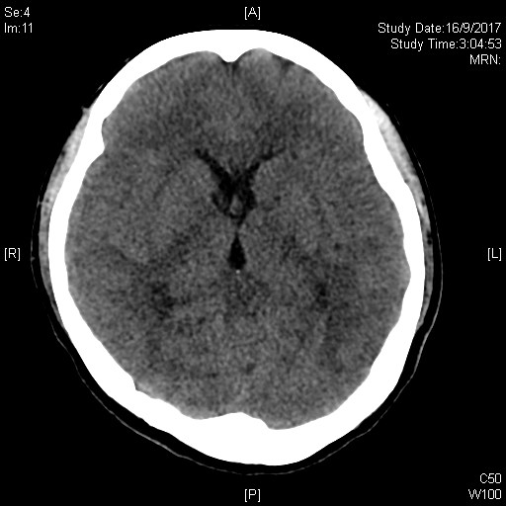

Slide 4
Questions
Name 4 CT abnormalities? (4)
Which part of the ventricle is most sensitive to increase CSF pressure – name one? (1)
What is the commonest cause of SAH? (1)
What are the TWO most common location for non-traumatic cause? (2)
Apart from diagnosis, what information the CT findings may convey – give TWO? (2)

Slide 5
Q2
M/25
slipped and fell in Gym room
Landed on right fist

Slide 6
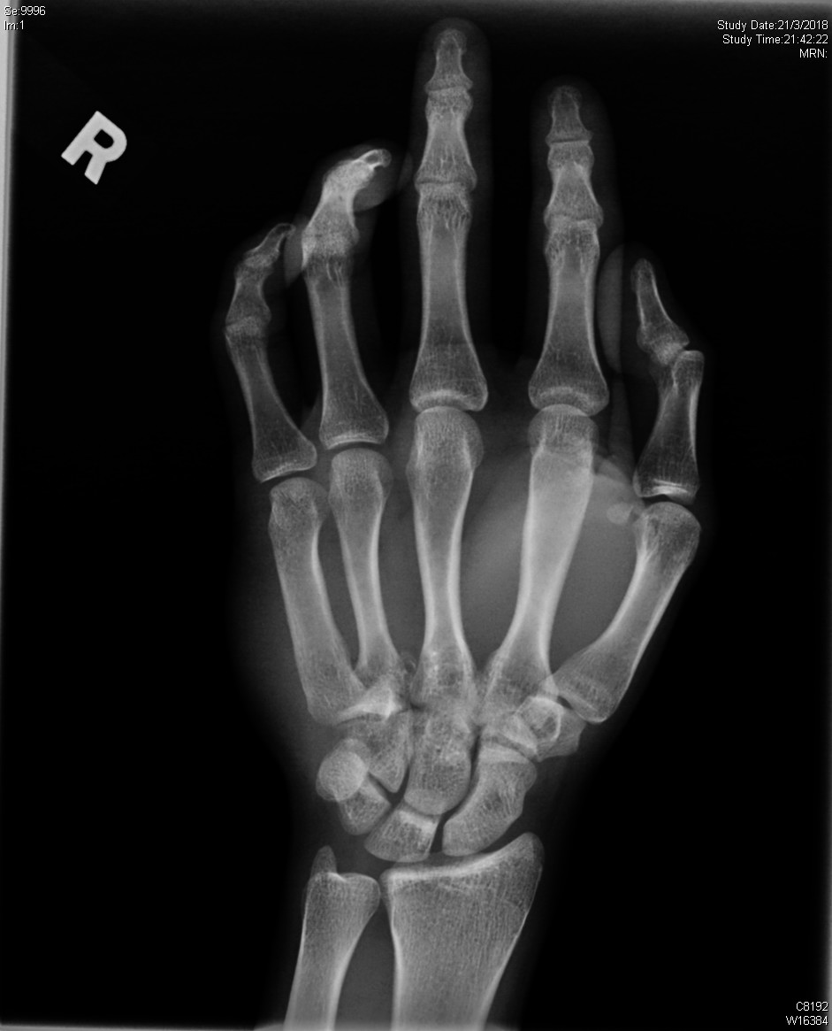
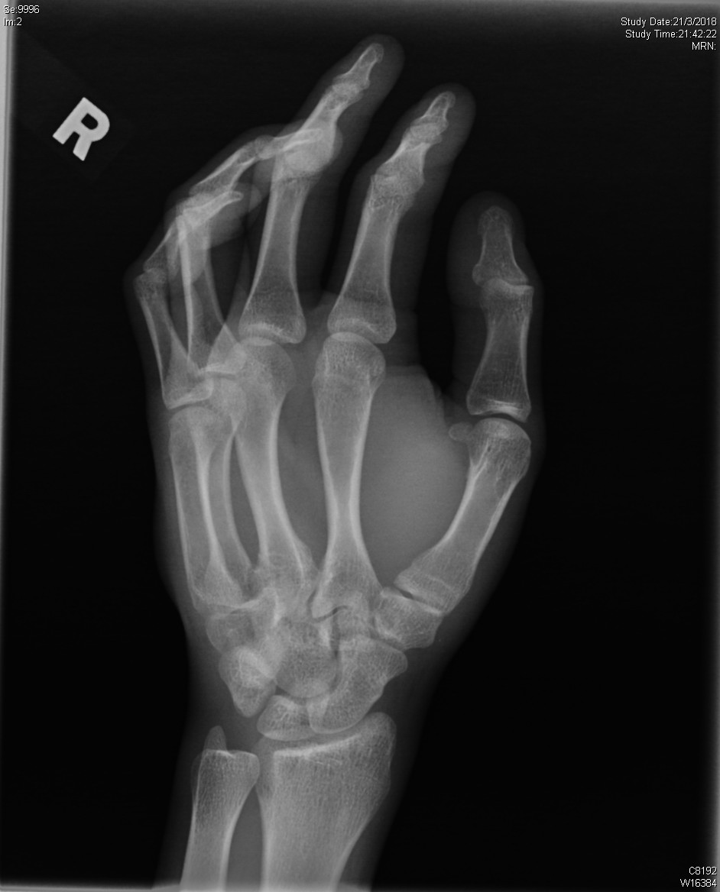
XR R hand

Slide 7
Questions
Name the carpal bones, in order (proximal & distal, medial to lateral) (2)
What are the TWO XR abnormalities? (2)
What additional view may help? (1)
What is the diagnosis? (1)
How is this sort of fractures classified? (2)
What is the treatment for this patient? (2)

Slide 8
Q3
F/80
Rheumatoid arthritis on Leflunomide, Methotrexate
Bilateral total knee replacement done
Presented to A&E for left thigh pain after slipped and fell
She was discharged after assessment but reattended 4 hours later for left thigh pain after falling from sofa

Slide 9
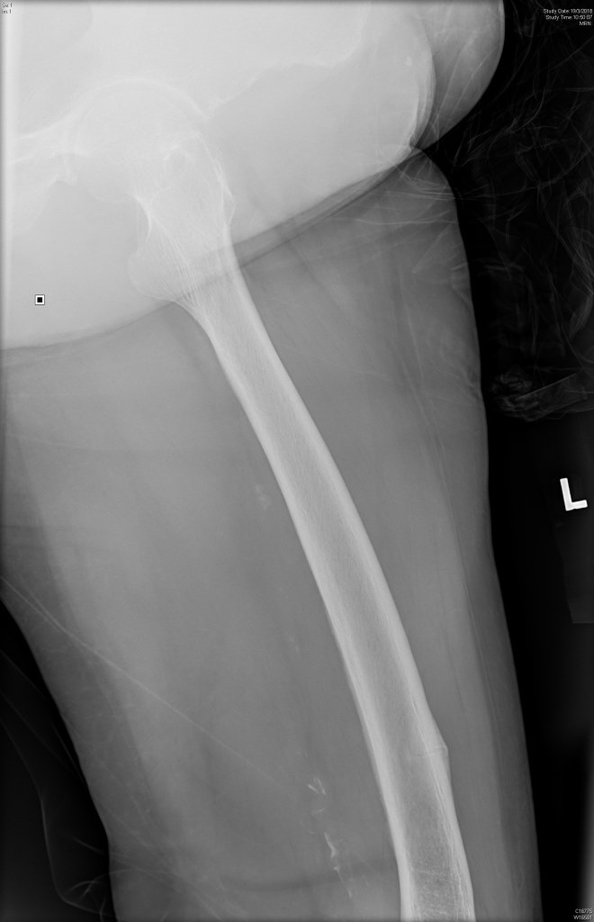
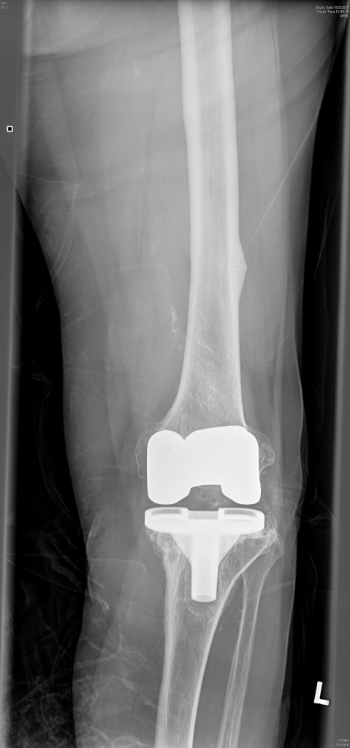

Slide 10
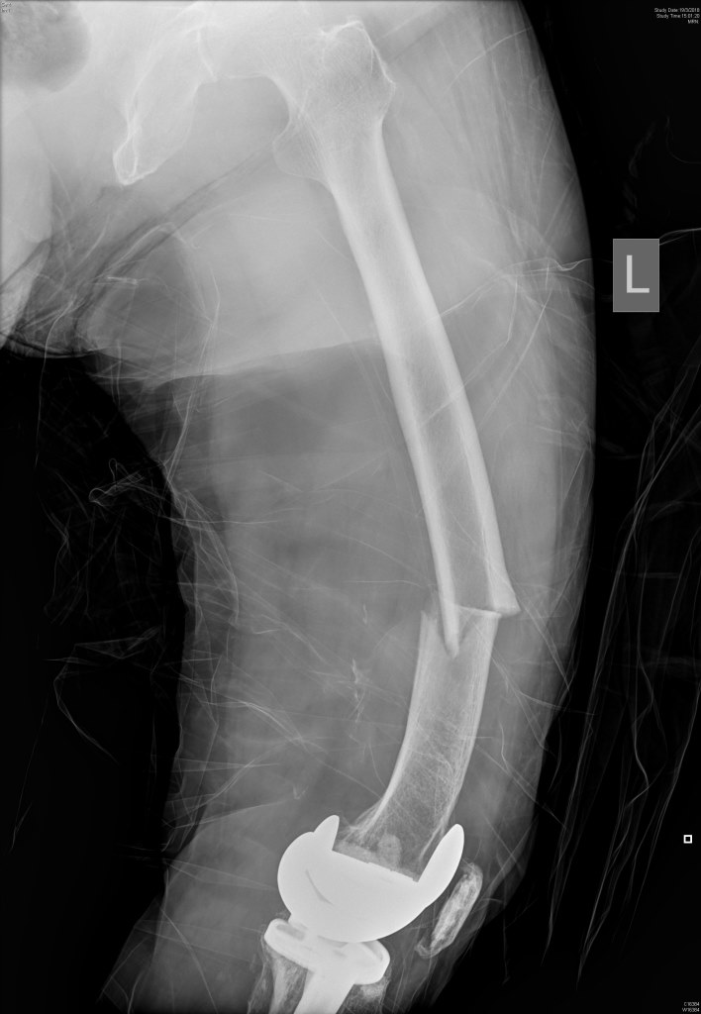
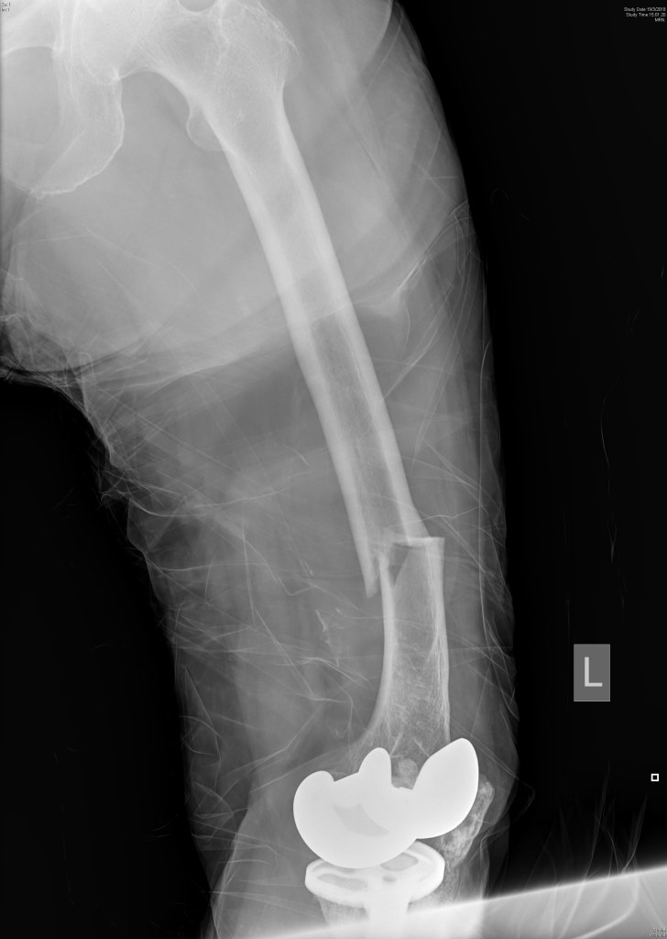

Slide 11
Questions
Describe TWO XR findings during 1st presentation (2)
Describe the XR abnormality at reattendance (2)
What is the specific diagnosis of this kind of fracutre? (1)
Name ONE medication which is usually allegedly associated? (1)
How could the 1st attendance be better managed? (1)
What are the optimal management
  Surgical (1)
  Medical (2)

Slide 12
Q4
A 29 years old lady presents with low back pain for a year. The severity of pain has been increasing in the recent few months. There are no history of significant injury.

Slide 13
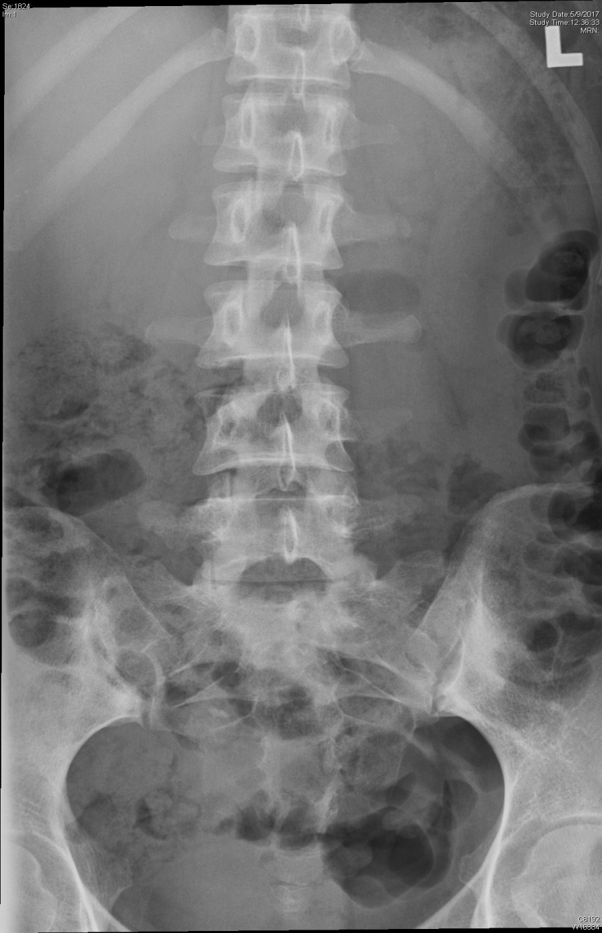
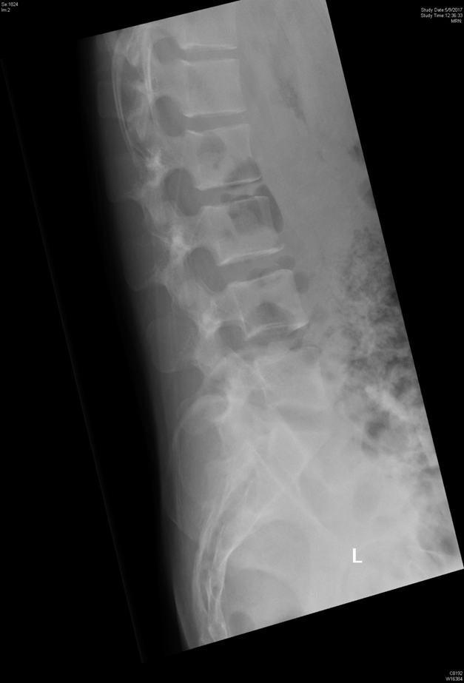

Slide 14
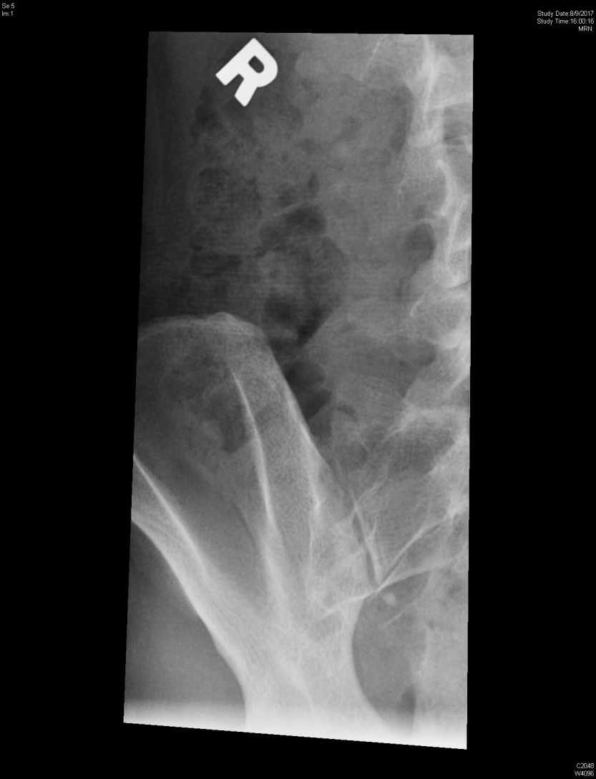
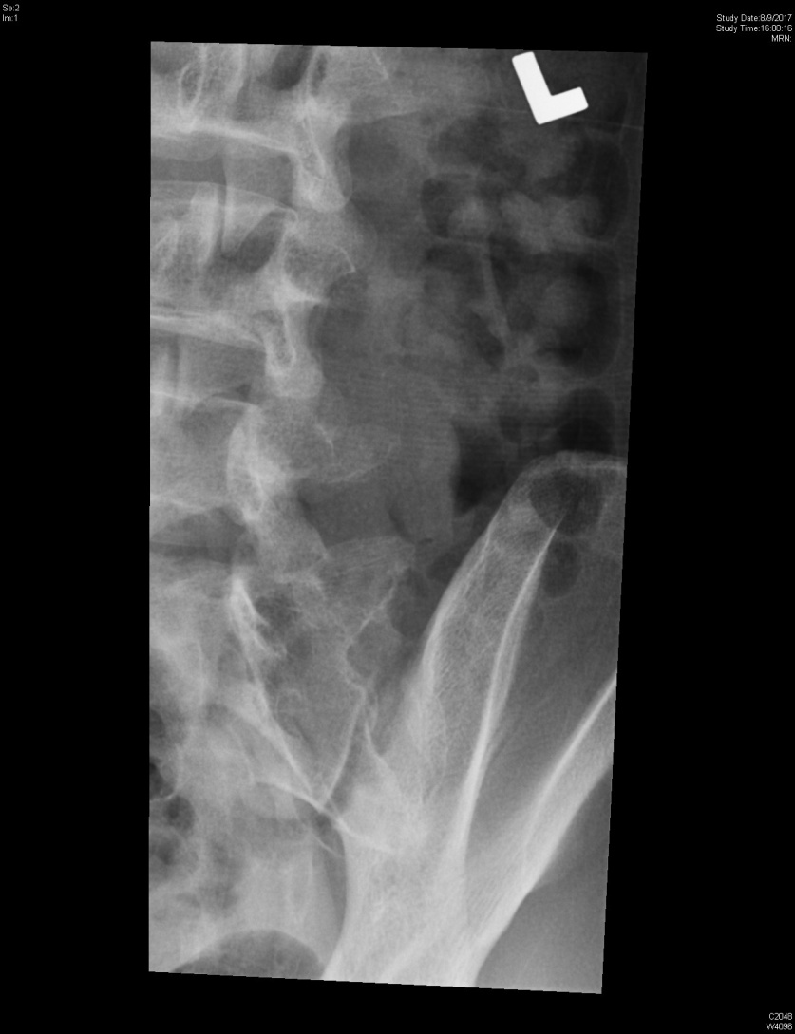
Both oblique view

Slide 15
Question
Name FOUR “red flags” of low back pain (2)
Describe TWO XR findings. What is the most possible diagnosis? (2)
Name ONE test to examine this patient bearing your suspected diagnosis (1)
Suggest ONE important blood tests that should be helpful for this patient for diagnosis and management (1)
Name TWO extra-articular manifestations of the condition? (2)
Give TWO management modalities for this condition? (2)

Slide 16
Q5
F/ 25
Brought in by ambulance for decreased level of consciousness.
Initial vitals: BP 80/50, HR 150, SpO2 97% on 4L O2, GCS E1V1M1
These are the initial blood test results
FIO2 0.3
pH 6.9
pCO2 10 mmHg
pO2 147 mmHg
Bicarbonate 2 mmol/L
Base excess -30
SaO2 saturation 98 %
Lactate 7.1 mmol/L
Na+ 140 mmol/L
K+ 6.0 mmol/L
Cl- 105 mmol/L
Creatinine 70 µmol/L
Urea 4.8 mmol/L
Glucose 5.2 mmol/L
Osmolality 360 mOsm/L

Slide 17
Questions
Identify the complete acid base abnormality in the above blood results (3)
Identify TWO other abnormalities in the above blood results (2)
Name TWO more laboratory tests that are indicated to aid in diagnosis (2)
Name one differential diagnosis (1)
The patient has gone into cardiac arrest shortly after intubation and mechanical ventilation. Suggest TWO measure to prevent peri-intubation cardiac arrest in this patient. (2)

Slide 18
Q6
M/ 19 involved in an high speed road traffic accident with deformed lower limbs. His lower body was trapped between two cars. His initial vitals are:
BP 70/40, HR 140
GCS E4V5M6
SpO2 100% on RA
Fast Scan was Positive, initial CXR and lung USG was normal.
Unmatched blood was given during resuscitation in the ED.

Slide 19
Q6
1) Name THREE acute non-immune mediated transfusion related complications (3)
He began to desaturates and complains of shortness of breathe after 3 units of blood was given
2) Name TWO possible causes of his shortness of breathe. (2)
He was rushed to the operating room for immediate laparotomy and external fixation of pelvis. His bleeding was found to be difficult to control with microvascular ooze.
3) Name THREE measures that can be employed in the ED to reduce acute trauma coagulopathy (3)
4) Give TWO additional measure that should be employed during transfusion if the patient is undergoing chemotherapy for bone marrow transplant? (2)

Slide 20
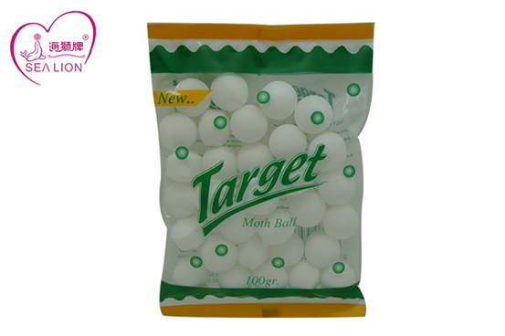
Q7
M/3 brought to AED by his mother suspected taken mothballs 1/2 hour ago. He is currently well.

Slide 21
Questions
What are the common active ingredients inside mothballs? (3)
Describe a bedside test available in Emergency Department to differentiate different types of mothballs? (3)
The boy suddenly developed generalized tonic- clonic convulsion.
What is the most likely cause? (1)
What is the toxic dose? (1)
Outline 2 modalities of management? (2)

