Slide 1
OSCE – 2.5.18
Princess Margaret Hospital
Dr. Winsome Lo

Slide 2
Question 1
A 38-year-old lady, with good past health, attended AED for RLQ pain for 2 days.
1a) Name 4 ddx of RLQ pain? (2 marks)
1b) Any clinical score for diagnosing acute appendicitis ?(1 mark)
1c) What are the signs and symptoms suggestive of acute appendicitis? (3 marks)
1d) What are the complications of untreated acute appendicitis? (2 marks)

Slide 3
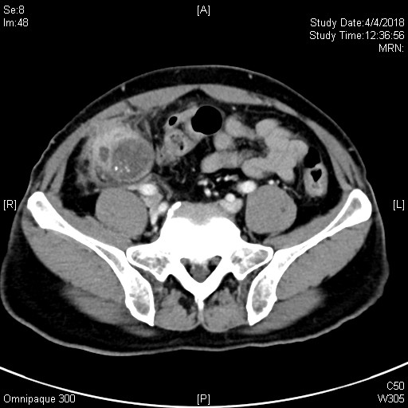
1e) Describe the CT finding here (2 marks)

Slide 4
Question 2
A 50-year-old gentleman attended AED for fever and malaise
2a) Describe the CXR finding. (2 marks)

Slide 6
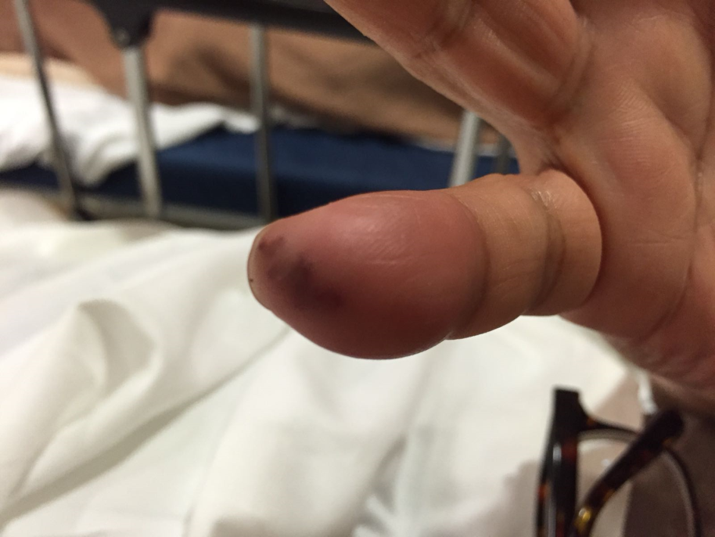
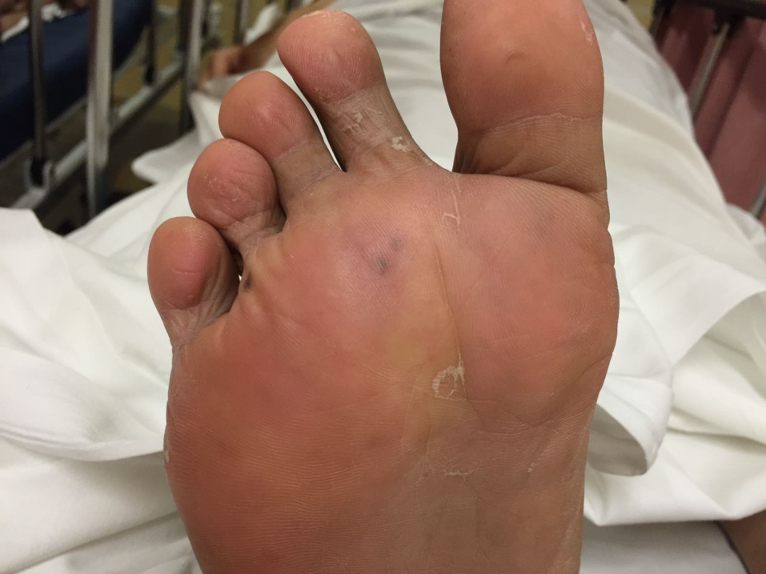
On examination, these lesions were found.

Slide 7
2b) How to differentiate between Osler Node and Janeway lesion? (2 marks)
2c) What are the risk factors of infective endocarditis? (2 marks)
2d) What other clinical signs will you look for? (1 mark)
2e) What are the most causative common organisms? (2 marks)
2f) Which heart valve is the most common valve to have vegetation? (1mark)

Slide 8
Question 3
A 70-year-old man, with history of HT, mild renal impairment (baseline Creatinine 130), and IFG, attended AED for 2 days history of diarrhoea.

Slide 9
Istat (Arterial) was taken in AED
pH 7.37
pCO2 3.32 kPa
pO2 27.44 kPa
BE -12.6 mmol/L
HCO3 11.8 mmol/L
Na 124 mmol/L
K 4.7 mmol/L
Chloride 108 mmol/L

Slide 10
3a) Describe the acid base abnormality (1mark)
3b) Is it compensated? (1mark)
3c) what will you calculate next and what is the result? (2 mark)
3d) What are the causes for this acid base abnormality? (2 mark)
3e) What is the next investigation? (1 mark)

Slide 11
Urine specimen
Sodium 32 mmol/L
Potassium 27 mmol/L
Chloride 81 mmol/L
3f) What is the urine anion gap? (1 mark)
3g) What is the most likely cause of this anion gap? (1 mark)
3h) Name one treatment to correct this acid-base disorder. (1 mark)

Slide 12
Question 4A
A 13-year-old boy has bilateral heel pain for 2 months. There was no history of injury.

Slide 13
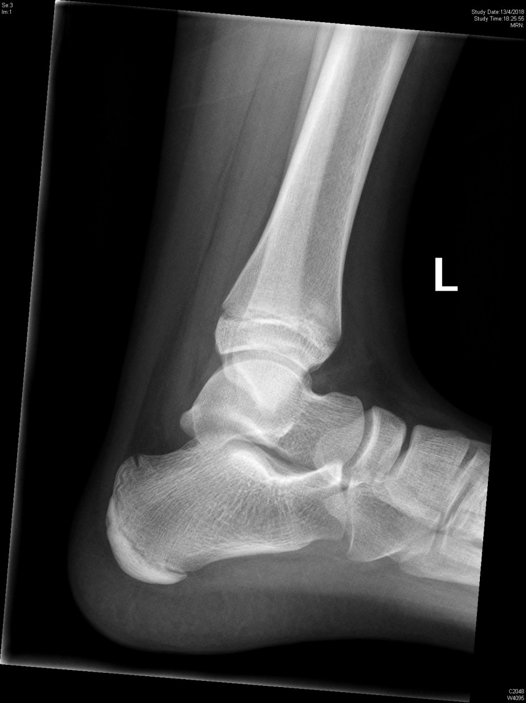
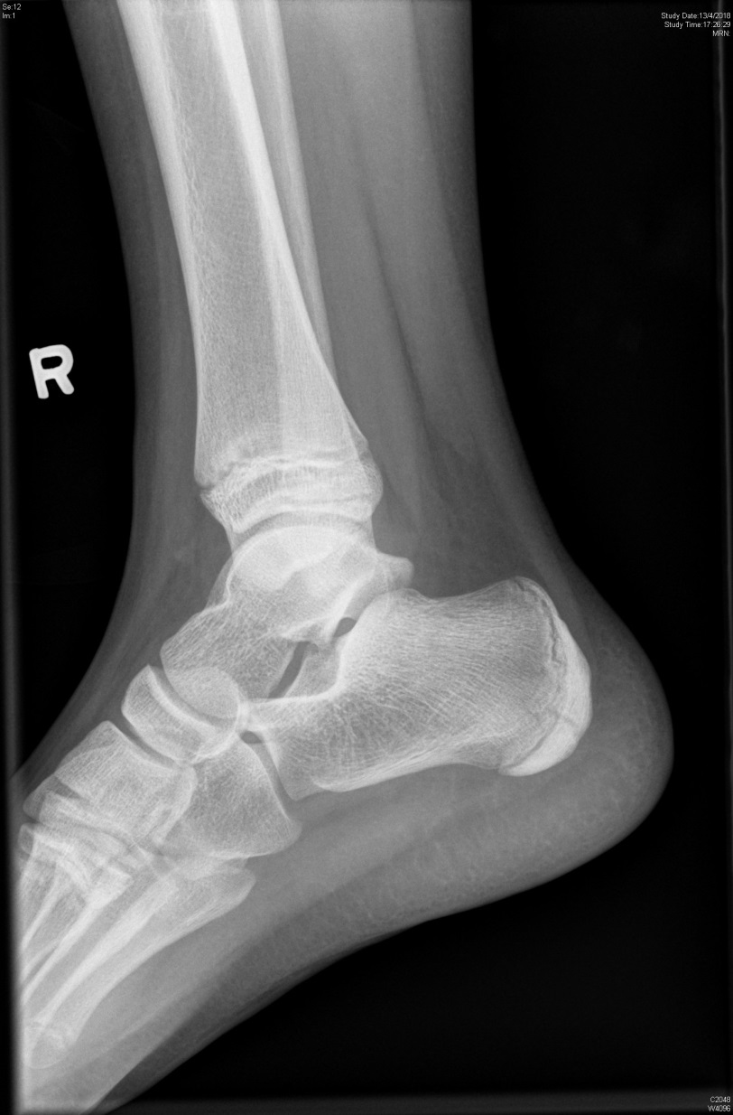

Slide 14
4a) What abnormality is shown on this xray? (1 mark)
4b) What is the name of this disease? (1 mark)
4c) What is the treatment? (1 mark)

Slide 15
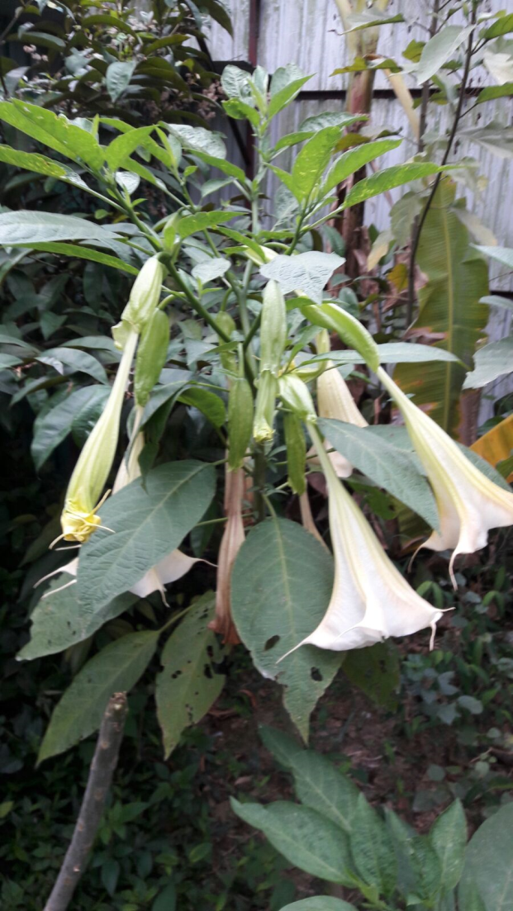
Question 4B
The following plant is one of the 4 main poisonous plants in Hong Kong.
What is the name of this plant? (1 mark)
What is the toxin? (1 mark)
What clinical toxidrome will the patient have? (1 marks)
What specific reversal drug will you give for severe toxicity, and how do you give? (2 marks)
What are the contraindications of this specific drug? (2 marks)

Slide 16
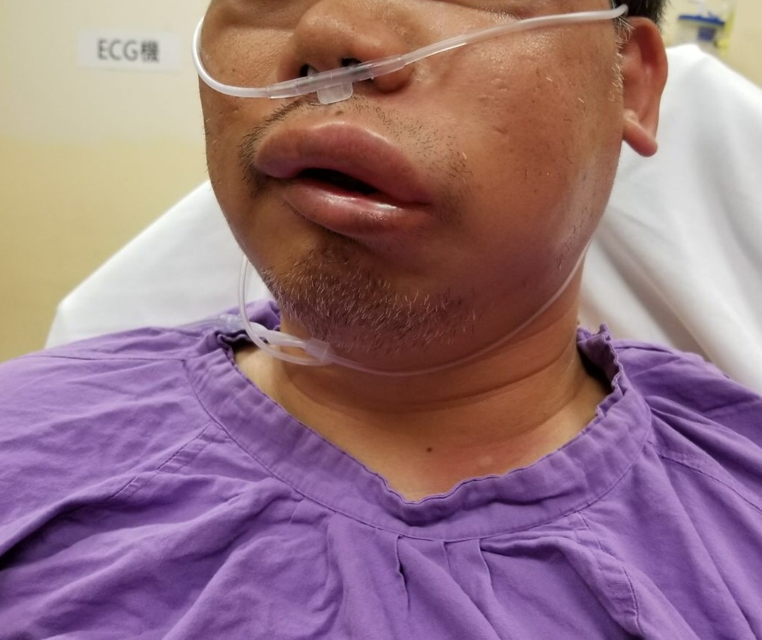
Question 5
A 40-year-old man presented to the AED. There was no sign of upper airway obstruction. Blood pressure and SpO2 were normal.

Slide 17
5a) What is the diagnosis? (1 mark)
5b) What are the 2 types of pathogenesis? (2 marks)
5c) What other symptoms the patient may also have? (2 marks)
5d) Name 2 most common drugs that cause the above condition. (2 marks)
5e) If the patient’s airway is not stable, what intubation method will you consider? (1 mark)
5f) Name 2 types of specific drug treatment for hereditary type of the condition. (2 marks)

