Slide 1
OSCE – 2.5.18
Princess Margaret Hospital
Dr. Winsome Lo

Slide 2
Question 1
A 38-year-old lady, with good past health, attended AED for RLQ pain for 2 days.
1a) Name 4 ddx of RLQ pain? (2 marks)
GI – Acute appendicitis, IBD, infectious colitis
Nephro – Nephrolithiasis
OG – Ovarian cyst, ovarian torsion, ectopic pregnancy
Others – Inguinal hernia
1b) Any clinical score for diagnosing acute appendicitis ?(1 mark)
Alvarado score

Slide 3
Alvarado score

Slide 4
1c) What are the signs and symptoms suggestive of acute appendicitis? (3 marks)
migration of pain, anorexia, nausea, RLQ tenderness, rebound pain, fever
1d) What are the complications of untreated acute appendicitis? (2 marks)
Abscess formation, rupture, peritonitis

Slide 5
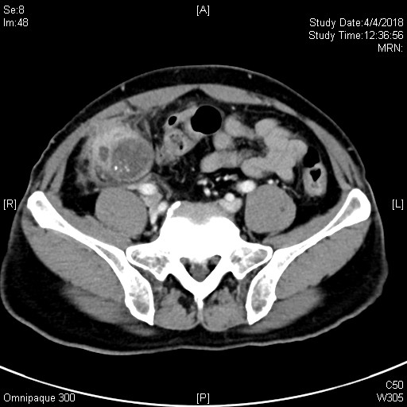
1e) Describe the CT finding here (2 marks)

Slide 6
A RLQ mass with enhancing irregular wall, Intraluminal cystic densities at mixed with calcifications are seen.
Appendiceal mucocele

Slide 7
Question 2
A 50-year-old gentleman attended AED for fever and malaise
2a) Describe the CXR finding. (2 marks)

Slide 8
Mitral valve replacement
Sternotomy wire
Right pleural effusion

Slide 9
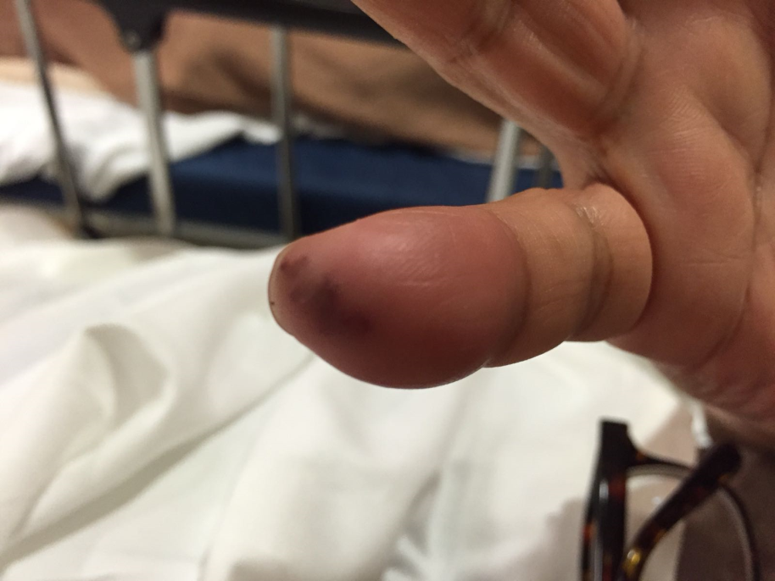
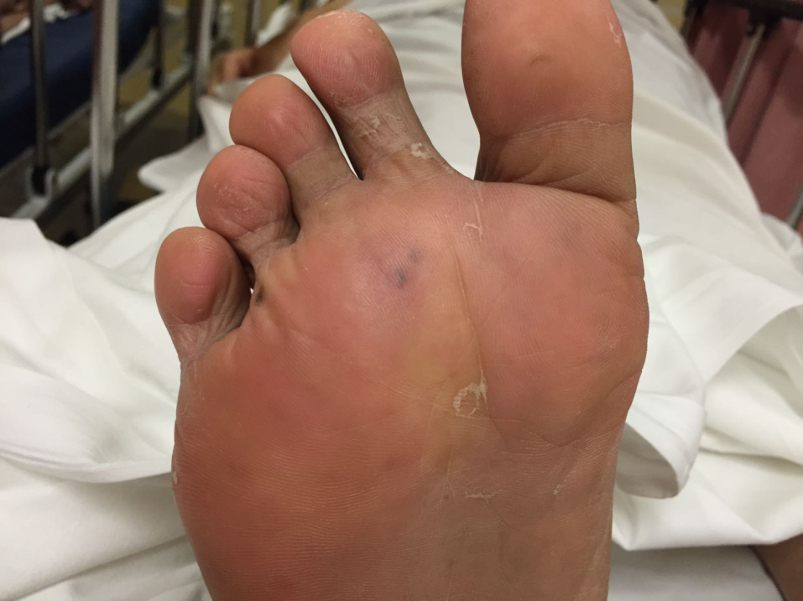
On examination, these lesions were found.

Slide 10
2b) How to differentiate between Osler Node and Janeway lesion? (2 marks)
Janeway lesion: non tender non palpable
Osler node: tender and palpable
2c) What are the risk factors of infective endocarditis? (2 marks)
Artificial heart valves, structural heart defect, valvular disease, history of IE, IVDA, chronic RRT
2d) What other clinical signs will you look for? (1 mark)
Septic emboli, conjunctival hemorrhage, splinter hemorrhage, heart murmur
2e) What are the most causative common organisms? (2 marks)
Staphylococcus Aureus, Streptococcus Viridan, Enterococci
2f) Which heart valve is the most common valve to have vegetation? (1mark)
Tricuspid valve

Slide 11
Question 3
A 70-year-old man, with history of HT, mild renal impairment (baseline Creatinine 130), and IFG, attended AED for 2 days history of diarrhoea.

Slide 12
Istat (Arterial) was taken in AED
pH 7.37
pCO2 3.32 kPa
pO2 27.44 kPa
BE -12.6 mmol/L
HCO3 11.8 mmol/L
Na 124 mmol/L
K 4.7 mmol/L
Chloride 108 mmol/L

Slide 13
3a) Describe the acid base abnormality (1mark)
Metabolic acidosis
3b) Is it compensated? (1mark)
Yes
Expected PO2 = 1.5 x 11.8 + 8 = 25.7mmHg = 3.4kPa

Slide 14
3c) what will you calculate next and what is the result? (2 mark)
AG = Na + K – Cl –HCO3 = 8.9
3d) What are the causes for this acid base abnormality? (2 mark)

Slide 15
Causes of normal anion gap metabolic acidosis
Addisons
Bicarbonate loss (GI, renal – RTA)
Chloride
Drugs (acetazolamide)

Slide 16
3e) What is the next investigation? (1 mark)
Urine Anion Gap

Slide 17
Urine specimen
Sodium 32 mmol/L
Potassium 27 mmol/L
Chloride 81 mmol/L
3f) What is the urine anion gap? (1 mark)
Urine AG = Na +K-Cl = -22
3g) What is the most likely cause of this anion gap? (1 mark)
GI loss of bicarbonate
3h) Name one treatment to correct this acid-base disorder. (1 mark)
Isotonic bicarbonate infusion

Slide 18
Question 4A
A 13-year-old boy has bilateral heel pain for 2 months. There was no history of injury.

Slide 19
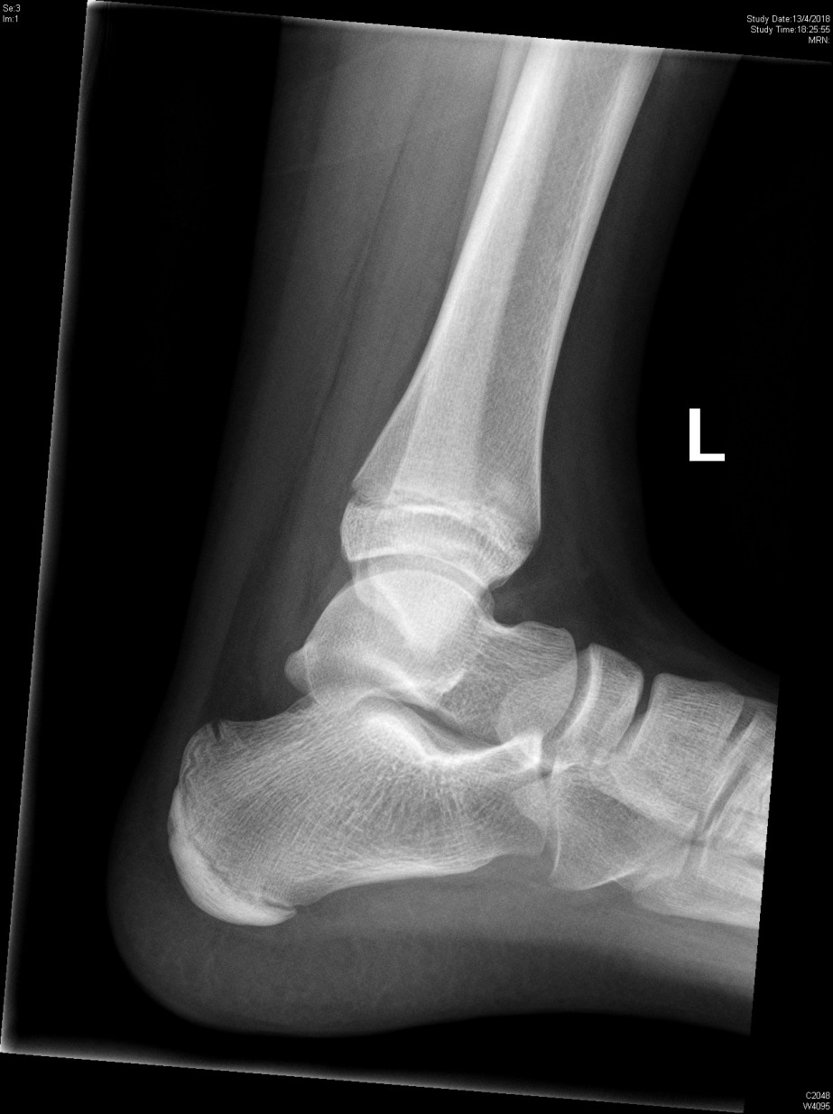
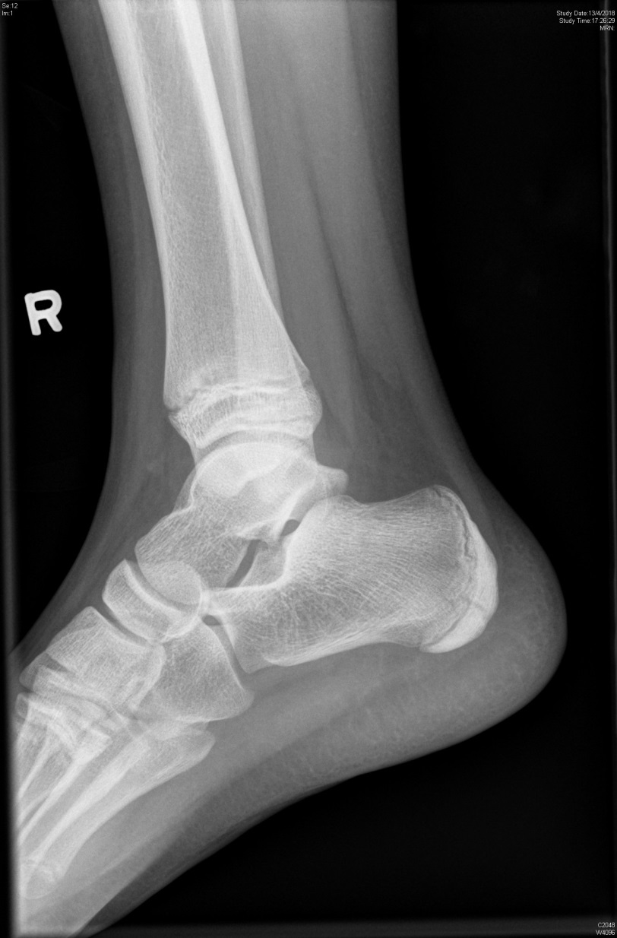

Slide 20
4a) What abnormality is shown on this xray? (1 mark)
Increased density over both apophysis of calcaneum
4b) What is the name of this disease? (1mark)
Sever disease
4c) What is the treatment? (1 mark)
Rest and oral painkiller

Slide 21
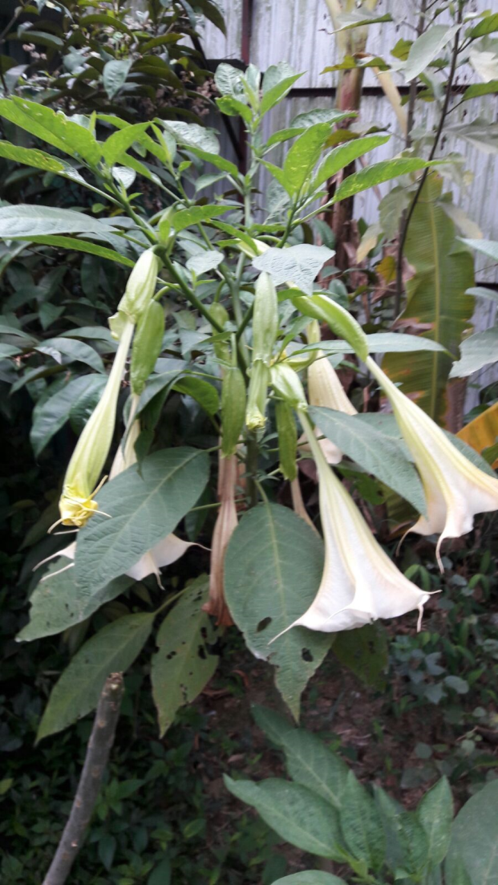
Question 4B
The following plant is one of the 4 main poisonous plants in Hong Kong.
What is the name of this plant? (1 mark)
Datura
What is the toxin? (1 mark)
Scopolamine, hyoscyamine, atropine
What clinical toxidrome will the patient have? (1 marks)
Anticholinergic toxidrome
What specific reversal drug will you give for severe toxicity, and how do you give? (2 marks)
Physostigmine
1-2 mg slow IV (5 min)
What are the contraindications of this specific drug? (2 marks)
TCA poisoning, AV block, widened QRS, asthma, CAD, PVD

Slide 22
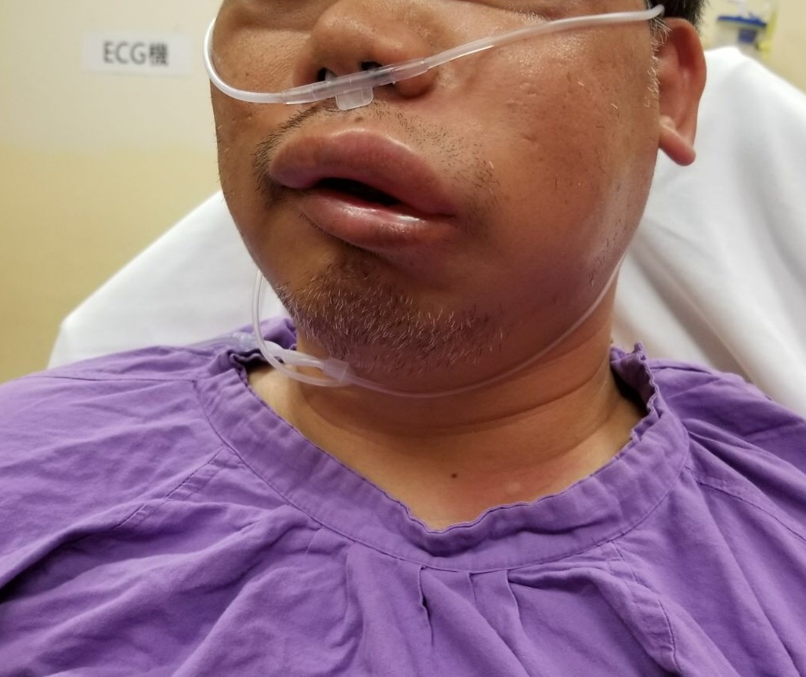
Question 5
A 40-year-old man presented to the AED. There was no sign of upper airway obstruction. Blood pressure and SpO2 were normal.

Slide 23
5a) What is the diagnosis? (1 mark)
Angioedema
5b) What are the 2 types of pathogenesis? (2 marks)
Histamine mediated
Bradykinin mediated
5c) What other symptoms the patient may also have? (2 marks)
GI symptoms: abdominal pain, nausea, vomiting
Urticaria

Slide 24
5d) Name 2 most common drugs that cause the above condition. (2 marks)
ACEI, NSAIDs
5e) If the patient’s airway is not stable, what intubation method will you consider? (1 mark)
Awake fibreoptic
5f) Name 2 types of specific drug treatment for hereditary type of the condition. (2 marks)
FFP, Icatibant (bradykinin receptor inhibitor)

Slide 25
The End!

