Slide 1
JCM OSCE – 6/6/2018
POK OI HOSPITAL

Slide 2
Question 1
A 50 year old man got bitten by an unknown snake while hiking today.
What are the recommended prehospital treatments? State 2.
ABC (neurotoxic Kraits / Cobra can cause respiratory failure)
Avoid excessive manipulation
Immobilize injury body part
Gentle cleansing of wound
Avoid incision / venom suction
Tourniquet maybe harmful as jeopardize limb circulation

Slide 3
Question 1
What are the important aspect for assessment for snake bite?
Snake identification (photos / dead snake)
Wound condition (look for fang marks and local symptoms)
Envenomation toxidrome (coagulopathy / ptosis / neurological symptoms)
What are the important treatments?
ATT
Wound dressing
Consider antibiotics
analgesics
Consider antivenom

Slide 4
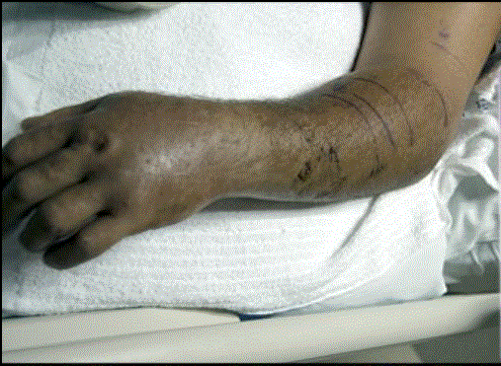
Question 1
On inspection patient left forearm was bitten by snake and the appearance was like this

Slide 5
Question 1
What is the likely culprit snake?
Viper
What are the possible complications
Compartment syndrome
Coagulopathy

Slide 6
Question 1
What are the pretreatments for antivenom treatments?
Resuscitation equipment standby
Consider anti histamine and hydrocortisone
What is the dosage adjustment for antivenom if the patient was a children?
Same total amount

Slide 7
Question 2
A 70 year old man presented to the AED department for fever and back pain.
List 3 differential diagnosis of fever with acute back pain?
Musculoskeletal cause (back abscess / osteomyelitis)
Renal cause (Acute pyelonephritis)
Vascular cause (mycotic aneurysm)

Slide 8
Question 2
Your junior colleague has taken a KUB during workup for the patient with the provisional diagnosis of acute pyelonephritis in his mind. Describe the X ray findings.
Curvilinear mass with calcification in the left paravertebral region

Slide 10
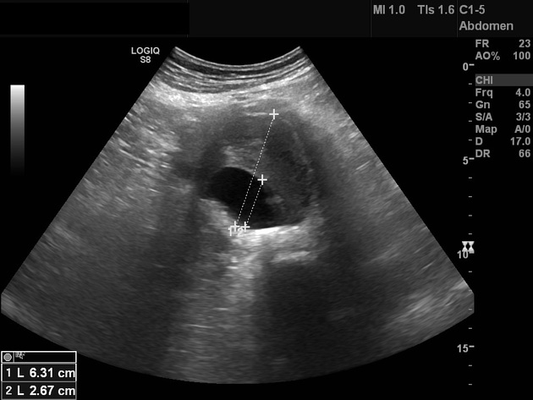
Question 2
BP 80/60, P110, T 38C
Ultrasound was done on this patient with the following findings. What is this view, findings and the diagnosis?

Slide 11
Question 2
Transverse view of the abdominal aorta
Dilated abdominal aorta (6cm)
Intramural thrombus
What is the provisional diagnosis for the above condition? What are the common risk factors?
Mycotic aneurysm
infective endocarditis (common)
intravenous drug use
immunosuppression
iatrogenic arterial trauma
pre-existing atherosclerotic plaque or a native aneurysm
prosthetic arterial devices (e.g. stents and grafts)

Slide 12
Question 2
CT was done for this patient, list some features which may be shown on CT
saccular, multilobulated appearance
adjacent soft tissue stranding
adjacent collection +/- gas
adjacent reactive lymphadenopathy
retroperitoneal para-aortic fluid collection and vertebral erosion

Slide 13
Question 2

Slide 14
Question 2
What are the common sites for such condition ?
thoracic and abdominal aorta
abdominal visceral arteries
lower extremity arteries
intracranial arteries
What are the most common pathogen?
Staphylococcus aureus
Salmonella species

Slide 15
Question 2
What is the immediate ED treatment?
Fluid resuscitation
Early antibiotics (Vancomycin / ceftriaxone)
Consult surgeon for operation

Slide 16
Question 3
A 40 year old man was found unconscious after being rescue back to the shore from submersion injury in the middle of the sea. No palpable pulse on assessment. You decided to initiate CPR for the patient.
What is your CPR step sequence? Why?
A-B-C instead of C-A-B
Most likely cause is hypoxia / respiratory arrest in drowning
Open airway with 2 rescue breaths, followed by chest compressions if no response

Slide 17
Question 3
Are abdominal thrust or Heimlich maneuver useful in expelling water out from the airway?
No
Water is absorbed if aspirated and seldom leads to mechanical obstruction to airway
It will delay CPR and hence lower its successful rate
What is the predominant cardiac arrest rhythm in drowning?
Asystole

Slide 18
Question 3
What is the pathophysiology of drowning?
Panic / vigorous struggling and breathholding
Water swallowed / aspiration
Laryngospasm after aspiration of water
Hypoxia / cardiac arrest
Water in alveoli cause surfactant dysfunction and washout
Decrease lung compliance and VQ mismatch

Slide 19
Question 3
What is the difference between seawater and freshwater drowning?
Seawater – hypertonicity
Plasma drawn into alveoli – pulmonary edema
Hypertonic serum
Freshwater – water pass through lungs to intravascular compartment
Serum dilution effect
Volume overload
However, water aspiration amount clinical insignificant if non fatal drowning

Slide 20
Question 3
How would you manage the patient if there is evidence of acute lung injury?
Bronchodilators for bronchospasm
Protective lung ventilation
Antibiotics if clinically chest infection / submerged in contaminated water
Can consider extracorporeal membrane oxygenation (ECMO)
What are the prognostic indicators for drowning?
Duration < 10 min
> 25min associated with low chance of favorable outcome

Slide 21
Question 4
A fish shop owner attended with multiple skin lesions over his hand
History of injury while cleaning fish tanks

Slide 23
Fish tank granuloma
Multiple slow-growing, inflamed red bump (nodule or plaque) at the trauma site
Painful and may become ulcerated or crusted
Skin changes usually appear about two to four weeks after the aquatic exposure
Pathogen : Myobacterium marinum

Slide 24
Diagnoses
Acid-fast staining from soft tissue drainage / biopsy
Specific low temperature cultures
35C / 28C – 32C
Histopathology
Immunohistochemistry
PCR

Slide 25
Diagnoses
Essential to obtain exposure history to get Dx
DDx
Bites / venomous stings of aquatic organisms

Slide 26
Water exposure infection
AVEEM
Areomonas
Most commonly GE
Can cause wound infection
Vibro vulnificus
Necrotizing infection
Edwardsiella Tarda
Erysipelothrix
Wide spread in different animals and aquatic condition
Can cause cellulitis
Myobacterium Marinum

Slide 27
Treatment
Wound dressing
Tetanus
Antibiotics
Surgical consultation if potential necrotizing infections

Slide 28
Antibiotics
Specific (Myobacterium marinum)
Dual therapy
Clarithromycin + ethambutol / rifampin
Mono therapy (superficial infections)
Clarithromycin / doxycycline / septrin

Slide 29
Complications
Tenosynovitis
Arthritis
Osteomyelitis
Disseminated infection (immunocompromised)

Slide 30
Question 5
A 45 year old lady attempted suicide by hanging. She was discovered and rescued by her husband. She was brought to AED.

Slide 31
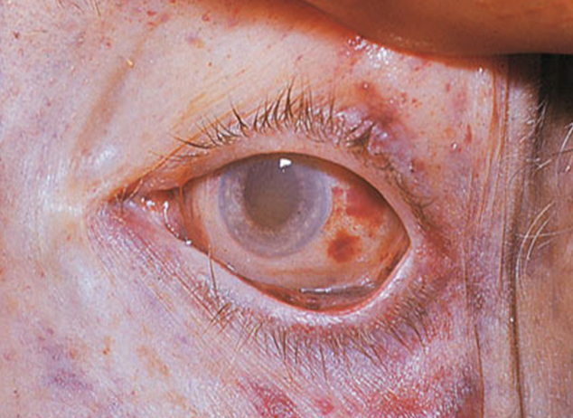
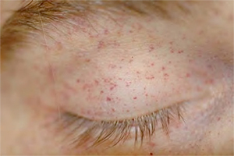

Slide 32
Question 5
What are the features in the clinical photo?
Ligature marks on anterior neck
Tardieu’s spots (asphyxial petechiae)
Subconjunctival petechia or hemorrhage

Slide 33
Question 5
What are the two types of hanging injury? What is the significance?
Judicial hanging
drop distance > body height
often results in cervical spine (Hangman’s fracture) and spinal cord injury
Non-judicial/suicidal hanging
Drop distance < body height / incomplete suspension
usual suicidal case, cervical spine injury rare

Slide 35
Question 5
Describe the X-ray features (2)
What is the usual mechanism?
Is hanging the most commonly associated injury?

Slide 36
Traumatic spondylolisthesis of axis(C2)
Fracture of pars interarticularis of C2
Most commonly Hyperextension-compression injury
Most commonly seen in MVC / contact sports injury. Sometimes seen in judicial hanging

Slide 38
Question 5
Name 3 possible causes of death of a hanging patient.
High cervical fracture / spinal cord injury (Judicial hanging)
Venous obstruction, leading to cerebral stagnant hypoxia, and then decrease muscle tone leading to further tightening
Arterial spasm due to carotid pressure, leading to low cerebral blood flow and collapse
Vagal reflex due to pressure to carotid body, results in extreme bradycardia and cardiac arrest

Slide 39
Question 5
Airway compromise is not thought to be the immediate cause of collapse
External compression of the airway structures requires significantly more force than the vascular structures and this is not thought to play a significant role
Several reports exist of suicidal posttracheostomy patients who successfully hung themselves with ligatures well above the tracheostomy

Slide 40
Question 5
Name 4 other possible complications of hanging.
Pneumothorax
Vascular injury
Esophageal rupture
Laryngeal fracture
Pulmonary edema
Aspiration pneumonia

Slide 41
The End

Slide 42
Pars vs pedicles

