Slide 1
OSCE
NLTH
9/2018

Slide 2
Case 1
M/57
Chest pain ~2 hours before attending AED
Pain subsided on arrival

Slide 3
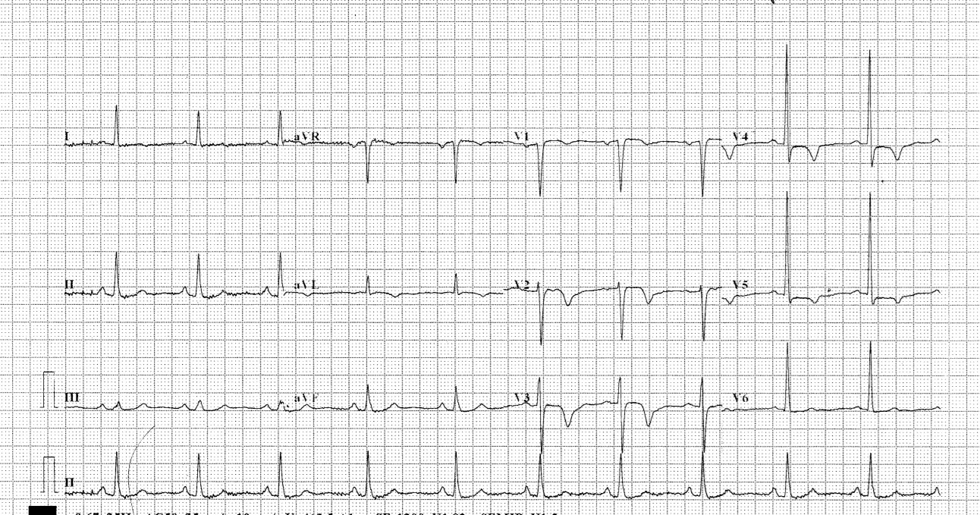
ECG done at 21:33
Please comment on ECG

Slide 4
He was transferred to PMH Med
1st TnI: 0.16
Recurrence of chest pain while waiting at PMH AED
ECG was done again

Slide 5
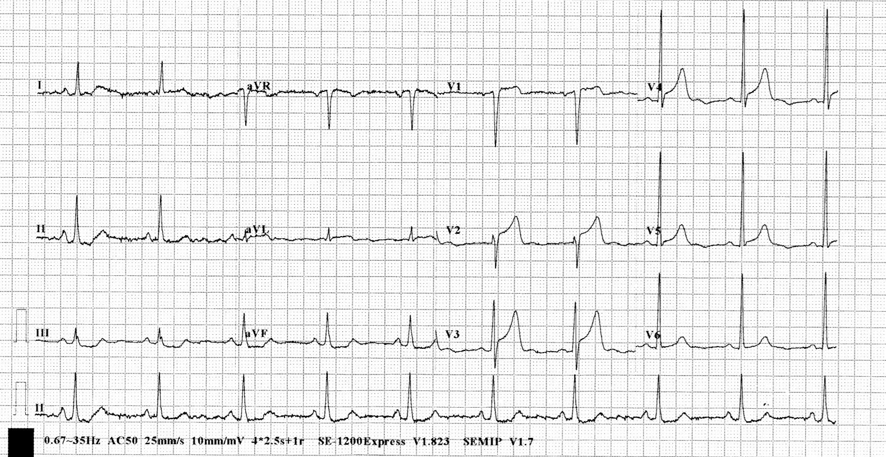
ECG done at 00:10
Please comment on ECG

Slide 6
Transferred to R room
Planned for thrombolytics

Slide 7
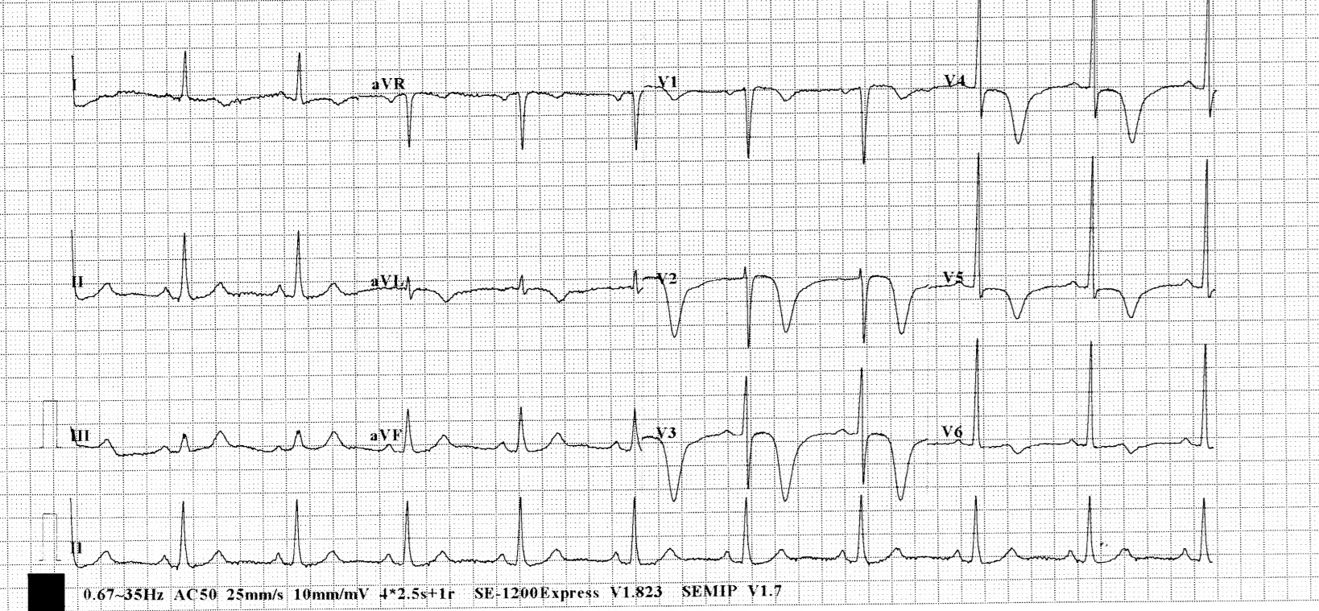
ECG done at 00:34
Please comment on ECG

Slide 8
What is the diagnosis?
What is the significance?
What are the types?

Slide 9
Wellen Syndrome
  pattern of deeply inverted or biphasic T waves in V2-3, which is highly specific for a critical stenosis of the left anterior descending artery (LAD)
  may be pain free by the time the ECG is taken and have normally or minimally elevated cardiac enzymes
  extremely high risk for extensive anterior wall MI
  Due to the critical LAD stenosis, these patients usually require invasive therapy, do poorly with medical management and may suffer MI or cardiac arrest if inappropriately stress tested

Slide 10
sudden occlusion of the LAD, causing a transient anterior STEMI. The patient has chest pain & diaphoresis; ECG may not be captured
Re-perfusion of the LAD (e.g. due to spontaneous clot lysis or prehospital aspirin). The chest pain resolves. ST elevation improves and T waves become biphasic or inverted. The T wave morphology is identical to patients who reperfuse after a successful PCI
If the artery remains occluded, the patient now develops an evolving anterior STEMI.

Slide 11
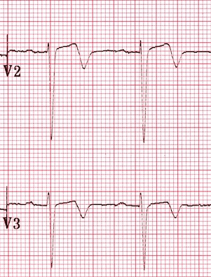
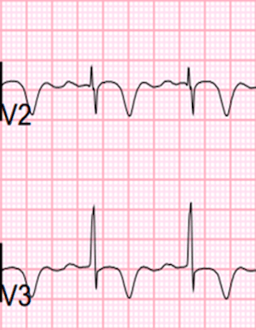
Type A:
  Biphasic, with initial positivity & terminal negativity (25% of cases)
Type B:
  Deeply and symmetrically inverted (75% of cases)
Type A
Type B

Slide 12
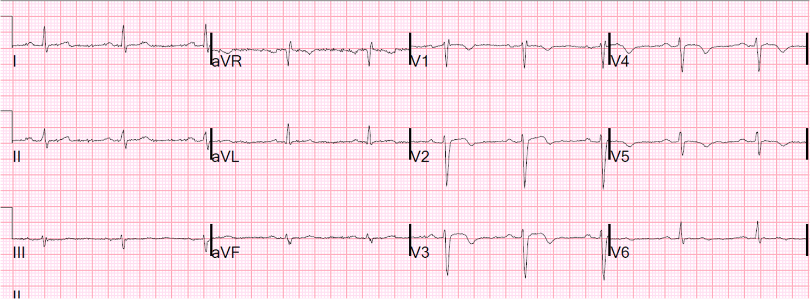
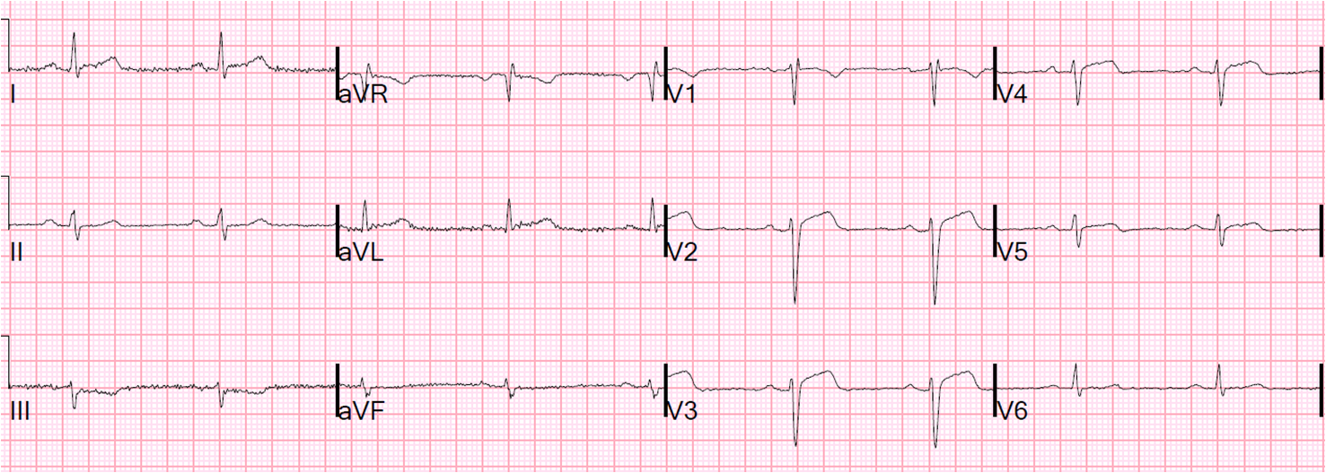
if the first ECG is
And second ECG is

Slide 13
What is this phenomenon?

Slide 14
Pseudo-normalization
The coronary perfusion is unstable, however, and the LAD can re-occlude at any time. If this happens, the first sign on the ECG is an apparent normalisation of the T waves — so-called “pseudo-normalisation”.
The T waves switch from biphasic/inverted to upright and prominent. This is a sign of hyperacute STEMI and is usually accompanied by recurrence of chest pain, although the ECG changes can precede the symptoms
If the artery remains occluded, the patient now develops an evolving anterior STEMI

Slide 15
Progress of our patient
HsTnI ~100 x 3
PCI done: showed LAD 90% stenosis, with stenting done

Slide 16
Name other STEMI equivalent ECG findings:

Slide 17
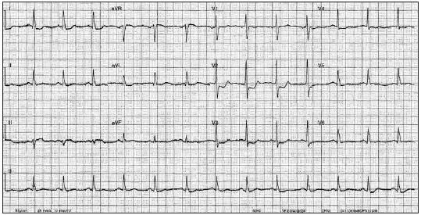
Posterior MI
  STD over V1-3

Slide 18
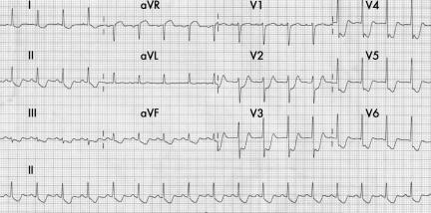
LMCA occlusion
  Seen in
    occlusion or near-occlusion of the left main artery;
    occlusion of the proximal left anterior descending artery
    severe multivessel coronary artery disease
  Findings:
    ST elevation in aVR ≥ 1mm
    ST elevation in aVR ≥ V1
    ST depression typically seen in lateral

Slide 19
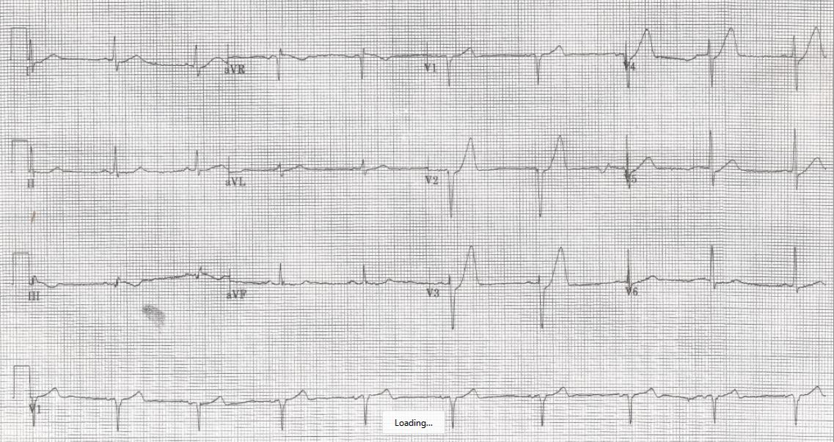
De Winter’s T Waves
  Suggestive of proximal LAD lesion
  12-Lead ECG findings
  Precordial ST-segment depression at the J-point
  Tall, peaked, symmetric T waves in the precordial leads
  Lead aVR shows slight ST-segment elevation in most cases

Slide 20
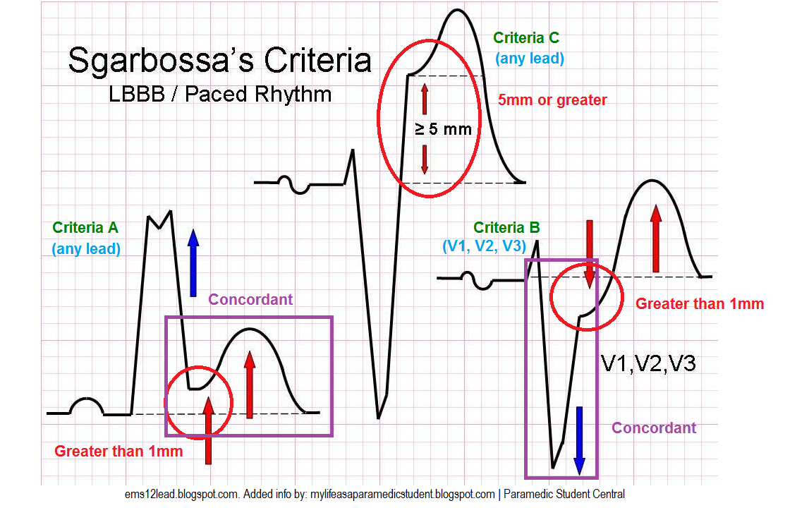
Sgarbossa's Criteria
  Used to identify STEMI in the setting of LBBB or pacemaker
  Criteria, ≥3 points = 98% probability of STEMI:
    ST elevation ≥1 mm in a lead with upward (concordant) QRS complex - 5 points
    ST depression ≥1 mm in lead V1, V2, or V3 - 3 points
    ST elevation ≥5 mm in a lead with downward (discordant) QRS complex - 2 points

Slide 21
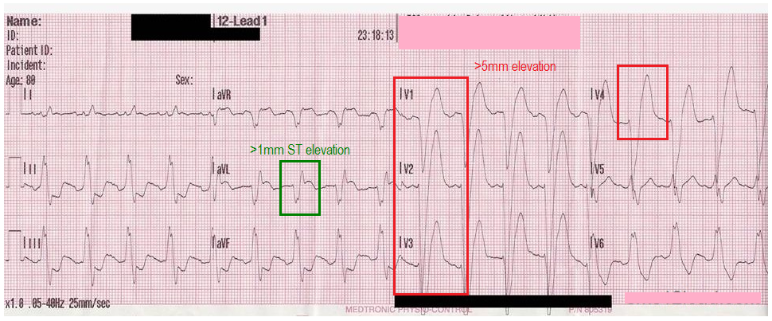
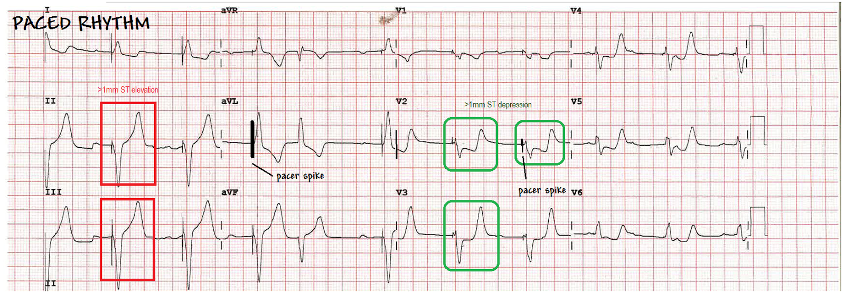

Slide 22
Case 2
M/52
Insidious onset of R hand/ wrist pain after playing golf x 2 weeks
Pain at around proximal hypothenar
Apparently normal XR R hand (AP + lateral)

Slide 23
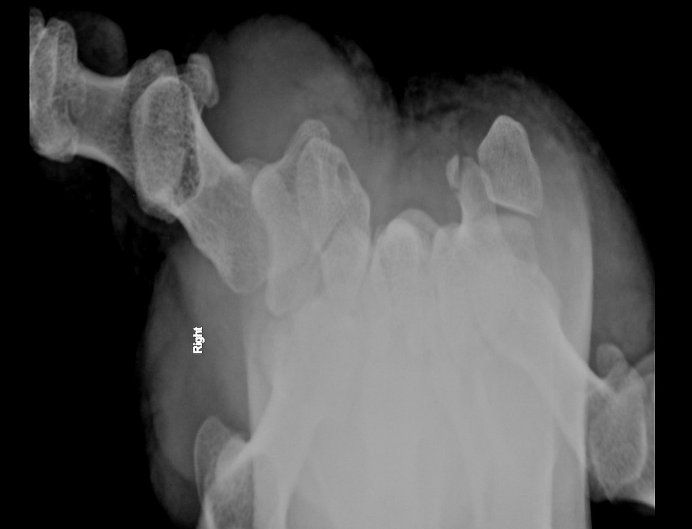
Name this view
How to perform this view
Name the abnormality

Slide 25
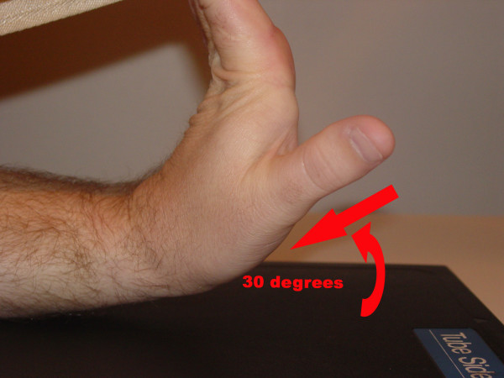
Name this view
  Carpal tunnel view
How to perform this view
  Extend hand ~30’
Name the abnormality
  Fracture hook of hamate

Slide 26
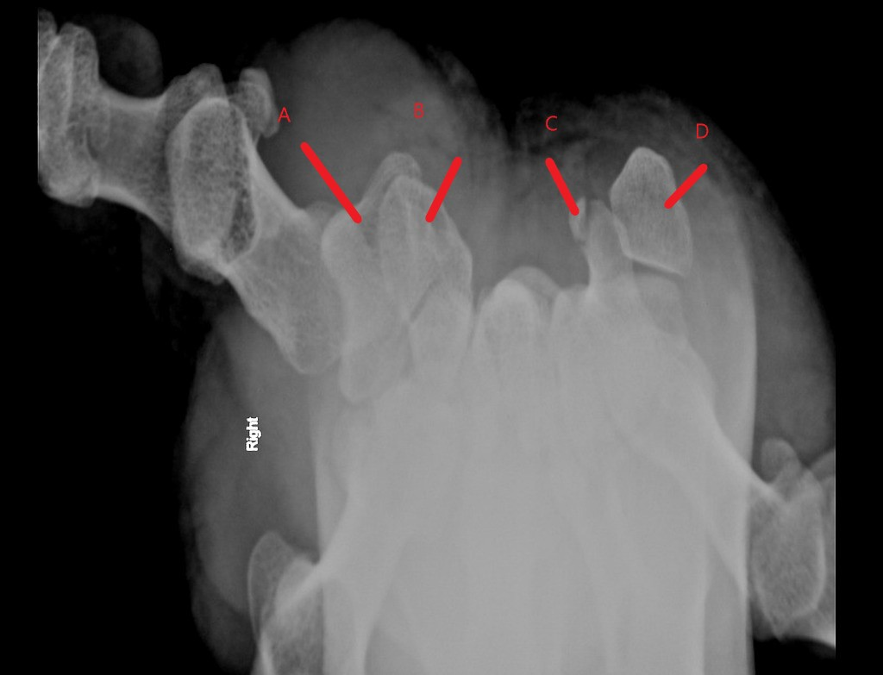
Name the other carpal bones

Slide 27
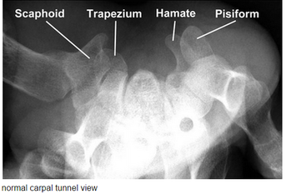
Name the other carpal bones

Slide 28
What is the most common cause of this injury ?
What physical signs may aid diagnosis?
What is common complication of this injury ?
What is the treatment?

Slide 29
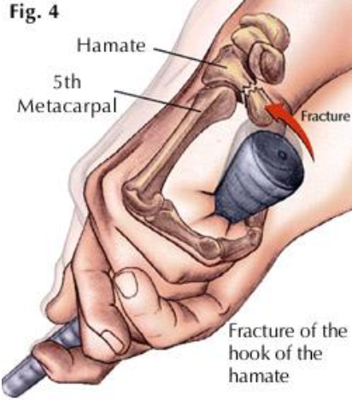
What is the most common cause of this injury ?
  Direct blow
    Golf, baseball, hockey tennis etc.

Slide 30
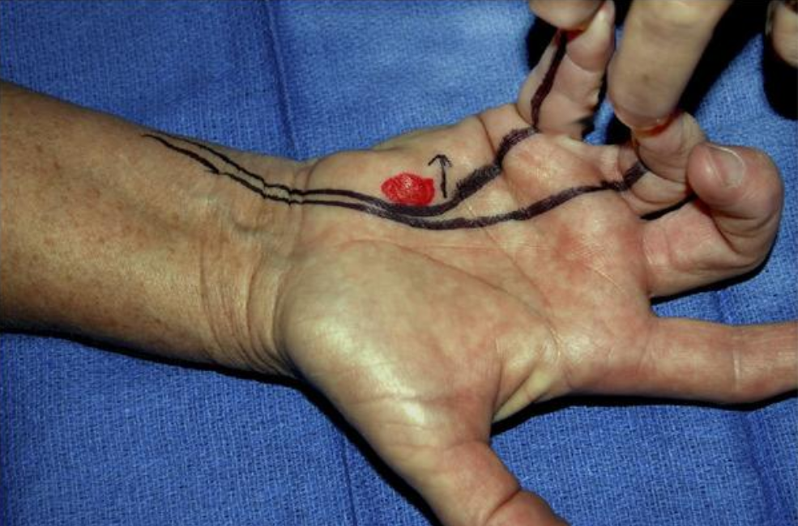
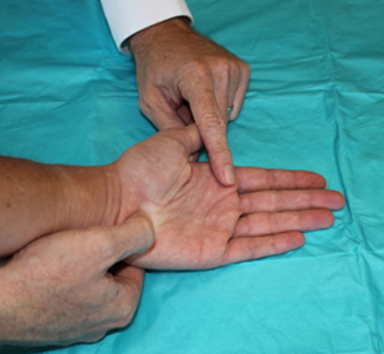
What physical signs may aid diagnosis?
  Pull test:
  Examiner pulls on 4th and 5th digits
  Flexor Digitorum Profundus tendons will displace the broken hook and reproduce exact severe pain

Slide 31
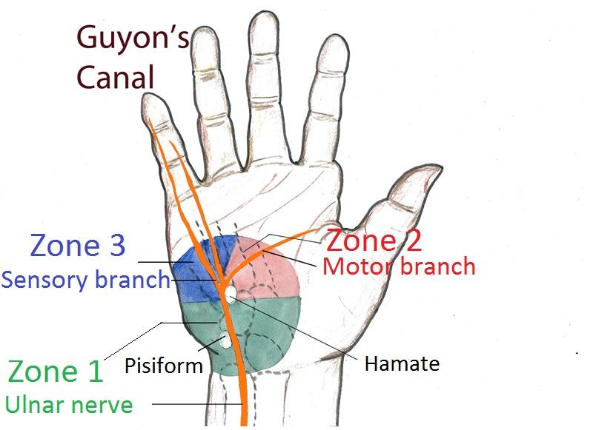
What is the common complication of this injury ?
  Ulnar nerve injury (usually motor branch) [Guyon canal syndrome]
    Can be iatrogenic
  Ulnar artery injury
  Non union
  Closed rupture of the flexor tendons to the small finger

Slide 32
What is the treatment?
  Non operative:
    Short arm cast x 6 weeks
    Including immobilization of 4th and 5th MCPJ
  Operative :
    ORIF/ excision of the fracture fragment
  Retrospective analyses have demonstrated non-union rates greater than 50% and as high as 80-90% with conservative treatment
  Multifactorial for non-union: poor blood supply, delayed diagnosis, and fragment displacement with continuous movement of the fourth and fifth digits while casted
  Therefore, all hamate hook fractures should be referred to a hand surgeon for possible surgical intervention

Slide 33
Case 3
A 46-year-old gentleman slipped and fell while walking on the street. His left eye fell onto a handrail.
He complained of left eye pain and decreased vision after the injury.

Slide 34
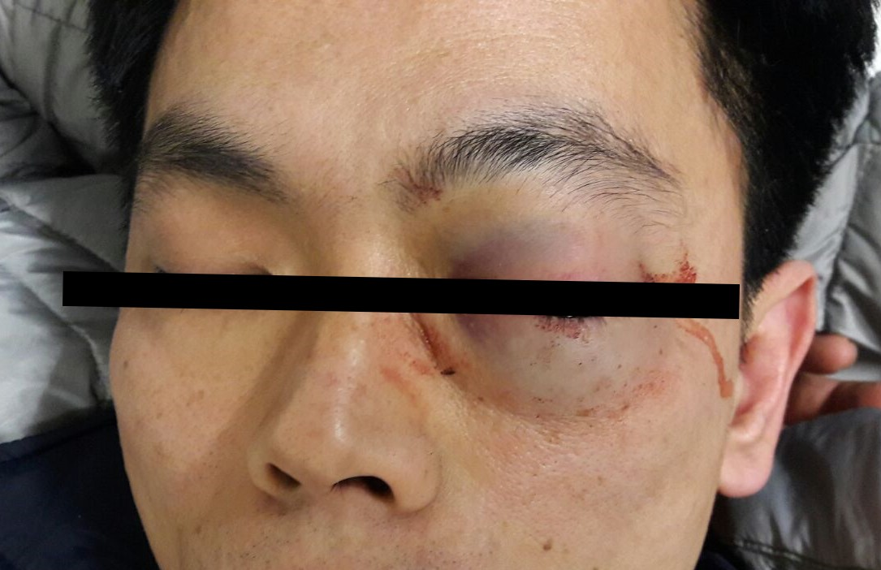
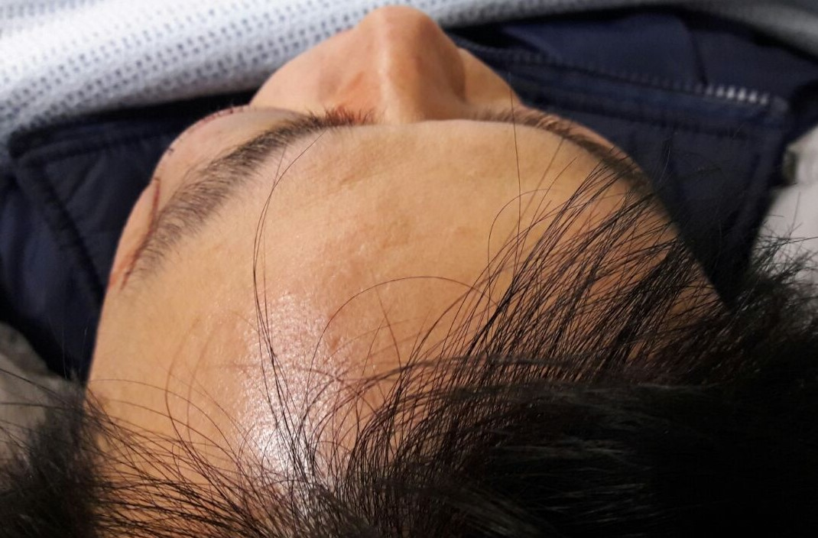

Slide 35
1. Describe the findings in the clinical photos. (1 mark)

Slide 36
  Left periorbital oedema and ecchymosis (0.5 mark)
  Marked left eye proptosis (0.5 mark)

Slide 37
2. What differential diagnosis that must be considered in this patient? (1 mark)

Slide 38
Acute traumatic retrobulbar haemorrhage (of left eye) (0.5 mark)
Left orbital emphysema (0.5 mark)

Slide 39
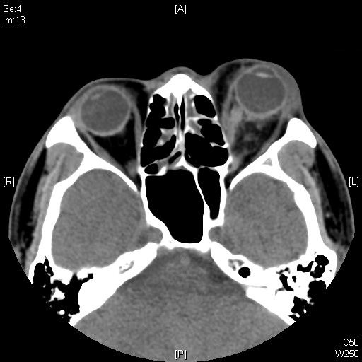
CT orbit was performed

Slide 40
3. Describe the CT findings. (1.5 marks)

Slide 41
Protrusion of left eye globe. (0.5 mark)
Left retrobulbar haematoma. (1 mark)

Slide 42
4. What other clinical signs to look for in this condition? (2 marks)

Slide 43
(Any 4 of the followings, 0.5 mark each)
Proptosis resistant to retropulsion
Restriction of extraocular movement
Impaired visual acuity
Afferent papillary defect
Elevated intraocular pressure
Pale optic disc

Slide 44
5. What are the possible causes of visual loss in this condition? (1 mark)

Slide 45
  (Any 2 of the followings, 0.5 mark each)
  Direct optic nerve compression
  Compression of optic nerve vasculature
  Central retinal artery occlusion

Slide 46
6. What bedside investigation can be used to detect this condition? What are the features to look for? (1 mark)

Slide 47
  Bedside ocular ultrasound (0.5 mark)
  Black or anechoic structure within the hyperechoic retrobulbar area (0.5 mark)

Slide 48
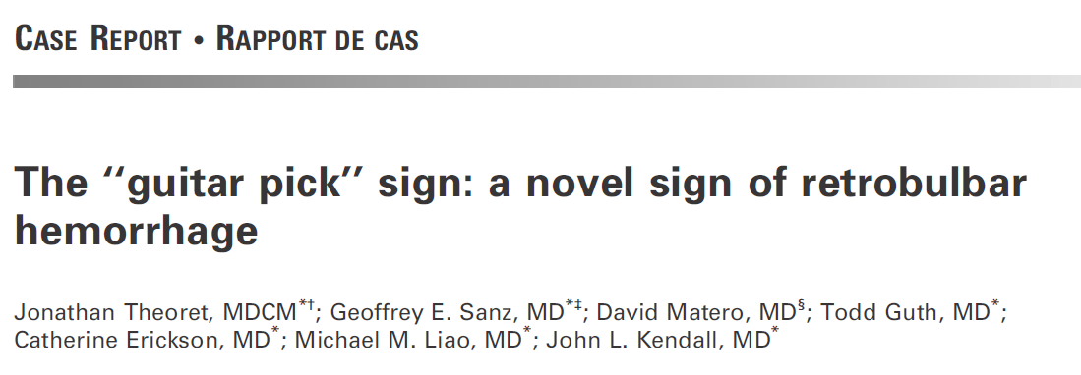
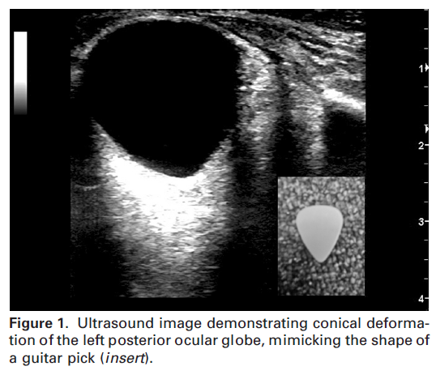
Theoret J, Sanz GE, Matero D, Guth T, Erickson C, Liao MM, Kendall JL. The "guitar pick" sign: a novel sign of retrobulbar hemorrhage. CJEM. 2011 May;13(3):162-4.

Slide 49
7. How to manage this patient? (2.5 marks)

Slide 50
Urgent eye consult/ referral (0.5 mark)
Medical treatment to reduce IOP (0.25 mark each)
  Mannitol
  Acetazolamide
  Topical timolol
  Corticosteroid
Orbital decompression by lateral canthotomy and Inferior cantholysis (1 mark)

Slide 51
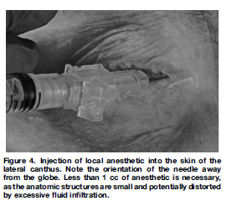
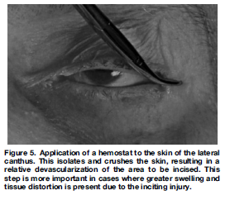
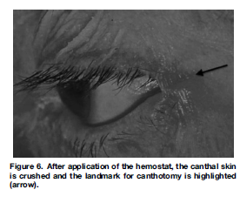
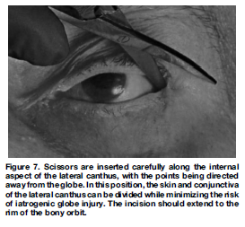
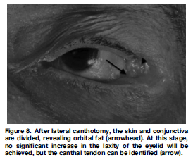
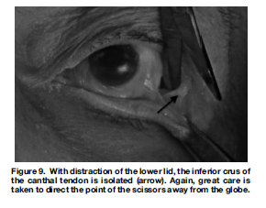
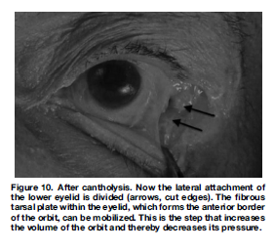
Rowh AD, Ufberg JW, Chan TC, Vilke GM, Harrigan RA. Lateral canthotomy and cantholysis: emergency management of orbital compartment syndrome. J Emerg Med. 2015 Mar;48(3):325-30.

Slide 52
Case 4
A 68-year-old Chinese lady with history of Ca liver and hypertension travelled from Canada to Hong Kong.
She complained of dizziness and then found collapsed on the plane
On arrival to AED, her GCS was E1V1M2 4/15. BP 164/82 mmHg. Pulse 98 bpm. SpO2: 96% on 100% O2. Pupils 4mm bilaterally and sluggish.
She was then intubated for airway protection. CT brain was done.

Slide 53
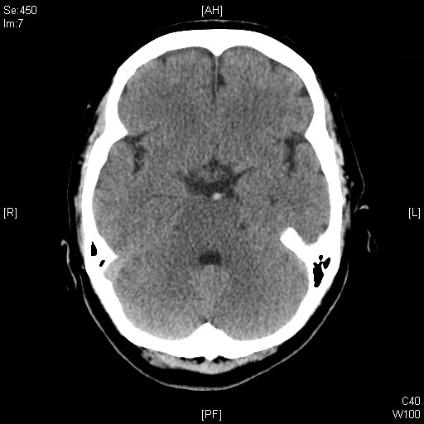

Slide 54
1. Describe the CT Brain findings. (0.5 mark) Name the sign shown on the CT Brain. ( 1 mark)

Slide 55
The basilar artery appears hyperdense. (0.5 mark)
Hyperdense basilar artery sign. (1 mark)

Slide 56
2. What is the significance of the finding? (1 mark)

Slide 57
This sign is suggestive of basilar artery occlusion.

Slide 58
3. Name 3 other causes of this radiological sign. (1.5 marks)

Slide 59
Atherosclerosis (0.5 mark)
High Haematocrit level (0.5 mark)
Streak artifacts due to the proximity of the basilar artery to complex bony structures (0.5 mark)

Slide 60
4. Name 2 parameters can be used to differentiate between these causes? (1 mark)

Slide 61
Density measurement (HU units) (0.5 mark)
HU/Hct ratio (to correct for HcT) (0.5 mark)

Slide 62
5. What is the reported sensitivity and specificity of this radiological sign? (1 mark)

Slide 63

Visual detection of the HBAS on CT
  Sensitivity 81% (0.5 mark)
  Specificity 91% (0.5 mark)

Slide 64
6. Apart from visual assessment of the CT films, what parameter can be used to improve the sensitivity? ( 1 mark)

Slide 65
Quantitative measurement of basilar artery attenuation (Hounsfield units)

Slide 66
Visual detection + Attenuation measurement
  Using a cut-off value 46.5 HU
  Sensitivity 94%
  Specificity 84%
Vonofakos et al. reported the attenuation values of basilar artery densities in BAO were higher than those of whole blood. (45 HU in their study).¹
However, densities of whole blood vary and can be as high as 56 HU.²
Vonofakos D, Marcu H, Hacker H. CT diagnosis of basilar artery occlusion. AJNR Am J Neuroradiol. 1983 May-Jun;4(3):525-8.
Norman D, Price D, Boyd D, Fishman R, Newton TH. Quantitative aspects of computed tomography of the blood and cerebrospinal fluid. Radiology. 1977 May;123(2):335-8.

Slide 67
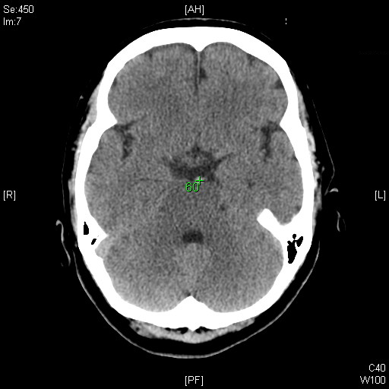

Slide 68
7. How to manage this patient? (3 marks)

Slide 69
Confirm with angiography e.g. CTA, MRA (1 mark)
Reperfusion therapy
  Thrombolysis (1 mark)
  Mechanical endovascular treatment e.g. stenting (1 mark)

Slide 70
Progress of the patient
CT angiogram was done:
  Acute hyperdense thrombus involving right vertebral artery V4 segment, basilar artery and bilateral P1 segment of PCA
  Extensive infarct of posterior circulation
  Features of increased ICP
In view of poor GCS and delayed onset time, neurologist suggested unlikely to benefit from IA intervention
Patients eventually succumbed 2 days later

Slide 71
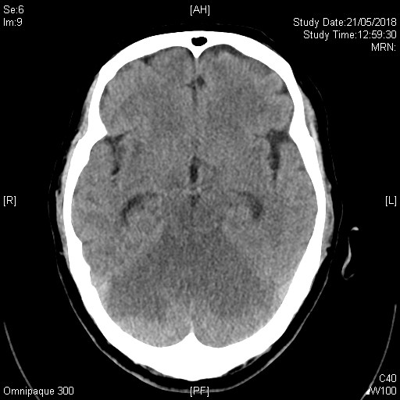

Slide 72
Case 5
A 79-year-old lady with history of hyperlipidemia, congestive heart failure and AF on apixaban, presented to the AED for fever, generalized malaise and fall with head injury.
She did not have LOC, vomiting or amnesia after the injury
Vitals signs:
  BP 140/70
  SpO2 98% on RA
  Temp 38C
Neurological examination:
  GCS 15/15, PERL 4mm
  No scalp wound/ haematoma
  limbs power 5-/5
NPS influenza A +ve
Admitted EMW for further management

Slide 73
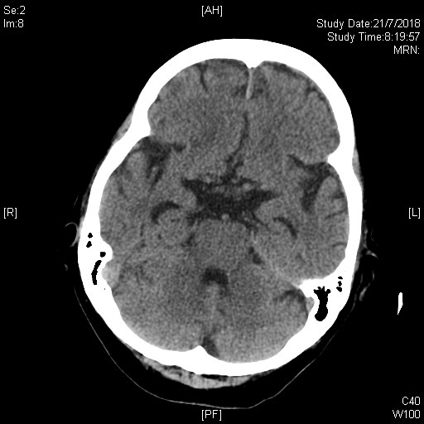
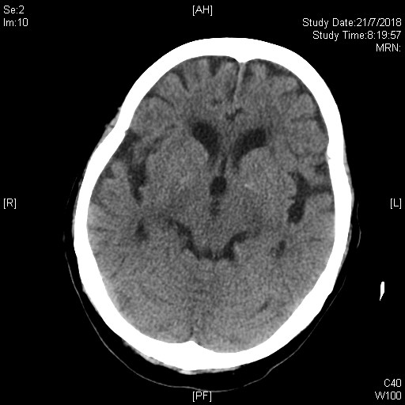
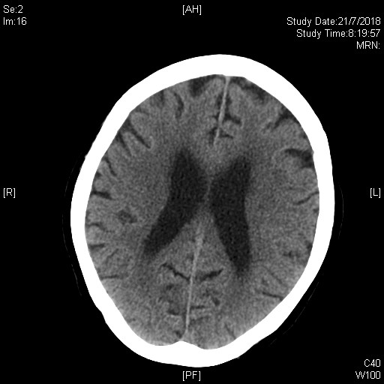
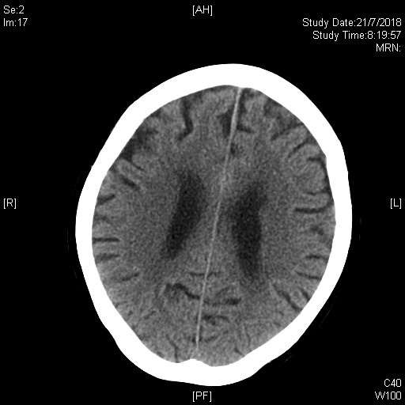

Slide 74
1. Describe the CT brain findings (2 marks)

Slide 75
Slight local thickening of the anterior falx cerebri and interhemospheric fissure (1 mark)
No abnormal attenuated lesion in the brain parenchyma (1mark)

Slide 78
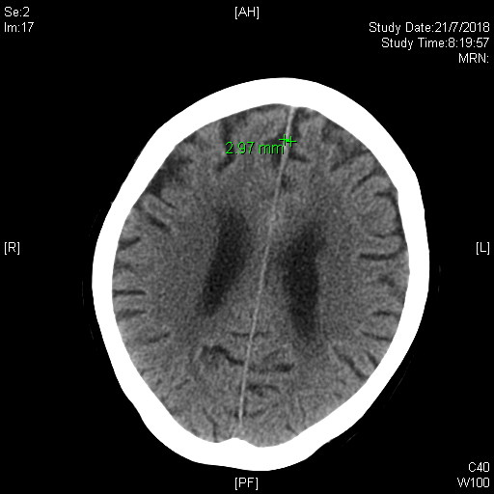

Slide 79
Patient developed lower limbs weakness after admission
GCS all along full
Lower limbs power 5-/5
CT brain was repeated 3 days after admission

Slide 80
2. Describe the second CT brain findings (3 marks)

Slide 81
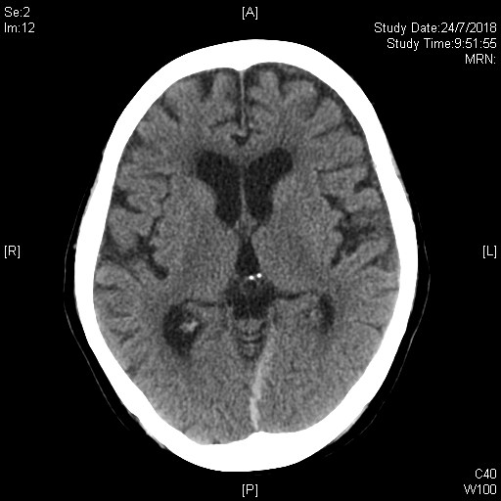
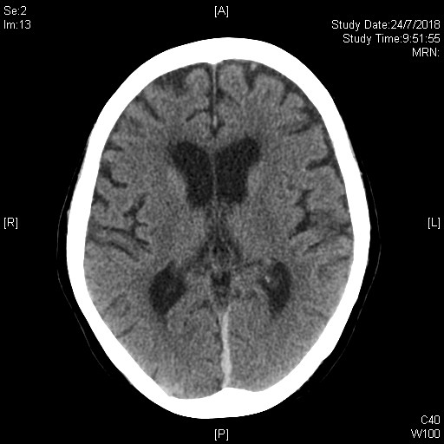
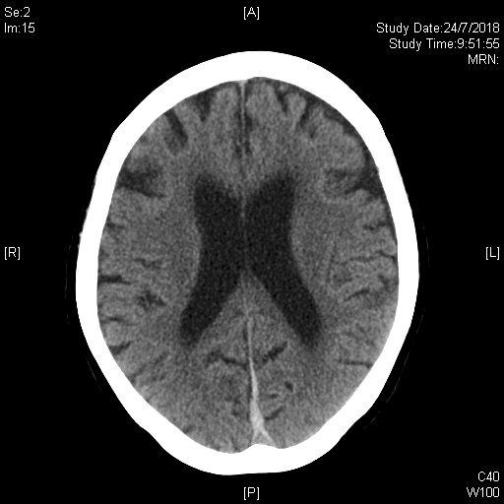
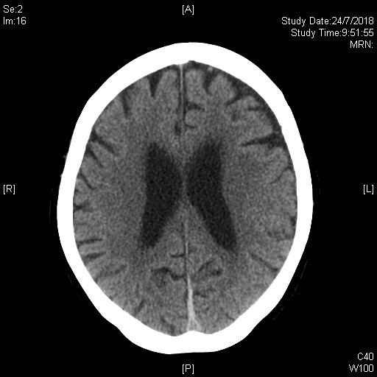

Slide 83
New posterior falcine (1 mark) and left tentorial (1 mark) subdural haematoma (SDH) (1 mark)

Slide 84
3. If the condition progresses, what clinical symptoms may develop? (2 mark)

Slide 85
“Falx syndrome” with leg weakness and alteration of consciousness (1 mark)
  Described for severe falcine SDH with usually than 10mm thickness
  Typical interhemispheric subdural haematoma and falx syndrome: four cases and a review of the literature: Zentralbl Neurochir 1995;56:51-60
Impaired conscious state (0.5 mark)
Symptoms of increased ICP, e.g. headache (0.5 mark)

Slide 86
4. How would you manage this patient? (2 marks)

Slide 87
Stop anticoagulant (1 mark)
Correct coagulopathy if clinical deterioration or size of SDH increases (0.5 mark)
Monitor for progression of symptoms (0.5 mark)

Slide 88
5. What are the indications of neurosurgical interventions for this condition?

Slide 89
(any 2, 0.5 mark for each)
Progression of LLs weakness or LLs paralysis
Signs of increased ICP
Large SDH (thickness> 15mm) with mass effect

Slide 90
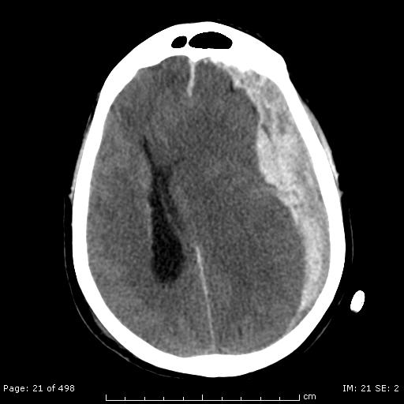
Acute SDH
Common causes:
  Head injury (may be trivial in elderly)
  Coagulopathies
Locations:
  Most commonly over part or entire convexity of brain
  Rarely along the falx cerebri (falcine or interhemispheric SDH) or along the tentorium cerebelli (tentorial SDH)

Slide 91
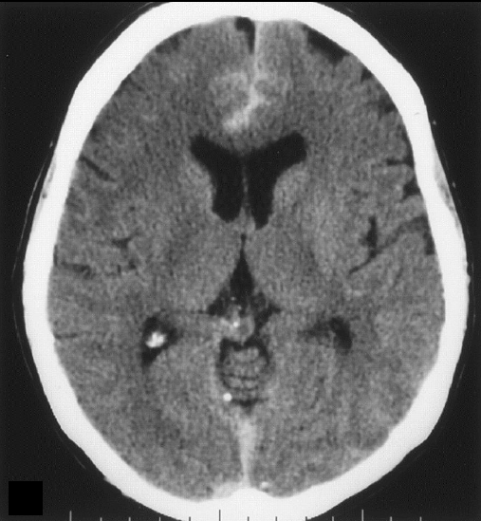
Falcine SAH Vs SDH
Hyperdensity with a zigzag configuration along the anterior interhemispheric fissure in SAH

Slide 92
Falcine/ interhemispheric SDH
Purposed pathogenic mechanism
  Tearing of the parasagittal bridging veins, veins in the interhemispheric fissure or branches of pericallosal artery
  Brain laceration in the interhemispheric fissure
Most common in the posterior part of the falx
  ?migration of blood from anterior falx to posterior falx due to gravity in our case
Rarely becomes chronic SDH
Clinical features of interhemispheric subdural hematomsas. Korean J Neurotrauma 2017;13(2):103-7

Slide 93
Isolated falcine SDH Vs convexity SDH
Regarded as benign entity among acute SDH
More favorable outcome
Rarely requires NS intervention

Slide 94
Progress of the patient
Stopped apixaban
Transferred to NS ward
GCS all along full
No progression of symptoms
Repeated CT brain showed resolving SDH

