Slide 1
OSCE
NLTH
9/2018

Slide 2
Case 1
M/57
Chest pain ~2 hours before attending AED
Pain subsided on arrival

Slide 3
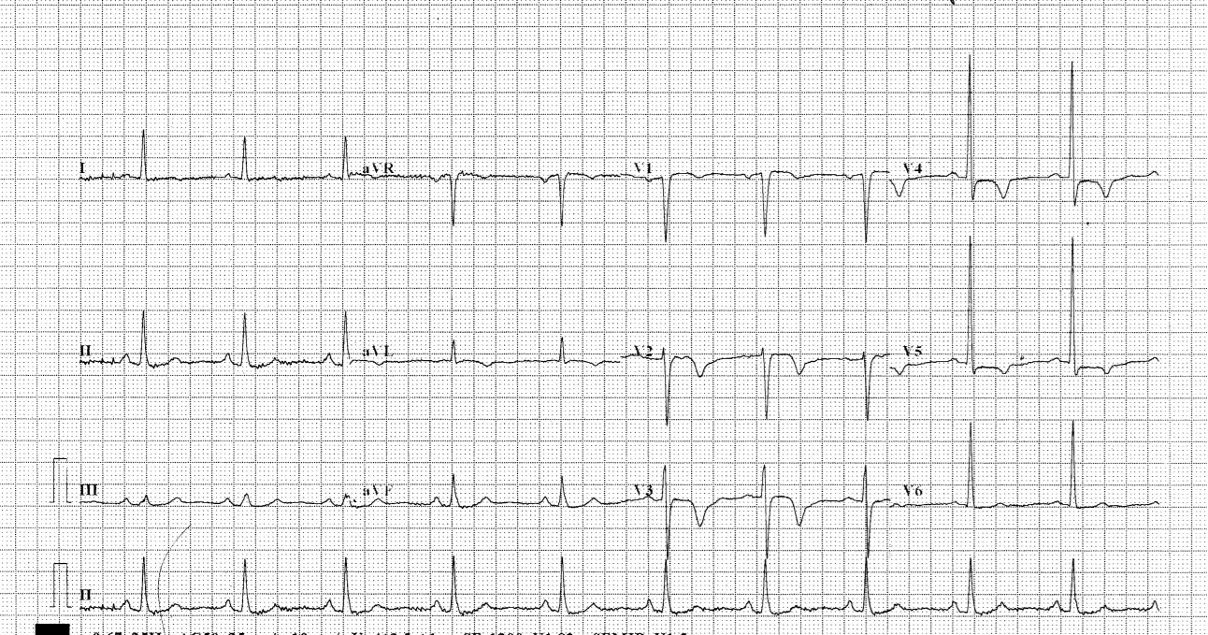
ECG done at 21:33
Please comment on ECG

Slide 4
He was transferred to PMH Med
1st TnI: 0.16
Recurrence of chest pain while waiting at PMH AED
ECG was done again

Slide 5
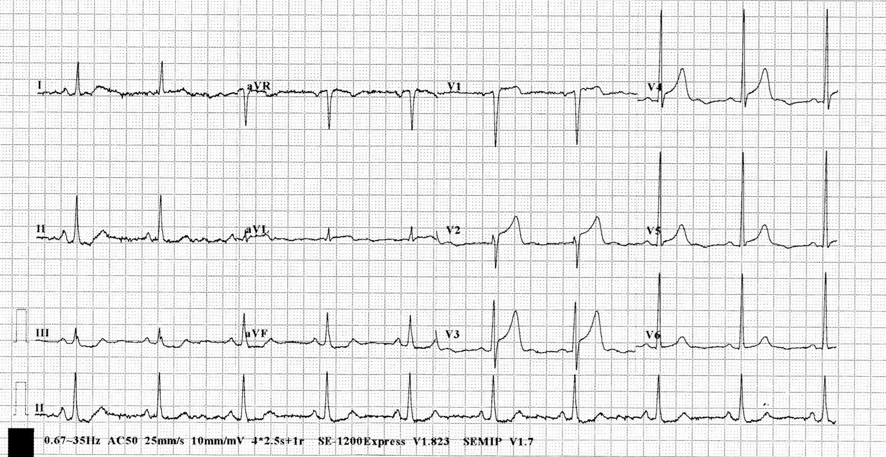
ECG done at 00:10
Please comment on ECG

Slide 6
Transferred to R room
Planned for thrombolytics

Slide 7
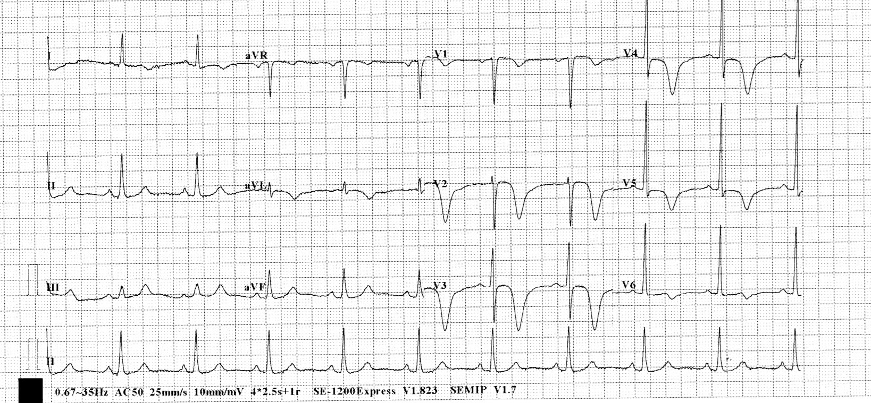
ECG done at 00:34
Please comment on ECG

Slide 8
What is the diagnosis?
What is the significance?
What are the types?

Slide 9
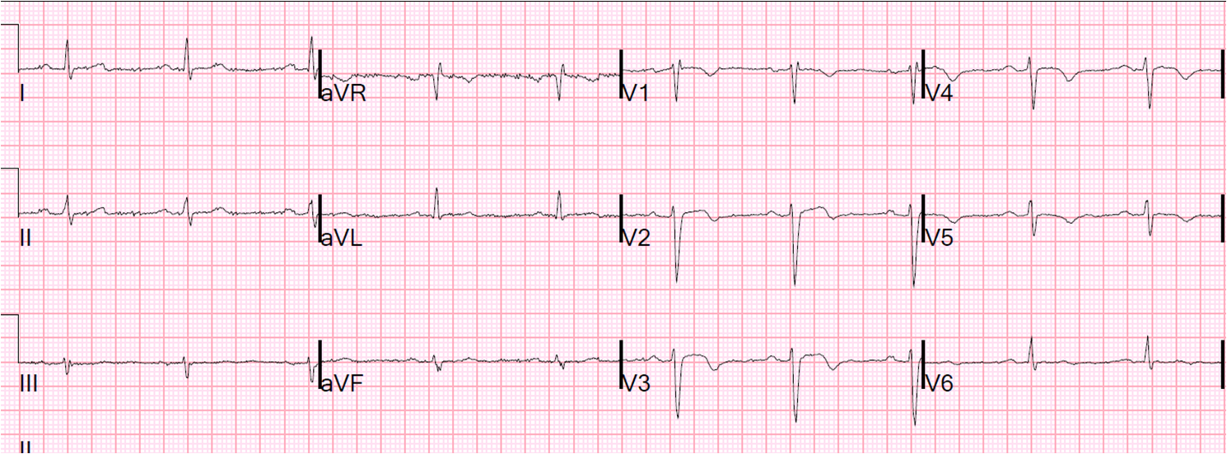
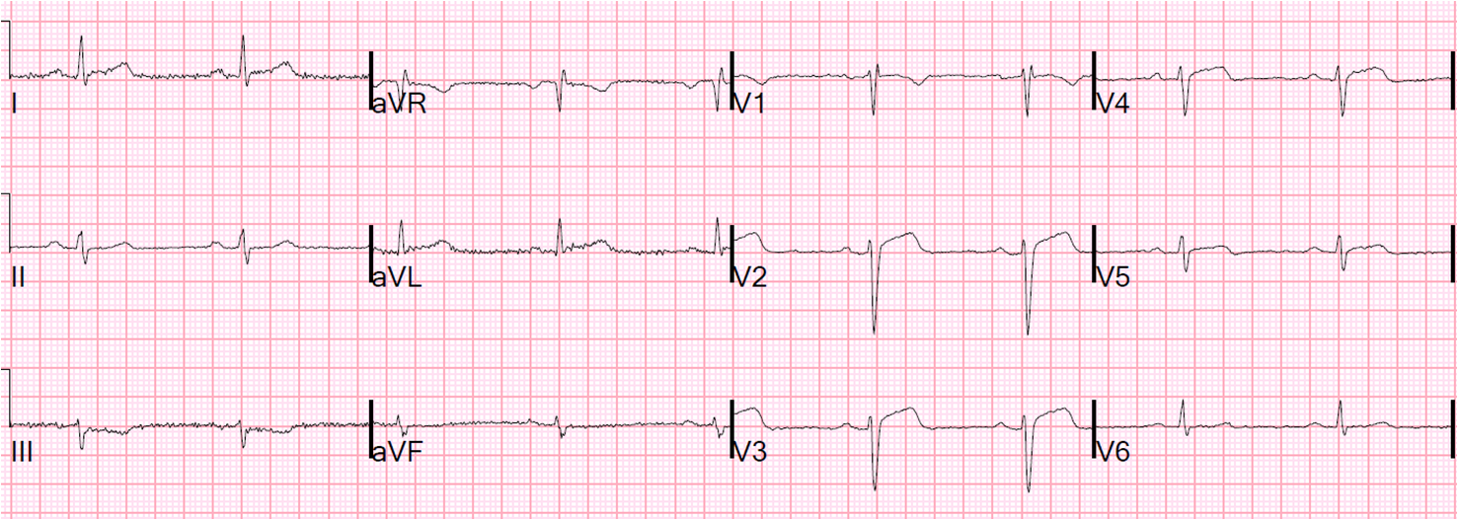
if the first ECG is
And second ECG is

Slide 10
What is this phenomenon?

Slide 11
Name other STEMI equivalent ECG findings:

Slide 12
Case 2
M/52
Insidious onset of R hand/ wrist pain after playing golf x 2 weeks
Pain at around proximal hypothenar
Apparently normal XR R hand (AP + lateral)

Slide 13
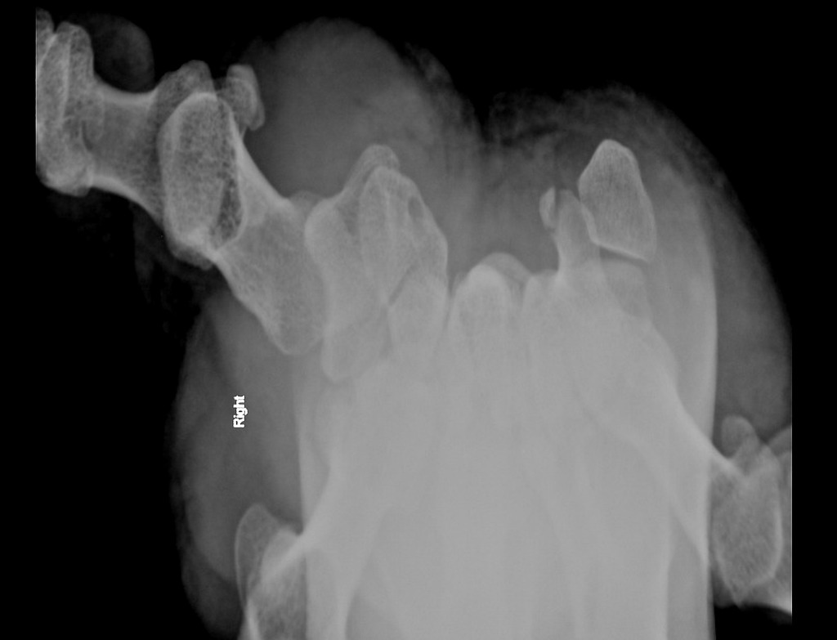
Name this view
How to perform this view
Name the abnormality

Slide 15
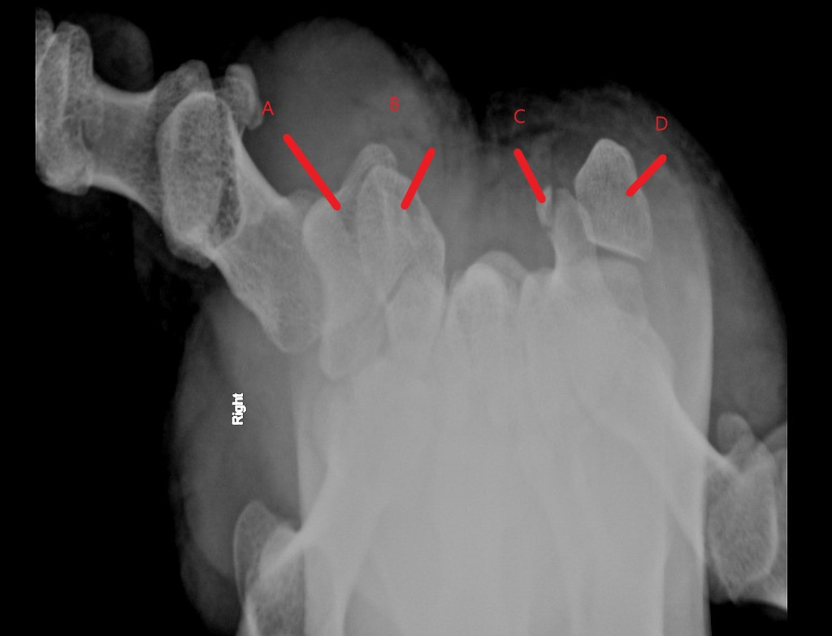
Name the other carpal bones

Slide 16
What is the most common cause of this injury ?
What physical signs may aid diagnosis?
What is common complication of this injury ?
What is the treatment?

Slide 17
Case 3
A 46-year-old gentleman slipped and fell while walking on the street. His left eye fell onto a handrail.
He complained of left eye pain and decreased vision after the injury.

Slide 18
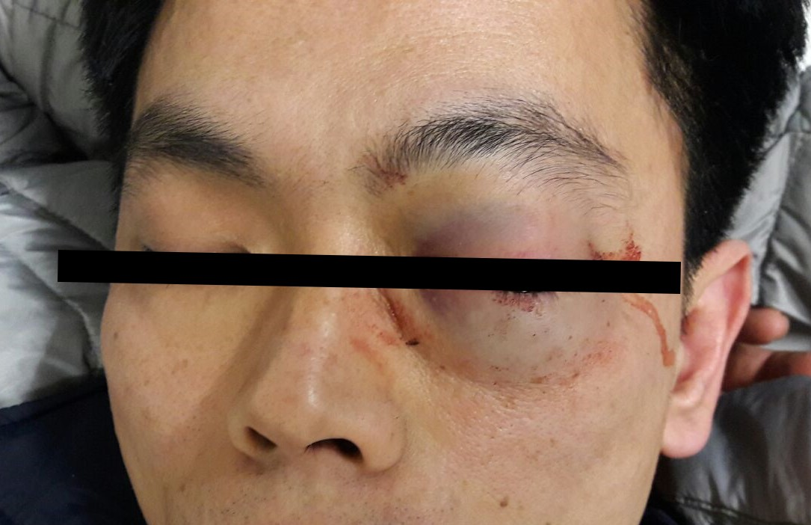
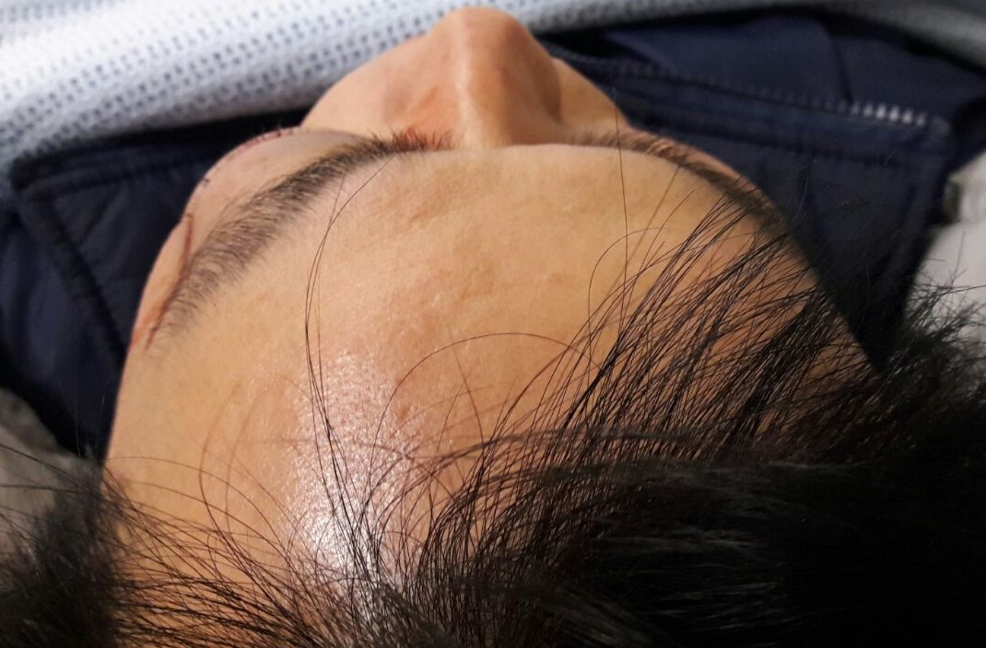

Slide 19
1. Describe the findings in the clinical photos. (1 mark)

Slide 20
2. What differential diagnosis that must be considered in this patient? (1 mark)

Slide 21
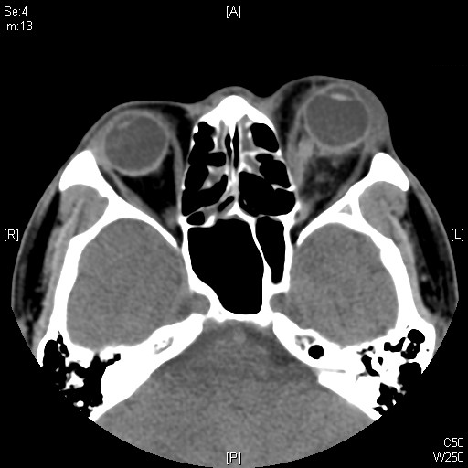
CT orbit was performed

Slide 22
3. Describe the CT findings. (1.5 marks)

Slide 23
4. What other clinical signs to look for in this condition? (2 marks)

Slide 24
5. What are the possible causes of visual loss in this condition? (1 mark)

Slide 25
6. What bedside investigation can be used to detect this condition? What are the features to look for? (1 mark)

Slide 26
7. How to manage this patient? (2.5 marks)

Slide 27
Case 4
A 68-year-old Chinese lady with history of Ca liver and hypertension travelled from Canada to Hong Kong.
She complained of dizziness and then found collapsed on the plane
On arrival to AED, her GCS was E1V1M2 4/15. BP 164/82 mmHg. Pulse 98 bpm. SpO2: 96% on 100% O2. Pupils 4mm bilaterally and sluggish.
She was then intubated for airway protection. CT brain was done.

Slide 28
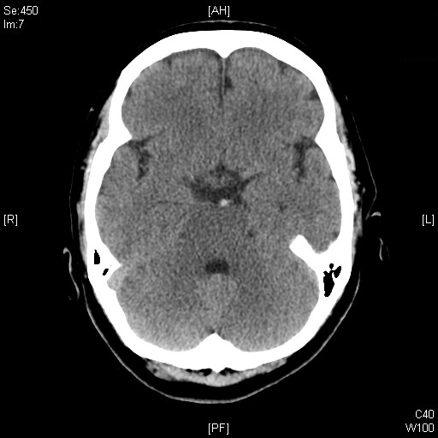

Slide 29
1. Describe the CT Brain findings. (0.5 mark) Name the sign shown on the CT Brain. ( 1 mark)

Slide 30
2. What is the significance of the finding? (1 mark)

Slide 31
3. Name 3 other causes of this radiological sign. (1.5 marks)

Slide 32
4. Name 2 parameters can be used to differentiate between these causes? (1 mark)

Slide 33
5. What is the reported sensitivity and specificity of this radiological sign? (1 mark)

Slide 34
6. Apart from visual assessment of the CT films, what parameter can be used to improve the sensitivity? ( 1 mark)

Slide 35
7. How to manage this patient? (3 marks)

Slide 36
Case 5
A 79-year-old lady with history of hyperlipidemia, congestive heart failure and AF on apixaban, presented to the AED for fever, generalized malaise and fall with head injury.
She did not have LOC, vomiting or amnesia after the injury
Vitals signs:
BP 140/70
SpO2 98% on RA
Temp 38C
Neurological examination:
GCS 15/15, PERL 4mm
No scalp wound/ haematoma
limbs power 5-/5
NPS influenza A +ve
Admitted EMW for further management

Slide 37
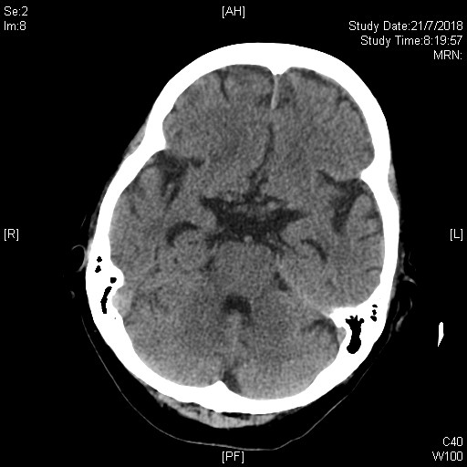
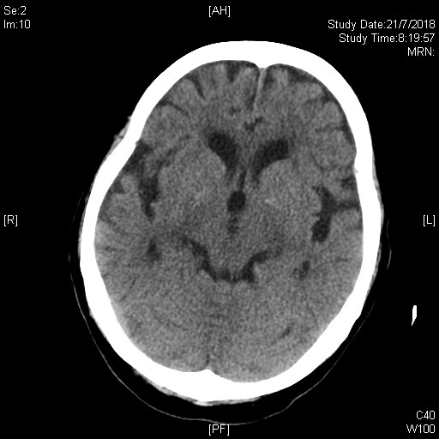

Slide 38
1. Describe the CT brain findings (2 marks)

Slide 39
Patient developed lower limbs weakness after admission
GCS all along full
Lower limbs power 5-/5
CT brain was repeated 3 days after admission

Slide 40
2. Describe the second CT brain findings (3 marks)

Slide 41
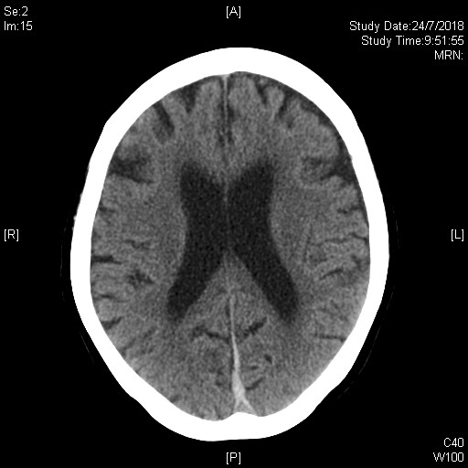
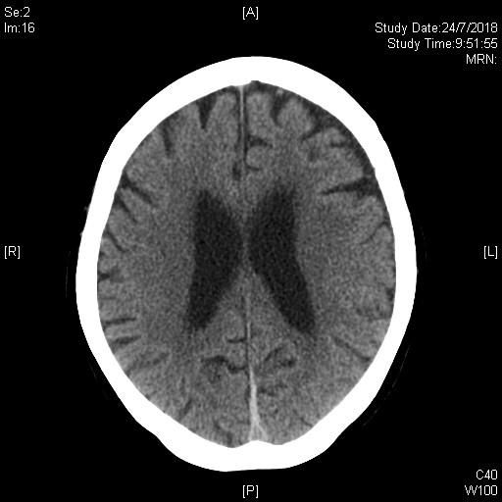

Slide 42
3. If the condition progresses, what clinical symptoms may develop? (2 mark)

Slide 43
4. How would you manage this patient? (2 marks)

Slide 44
5. What are the indications of neurosurgical interventions for this condition?

