Slide 1
OSCE
03-10-2018
YCH
(Section A)

Slide 2
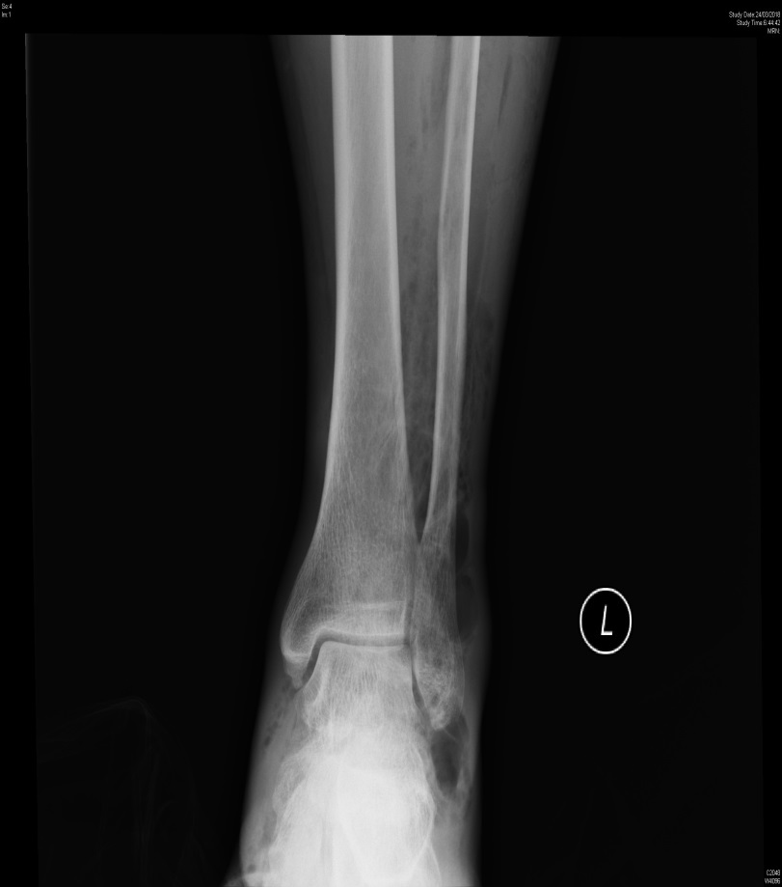
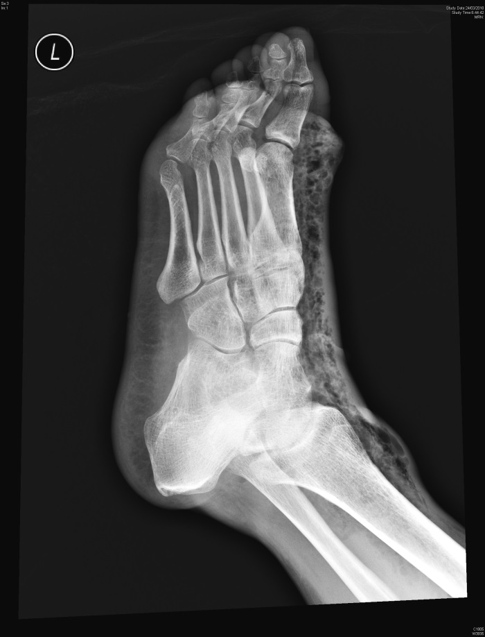
Case 1: M/47, DM/CHF/Epilepsy C/O: L foot swelling for 2/7 with pain and redness BP: 142/59, Pulse: 130, RR: 14, Temp: 38.2˚C, L foot blisters, Hstix: 16.0

Slide 3
What is your x-ray finding? (1 mark)
What is your diagnosis? (1 mark)
What is your management? (2 marks)
Admit which specialty? (1 mark)

Slide 4
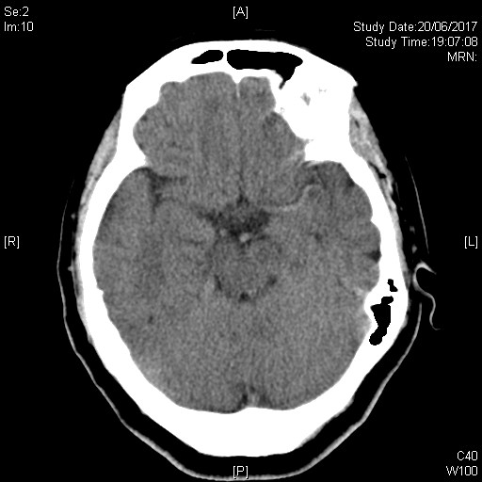
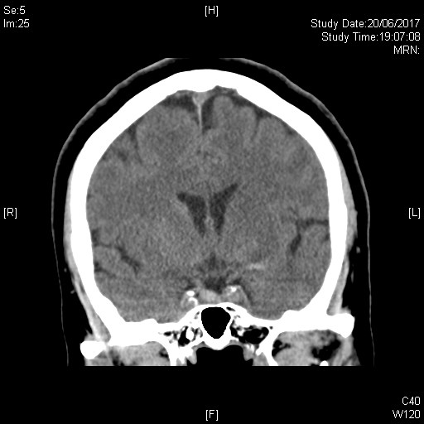
Case 2: F/65, Good past health C/O: Sudden collapse, BP: 211/94, Pulse: 63, Temp: 35.9˚C, GCS: 11/15

Slide 5
What is your x-ray findings? (2 marks)
What is your diagnosis? (3 marks)

Slide 6
Case 3: M/49, C/O: Chest discomfort and cough for 4/7, Hx of chest contusion 2/12 BP: 133/86, Pulse: 73, RR: 14, Temp: 36.1°C, SpO2: 97%

Slide 7
What is your x-ray finding? (1 mark)
What is your differential diagnosis? (3 marks)
Any further radiological Investigation? (1 mark)

Slide 8
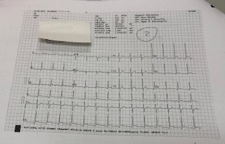
Case 4: M/17, NSNK C/O: Chest pain for 1/7, URTI 2-3/7 BP: 134/72, Pulse: 79, RR: 14, Temp: 36.5°C

Slide 9
What is your ECG findings? (1 mark)
What is your differential diagnosis? (2 marks)
What is your management? (2 marks)

Slide 10
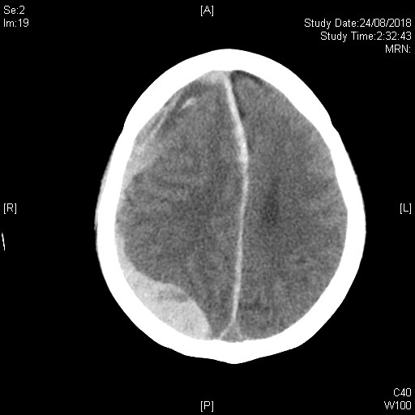
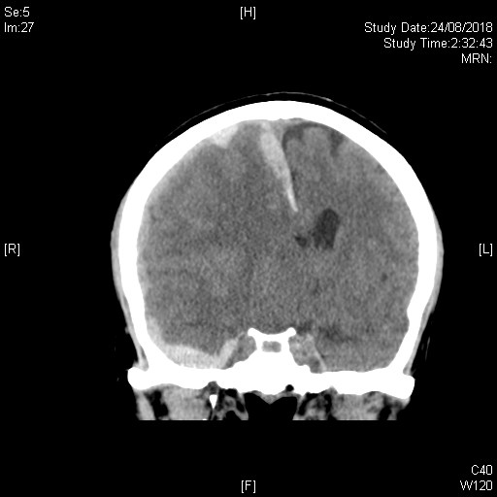
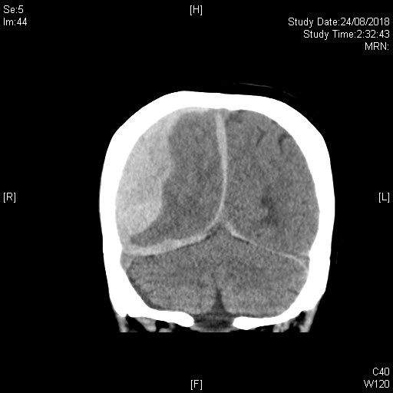
Case 5: F/49, Alcoholic, thrombocytopenia C/O: Dizziness for 2/7, HI+ GCS: 15/15, BP: 135/83, Pulse: 78, RR: 14, Temp: 36.5°C Decreased GCS in AED: 9/15

Slide 11
What is your x-ray findings? (3 marks)
What is your diagnosis? (2 marks)

Slide 12
Case 6: F/60, ESRF/HT/DM C/O: Dizziness and limbs weakness for 2/52 BP: 130/70, Pulse: 54, RR: 14, Temp: 36.0°C, Hstix: 16.9

Slide 13
What is your ECG findings? (2 marks)
What is your diagnosis? (1 mark)
What is your management? (2 marks)

Slide 14
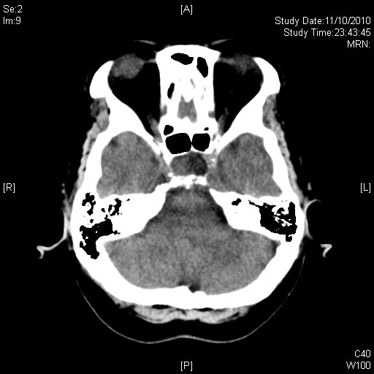
Case 7: F/64, DM/HT C/O: Dizziness for 1/12 GCS: 15/15, BP: 145/93, Pulse: 70, RR: 14, Temp: 36.7°C

Slide 15
What is your x-ray finding? (1 mark)
What is your diagnosis? (1 mark)
What is your management? (3 marks)

