Slide 1
OSCE
03-10-2018
YCH
(Section B)

Slide 2
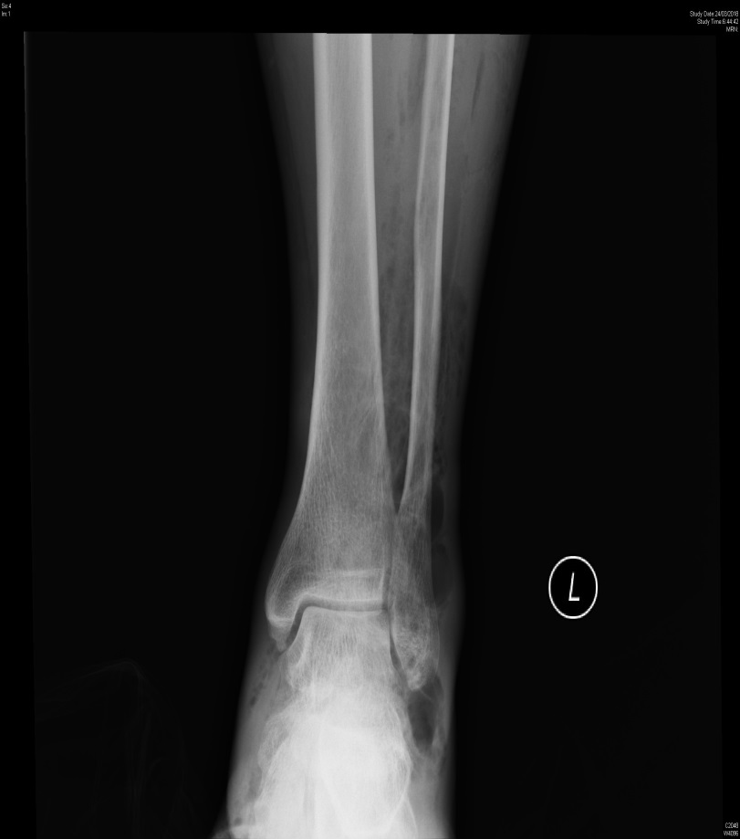
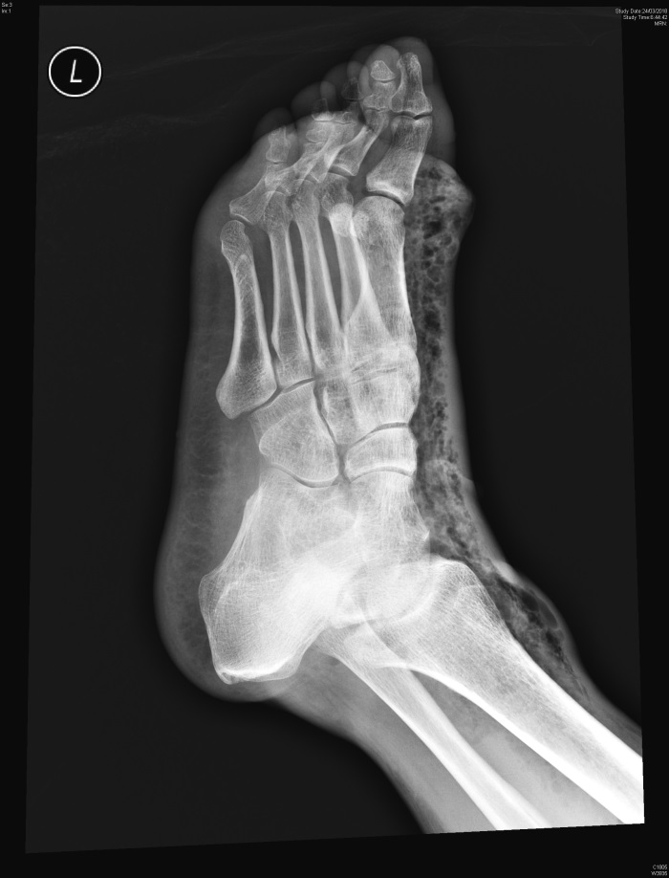
Case 1: M/47, DM/CHF/Epilepsy C/O: L foot swelling for 2/7 with pain and redness BP: 142/59, Pulse: 130, RR: 14, Temp: 38.2˚C, L foot blisters, Hstix: 16.0

Slide 3
What is your x-ray finding? (1 mark): Gas+ underneath skin
What is your diagnosis? (1 mark): Necrotizing fasciitis, Gas forming infections
What is your management? (2 marks): IVF, IV antibiotics, Blood tests: CBP, LRFT, ABG, Glucose, ASOT, Lactate, CRP, CK, Blood/ wound culture
Admit which specialty? (1 mark): O&T

Slide 4
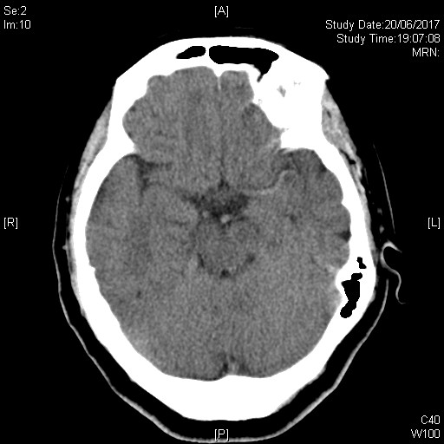
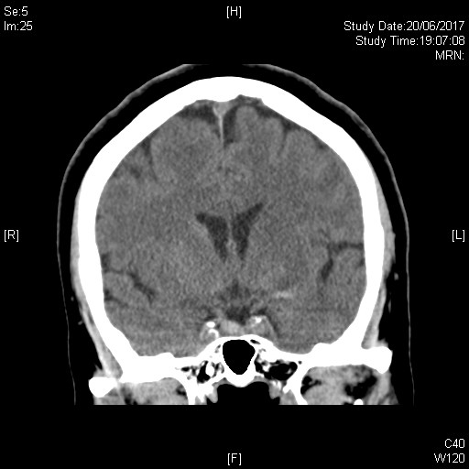
Case 2: F/65, Good past health C/O: Sudden collapse, BP: 211/94, Pulse: 63, Temp: 35.9˚C, GCS: 11/15

Slide 5
What is your x-ray findings? (2 marks): Hyperdense L MCA sign, Blurring of white/grey differentiation of L basal ganglion region
What is your diagnosis? (3 marks): L MCA thrombosis

Slide 6
Case 3: M/49, C/O: Chest discomfort and cough for 4/7, Hx of chest contusion 2/12 BP: 133/86, Pulse: 73, RR: 14, Temp: 36.1°C, SpO2: 97%

Slide 7
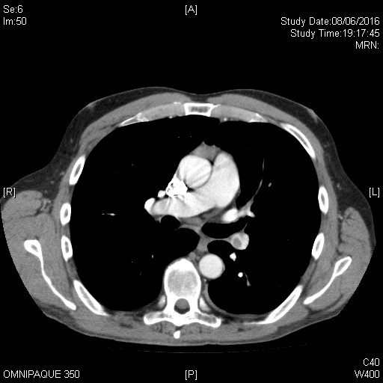
What is your x-ray finding? (1 mark): LLZ wedge opacity, Hampton’s hump
What is your differential diagnosis? (3 marks): infection, contusion, infarct due to pulmonary embolism, (malignancy)
Any further radiological Investigation? (1 mark): Doppler, CT angiogram, Catheter pulmonary angiogram, V/Q scan

Slide 8
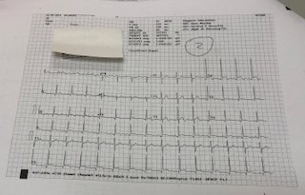
Case 4: M/17, NSND C/O: Chest pain for 1/7, URTI 2-3/7 BP: 134/72, Pulse: 79, RR: 14, Temp: 36.5°C

Slide 9
What is your ECG finding? (2 marks): ST elevation, TWI
What is your differential diagnosis? (1 mark): Pericarditis, (r/o AMI)
What is your management? (2 marks): CBP, ESR, LRFT, TnI, CK, Viral titer, Blood culture, AFB, Autoimmune markers, Echocardiogram, NSAID, ? Steroid

Slide 10
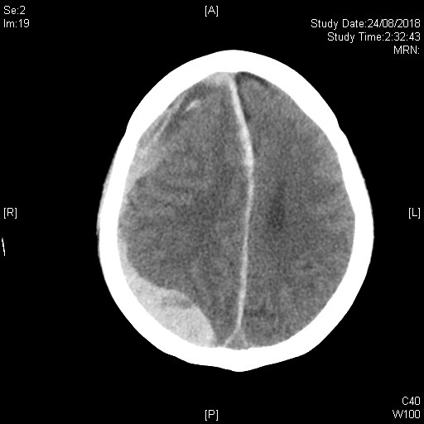
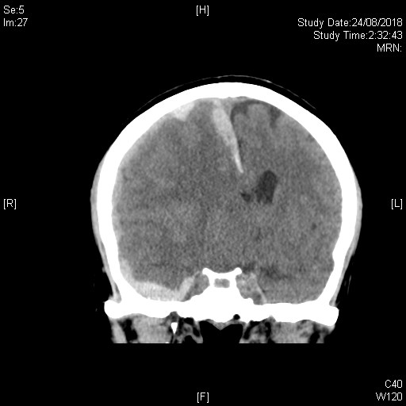
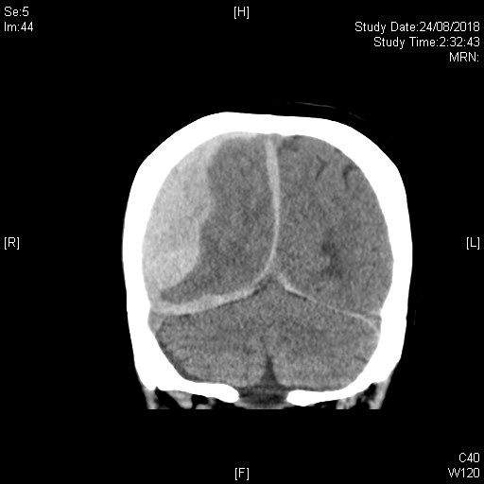
Case 5: F/49, Alcoholic, thrombocytopenia C/O: Dizziness for 2/7, HI+ GCS: 15/15, BP: 135/83, Pulse: 78, RR: 14, Temp: 36.5°C Decreased GCS in AED: 9/15

Slide 11
What is your x-ray finding? (3 marks): Hyperdense collections R cerebral, falx cerebri and bil tentorium cerebelli, midline shift, compressed R lat ventricle
What is your diagnosis? (2 marks): Acute SDH

Slide 12
Case 6: F/60, ESRF/HT/DM C/O: Dizziness and limbs weakness for 2/52 BP: 130/70, Pulse: 54, RR: 14, Temp: 36.0°C, Hstix: 16.9

Slide 13
What is your ECG finding? (2 marks): Tall T, TWI, Bradycardia, ? Heart block, diminished P wave, prolonged PR, widened QRS, ? Sine-wave
What is your diagnosis? (1 mark): Hyperkalemia
What is your management? (2 marks): Ca++ gluconate, NaHCO3, Lasix, Insulin/Dextrose, Ventolin puff, IV Albuterol, Ion-exchange resins, Hemodialysis

Slide 14
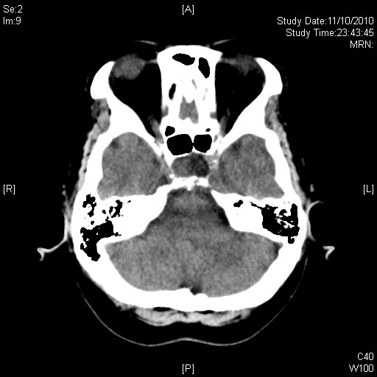
Case 7: F/64, DM/HT C/O: Dizziness for 1/12 GCS: 15/15, BP: 145/93, Pulse: 70, RR: 14, Temp: 36.7°C

Slide 15
What is your x-ray finding? (1 mark): Pituitary mass
What is your diagnosis? (1 mark): Pituitary macroadenoma,
What is your management? (3 marks): Any nipple discharge, Fundi, Visual field, Blood: hormonal tests, MRI

