Slide 1
Joint Clinical Meeting OSCE
07 Nov 2018
KWH

Slide 2
Case 1
10/Boy
PMHx: asthma
Mild URTI symptoms x 1 week
Sudden onset of SOB at home
Increasing in severity
Given ventolin puff at home but no improve
Upon AED arrival
Lethargic, obey command, CR <2 sec
HR 150, SaO2: 98% on non rebreathing mask
RR:44-50
Chest: poor AE with expiratory wheeze

Slide 3
Case 1 (Questions)
How do you classify the severity of acute exacerbation of asthma?
What is the severity of this patient?
What is the management plan?
If you decided to intubate the patient, what induction agent you would use?
What ventilation strategy would be use in the patient?

Slide 4
Case 1 (Answer)
How do you classify the severity of acute exacerbation of asthma? What is the severity of this patient?
The severity of asthma can be classified into
Mild: SOB when walking, SaO2 >95%, no respiratory distress
Moderate: SOB at rest, Sao2 >92%, PER >50%, talk in full sentence
Severe: SaO2 <92% PER <50%, use of accessory muscle, HR>130, RR>50, too breathless to talk
Life-threatening: SAO2<92%, PER <33%, cyanosis, altered mental, silent chest, poor respiratory effort
The patient is in severe exacerbation of asthma and progressing to life-threatening asthma

Slide 5
Case 1 (Answer)
What is the management plan?
Goal of management:
Rapid reversal of airflow obstruction – bronchodilator/steroid
Correction of hypoxemia – O₂
Manage in resuscitation room
Monitoring of respiratory rate, heart rate, oxygen saturation, degree of alertness with regular reassessment
ABG CXR
O₂
Medication:
Bronchodilator (Ventolin) nebulized or inhaler
Steroid – methylprednisolone 1 to 2 mg/kg
magnesium sulfate - (75 mg/kg, maximum 2.5 g administered over 20 minutes if still no improvement
Obvious respiratory distress that the clinician judges to be unsustainable require prompt intubation

Slide 6
Case 1 (Answer)
If you decided to intubate the patient, what induction agent you would use?
Induction agent:
ketamine (bronchodilation) 1-2 mg/kg
What ventilation strategy would be use in the patient?
Permissive hypercarbia to avoid barotrauma/auto-Peep
Ventilator setting:
small vital volume: 6ml/kg
low RR: 8-10/minute
Longer I:E ratio 1:4-5
Peep: 0

Slide 7
Case 2
62/M
History of ESRF, thyrotoxicosis with recently thyroidectomy done
C/O dizziness, both hands and feet numbness and generalized weakness
Muscle spasm and twitching, brisk reflexes
Chest/CVS/Abdomen: NAD

Slide 8
Case 2

Slide 9
Case 2 (Questions)
What is the provisional diagnosis?
What further examinations and investigations you would like to do?
From the ECG, what do you worry about?
How do you manage this patient?

Slide 10
Case 2 (Answer)
What is the provisional diagnosis?
Hypocalcaemia related to recent thyroidectomy
What further examinations and investigations you would like to do?
Physical examination
Trousseau's sign — the induction of carpopedal spasm by inflation of a sphygmomanometer above systolic blood pressure for three minutes
Chvostek's sign — contraction of the ipsilateral facial muscles elicited by tapping the facial nerve just anterior to the ear
Laboratory test to confirm Hypocalcaemia
Calcium corrected with serum albumin
Corrected Ca²⁺ = Measured Ca²⁺ + (40-albumin)/40
Ionized calcium
Additional test: Magnesium, parathyroid hormone, phosphate

Slide 11
Case 2

Slide 12
Case 2 (Answer)
From the ECG, what do you worry about?
Prolong QTc
Torsade's de pointes can potentially be triggered
How do you manage this patient?
Put on close monitoring (cardiac monitor, vital signs)
IV Calcium is indicate in following condition
1. Symptoms (carpopedal spasm, tetany, seizures)
2. A prolonged QT interval
3. In asymptomatic patients with an acute decrease in serum corrected calcium to ≤ 1.9 mmol/L
IV calcium 1 or 2 g of calcium gluconate/chloride, infused over 10 to 20 minutes

Slide 13
Case 3
22/M
Good past health
vomiting then collapsed at home
taken unknown med, unknown time of ingestion
arrived at your emergency department with the following vital signs:
Temp 37
BP 120/70
P 100 in sinus rhythm
RR 14
SaO2 98% on non-breathing mask
GCS 3/15 with pin-point pupils

Slide 14
Case 3
What is the initial management plan?
After the initial management in 1, the ECG suddenly changed.
Please describe the ECG
What is the subsequent management?

Slide 15
Case 3
The AXR showed radio-opaque substance in stomach.
Please list 3 drugs are radiopaque on x-ray.
What is the likely drug in this patient?

Slide 16
Case 3 (Answer)
What is the initial management plan?
Airway, Breathing : assess the airway patency, provide oxygen consider to intubate this patient in term of low GCS and history of vomiting
Circulation: IV assess, IVF
Continuous monitor: BP/P, SaO2, cardiac monitor
Ix:
H’stix
ECG – rhythm, rate, QT, QRS complex
CXR - pulmonary edema or pneumonitis
ABG - confirm hypoxia, metabolic acidosis
R/LFT -
urinalysis – proteinuria, myoglobin
Decontamination: nil, unknown drug and time of ingestion
Antidote: nil, unknown drug

Slide 17
Case 3 (Answer)
After the management in 1, the ECG suddenly changed.
Please describe the ECG
Polymorphic ventricular rhythm
the QRS complexes “twist” around the isoelectric line
Torsade's de pointes rhythm

Slide 18
Case 3 (Answer)
What is the subsequent management?
Assess the pulse
No pulse – defibrillation
Pulse with lowish BP or no BP – cardioversion
Heamodynamically stable –
Magnesium – IV MgSO4 first-line therapy, being highly effective for both the treatment and prevention, 2g over 1 min
Isoproterenol – Isoproterenol, 2 mcg/min in adults, titrated to achieve a heart rate of 100 beats per minute
Correct the underlying electrolyte abnormality if any

Slide 19
Case 3 (Answer)
The AXR showed radio-opaque substance in stomach.
Please list 3 drugs are radiopaque on x-ray.
the mnemonic CHIPES:
C - Calcium Carbonate, chloral hydrate
H - Heavy metals – mercury, lead
I - Iron and Iodine
P - Phenothiazines (includes antipsychotics like chlorpromazine (thorazine) and antiemetics like prochlorperazine (compazine))
E - Enteric coated pills
S - Solvents [halogenated ones like chloroform]
What is the likely drug in this patient?
chloral hydrate (ventricular arrhythmia and coma)

Slide 20
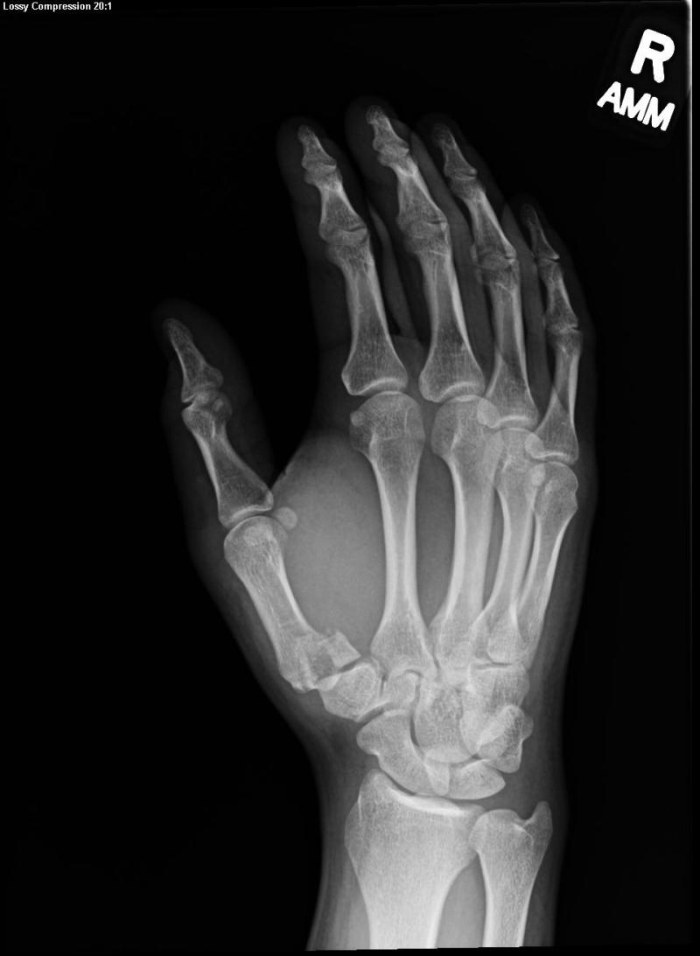
Case 4
27 Male
Complained of right
thumb pain when
practicing boxing

Slide 21
Case 4
Please describes the x-ray finding
What is the named of the fracture?
What is the common mechanism of injury?
What is the management plan?

Slide 22
Case 4 (answer)
Please describes the x-ray finding.
displaced fracture involving the articular surface of the base of the right thumb metacarpal.
subluxed carpo-metacarpal joint
What is the named of the fracture?
Bennett fracture

Slide 23
Case 4 (answer)
What is the common mechanism of injury?
The common injury mechanism is an axial loading onto a flexed thumb metacarpal joint

Slide 24
Case 4 (answer)
What is the management plan?
Analgesics e.g. NSAID
Immobilization e.g. thumb Spica
early orthopedics referral for definitive treatment
closed reduction alone is unlikely to be successful as CMC stability is compromised by the pull of APL
closed reduction with K-wire fixation
open reduction and internal fixation

