Slide 1
OSCE Question
PWH AED
8 July 2015

Slide 2
Question 1
50/M
History of DM on insulin
Attended AED for progressive increase in pain in the floor of the mouth, difficulty and painful swallowing for few days. His voice was muffled. No stridor
Vital sign: BP 156/95 mmHg; Pulse 102/min; SpO2 100 at 2L n.c.
Temperature: 38.2 degree celsus

Slide 3
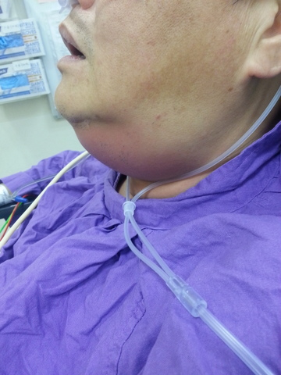

Slide 5
Contrast CT neck

Slide 6
Question 1
1a. Describe the findings in the X-ray
1b. What is your diagnosis?
1c. Describe any 2 physical signs on examination that may suggestive of the diagnosis in 1b
1d. What is the common cause/origin of this condition?
1e. Describe the CT findings
1f. What is the most important potential complication in this condition?
1g. Outline the management in AED and disposition

Slide 7
Question 2
50/F. History of HT, DM default FU for 3 months
Complained of left loin and back pain for 3 weeks Persistent, radiates to buttock, aggravated by left leg movement. Fever+ Chills+ for 1 week
T 39'C BP 110/80 P 90
Bedside glucose 18
Urine multistix rbc 1+, wcc 1+, nitrate –ve, ketone –ve
PT -ve

Slide 9
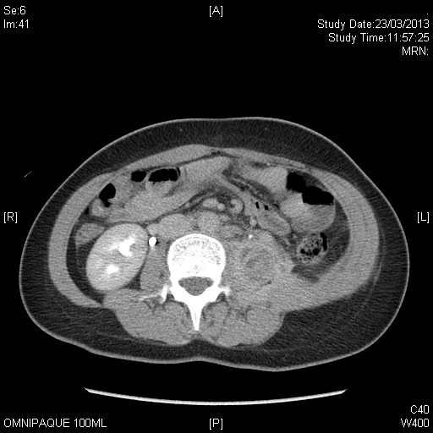
Contrast CT abdomen

Slide 10
2a. Suggest 3 differential diagnosis of fever and left back pain
2b. Patient persistently kept her left hip in flexion posture. Pain was elicited when attempt to passively extend her left hip. What is the name of the physical sign being demonstrated?
2c. Describe the KUB findings
2d. Describe the findings in the CT abdomen
2e. Outline subsequent management plan for this patient

Slide 11
Question 3
25/M
Episodic palpitation for few years
No associated with chest pain

Slide 12
ECG 1 (Asymptomatic)

Slide 13
ECG 2

Slide 14
3a. List TWO abnormalities in the ECG 1
3b. What is the diagnosis and what cause this problem?
3c. Patient suddenly develop an arrhythmia (ECG2), describe the ECG findings and what is the diagnosis?
3d. Your colleague suggest to try iv 5mg verapamil to treat the condition in ECG 2. What is your opinion? What is the treatment option for this arrhythmia?
3e. Beside the arrhythmia showed in ECG 2. Name another 2 arrhythmias that could occur in the medical condition in question 3b
3g. After the arrhythmia settled and stabilized. What is definitive treatment for this patient to prevent arrhythmia in future?

Slide 15
Question 4
59/F. History of DM, HT, hyperlipidaemia
Current medication: Metformin, diamicron, atenolol, lisinopril, simvastatin
Tightness in her throat and lip swelling while sleeping in the middle of night
No skin rash or itchiness
Vital sign BP 138/77, pulse 80/min, SpO2 98 RA
Patient revealed she had 2 episodes of similar lip swelling in recent 2 month

Slide 17
Question 4
4a. What is the diagnosis?
4b. What medication she currently taking could account for her recurrent attack of the condition?
4c. The condition is now confirmed due to the medication mentioned in 4b. The patient had received iv antihistamine and hydrocortisone, imi epinephrine but lack of response. What is the reason? Name the mediator involved in that condition
4d. Outline the management plan
4e. Name 1 specific therapies that may be helpful in severe and progressing symptoms.

Slide 18
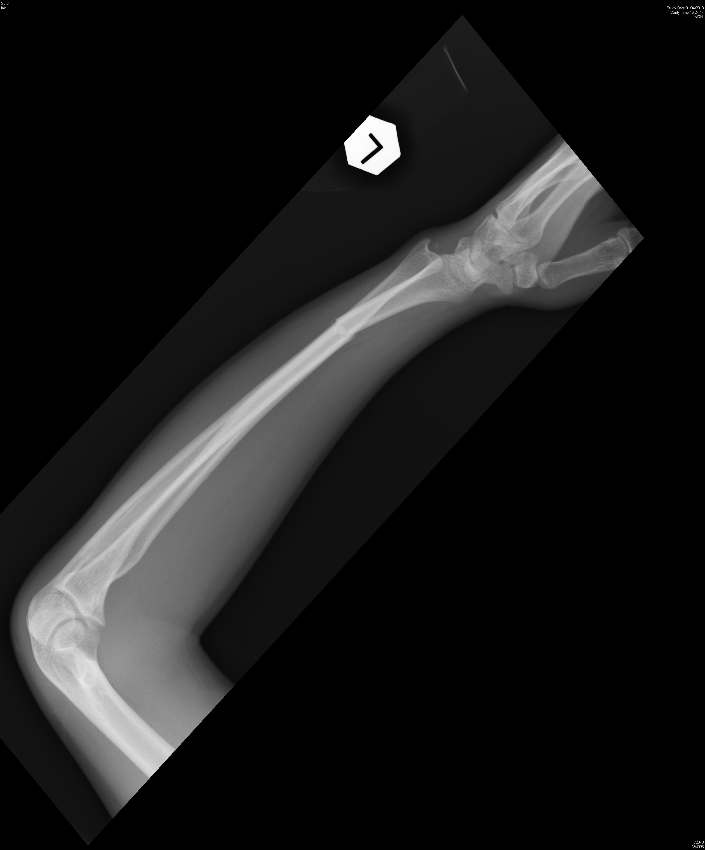
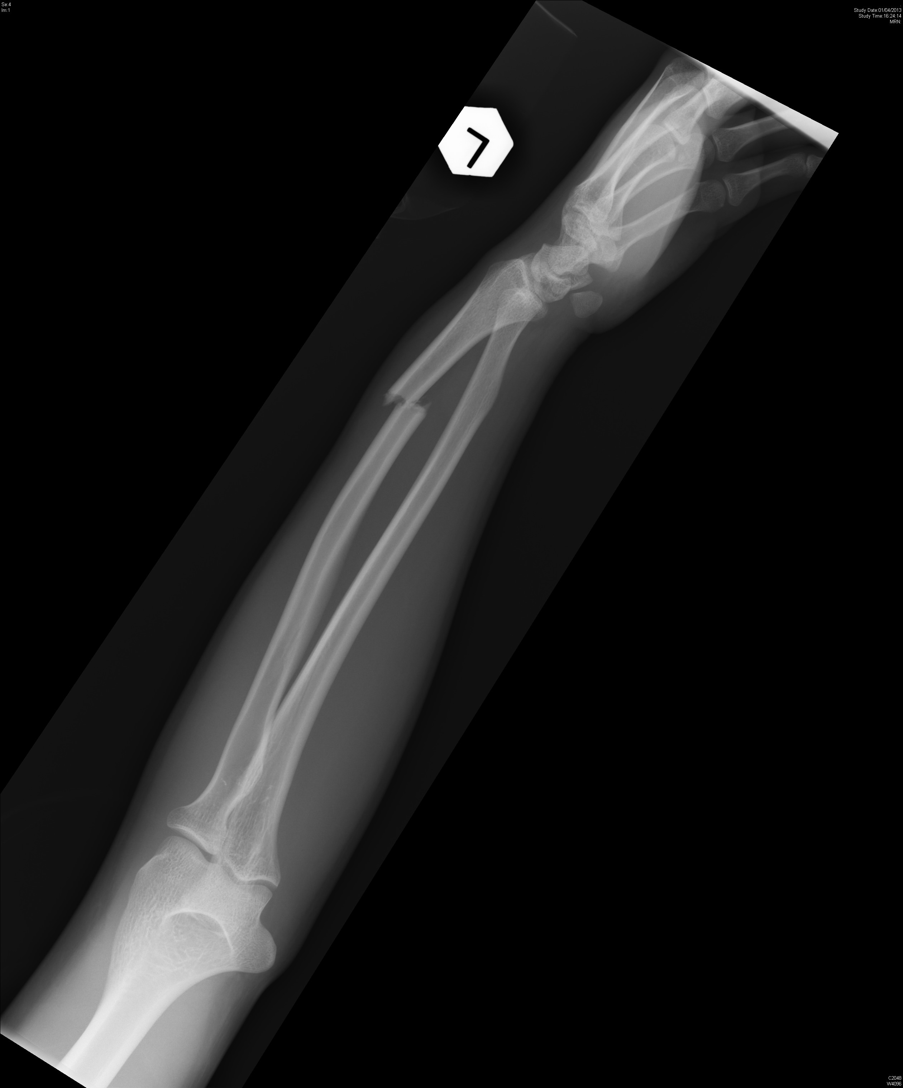
Question 5a. 20/M fell on left outstretched hand during football game. No external wound. What is the diagnosis and management?

Slide 19
Question 5b.
31/M
Body building trainer. Tripped and fell with right hand hit onto ground
Right hand pain. Swelling over dorsum of right hand. No external wound
X-ray right hand taken. What is the diagnosis and definitive management?

Slide 20
