Slide 1
OSCE JCM 2-2016
YCH AED

Slide 2
Q1 A 20 years old man presented with syncope today. Also fever, running nose and cough for 2 days

Slide 3
A.What are the ECG findings?
Coved ST segment elevation >2mm in >1 of V1-V2 followed by a negative T wave
B.What is the diagnosis?
Brugada type 1

Slide 4
C. What are the other clinical criteria to make the diagnosis?
Documented ventricular fibrillation (VF) or polymorphic ventricular tachycardia (VT)
Family history of sudden cardiac death at <45 years old
Coved-type ECGs in family members
Inducibility of VT with programmed electrical stimulation
Syncope
Nocturnal agonal respiration

Slide 5
D.What is the definitive treatment?
Implantable cardioverter defibillator (ICD)
E.The ECG record (few weeks ago) has no abnormality detected, why ?
ECG changes can be transient with Brugada syndrome
can also be unmasked or augmented by multiple factors:
Fever
Ischaemia
Drugs
Sodium channel blockers eg: Flecainide, Propafenone
Calcium channel blockers
Alpha agonists
Beta Blockers
Nitrates
Cholinergic stimulation
Cocaine
Alcohol
Hypokalaemia
Hypothermia
Post DC cardioversion

Slide 6
Q2.A 51 man presented with retrosternal chest pain for 2 hours BP 176/115 P 130

Slide 7
What are the ECG findings?
Sinus tachycardia, STE over lead aVR, widespread STD ( inferior leads, V4-6)
What are the DDx?
Left main coronary artery (LMCA)
proximal LAD occlusion
Severe triple vessels disease
Where is the lesion?
Likely LMCA (STE over aVR > V1 )
What is the preferred treatment?
Emergency angiography +/- CABG

Slide 8
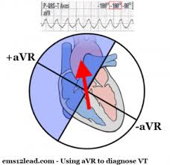
What aVR tell us ?
Lead aVR
right upper portion of the heart
right ventricular outflow tract
the basal portion of the interventricular septum
Lead aVR
electrically opposite to the left-sided leads I, II, aVL and V4-6
ST depression in these leads will produce reciprocal ST elevation in aVR

Slide 9
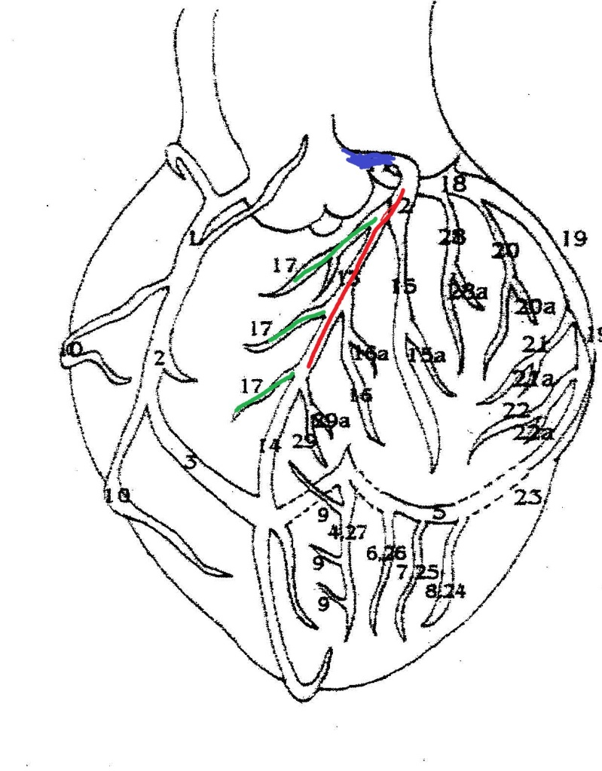
Mechanism of STE in aVR
Diffuse subendocardial ischaemia
(producing reciprocal change in aVR)
Transmural ischaemia / infarction of the basal interventricular septum
(e.g. due to a proximal occlusion within the left coronary system)

Slide 10
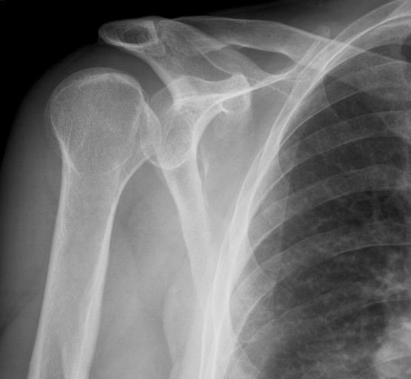
Q3 A 30 years old man fall on level ground

Slide 11
What are the x ray findings and diagnosis?
Light bulb sign
Posterior shoulder dislocation
What other images would you order to confirm your diagnosis?
Axillary view
Scapula Y view
What past medical history the patient may has?
Epilepsy
What is the treatment?
Close reduction under sedation / GA
Traction and counter traction

Slide 12
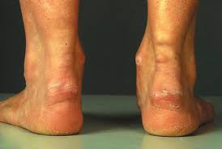
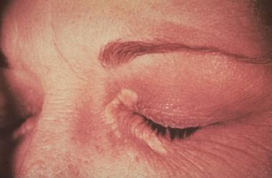
Q4 A 30 years old woman presented with heel pain and lumps over eyes for few months

Slide 13
What are the clinical findings?
Xanthoma over Achilles tendon and eyelids
What is the diagnosis?
Familial Hypercholesterolemia
What other investigation(s) would you order to confirm your diagnosis?
Fasting lipid profile

Slide 14
Q5 A 13 years old Pakistan girl with history of coeliac disease and default follow up. She presented with both knee pain for few months

Slide 15
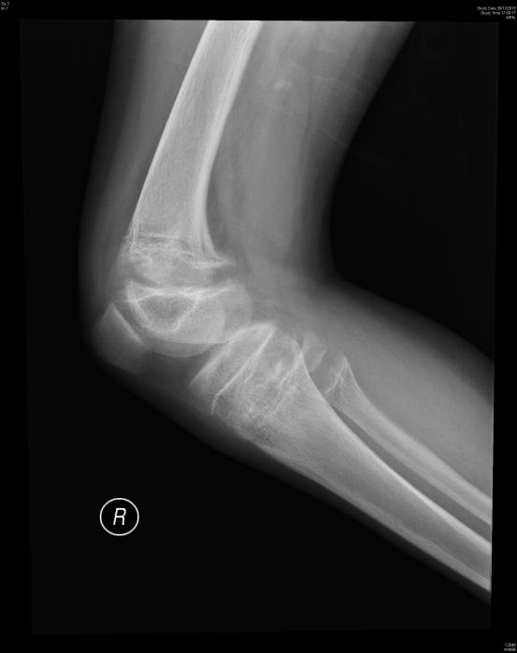
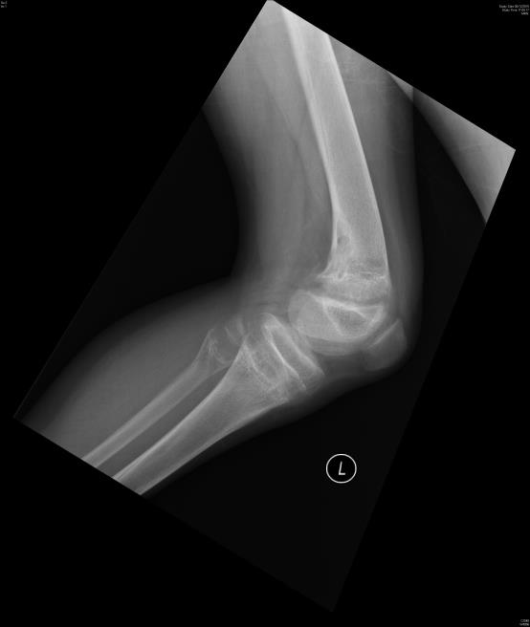

Slide 17
What are the x ray findings?
Bone cyst over left distal femur
Widening of growth plate of the long bone
Mild cupping and splaying of the metaphysis of tibia , fibula and distal femur bilaterally
What is the diagnosis?
rickets

Slide 21
What other investigation(s) would you order to confirm your diagnosis?
Vit D level
What is the cause of the disease in this patient?
Coeliac disease causing malabsorption

Slide 23
End

