Slide 1
OSCE Answers
Hong Kong College of Emergency Medicine
Joint Didactic Meeting 2/9/2015
Department of Accident and Emergency Princess Margaret Hospital
JCM 2/9/2015

Slide 2
Case 1

Slide 3
Case 1
A 71-year-old lady presented with left sided throat pain after fish bone ingestion.
She had attempted self induced vomiting but failed.
Afebrile, BP127/66 P79
Throat: congested
Chest clear
DL: No foreign body seen

Slide 5
Questions
What is the abnormality? (1 mark)
Name one clinical sign you would look for (1 mark)
List two causes for the above condition (2 marks)
Name 2 investigations that are helpful (2 marks)

Slide 6
What is shown on the CT film? (1 mark)
List 3 potential complications. (3 marks)

Slide 7
Answers to Case 1

Slide 8
What is the abnormality? (1 mark)
Gas in retropharyngeal space
Potential space in neck, bound by
Superior: skull base
Inferior: fascial layers at T2
Anterior: buccopharyngeal fascia
posterior: alar fascia, a poor barrier that separates this space from prevertebral space, which continues into posterior mediastinum

Slide 9
Name one clinical sign you would look for (1 mark)
Surgical emphysema in neck

Slide 10
List two causes for the above condition (2 marks)
Traumatic – Ruptured oesophagus
Infection – Retropharyngeal abscess
Gas in retropharyngeal space can come from
Viscus: esophageal rupture, pneumomediastinum, pneumothorax, lung contusion
Due to trauma, FB, vomiting
Gas forming organisms, polymicrobial with anaerobes and aerobes, infection from
Tonsils, pharynx
Foreign body
Iatrogenic e.g. dental procedures

Slide 11
Name 2 investigations that are helpful (2 marks)
CT neck
Gastrografin swallow

Slide 12
What is shown on the CT film? (1 mark)
Surgical emphysema along pre-vertebral plane extending into superior mediastinum

Slide 13
List 3 potential complications. (3 marks)
Airway obstruction
Mediastinitis, Pneumonia, Intrathoracic abscesses
Osteomyelitis, cranial nerve palsies, epidural abscesses
Sepsis
Jugular vein thrombosis

Slide 14
Case 2

Slide 15
Case 2
M/52 Smoker, History of DM, HT
Attended AED for vomiting undigested food after dinner
Multiple similar episodes
No other GI symptoms
T36.7C BP 105/83 P105, mild dehydration
No pallor, jaundice or palpable cervical lymph nodes
No peritoneal signs or definite abdominal masses
H’stix 5.2

Slide 17
Questions
Describe the X-ray finding (1 mark)
What is the diagnosis (1 mark)
What particular physical sign will you look for? (1 mark) How would you illicit the sign? (1 mark)
What are the causes of this condition? (4 marks)
Describe the electrolyte disturbances if this condition persists (4 marks)
Outline the management in AED and disposition (3 marks)

Slide 18
Answers

Slide 19
Describe the X-ray finding (1 mark)
Grossly dilated stomach with retained food substances
Bowels displaced to periphery especially to right flank
Absence of bowel air may also be seen in GOO

Slide 20
What is your diagnosis (1 mark)
The clinical picture suggests gastric outlet obstruction

Slide 21
What other physical sign will you look for? (1 mark) How would you illicit the sign? (1 mark)
The succussion splash
Audible when we shake patient’s abdomen, stethoscope may be used to facilitate detection of the splash sound

Slide 22
What are the causes of this condition? (4 marks)
Functional (autonomic neuropathy): DM, Parkinson disease (1mark)
Mechanical causes can be divided into luminal, mural, extrinsic causes
Luminal (1mark for any one)
Bezoar stones
Gallstone obstruction (Bouveret syndrome)
Mural (1mark for any one)
Strictures, underlying causes includes peptic ulcers, caustic ingestion, Crohn’s disease
Tumours (benign or malignant including pancreatic tumours, ampullary cancer)
TB
Iatrogenic (e.g. slipped gastric banding, strictures from anastomoses)
Extrinsic (1mark for any one)
Pancreatic pseudocyst
Lymphoma, metastasis
Notes:
Bouveret syndrome is a very uncommon form of gallstone ileus caused by the passage and impaction of a large gallstone through a cholecystoduodenal fistula into the duodenum, resulting in gastric outlet obstruction. It was first described in 1770 by Beaussier
For hypertrophic pyloric stenosis in paediatrics:
Typically male, age 2-8 weeks, visible peristaltic wave, epigastric “olive” mass found in 80% patients

Slide 23
Describe the electrolyte disturbances if this condition persists (4 marks)
The underlying metabolic disturbance is hypokalemic hypochloremic metabolic alkalosis (3 marks)
The patient will also produce paradoxical aciduria (1 mark)

Slide 24
Notes
There is loss of HCl via vomiting. It renders the patient hypochloraemic
Loss of chloride increases bicarbonate production, together with loss of acid, causes metabolic alkalosis
Hypokalemia is secondary to
loss from vomiting, and
Loss via Na/K exchanger in kidney after K+ ion shifts out from cell due to alkalosis

Slide 25
Notes
Paradoxical aciduria is explained by the kidneys prioritize volume preservation by RAA system activation, hence
Na exchange with H+, thus further H+ loss
(aggravating alkalosis and potassium loss)
The urine appears paradoxically acidic in an alkalotic patient.

Slide 26
Outline the management in AED and disposition (3 marks)
Fluid replacement with potassium supplementation
Fluid resuscitation will allow body correct the alkalosis
The stomach should be emptied by gastric tube to prevent further vomiting and aspiration
The patient should then be admitted to surgical department for further investigations

Slide 27
Case 3

Slide 28
Case 3
M/66 longstanding back pain
Taxi driver, sprained neck when hit by private car from behind in front of a traffic light in street
Exact speed unknown, seat belt on
He complained of severe neck pain
Physical exam showed severe mid-cervical tenderness
4 limbs power full

Slide 29
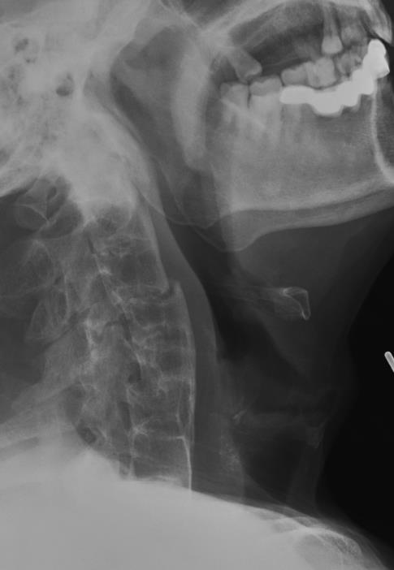
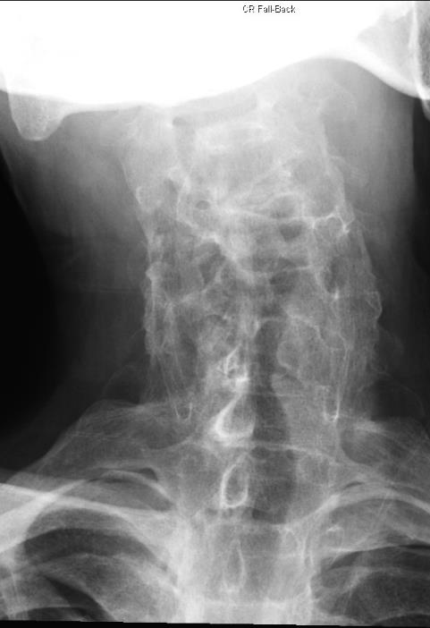

Slide 30
Questions
Describe the injury (3 marks)
Describe the other XR abnormalities (3 marks)
What is the management in AED? (3 marks)
What further investigation will you perform? (2 marks)

Slide 31
You have obtained the MRI images of this patient
Describe the MRI findings (3 marks)

Slide 32
Answers

Slide 33
Describe the injury (3 marks)
C1 to inferior plate of C7 visible
Anterior translocation of C4 and C5 relative to both upper and lower vertebrae
Disruption of the calcified anterior longitudinal ligament over C3/4
Possible transverse fracture of inferior facet joint of C3
Overall, there is acute transdiscal fracture over C3/4 IVD with anterior displacement of the vertebral column

Slide 34
Notes
It is difficult to determine whether the facet joint disruption is unilateral or bilateral from these X-ray films
C5 is also displaced anteriorly over C6
Likely old injury as C5/6 fusion is seen
The opacified ALL is not disrupted

Slide 35
Describe other XR abnormalities (3 marks)
In addition to the injury, underlying ankylosing spondylitis is seen, as evidenced by
Sclerosis of superior and inferior margins of vertebral bodies (Romanus lesion)
Extensive syndesmophytes formation, bridged, resulting in a bamboo spine appearance
Opacification of the anterior longitudinal ligament

Slide 36
What is the management & disposition in AED? (3 marks)
The patient must be given a rigid neck collar
Log-roll maneuver must be observed during turning
He should be given adequate pain control
Admit the patient to Department of O&T

Slide 37
What further investigation will you perform? (2 marks)
Plain CT scan of C-spine
MRI scan of spinal cord

Slide 38
Describe the MRI findings (3 marks)
There is anterior translocation of C4/5
Narrowing of spinal canal
Impingement on spinal cord
No acute hematoma seen
No acute cord edema seen on T2 sequence

Slide 39
Notes
The patient probably has no acute cord transection
However there can still be cord damages due to spinal shock, cord infarction
The fracture is unstable and the patient is at high risk of cord injury
The normal diameter of the cervical spinal canal is around 17 mm.
The average diameter of the spinal cord in the C-spine is 10 mm
10 mm to 13 mm is likely to cause symptoms
<10mm is clearly stenosis
No clear consensus on radiological criteria for diagnosis of spinal stenosis

Slide 40
More on spinal injuries of AS patients
55% cervical, 32% thoracic, 13% lumbar
Hyperextension was the most common mechanism
C6-7 most commonly injured
Fractures through disc space was most common (37% of C-spine fractures)
Cervical fractures are mostly likely associated with spinal cord injuries (75% in the series)
Troy Caron, DO, Spine Fractures in Patients with Ankylosing Spinal Disorders; SPINE, vol 25, 2010

Slide 41
Case 4

Slide 42
Case 4
M/37
Attended AED for palpitation for one hour.
No chest pain or syncope.
Afebrile, BP135/94 mmHg
An ECG has been performed.

Slide 44
Questions
Describe the ECG findings (4 marks)
List four ECG features which favour a diagnosis of VT rather than an SVT with aberrancy (4 marks)
What is the diagnosis? (1 mark)
What is the drug of choice to treat this arrhythmia? (1 mark)
Where does this arrhythmia arise from anatomically? (1 mark)

Slide 45
Answers

Slide 46
Describe the ECG findings (4 marks)
Wide complex tachycardia at about 180/min
Superior (or left axis) deviation (-90 degrees)
QRS interval 140ms
RBBB morphology (RSR’ in V1 and V2)

Slide 47
List four ECG features which favour a diagnosis of VT rather than an SVT with aberrancy (4 marks)
Absence of typical RBBB or LBBB morphology
Extreme axis deviation
Very broad complexes (QRS complex >160ms)
AV dissociation (P and QRS complexes at different rates)
Presence of capture beats
Presence of fusion beats
Positive or negative concordance throughout the precordial leads
Brugada’s sign – the distance from the onset of the QRS complex to the nadir of the S-wave is > 100ms
Josephson’s sign – notching near the nadir of the S-wave
RSR’ complexes with taller first R peak (R) than the second R peak (R1)

Slide 48
What is the diagnosis? (1 mark)
Fascicular VT

Slide 49
What is the drug of choice to treat this arrhythmia? (1 mark)
Verapamil

Slide 50
Where does this arrhythmia arise from anatomically? (1 mark)
Left ventricle (usually from an ectopic focus in the posterior fascicle of the left bundle branch)

Slide 51
Case 5

Slide 52
Case 5
F/74 OAHR, Hx of CRHD, MS, CHF
Brought to AED for abdominal pain and repeated vomiting.
T38.4C BP93/60 P127 Dehydrated
Abdomen: Mildly distended

Slide 54
Questions
What is the abnormality? (1 mark)
What are the initial management steps? (3 marks)
What investigation would you perform? (1 mark)

Slide 55
What is the diagnosis? (1 mark)
What are the risk factors? (2 marks)
What is the classical sign for this condition? (1 mark)

Slide 56
Answers

Slide 57
What is the abnormality? (1 mark)
Dilated small bowel loops
No dilated large bowel noted, signifying small bowel obstruction

Slide 58
What are the initial management steps? (3 marks)
Patient should be kept nil by mouth
Ryle’s tube insertion to decompress the GI tract and reduce vomiting
Rehydration with IVF
As she is dehydrated, running a low blood pressure and fever

Slide 59
What investigation would you perform? (1 mark)
CT abdomen and pelvis with contrast
In virgin abdomen, causes of SBIO are commonly
hernia, extrinsic compression from peritoneal deposits, congenital adhesions (not likely for an old lady)
luminal causes are FB, bezoar, food bolus (esp. for elderly)
In the wall, there can be tumour at ICV, SB tumours are uncommon; strictures due to Crohn's disease are also possible
Otherwise, SBIO are commonly caused by adhesions
Don’t forget functional causes e.g. sepsis, electrolyte problems

Slide 60
What is the diagnosis? (1 mark)
Left obturator hernia causing small bowel obstruction

Slide 61
What are the risk factors? (2 marks)
Elderly female
Thin body build/recent weight loss
Notes
Obturator hernias are a rare type of hernia. They are more commonly right sided, but can be bilateral.
Women with wider obturator foramen is at risk.
Risk is higher in elderly, malnourished ladies and in the setting of weight loss as the peritoneal fat is loss.
The hernia sac usually contains SB, but LB, omentum, appendix or fallopian tube, omentum is possible.
The diagnosis is usually made on CT scan or intraoperatively.

Slide 62
What is the classical sign for this condition? (1 mark)
Howship-Romberg sign
It is pain over medial thigh aggravated by hip extension, abduction and internal rotation
Notes
Clinically, it can present as obturator neuralgia (groin pain radiating medially to the knee) ← compression of the obturator nerve
Rarely there may be palpable proximal thigh mass (confused with femoral hernias), or ecchymosis of the thigh if bowel necrosis has occurred

Slide 63
Case 6

Slide 64
Case 6
M/53 Good past health
Brought to AED after his face caught fire in the early morning when he opened up a lid of the pot which was left cooking overnight in kitchen.
BP125/86 P110 SpO2 100% (100% O2 from ambulance)
The plastic surgeon of burn unit agreed to take over the patient.

Slide 65
Questions
List four risk factors that are associated with inhalation injury (4 marks)
How would you secure the airway of the patient prior to transfer? (1 mark)
Name one advantage and disadvantage of this method (2 marks)

Slide 66
Below is a still image obtained while securing the airway of the patient, describe the image (1 mark)
How would you secure the airway if the method you mentioned earlier is not available? (3 mark)

Slide 67
Answers

Slide 68
List four risk factors that are associated with inhalation injury (4 marks)
History
Exposure to a fire or heavy smoke
Confinement in a burning environment
History of loss of consciousness
Physical examination
Facial and/or neck burns
Singed nasal vibrissae and eyebrows
Hoarseness
Stridor
Wheezing
Tachypnoea
Carbonaceous sputum
Soot particles in oropharynx

Slide 69
How would you secure the airway prior to transfer? (1 mark)
Awake fiberoptic intubation technique

Slide 70
Name one advantage and disadvantage of this method (2 marks)
Pros
Considered as the gold standard in the management of an anticipated difficult airway
No (or minimal) risk of losing the airway
Cons
Technically demanding procedure – expertise may not be available in the emergency department
Patient co-operation is required
Prolonged time to intubation as compared to other methods

Slide 71
Describe the image (1 mark)
Soot particles over pharynx and larynx
Swollen epiglottis and glottis

Slide 72
How would you secure the airway if the method you mentioned earlier is not available? (3 mark)
To secure a difficult airway, possible options include
Intubation
Awake intubation with direct laryngoscope
Awake intubation with video laryngoscope
Surgical airway
Percutaneous or needle cricothyroidotomy
+Awake surgical tracheostomy
Call for help from including seniors, anaesthetists, ICU, surgeons
Notes
You may consider intubation with rapid sequence intubation in this case since the airway is still patent despite the edema
+Not feasible if urgent airway control needed

Slide 73
Credits
Thanks to Dr. T. L. Hui, Dr. William C. L. Wong, Dr. K. Y. Lung, Dr. Jerome L. T. So

