Slide 1
OSCE Questions
Hong Kong College of Emergency Medicine
Joint Didactic Meeting 2/9/2015
Department of Accident and Emergency Princess Margaret Hospital
JCM 2/9/2015

Slide 2
Case 1

Slide 3
Case 1
A 71-year-old lady presented with left sided throat pain after fish bone ingestion.
She had attempted self induced vomiting but failed.
Afebrile, BP127/66 P79
Throat: congested
Chest clear
DL: No foreign body seen

Slide 5
Questions
What is the abnormality? (1 mark)
Name one clinical sign you would look for (1 mark)
List two causes for the above condition (2 marks)
Name 2 investigations that are helpful (2 marks)

Slide 6
What is shown on the CT film? (1 mark)
List 3 potential complications. (3 marks)

Slide 7
Case 2

Slide 8
Case 2
M/52 Smoker, History of DM, HT
Attended AED for vomiting undigested food after dinner
Multiple similar episodes
No other GI symptoms
T36.7C BP 105/83 P105, mild dehydration
No pallor, jaundice or palpable cervical lymph nodes
No peritoneal signs or definite abdominal masses
H’stix 5.2

Slide 10
Questions
Describe the X-ray finding (1 mark)
What is the diagnosis (1 mark)
What particular physical sign will you look for? (1 mark) How would you illicit the sign? (1 mark)
What are the causes of this condition? (4 marks)
Describe the electrolyte disturbances if this condition persists (4 marks)
Outline the management in AED and disposition (3 marks)

Slide 11
Case 3

Slide 12
Case 3
M/66 longstanding back pain
Taxi driver, sprained neck when hit by private car from behind in front of a traffic light in street
Exact speed unknown, seat belt on
He complained of severe neck pain
Physical exam showed severe mid-cervical tenderness
4 limbs power full

Slide 13
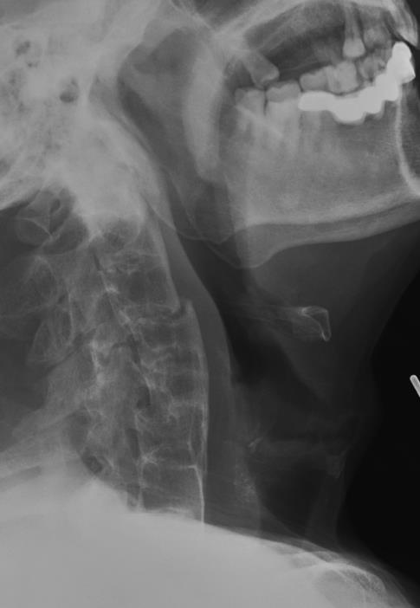
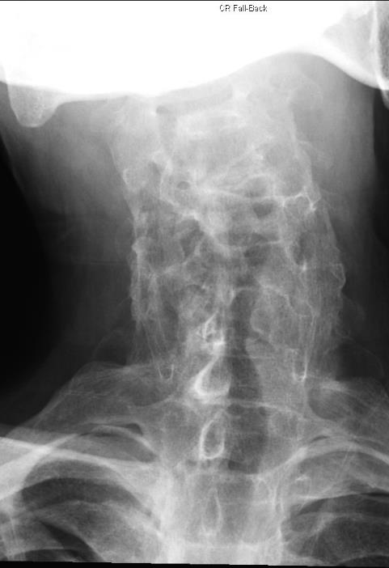

Slide 14
Questions
Describe the injury (3 marks)
Describe the other XR abnormalities (3 marks)
What is the management in AED? (3 marks)
What further investigation will you perform? (2 marks)

Slide 15
You have obtained the MRI images of this patient
Describe the MRI findings (3 marks)

Slide 16
Case 4

Slide 17
Case 4
M/37
Attended AED for palpitation for one hour.
No chest pain or syncope.
Afebrile, BP135/94 mmHg
An ECG has been performed.

Slide 19
Questions
Describe the ECG findings (4 marks)
List four ECG features which favour a diagnosis of VT rather than an SVT with aberrancy (4 marks)
What is the diagnosis? (1 mark)
What is the drug of choice to treat this arrhythmia? (1 mark)
Where does this arrhythmia arise from anatomically? (1 mark)

Slide 20
Case 5

Slide 21
Case 5
F/74 OAHR, Hx of CRHD, MS, CHF
Brought to AED for abdominal pain and repeated vomiting.
T38.4C BP93/60 P127 Dehydrated
Abdomen: Mildly distended

Slide 23
Questions
What is the abnormality? (1 mark)
What are the initial management steps? (3 marks)
What investigation would you perform? (1 mark)

Slide 24
What is the diagnosis? (1 mark)
What are the risk factors? (2 marks)
What is the classical sign for this condition? (1 mark)

Slide 25
Case 6

Slide 26
Case 6
M/53 Good past health
Brought to AED after his face caught fire in the early morning when he opened up a lid of the pot which was left cooking overnight in kitchen.
BP125/86 P110 SpO2 100% (100% O2 from ambulance)
The plastic surgeon of burn unit agreed to take over the patient.

Slide 27
Questions
List four risk factors that are associated with inhalation injury (4 marks)
How would you secure the airway of the patient prior to transfer? (1 mark)
Name one advantage and disadvantage of this method (2 marks)

Slide 28
Below is a still image obtained while securing the airway of the patient, describe the image (1 mark)
How would you secure the airway if the method you mentioned earlier is not available? (3 mark)

