Slide 1
JCM OSCE
August 2014
NDH A&E

Slide 2
Case 1
M/67
Hx of DM, BPH, soft tissue sacroma
Complaint of right shoulder pain for one day
There is no Hx of injury
P/E: There is mild tenderness over right shoulder, ROM full
Xray Rt shoulder taken

Slide 3
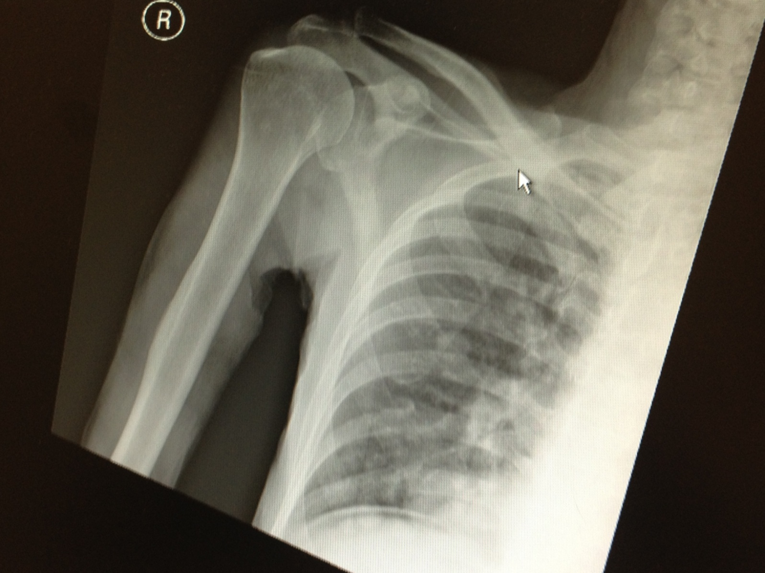

Slide 4
1. Describe the Xray findings.
2. What would you like to examine the patient apart from the shoulder after reading the XRay?
3. What investigation will you order?
4. Suggest 3 differential diagnosis.
5. Suggest ED managements.

Slide 5
Case 2
M/35
Taxi passenger involved in traffic accident
Complaint of right hip pain
Xray is taken

Slide 7
1. Describe the Xray findings.
2. What is your diagnosis?
3. What investigation you suggest?
4. What is the typical mechanism of injury.
5. What clinical features of the hip do you expect.
6. Give 2 complications of the above condition.

Slide 8
Case 3
M/62
GPH
Complaint of cough for 7-8 months, no hemoptysis/ weight loss/ fever
P/E: BP 155/87 p83, SaO2 100% RA. Afebrile
CXR taken

Slide 10
1. What’s the abnormality.
2. Suggest 3 investigations.
3. The above patient suddenly develop left side weakness, what do you suspect?
4. What investigation will you do?

Slide 11
Case 4
F/33
GPH
Presented with Rt upper toothache for one day
Pain radiate to right lower jaw with difficulty in swallowing
No Hx of trauma
Xray neck taken

Slide 13
Describe the Xray findings.
What’s your diagnosis.
Give 3 symptoms and 3 physical signs you will look for.
What are the most common involved organisms.
Suggest 2 complications of the above condition.
Suggest 3 ED managements.

Slide 14
Case 5
M/11
NKDA
GPH
Sudden onset severe central chest pain for 2 hours
No Hx of injury
No SOB
No cough but with sore throat
CXR taken

Slide 16
Describe the Xray findings.
What’s your diagnosis?
Give 2 physical signs for the above condition.
4. What are the causes of the above condition.
5. Suggest 2 complications of the above condition.

