Slide 1
JCM OSCE
August 2014
NDH A&E

Slide 2
Case 1
M/67
Hx of DM, BPH, soft tissue sacroma
Complaint of right shoulder pain for one day
There is no Hx of injury
P/E: There is mild tenderness over right shoulder, ROM full
Xray Rt shoulder taken

Slide 3
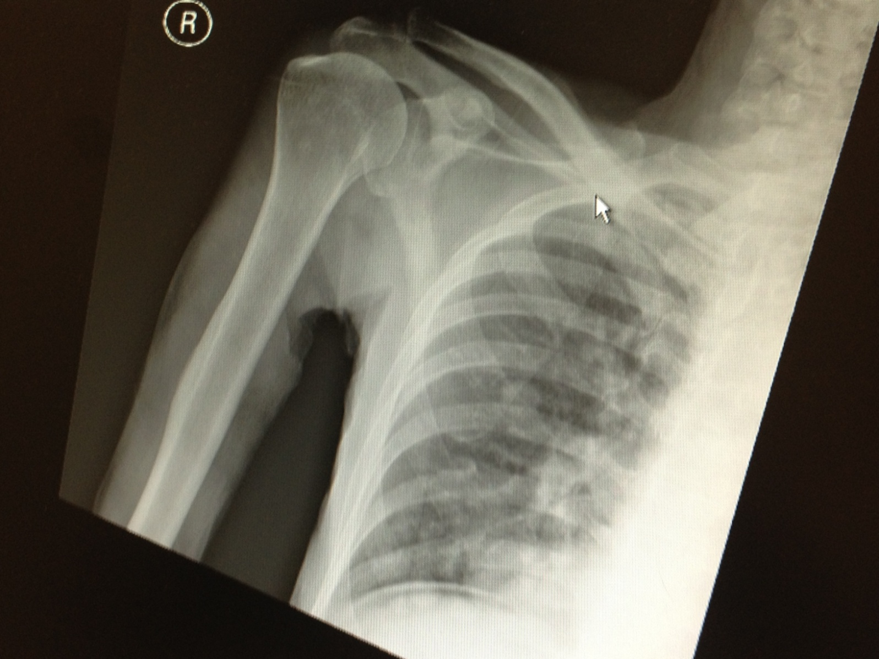

Slide 4
Describe the Xray findings.
What would you like to examine the patient apart from the shoulder after reading the XRay?
What investigation will you order?
Suggest 3 differential diagnosis.
Suggest ED managements.

Slide 5
1. Describe the Xray findings.
There is no fracture/ bony lesion seen in the shoulder region, but free gas is seen under the right hemi-diaphragm.

Slide 6
2. What would you like to examine the patient apart from the shoulder after reading the XRay?
Examine for any abdominal signs.

Slide 7
3. What investigation will you order?
CXR ecect film

Slide 8
4. Suggest 3 differential diagnosis.
This is likely to be the radiated shoulder pain. DDX: perforation of GU/ DU/ intestine, traumatic injury in the abdomen, post laparoscopic surgery

Slide 9
5. Suggest ED managements.
Keep NPO
monitor vitals
set up 2 large IV drip, resuscitate as necessary
pain relief
blood (CBC, L/RFT, clotting, X-match)
consult surgery

Slide 10
Case 2
M/35
Taxi passenger involved in traffic accident
Complaint of right hip pain
Xray is taken

Slide 12
1. Describe the Xray findings.
2. What is your diagnosis?
3. What investigation you suggest?
4. What is the typical mechanism of injury.
5. What clinical features of the hip do you expect.
6. Give 2 complications of the above condition.

Slide 13
1. Describe the Xray findings.
There is widening of right hip joint space. Right hip is in internal rotation and adducted. There is no other pelvic bone fracture.

Slide 14
2. What is your diagnosis?
Suspected posterior right hip dislocation.

Slide 15
3. What investigation you suggest?
CT right hip is suggested.

Slide 16
4. What is the typical mechanism of injury.
Dashboard injury – classically is unrestrained occupant of a motor vehicle accident, especially collisions which are head-on, in which the flexed knee strikes dash with hip flexed and adducted

Slide 17
5. What clinical features of the hip do you expect.
The hip should be held slightly flexed, adducted and internally rotated, leg appears shortened, femoral head palpable in buttock

Slide 18
6. Give 2 complications of the above condition.
Foot drop from sciatica nerve compression, avascular necrosis of the femoral head

Slide 19
Case 3
M/62
GPH
Complaint of cough for 7-8 months, no hemoptysis/ weight loss/ fever
P/E: BP 155/87 p83, SaO2 100% RA. Afebrile
CXR taken

Slide 21
1. What is the abnormality.
2. Suggest 3 investigations.
3. The above patient suddenly develop left side weakness, what do you suspect?
4. What investigation will you do?

Slide 22
1. What is the abnormality.
There is soft tissue thicking in the right paratracheal region, this is likely to be a distorted minor fissure, whose lateral aspect is concave inferiorly and whose medial aspect is convex inferiorly, known as “Golden S sign”, suggest lung collapse with underlying CA lung. The trachea is also mildly deviated to the right side.

Slide 23
2. Suggest 3 investigations.
Sputum for cytology, CT thorax with contrast, bronchoscopy, tumor markers suggestive of other primary

Slide 24
3. The above patient suddenly develop left side weakness, what do you suspect?
Brain metastasis +/- intracranial hemorrhage

Slide 25
4. What investigation will you do?
CT brain +/- contrast

Slide 26
Case 4
F/33
GPH
Presented with Rt upper toothache for one day
Pain radiate to right lower jaw with difficulty in swallowing
No Hx of trauma
Xray neck taken

Slide 28
Describe the Xray findings.
What is your diagnosis.
Give 3 symptoms and 3 physical signs you will look for.
What are the most common involved organisms.
Suggest 2 complications of the above condition.
Suggest 3 ED managements.

Slide 29
1. Describe the Xray findings.
There is prevertebral soft tissue swelling (>1 vertebrae thickness) at the C2/3 level

Slide 30
2. What is your diagnosis.
Retropharyngeal abscess

Slide 31
3. Give 3 symptoms and 3 physical signs you will look for.
Symptoms: Fever, sore throat, dysphagia, neck pain, dyspnoea, poor oral intake, muffled voice
Signs: posterior pharyngeal edema, nuchal rigidity, respiratory distress, stridor, cervical lymphadenopathy, drooling, fever

Slide 32
4. What are the most common involved organisms.
Cultures from retropharyngeal abscess are polymicrobia. The most common aerobic species isolated are beta-hemolytic Strept, Strept. Viridans and S. aureus. Bacteroides and Peptostreptococcus are the most common isolated anaerobes.

Slide 33
5. Suggest 2 complications of the above condition.
Airway obstruction, mediastinitis, aspiration pneumonia, epidural abscess, jugular venous thrombosis, necrotizing fasciitis, sepsis, erosion into the carotid artery

Slide 34
6. Suggest 3 ED managements.
Keep NPO and fluid resuscitation if necessary
close monitoring of vital signs esp airway condition
IV antibiotics
consult ENT

Slide 35
Case 5
M/11
NKDA
GPH
Sudden onset severe central chest pain for 2 hours
No Hx of injury
No SOB
No cough but with sore throat
CXR taken

Slide 37
Describe the Xray findings.
What is your diagnosis?
Give 2 physical signs for the above condition.
What are the causes of the above condition.
Suggest 2 complications of the above condition.

Slide 38
1. Describe the Xray findings.
There is gas seen over bilateral cervical and also mediastinum region. There is no pneumothorax seen.

Slide 39
2. What is your diagnosis?
Pneumomediastinum

Slide 40
3. Give 2 physical signs for the above condition.
surgical emphysema, Hamman sign (precordial crepitations and diminution of HS), associated sign of pneumothorax

Slide 41
4. What are the causes of the above condition.
Spontaneous, elevated pulmonary pressures (forceful coughing, crying, vomiting, Valsalva maneuver), Respiratory illness (COAD, asthma), organ injury (tracheobronchial rupture, esophageal injury, perforation of hollow abdominal viscus)

Slide 42
5. Suggest 2 complications of the above condition.
Pneumothorax, tension pneumomediastinum, mediastinitis

Slide 43
The End
Thank you

