Slide 1
JCM OSCE
Questions and Answers
6th May 2015
Queen Mary Hospital

Slide 2
Question 1a
A family of 2 members developed abdominal pain, nausea and vomiting one hour after eating mushroom. It was picked at the hillside and well-cooked. In addition to the usual steps to manage as food poisoning and to trace the culprit, what single most important question should you ask to assess the risk and severity of mushroom poisoning?

Slide 3
Answer 1a
Time and onset of symptoms.
The most toxic mushrooms are cytotoxic. Time is needed for the uptake of toxins into cells and deprivation of end organ reserve.
Delayed onset (> 6 hours) usually implies potentially fatal mushroom ingestion.

Slide 4
Question 1b
It was lucky that their relatives got some uncooked specimen for your identification. Who should you consult? How should you prepare and store the specimen?

Slide 5
Answer 1b
Hong Kong Poison Information Centre
  Amatoxin/ phallotoxin analysis by TRL
  Friendly collaboration with Prof. S.W. Chiu (mycologist) for recognition of mushroom species

Slide 6
Answer 1b
Preparation of specimens:
  Fresh intact specimens are the best
  Save more samples if possible, together with original package
  Wrap in aluminium foil or wax paper and then put into paper bag
  Store in refrigerator but do not freeze
  Cooked specimen, gastric content and stool may contain mushroom remnants that may be useful if fresh specimen is not available

Slide 7
Question 1c
Here is the most deadly mushroom in the world. Do you know its name and action? (Pictures 1 and 2)

Slide 8
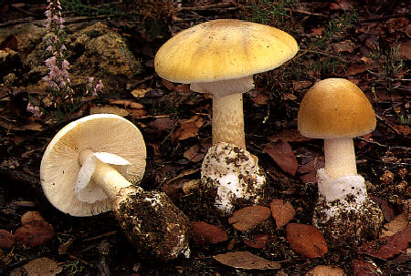
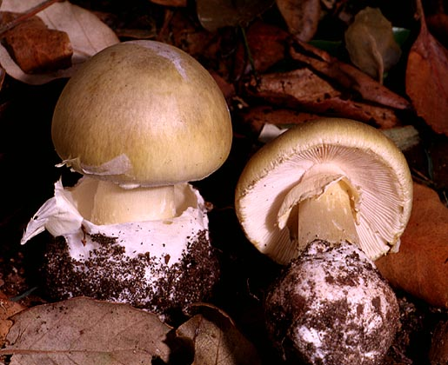
Picture 1
Picture 2

Slide 9
Question 1c
Amanita Phalloides (Death Cap)
It contains amatoxin.
  Cytotoxic
  GI symptoms in 6 – 10 hours
  Fulminant liver failure and renal impairment after 2 – 3 days

Slide 10
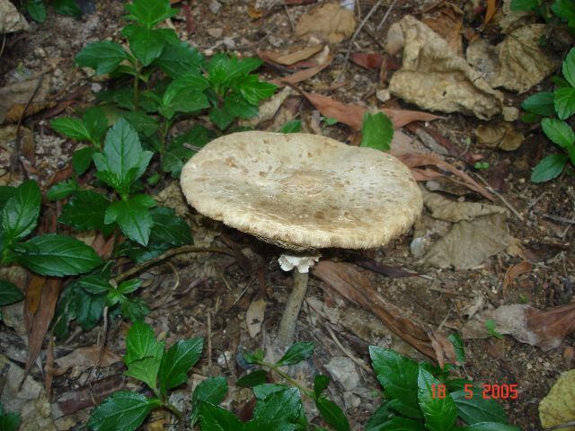
Question 1d (Distinction Q.)
This is the mushroom eaten by this family (Picture 3). Do you know its name?
Picture 3

Slide 11
Answer 1d
Macrolepiota
It causes self-limiting GI symptoms.

Slide 12
Question 2
A 37-year-old man attended A&E because of pain over his right wrist for one week after a fall from ladder.
(a) What are the X-rays abnormalities?

Slide 13
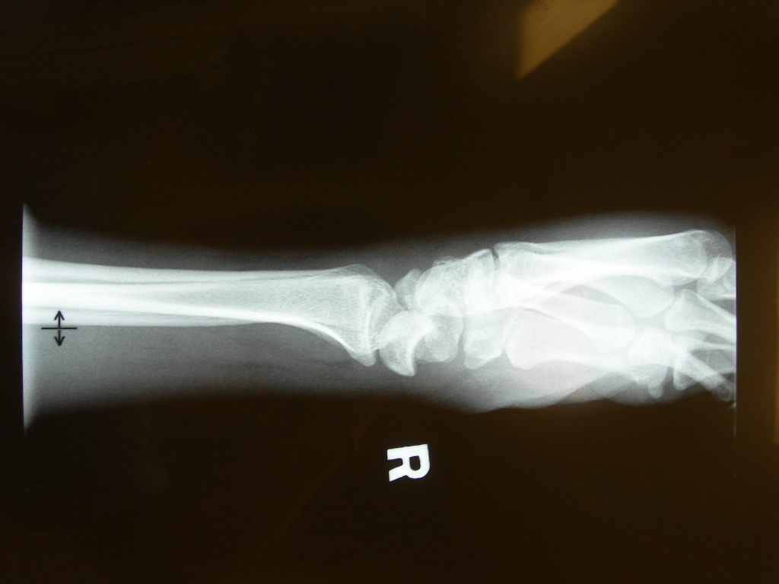

Slide 14
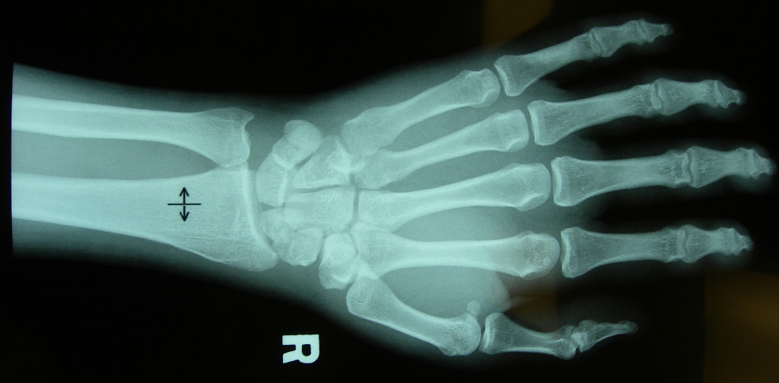
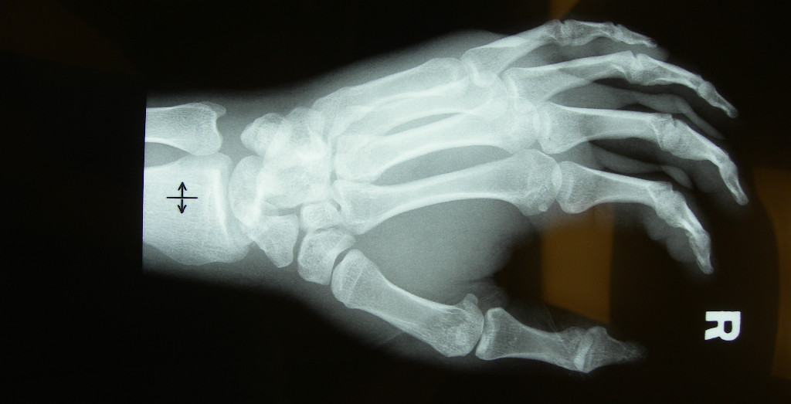

Slide 15
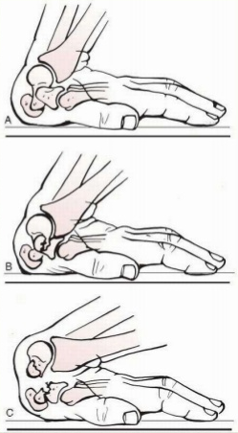
Answer 2a
Transcaphoid perilunate dislocation
Common in young adults
Fall on oustretched hand
Mechanism – bending with dorsal compression and tension on palmar surface owing to forced dorsiflexion

Slide 16
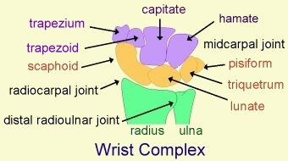
Perilunate Dislocation
60% with scaphoid fracture
Radiolunate articulation is preserved
Capitate dislocates almost always dorsal to the lunate
capitolunate joint is disrupted, and the lunate projects through the space of Poirier
Proximal pole of scaphoid retains its articulation with the lunate, whereas the distal pole retains its relationship with the distal carpal row
Image courtesy: http://www.pt.ntu.edu.tw/hmchai/Kines04/KINupper/Wrist.htm

Slide 17
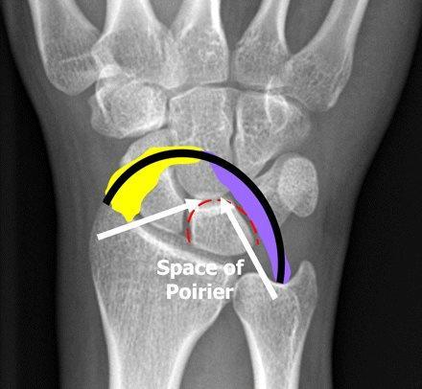
Space of Poirier
Space between “greater arc” and “lesser arc”
Greater arc
  Radiocapitate (yellow) and ulnocapitate (purple) ligaments interdigitate, forming arcuate ligament
Lesser arc
  Scapholunate and lunotriquetral ligaments
Image courtesy: https://indianclinicalknowledgedotnet1.wordpress.com/2012/10/24/space-of-poirier/

Slide 18
Question 2
(b) What are the possible complications?
# scaphoid:
  AVN
  Non-union
  Secondary OA
  Sudeck atrophy
Perilunate dislocation:
  Median nerve palsy (carpal tunnel syndrome)
  Sudeck atrophy
  AVN
  Long-term carpal instability: Dorsal/Volar Intercalated Segment Instability (DISI/VISI)
(c) What is your treatment?
  Prompt ORIF

Slide 19
Question 3a
A 20 years old man had a routine pre-employment check in a health care centre. He was referred to A&E because his ECG was commented “abnormal” by the ECG machine. He was asymptomatic. Another ECG performed in A&E showed no serial changes.
Describe the ECG.

Slide 20
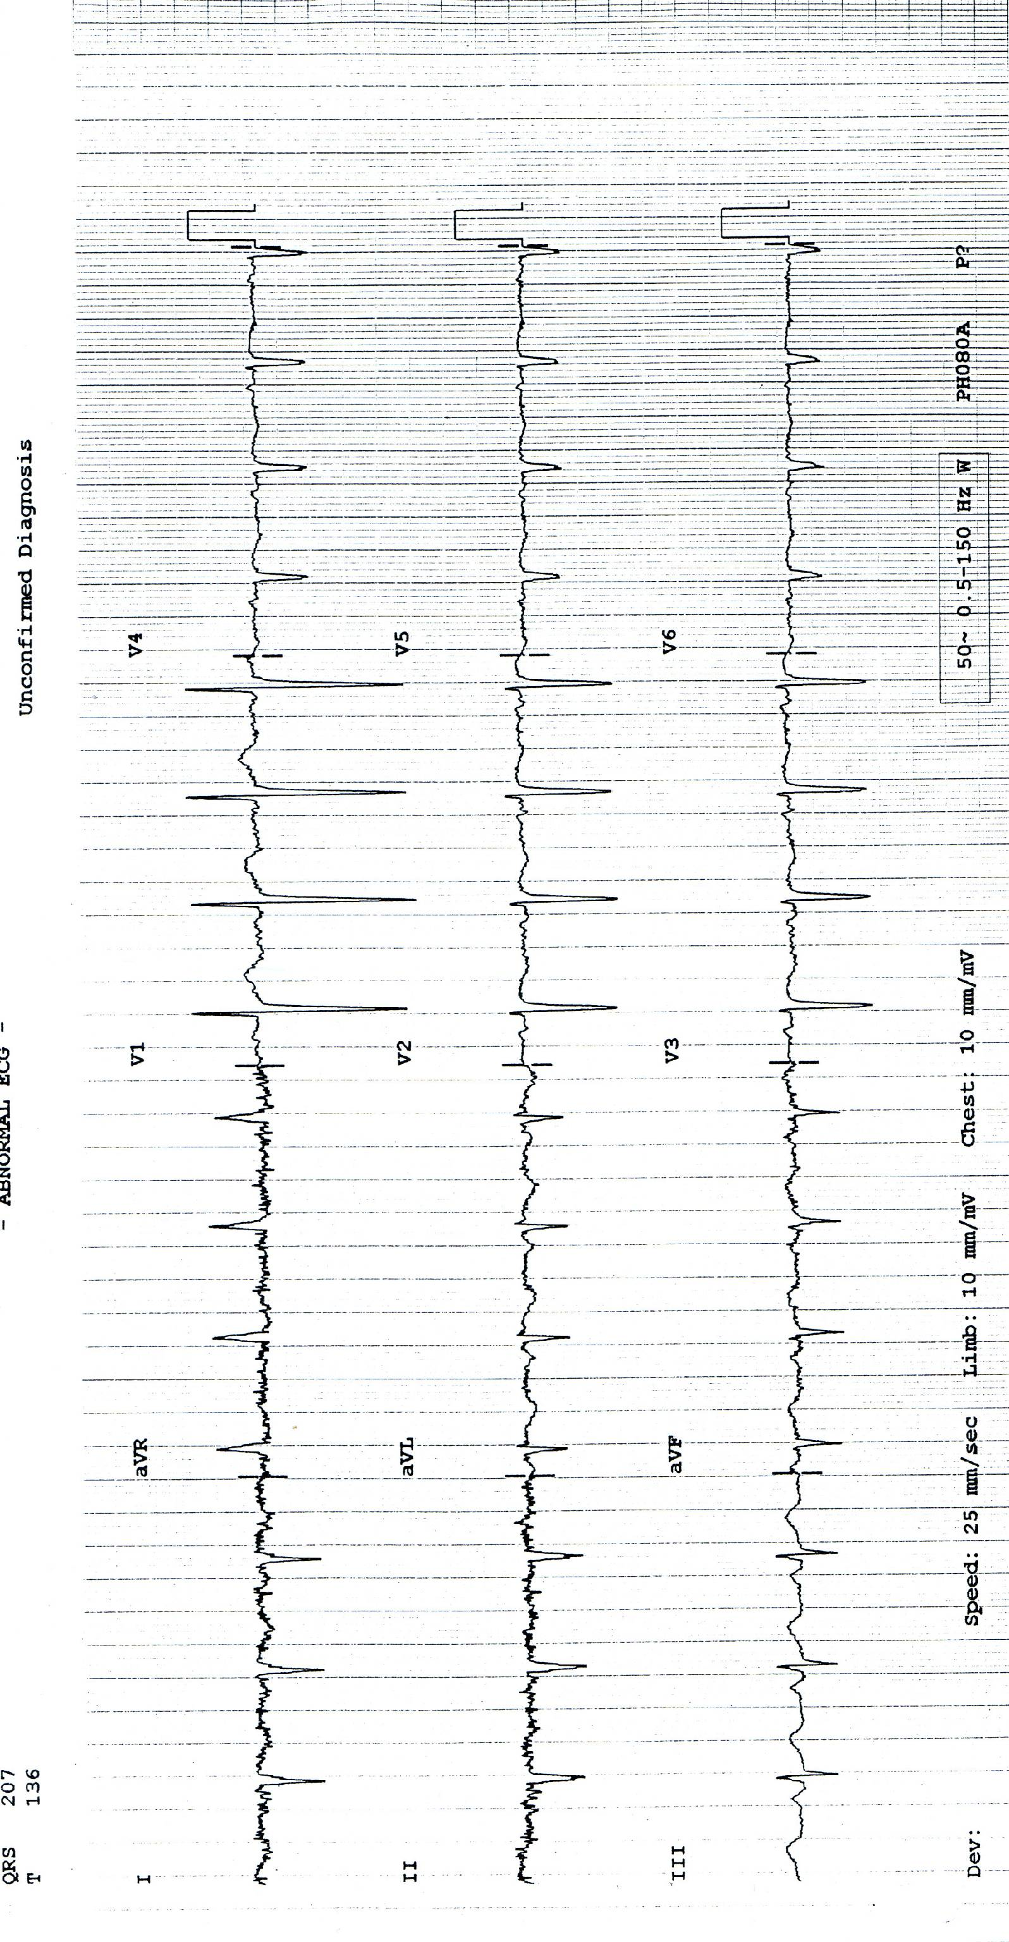
1. RAD
2. R in aVR
3. R wave regression over chest leads

Slide 21
Question 3
(b) What is the likely diagnosis?
Dextrocardia
(c) How would you confirm the diagnosis by simple means in A&E?
Physical examination, CXR

Slide 22
Question 4
A 34-year-old woman complained right upper quadrant pain and fever for five days. Mild localised tenderness was elicited at the right upper quadrant. She was not pregnant. BP was 109/61mmHg and pulse rate was 102/min.
(a) Suggest 4 differential diagnoses.
(b) List 3 abnormalities of the CT film.

Slide 23
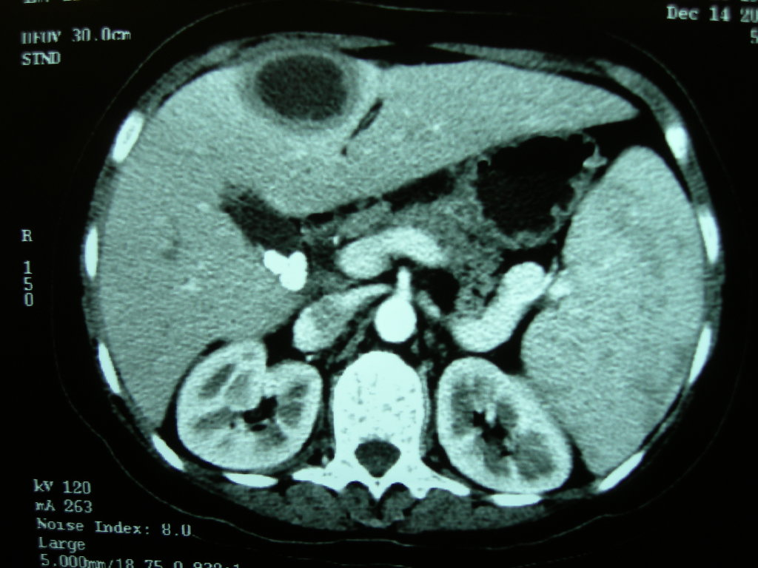

Slide 24
Answer 4
Biliary colic, acute cholecystitis, acute cholangitis, hepatitis, liver abscess, RLL pneumonia
CT: multiple gallstones; complicated cystic lesion (infected cyst or abscess), hepatosplenomegaly

Slide 25
Question 4
(c) What is the most likely diagnosis?
Liver abscess
(d) Give 2 possible causative organisms of this disease in
(i) Developed: E. Coli (most common), K. pneumoniae, Bacteroides, Enterococci, Anaerobeic Streptococci, and Microaerophilic Streptococci
(ii) Developing: Entamoeba histolytica

Slide 26
Question 5
An elderly was brought to the Accident and Emergency Department because of colour changes of his urine in urinary catheter and bedside bag. He was bed-ridden and needed to use long term urinary catheterisation.
(Photo)

Slide 27
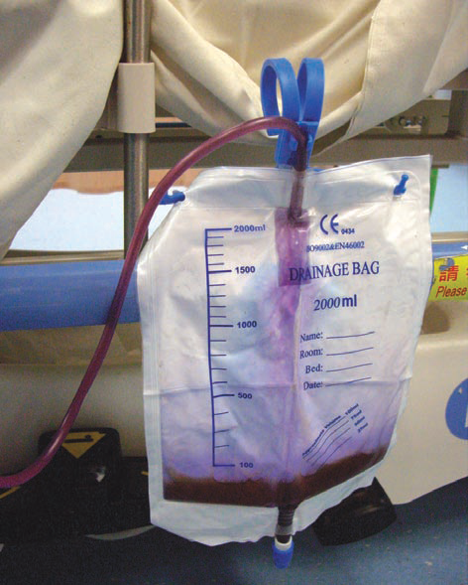

Slide 28
Question 5
What is the name of this condition?
Purple urine bag syndrome

Slide 29
Question 5
(b) Give 3 common risk factors for this condition.
  Constipation
  DM
  Advanced age
  Women
  Chronically catheterized
  Bacterial urinary infections that produce sulphatase/ phosphatase

Slide 30
Question 5
The etiology is due to indigo (blue) and indirubin (red) or to their mixture that becomes purple.
***Escherichia coli, Klebsiella pneumoniae, Enterobacter agglomerans, Pseudomonas aeruginosa, Proteus species, Providencia species, Enterococcus species and Streptococcus faecalis

Slide 31
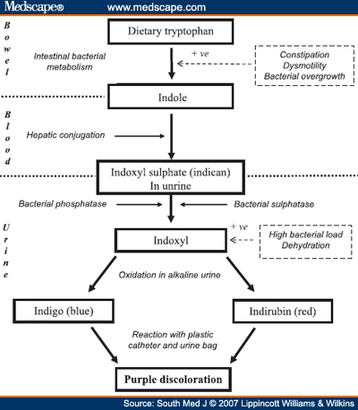
www.medscape.com

Slide 32
Question 5
(c) Briefly describe your management.
  Change urinary catheter +/- antibiotics

Slide 33
Question 6
A 64-year-old man presented to Emergency room because of abdominal pain, vomiting and shortness of breath. The abdomen was distended with no pulsatile mass. His ECG showed atrial fibrillation.

Slide 34
Question 6
The result of arterial blood gas was as follows:
pH 7.029, pCO₂ 1.93 kPa, pO₂ 23.1 kPa, BE –27, HCO₃ 3.8 mmol/L, SaO2 99%
Na 136 mmol/L, K 4.0 mmol/L, Cl 95 mmol/L
H’Stix 11.7 mmol/L
Urgent CT abdomen was performed.

Slide 35
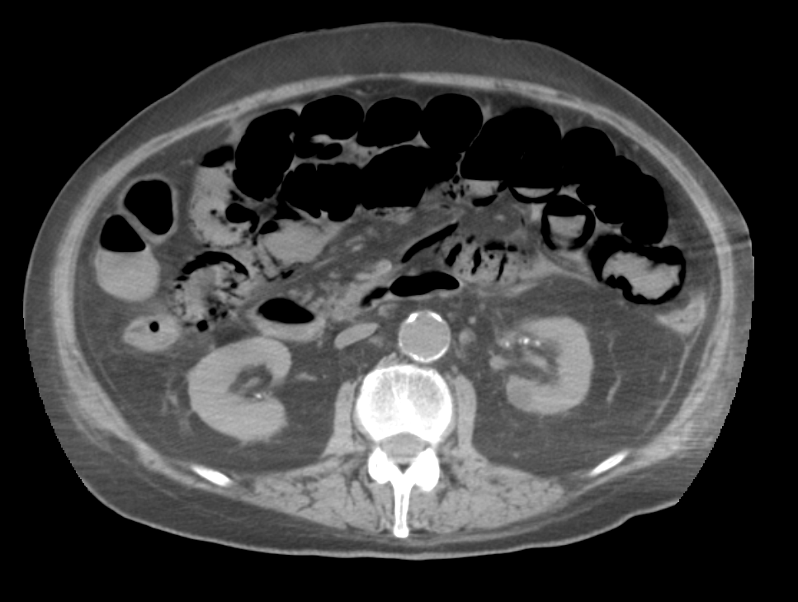

Slide 38
Question 6
(a) Comment on the blood gas and calculate the anion gap.
  Anion gap metabolic acidosis:
  Na (+ K) – Cl - HCO3 = 136 (+ 4) – 95 - 3.8 = 41.2
(b) Describe the features of CT abdomen.
  Pneumatosis intestinalis, porto-venous gas, pneumoperitoneum
(c) What is the most likely diagnosis?
Ischaemic bowel

Slide 39
END

