Slide 1
JCM OSCE Answer
POH A&E
4th June, 2014

Slide 2
Question 1
44/M
Construction worker
Neck injury after accidentally fell from 3m of height
Complained with 4 limbs weakness
CT C-spine was taken

Slide 3
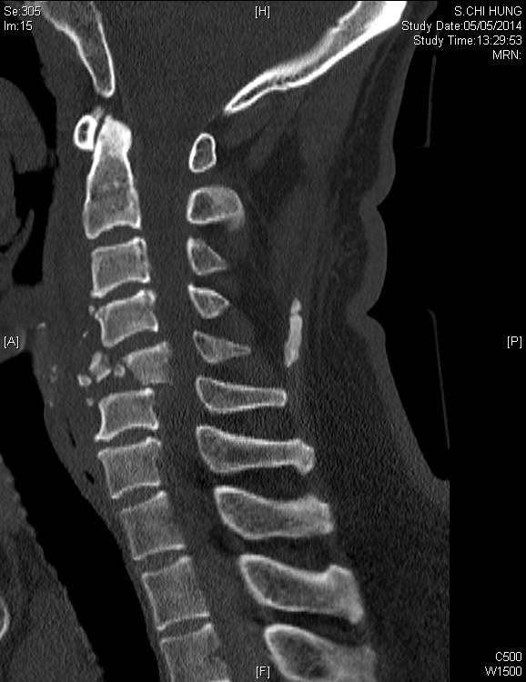
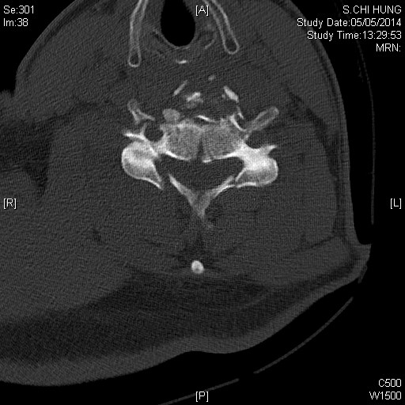
Question 1

Slide 4
Question 1
Describe the CT findings.
Burst fracture of the vertebral body of C5, with posterior displacement
Fracture of both lamina of C5, with anterior displacement of the fractured part
Resulting in narrowing of spinal canal
Name 3 aspects of consideration specifically in this patient in primary survey.
Immediate spinal protection with immobilization
Airway: Anticipate difficulty airway management, in-line immobilization if proceed to intubation
Breathing: Lower cervical injury may cause phrenic nerve paralysis
Circulation: Neurogenic shock
Disability: Identify the sensory and motor level

Slide 5
Question 1
Suggest 6 features of spinal cord injury.
Flaccid areflexia and anal sphincter
Diaphragmatic breathing
Ability to flex, but not extend at the elbow
Grimace to pain above, but not below the clavicle
Hypotension with bradycardia
Priapism
What are neurogenic shock and spinal shock?
Neurogenic shock: hypotension with bradycardia attributed to interruption of sympathetic pathways in the spinal cord causing decreased vascular resistance
Spinal shock: transient loss of function of the spinal cord following acute spinal injury

Slide 6
Question 1
Name the series of study that investigate the efficacy of steroid in spinal cord injury. What is the result?
NASCIS (National Acute Spinal Cord Injury Studies) I, II, III
Only marginal neurological outcome benefit in subgroup analysis
<8 hours from injury → controversial
>8 hours from injury → no indication

Slide 7
Question 2
25/M
Good past health
Hit by another person by fist after argument at a bar
L eye injury
P/E showed L peri-orbital swelling and subconjunctival hemorrhage

Slide 8
Question 2
Name 4 physical findings you would like to check and document.
Glasgow Coma Scale
Pupil size
Signs of ruptured eyeball and hyphema
Extra-ocular movement
Infraorbital nerve function
Presence of endophthalmos
The patient complained with left cheek numbness, what is the cause?
Infraorbital nerve involvement
What further imaging will you consider?
CT orbit

Slide 9
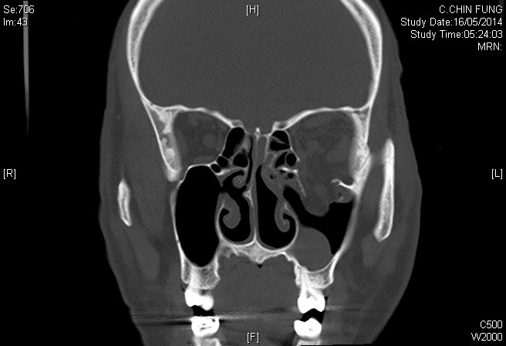
Question 2

Slide 10
Question 2
Describe the CT findings.
Fracture of medial and inferior orbital wall
Fluid level at L maxillary sinus
Tear drop sign
What is the name of the weakest point in the medial wall of the orbit?
Lamina papyracea

Slide 11
Question 2
Suggest 3 ED treatments.
Analgesics
Eye protection by eye shield
Avoid valsalva / blowing the nose
Antibiotics
Urgent Ophthalmology consultation
Name 2 indications for surgical treatment.
Enophthalmos greater than 2mm
Entrapment of extraocular muscles
Double vision on primary or inferior gaze
Fracture greater than 50% of orbital floor

Slide 12
Question 3
60/M, good past health
Manual worker
Attended A&E for R wrist pain for 2 years
He had history of repeated minor R wrist injury by spraining in the past
P/E showed R wrist swelling, stiffness and decreased ROM
X ray was taken

Slide 13
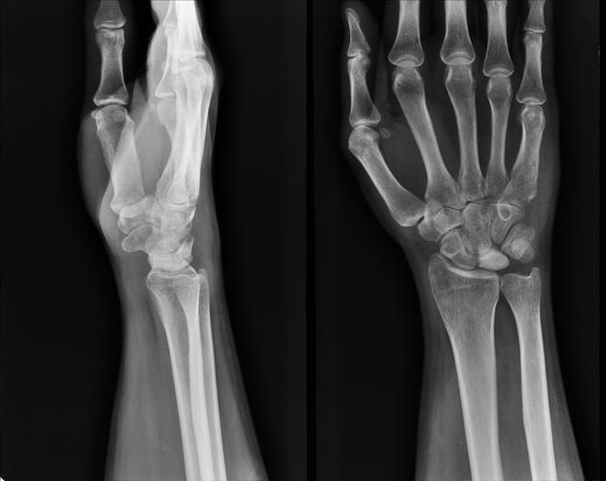
Question 3

Slide 14
Question 3
Describe the X ray findings.
Sclerosis and hyperdensity over the lunate
What is the diagnosis?
Kienböck's disease
What is the cause of the above diagnosis?
Progressive collapse of the lunate
Disruption of the blood supply, possibly related to undiagnosed fractures of the lunate, repetitive trauma, or abnormal biomechanical loading patterns at the radiocarpal joint
Eventual avascular necrosis of lunate

Slide 15
Question 3
What are the classical X ray findings of the above diagnosis?
stage I : normal radiograph
stage II : increased radiodensity of lunate with possible decrease of lunate height on radial side only
stage IIIa : lunate collapse, no scaphoid rotation
stage IIIb : lunate collapse, fixed scaphoid rotation
stage IV : degenerative changes around lunate
What other investigations can be performed to confirm the diagnosis in early stage?
Bone scan, MRI

Slide 16
Question 4
21/M
Hit onto the wall with R fist during emotional upset
Complained with R hand pain afterwards
X ray was taken

Slide 17
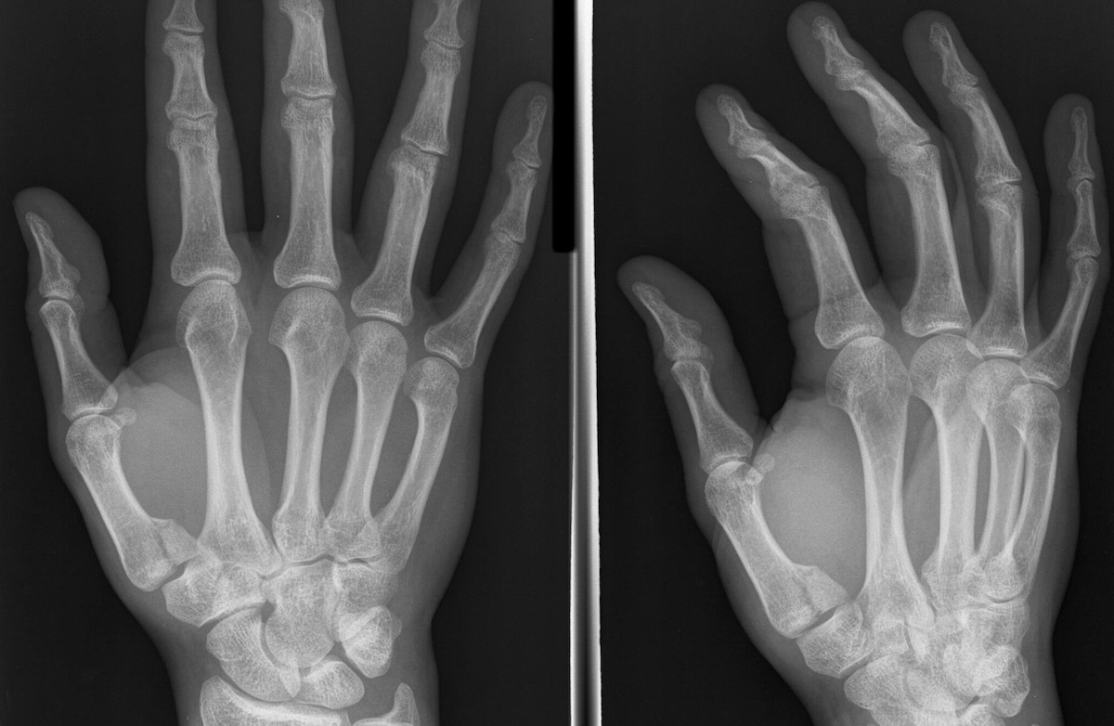
Question 4

Slide 18
Question 4
Describe the X ray findings
Fracture involving the articular surface of the base of the right thumb metacarpal
It is slightly displaced and the carpo-metacarpal joint is slightly subluxed
What is the name of the injury?
Bennett fracture
What is the typical mechanism of this injury?
Axial loading to a partially flexed thumb
Fist fight

Slide 19
Question 4
What is Rolando fracture?
a comminuted version of a Bennett fracture
the fragments may form a T or Y pattern at the base of the MC
Name 3 complications.
Joint stiffness and 1st CMCJ arthritis
Malunion
Non-union
What is the plan of management?
RICE
Thumb spica splint
Ortho admission

Slide 20
Question 5
33/F, Indonesian domestic helper
Complained with abdominal pain for 3 days
BP 95/56, P140
Temp 39.1deg
P/E: tenderness over epigastrium
Warm periphery

Slide 21
Question 5
What condition is the patient suffering from?
Septic shock, source likely from intra-abdominal infection
Suggest 3 differential diagnoses to cause the above condition.
Perforated peptic ulcer with peritonitis
Cholangitis
Acute pancreatitis
Suggest 5 ED management.
Fluid resuscitation
Inotropic support if necessary
Early antibiotics
Investigations including blood taking, USG or CT if stable to identify source of infection
Consult ICU

Slide 22
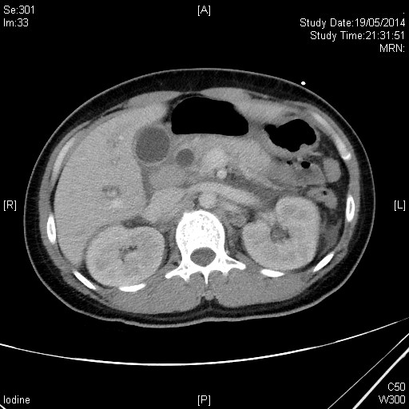
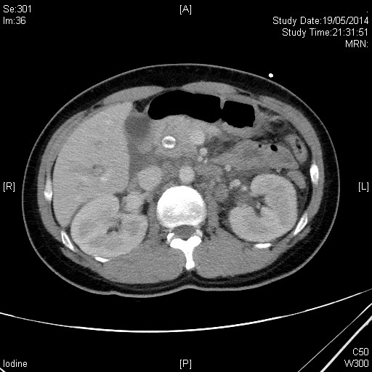
Question 5
A
CT film 1
CT film 2

Slide 23
Question 5
What is the abnormality in CT film 1?
Grossly dilated intrahepatic ducts
What is A?
An obstructive radio-opaque stone at distal common bile duct
What is the diagnosis?
Cholangitis with an obstructive CBD stone, presented with septic shock
What is the immediate management?
Antibiotics
Urgent relief of biliary obstruction by ERCP

Slide 24
Thank you.

