Slide 1
JCM OSCE
POH A&E
4th June, 2014

Slide 2
Question 1
44/M
Construction worker
Neck injury after accidentally fell from 3m of height
Complained with 4 limbs weakness
CT C-spine was taken

Slide 3
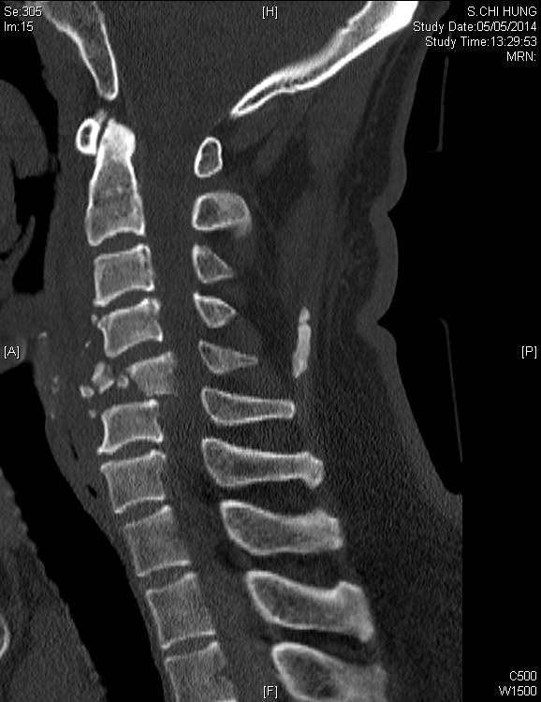
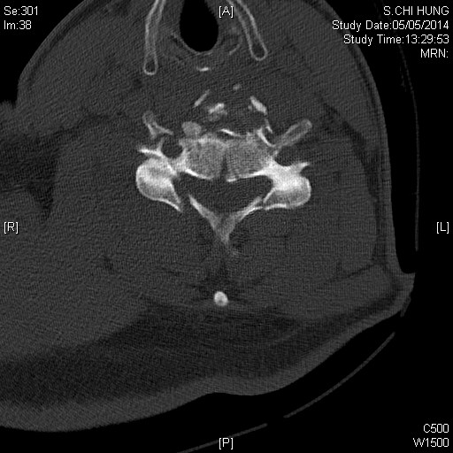
Question 1

Slide 4
Question 1
Describe the CT findings.
Name 3 aspects of consideration specifically in this patient in primary survey.
Suggest 6 features of spinal cord injury.
What are neurogenic shock and spinal shock?
Name the series of study that investigate the efficacy of steroid in spinal cord injury.

Slide 5
Question 2
25/M
Good past health
Hit by another person by fist after argument at a bar
L eye injury
P/E showed L peri-orbital swelling and subconjunctival hemorrhage

Slide 6
Question 2
Name 4 physical findings you would like to check and document.
The patient complained with left cheek numbness, what is the cause?
What further imaging will you consider?

Slide 7
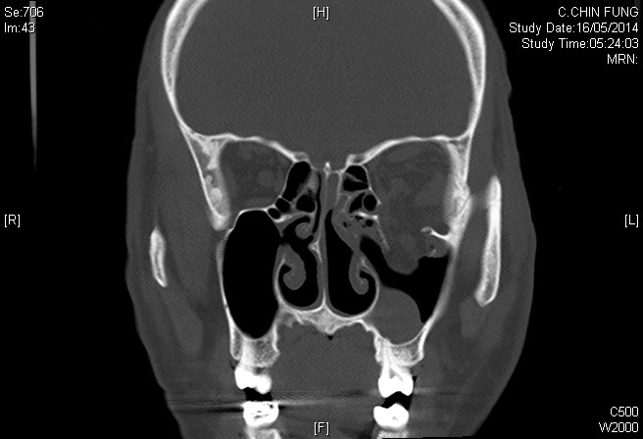
Question 2

Slide 8
Question 2
Describe the CT findings.
What is the name of the weakest point in the medial wall of the orbit?
Suggest 3 ED treatments.
Name 2 indications for surgical treatment.

Slide 9
Question 3
60/M, good past health
Manual worker
Attended A&E for R wrist pain for 2 years
He had history of repeated minor R wrist injury by spraining in the past
P/E showed R wrist swelling, stiffness and decreased ROM
X ray was taken

Slide 10
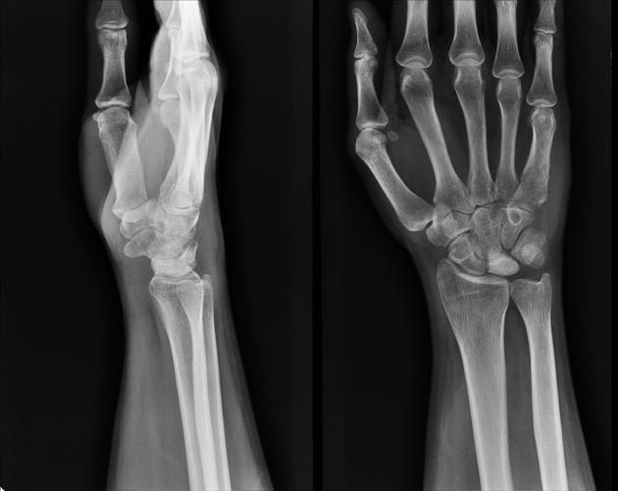
Question 3

Slide 11
Question 3
Describe the X ray findings.
What is the diagnosis?
What is the cause of the above diagnosis?
What are the classical X ray findings of the above diagnosis?
What other investigations can be performed to confirm the diagnosis in early stage?

Slide 12
Question 4
21/M
Hit onto the wall with R fist during emotional upset
Complained with R hand pain afterwards
X ray was taken

Slide 13
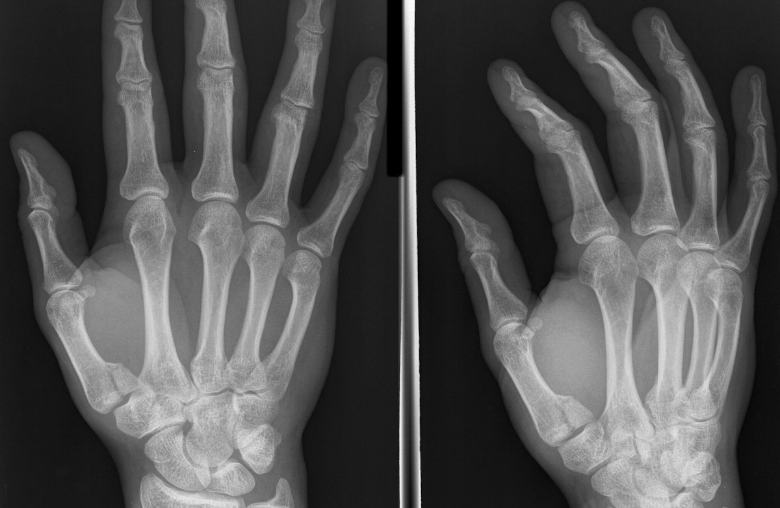
Question 4

Slide 14
Question 4
Describe the X ray findings
What is the name of the injury?
What is the typical mechanism of this injury?
What is Rolando fracture?
Name 3 complications.
What is the plan of management?

Slide 15
Question 5
33/F, Indonesian domestic helper
Complained with abdominal pain for 3 days
BP 95/56, P140
Temp 39.1deg
P/E: tenderness over epigastrium
Warm periphery

Slide 16
Question 5
What condition is the patient suffering from?
Suggest 3 differential diagnoses to cause the above condition.
Suggest 5 ED management.

Slide 17
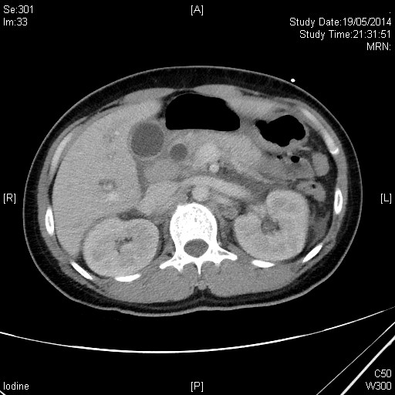
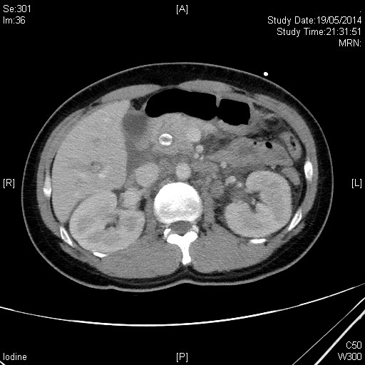
Question 5
A
CT film 1
CT film 2

Slide 18
Question 5
What is the abnormality in CT film 1?
What is A?
What is the diagnosis?
What is the immediate management?

Slide 19
Thank you.

