Slide 1
OSCE 6-7-2016
UCH

Slide 2
Case 1
A 46 year-old man presented with sudden onset of bitemporal headache.
His past medical history was unremarkable.
His blood pressure was 150/100, pulse 90/min.;
GCS 15/15, no neck rigidity, limbs power full
CT brain was done.

Slide 4
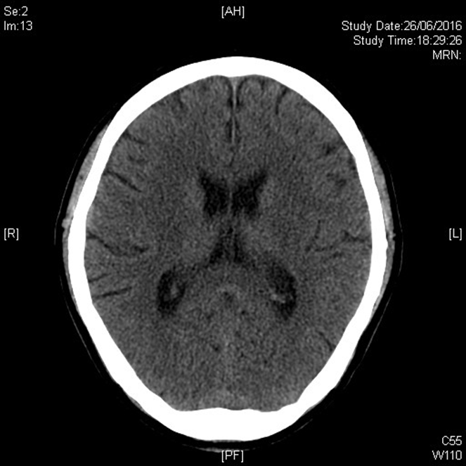
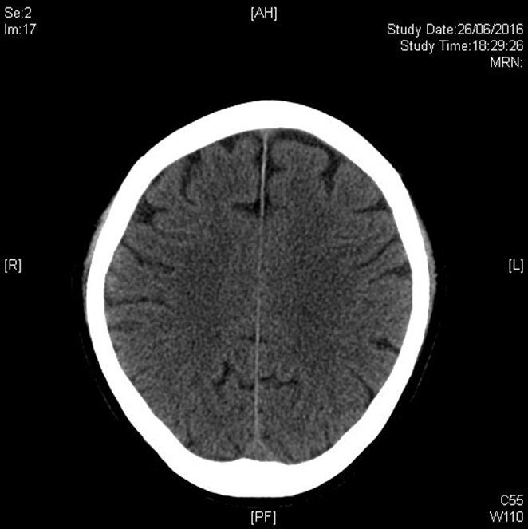

Slide 5
Case 1
What is the abnormal CT finding?
What is the likely diagnosis?
What neurological examination do you need to perform? (3 points)
What is the potential medical emergency of that diagnosis?
What further investigations are needed to be done? (2 points)

Slide 6
Case 2
A 33 year-old man present with right knee sprain while walking down stairs.
X-ray right knee was done.

Slide 8
Case 2
What is the X-ray finding?
What is the diagnosis?
What is the typical mechanism of the injury?
What is the most common associated injury?

Slide 9
Case 3
A 53 year old gentleman complained of epigastric discomfort for 2 weeks with progressive epigastric distention and repeated vomiting.

Slide 10
The following show the ultrasound image of his upper abdomen:

Slide 11
Case 3
Name structures A to C.
What is the likely diagnosis?
Name 3 etiologies.
What classical physical sign may be present?
List 3 further investigations for confirmation or further evaluation.

Slide 12
Case 4
A 69 year-old woman presented with lower limbs weakness for two weeks. She had history of fall with minor head injury due to weakness.
CT scan was done.

Slide 13
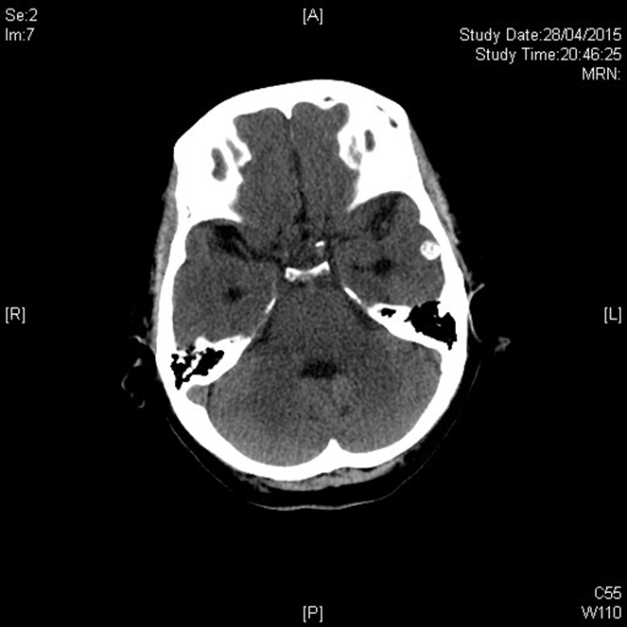
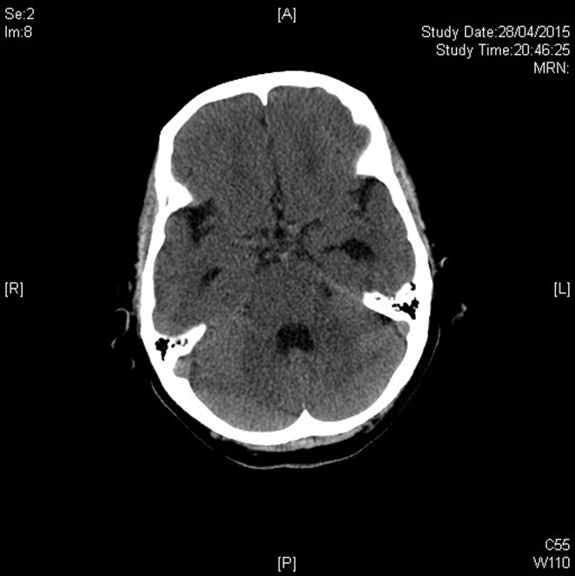

Slide 14
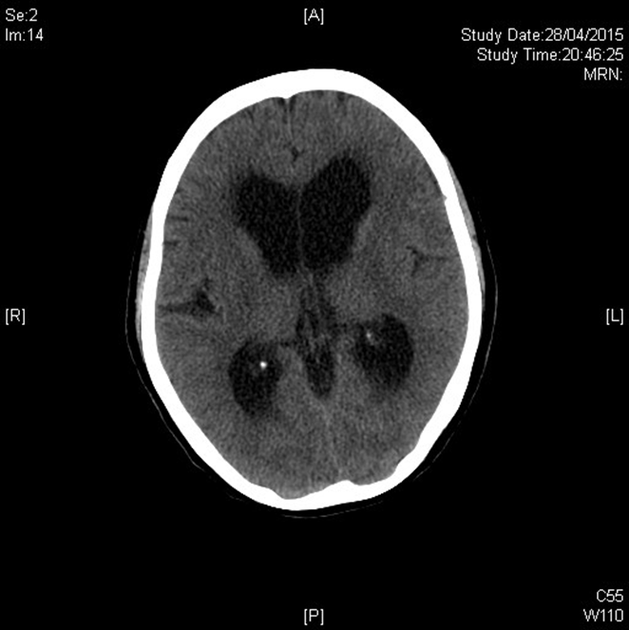
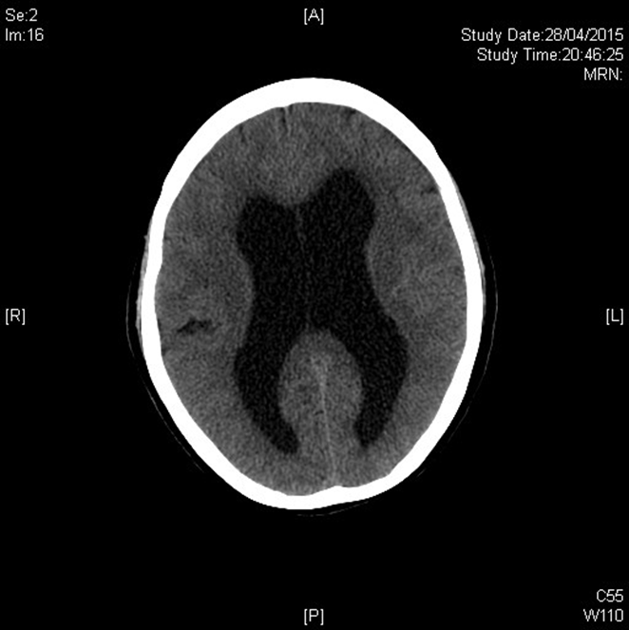

Slide 15
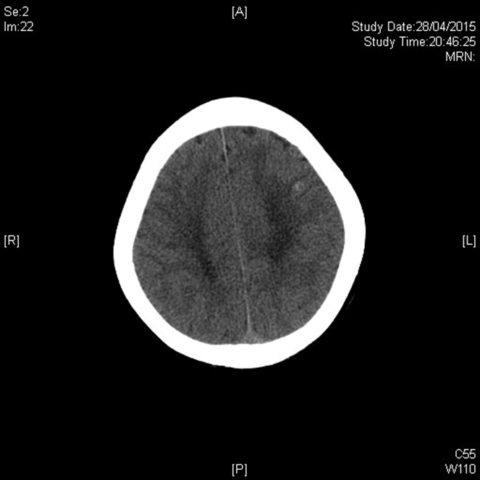

Slide 16
Case 4
What are the abnormal CT findings? (2 points)
What is the likely diagnosis? (2 points)
Name three other indicated investigations.

Slide 17
Case 5
A 10 year-old girl presented with right mandibular swelling for three weeks. She was treated by a course of oral antibiotics from GP with no response.
X-ray right mandible was done.

Slide 20
Case 5
What are the abnormal X-ray findings? (2 points)
What clinical finding do you need to look for?
What is the diagnosis?
What is the mainstay of treatment?

