Slide 1
OSCE 2016 April
RH AED

Slide 2
Case 1
65 years old lady. She had history of DM, HT and chronic renal failure. She claimed to have pain on the left leg for two days. She denied of any injury.

Slide 4
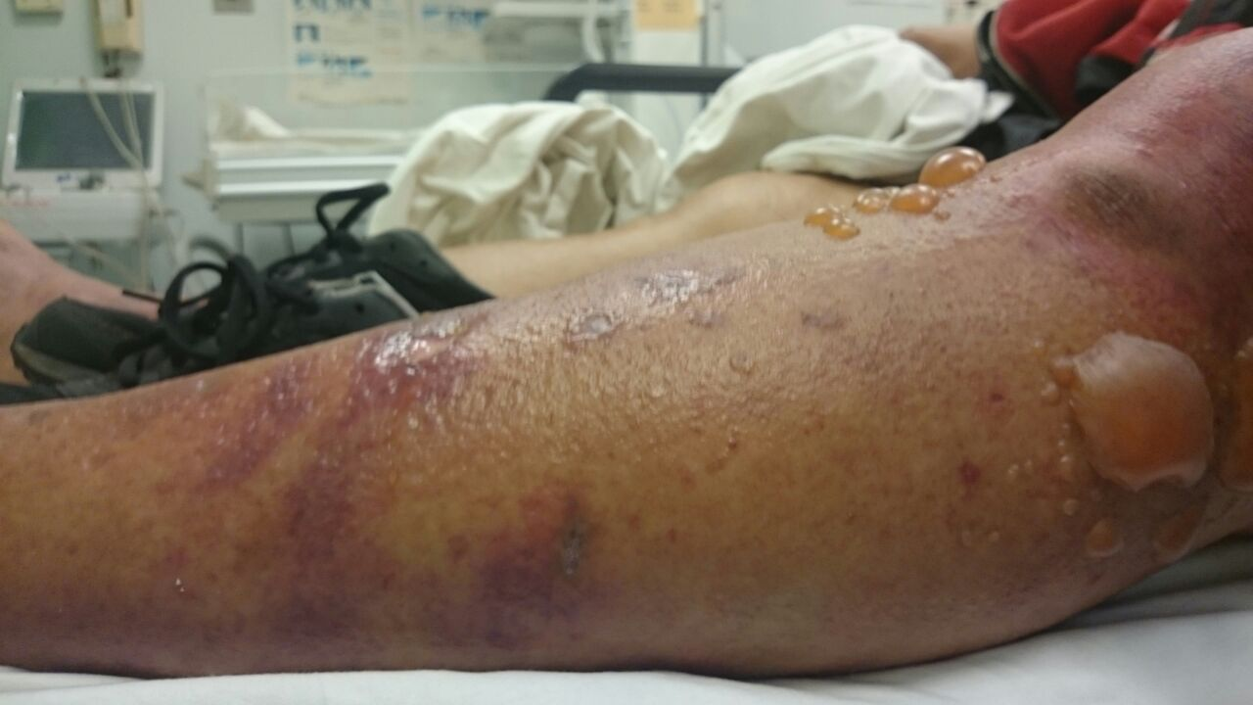

Slide 5
Question 1.1 What are the signs of the patient?
Question 1.2 What is the diagnosis ? Is there any classification?
Question 1.3 Is there any diagnostic scoring system to distinguish this condition from other similar conditions?
Question 1.4
What is the management plan in emergency room?

Slide 6
Case 2
60 years old lady compliant of headache for few days. She had a minor head injury one week ago. There is no abnormal neurological sign detected.

Slide 7
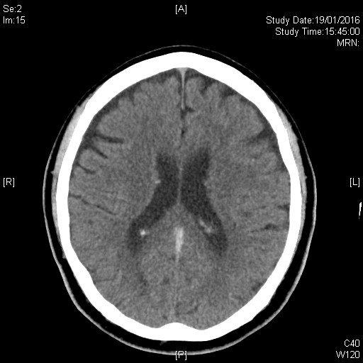
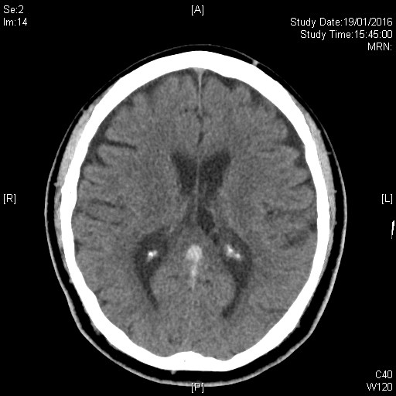
Question 2.1 What is the CT brain abnormality?

Slide 8
Question2.2 What are the risk factors associated in the disease?
Question2.3 What are the other investigations?
Question 2.4 What is the treatment principle for this condition?

Slide 9
Case 3
30 years old man found drowsiness in street, with a empty bag of unknown medicines.

Slide 10
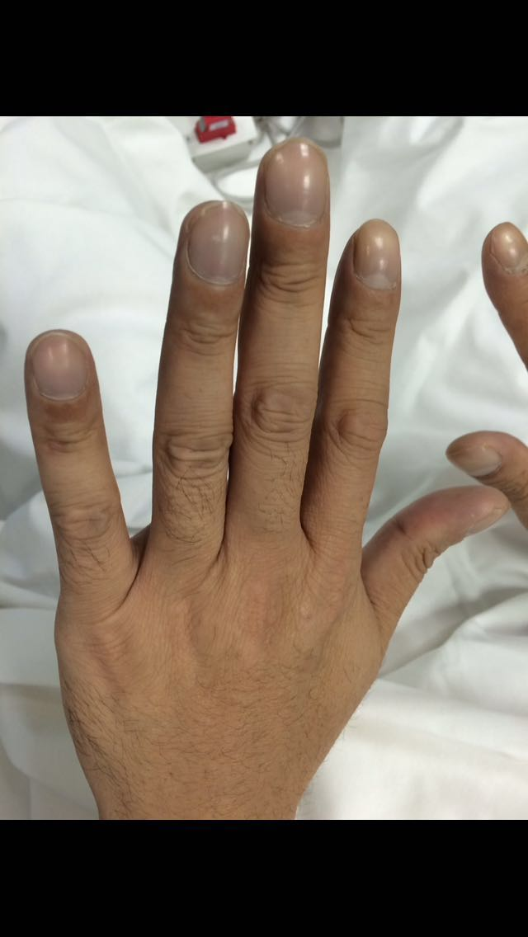
Question 3.1 Please comment on the photo.

Slide 11
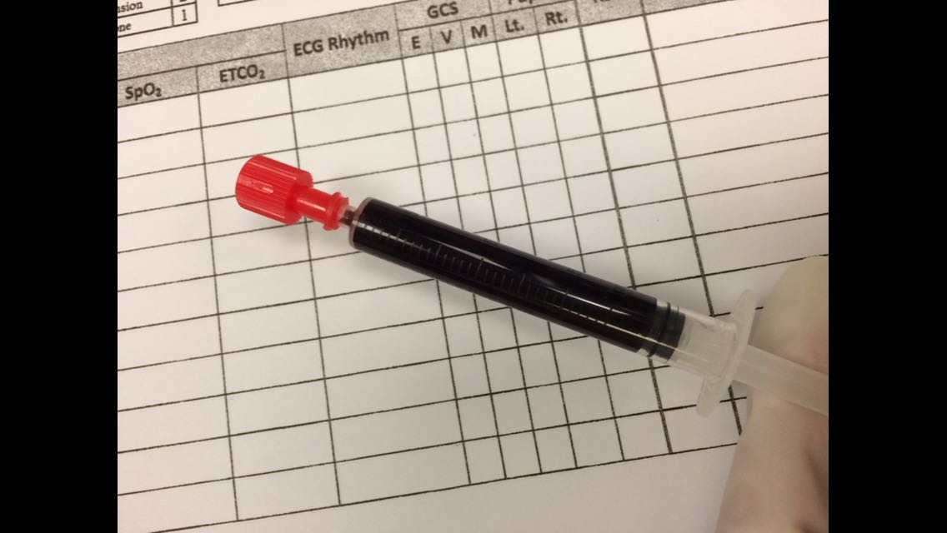
Question3.2 What are the bedside investigations?
Question3.3 Please comment on the photo of his blood sample.

Slide 12
Question3.4 Is there any specific treatment for this condition? And what are the indications and contraindications?

Slide 13
Case 4
38 years old man compliant of severe chest pain radiated to back, vital sign stable. ECG done.

Slide 14
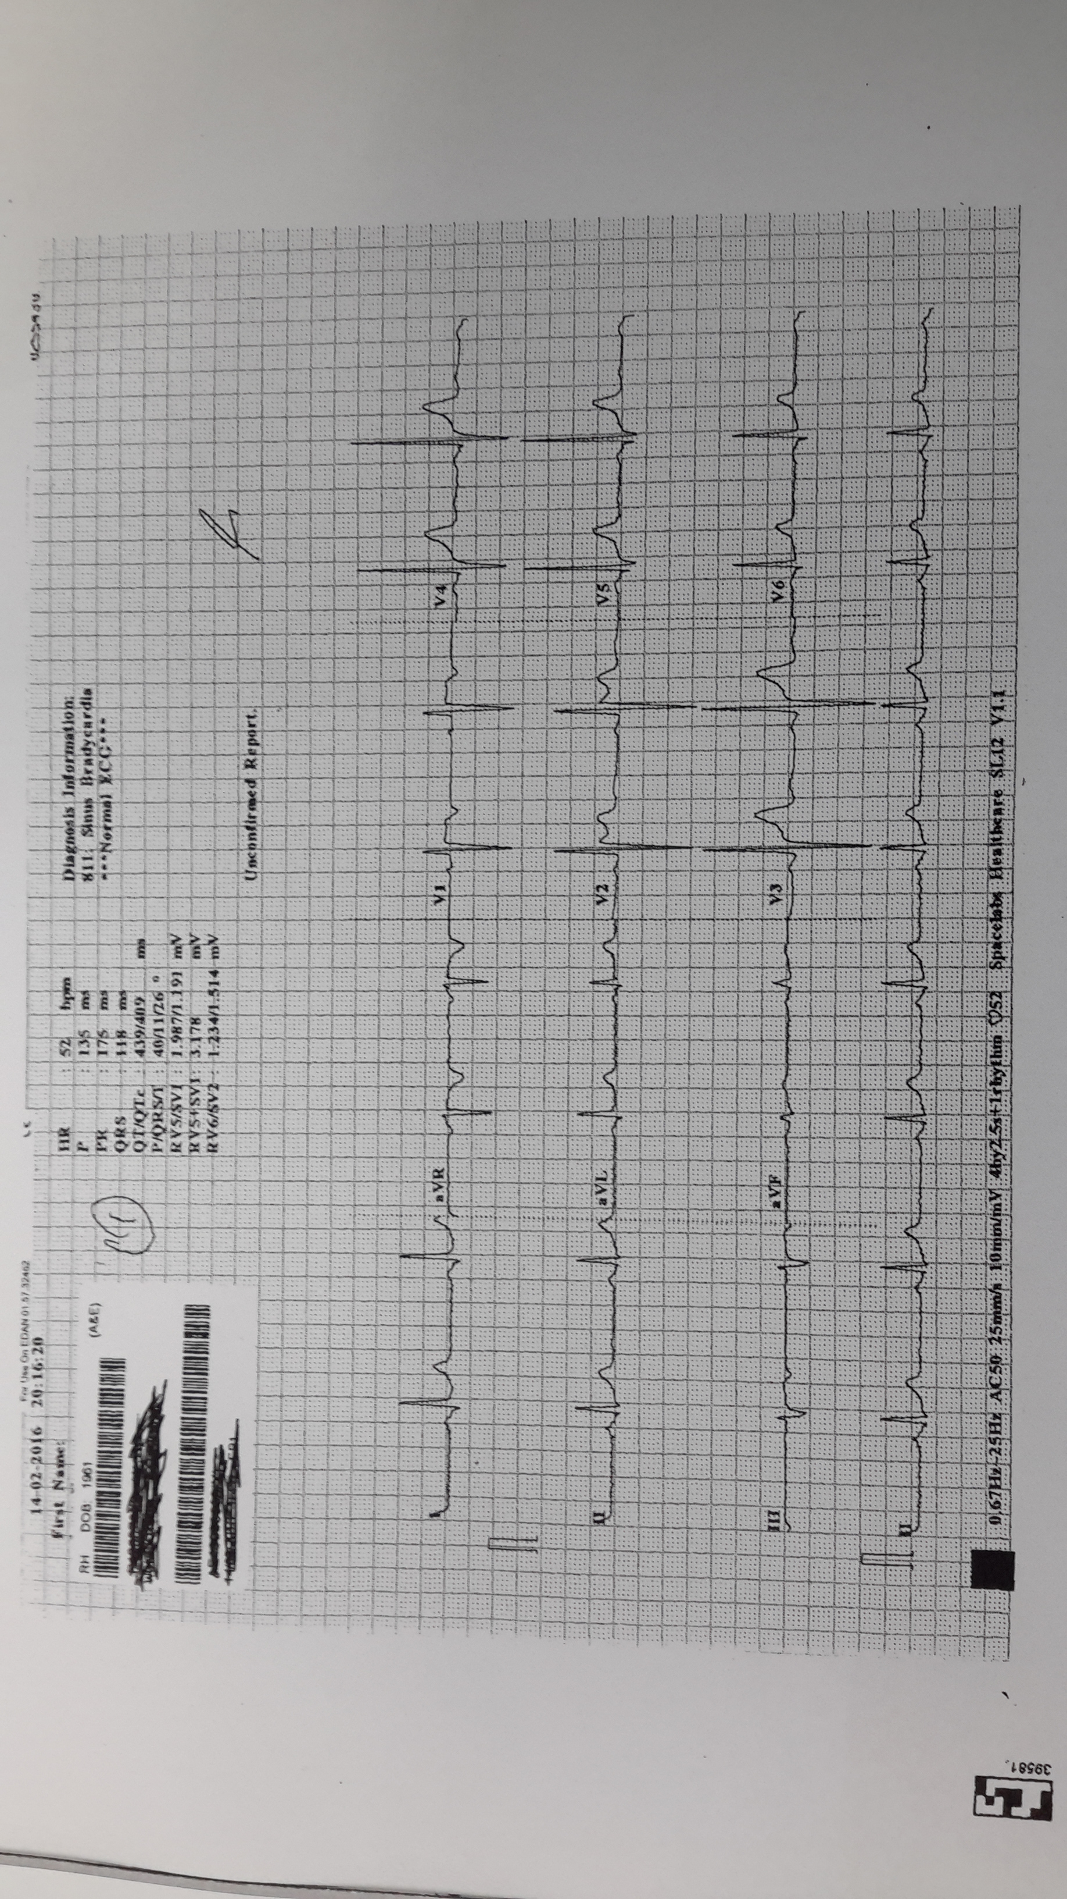
Question4.1 Please comment on the ECG, Is there any method to increase the sensitivity to catch this condition.

Slide 15
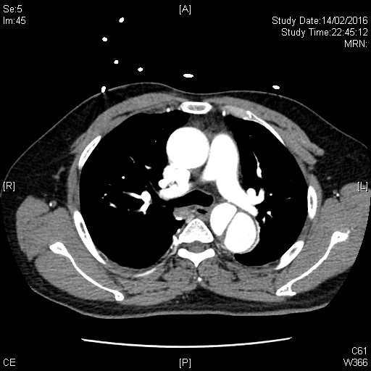
Question4.2 Please comment on the CT thorax.

Slide 16
Question 4.3 What are the management in the emergency department
Question4.4 What is the indications of surgery for the above patient.

Slide 17
Case 5
65 years old man, compliant of sorethroat.

Slide 18
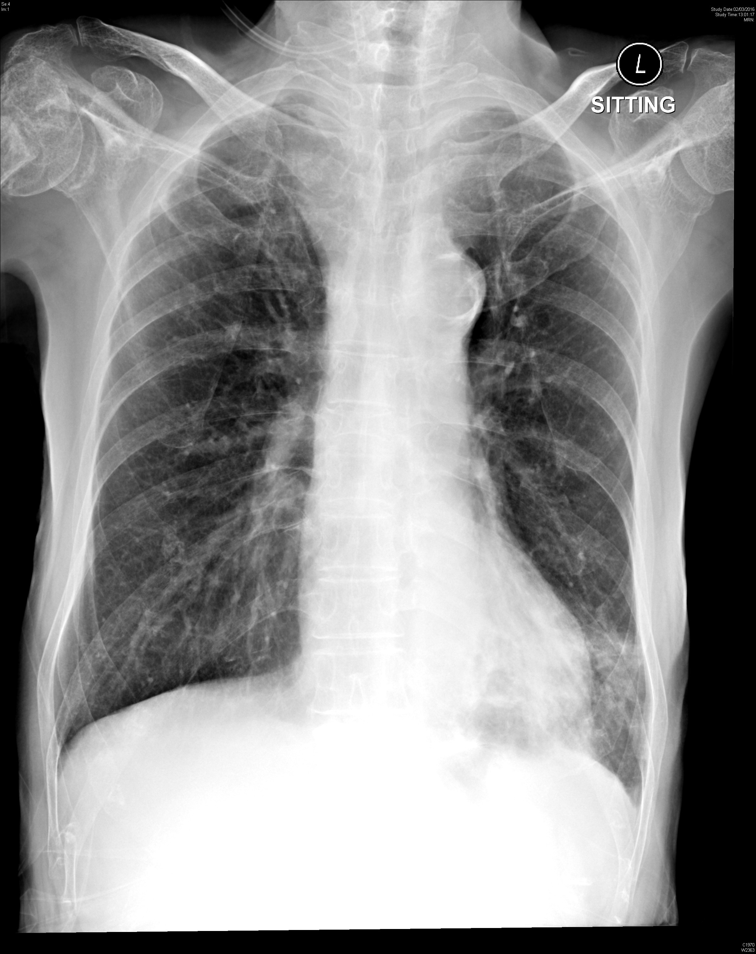
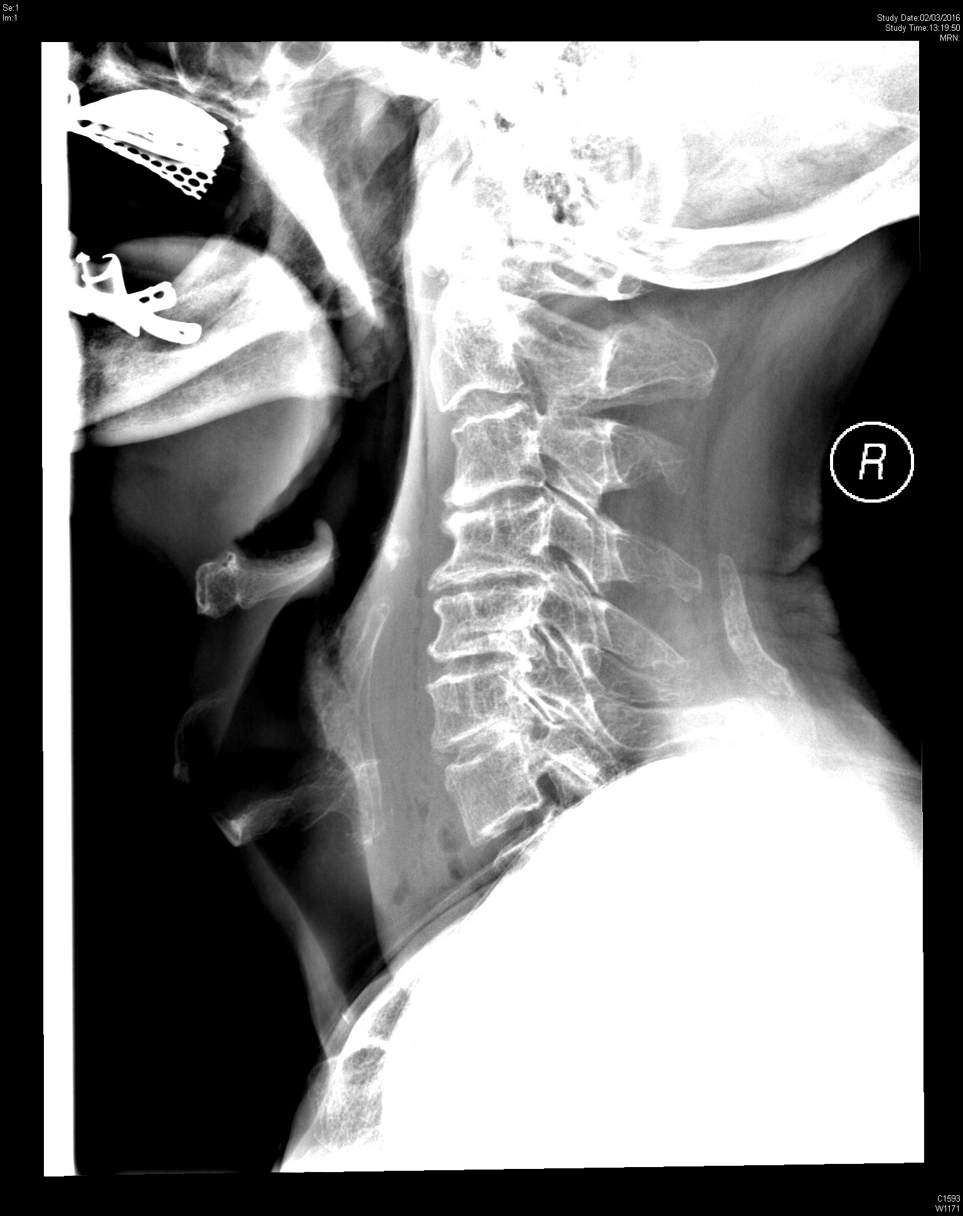
Question5.1 Please comment on the neck X ray and chest X ray

Slide 19
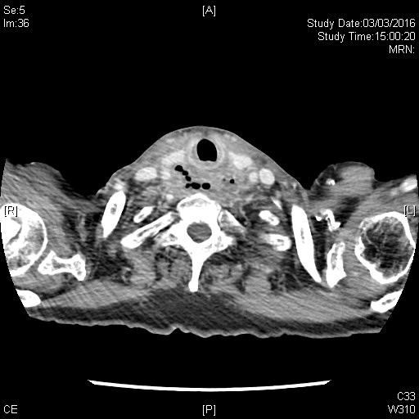
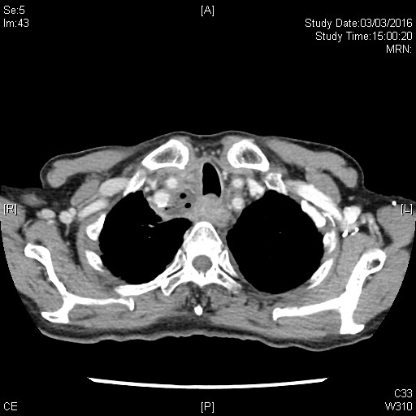
Question5.2 please comment on the CT film for her

Slide 20
Question 5.3 what are the possible causes ?
Question 5.4 What are the Neck X ray finding of FBI ?

Slide 21
Case 6
30 years old man, both eyes were punched by the others three days ago. There is no decrease of vision acuity.

Slide 22
Qestion6.1 Please comment on the Xray.

Slide 23
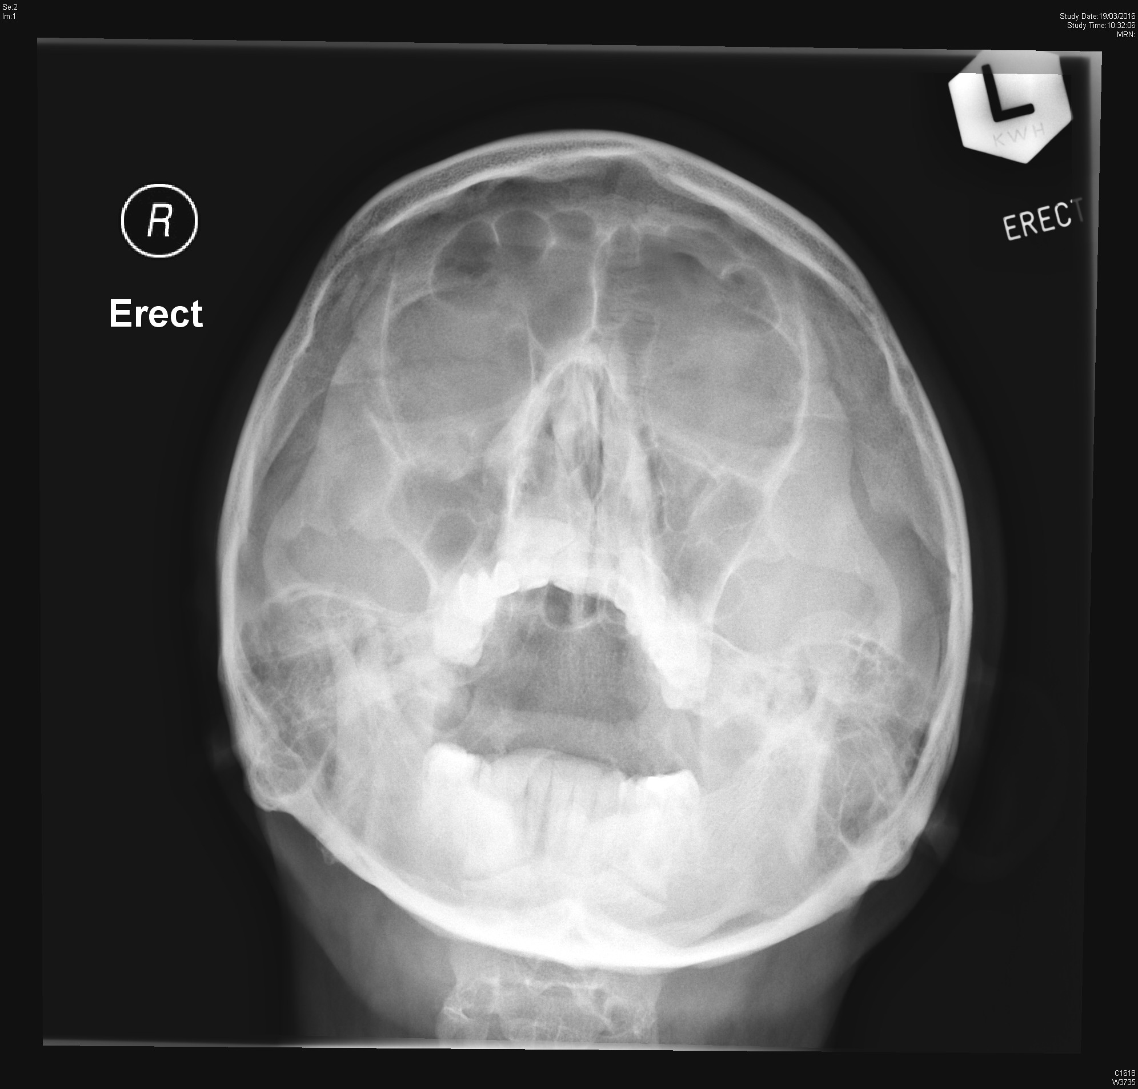

Slide 24
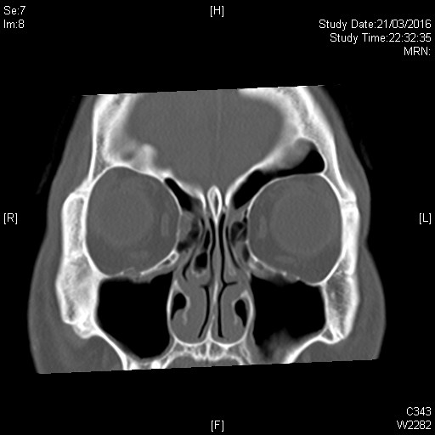
Question6.2 Please comment on the CT film

Slide 25
Question 6.3 What are the physical findings of this condition?
Question 6.4 What is the management plan for him in emergency department?

Slide 26
Case 7
60 years old woman, left frank pain with fever for 3 days.
BP 126/75 P130 temp 38.5

Slide 27
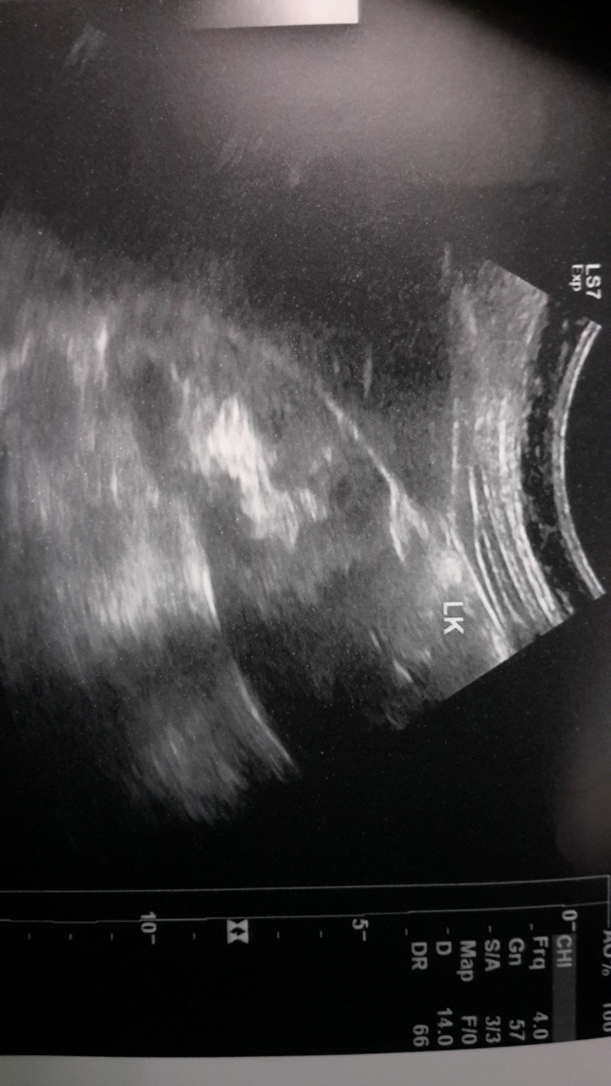
Question 7.1 Please comment on the Ultrasound. What is your diagnosis?

Slide 28
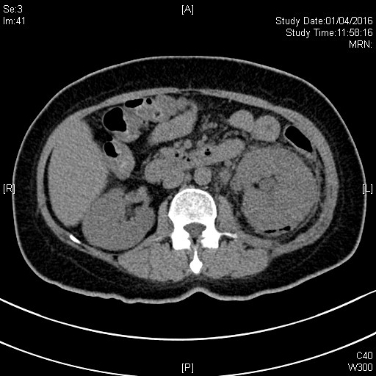
Question 7.2 Please comment on the CT film

Slide 29
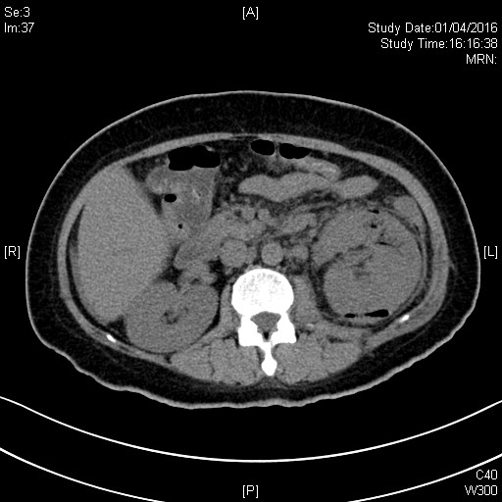
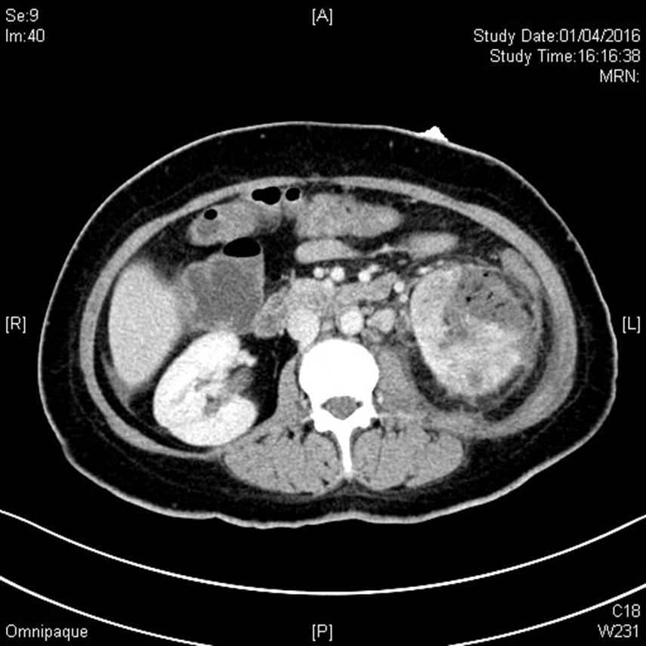
Question 7.3 please comment the CT film after few hours.

