Slide 1
OSCE Answer
PWH AED
8 July 2015

Slide 2
Question 1
50/M
History of DM on insulin
Attended AED for progressive increase in pain in the floor of the mouth, difficulty and painful swallowing for few days. His voice was muffled. No stridor
Vital sign: BP 156/95 mmHg; Pulse 102/min; SpO2 100 at 2L n.c.
Temperature: 38.2 degree celsus

Slide 3
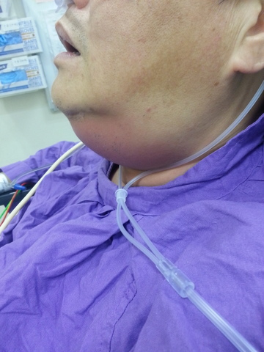

Slide 4
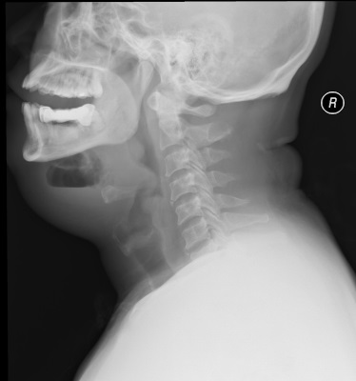
1a. Describe the findings in the X-ray
Soft tissue swelling over the submandibular soft tissue
Gas formation with a fluid level in the affected soft tissue suggestive of abscess formation

Slide 5
1b. What is your diagnosis?
Ludwig’s angina – a bilateral infection of the submandibular space
Submandibular abscess

Slide 6
1c. Describe any 2 physical signs on examination that may suggestive of the diagnosis in 1b
Tender, symmetric swelling and ‘woody’ induration in the submandibular area. Crepitus may be present
The mouth is held open by sublingual swelling
The floor oropharynx may be elevated and erythematous, tender to palpation
Posterior displacement of tongue

Slide 7
1d. What is the common cause/origin of this condition?
Dental infection (lower molar teeth) account for ~ 80% of cases of Ludwig’s angina

Slide 8
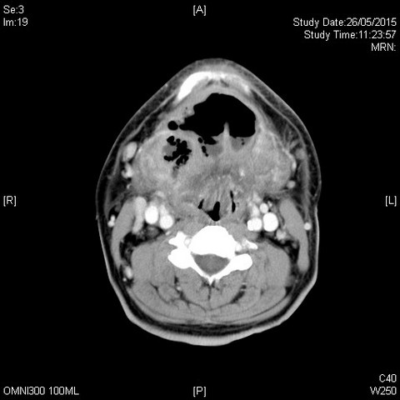
1e. Describe the findings of contrast CT neck
1. Submandibular abscess with gas formation

Slide 9
1f. What is the most important potential complication in this condition?
Airway compromise is a potential complication and require rapid intervention if deteriorate

Slide 10
1g. Outline the management in AED and disposition
Close monitoring for potential upper airway obstruction
Early broad spectrum antibiotic (with aerobic and anaerobic coverage)
Urgent maxillofacial surgeon consultation for incision and drainage of the abscess

Slide 11
Question 2
50/F. History of HT, DM default FU for 3 months
Complained of left loin and back pain for 3 weeks Persistent, radiates to buttock, aggravated by left leg movement. Fever+ Chills+ for 1 week
T 39'C BP 110/80 P 90
Bedside glucose 18
Urine multistix rbc 1+, wcc 1+, nitrate –ve, ketone –ve
PT -ve

Slide 13
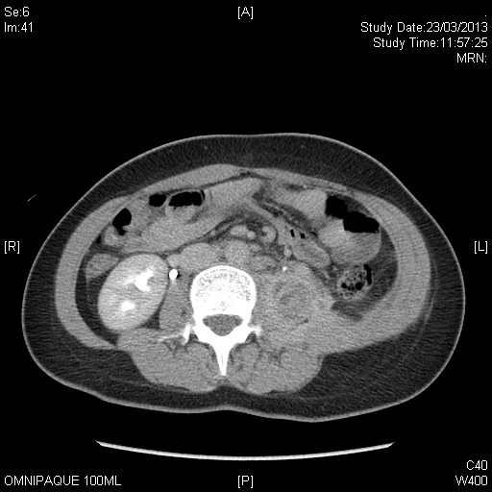
Contrast CT abdomen

Slide 14
2a. Suggest 3 differential diagnosis of fever and left back pain
1. Osteomyelitis/ discitis
2. Epidural abscess
2. Pyelonephritis
3. Endocarditis with seeding to vertebral column
4. Psoas abscess
5. Pneumonia

Slide 15
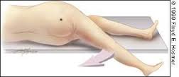
2b. Patient persistently kept her left hip in flexion posture. Pain was elicited when attempt to passively extend her left hip. What is the name of the physical sign being demonstrated?
‘Psoas sign’
- Indicates irritation to the iliopsoas group of hip flexors in the abdomen
- Positive if there is retroperitoneal irritation e.g. inflamed appendix is retrocaecal in orientation, psoas abscess, haemorrahge of iliac vessel

Slide 16
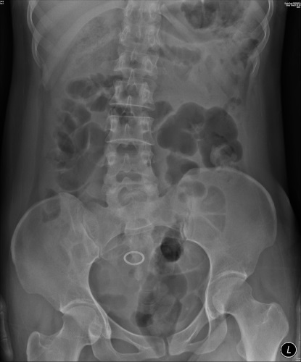
2c. Describe the KUB findings
1. Presence of IUCD
2. Loss of left psoas muscle definition
Right psoas line can be define

Slide 17
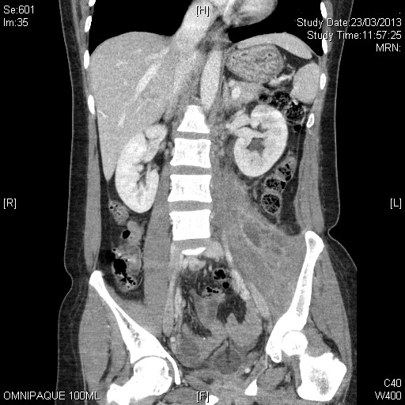
2d. Describe the findings in the CT abdomen
1. Enlarged left psoas muscle with multiple septated cystic lesion within it → Psoas abscess
2. Mild left hydronephrosis

Slide 18
2e. Outline subsequent management plan for this patient
1. Prompt Intravenous antibiotic after septic workup (blood culture, urine culture)
2. US/CT guided drainage of left psoas abscess.

Slide 19
Question 3
25/M
Episodic palpitation for few years
No associated with chest pain

Slide 20
ECG 1 (Asymptomatic)

Slide 21
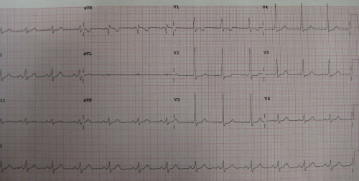
3a. List TWO abnormalities in the ECG 1
ECG 1
1. Short PR interval < 120ms
2. Delta wave – slurring slow rise of initial portion of QRS
3. Positive R in V1

Slide 22
3b. What is the diagnosis and what cause of this problem?
Wolff–Parkinson–White syndrome, type A
A congenital problem with the present of an accessory pathway - Bundle of Kent – between atria and ventricle

Slide 23
3c. Patient suddenly develop an arrhythmia, describe the ECG findings and what is the diagnosis?
ECG 2
HR > 200/min
Irregular wide QRS complex rhythm
QRS complex change in shape and morphology
Unlike in polymorphic VT, axis remain stable
Diagnosis is WPW in AF

Slide 24
3d. Your colleague suggest to try iv 5mg verapamil to treat the condition in ECG2. What is your opinion? What is the treatment option for this arrhythmia?
Verapamil (or any AV blocking drugs) is contraindicated in WPW with AF because it may increase conduction via accessory pathway with a resultant increase in ventricular rate and possible degeneration into VT/VF
For haemodynamic unstable patient, treatment is synchronized DC cardioversion.
Medical treatment options in stable patient is procainamide

Slide 25
3e. Beside the arrhythmia showed in ECG 2. Name another 2 arrhythmias that could occur in the medical condition in question 3b
1. Orthodromic atrioventricular re-entry tachycardia (a form of SVT)
2. AV re-entry tachycardia with antidromic conduction (regular wide complex tachycardia, usually treat as VT in EM setting)

Slide 26
3g. After the arrhythmia settled and stabilized. What is definitive treatment for this patient to prevent arrhythmia in future?
Destruction of the abnormal electrical pathway by radiofrequency catheter ablation

Slide 27
Question 4
59/F. History of DM, HT, hyperlipidaemia
Current medication: Metformin, diamicron, atenolol, lisinopril, simvastatin
Tightness in her throat and lip swelling while sleeping in the middle of night
No skin rash or itchiness
Vital sign BP 138/77, pulse 80/min, SpO2 98 RA
Patient revealed she had 2 episodes of similar lip swelling in recent 2 month

Slide 29
4a. What is the diagnosis?
Angioedema (mainly affect the upper lip)

Slide 30
4b. What medication she currently taking could account for her recurrent attack of the condition?
Lisinopril (ACEI induced angioedema- urticaria and skin itchiness are typically absent)
This patient recently had Lisinopril step up from 5mg to 10mg daily in GOPD. The 1st episode of angioedema was 3 weeks after increasing the dosage of this medication

Slide 31
4c. The condition is now confirmed due to the medication mentioned in 4b. The patient had received iv antihistamine and hydrocortisone, imi epinephrine but lack of response. What is the reason? Name the mediator involved in that condition
ACEI precipitate attacks of angioedema by directly interfering the degradation of braydkinin
Antihistamines, glucocorticoids, and epinephrine are effective to treat allergic, histamine-induced angioedema. They are not known to alter levels of bradykinin and are usually considered ineffective or minimally effective in treating ACE inhibitor-induced angioedema

Slide 32
4d. Outline the management plan
1. The initial goal of therapy is airway management. Repeatedly monitored the airway until the swelling clearly resolving
2. Stop ACEI (Lisinopril) and change to another class anti-HT medication– Angioedema usually resolve within 24 to 72 hours.

Slide 33
4e. Name 1 specific therapies that may be helpful in severe and progressing symptoms.
1. FFP ( serum contain the enzyme ACE)
Case reports have described administration of FFP leading to rapid improvement of ACE inhibitor-induced angioedema without further recurrence of symptoms
Karim MY, Masood A. J Allergy Clin Immunol. 2002;109(2):370.
Hassen GW et al. J Emerg Med. 2013;44(4):764
The usual dose of plasma is 2 units for adults.
Swelling usually resolved within two to four hours of plasma administration

Slide 34
2. Icatibant
A synthetic bradykinin B2 receptor antagonist
Has recently also been shown to be effective for the treatment of ACE inhibitor-related angioedema in a phase 2 randomized trial of 27 adults presenting to the emergency department with angioedema of the upper aerodigestive tract
BaşM et al. N Engl J Med. 2015 Jan;372(5):418-25

Slide 35
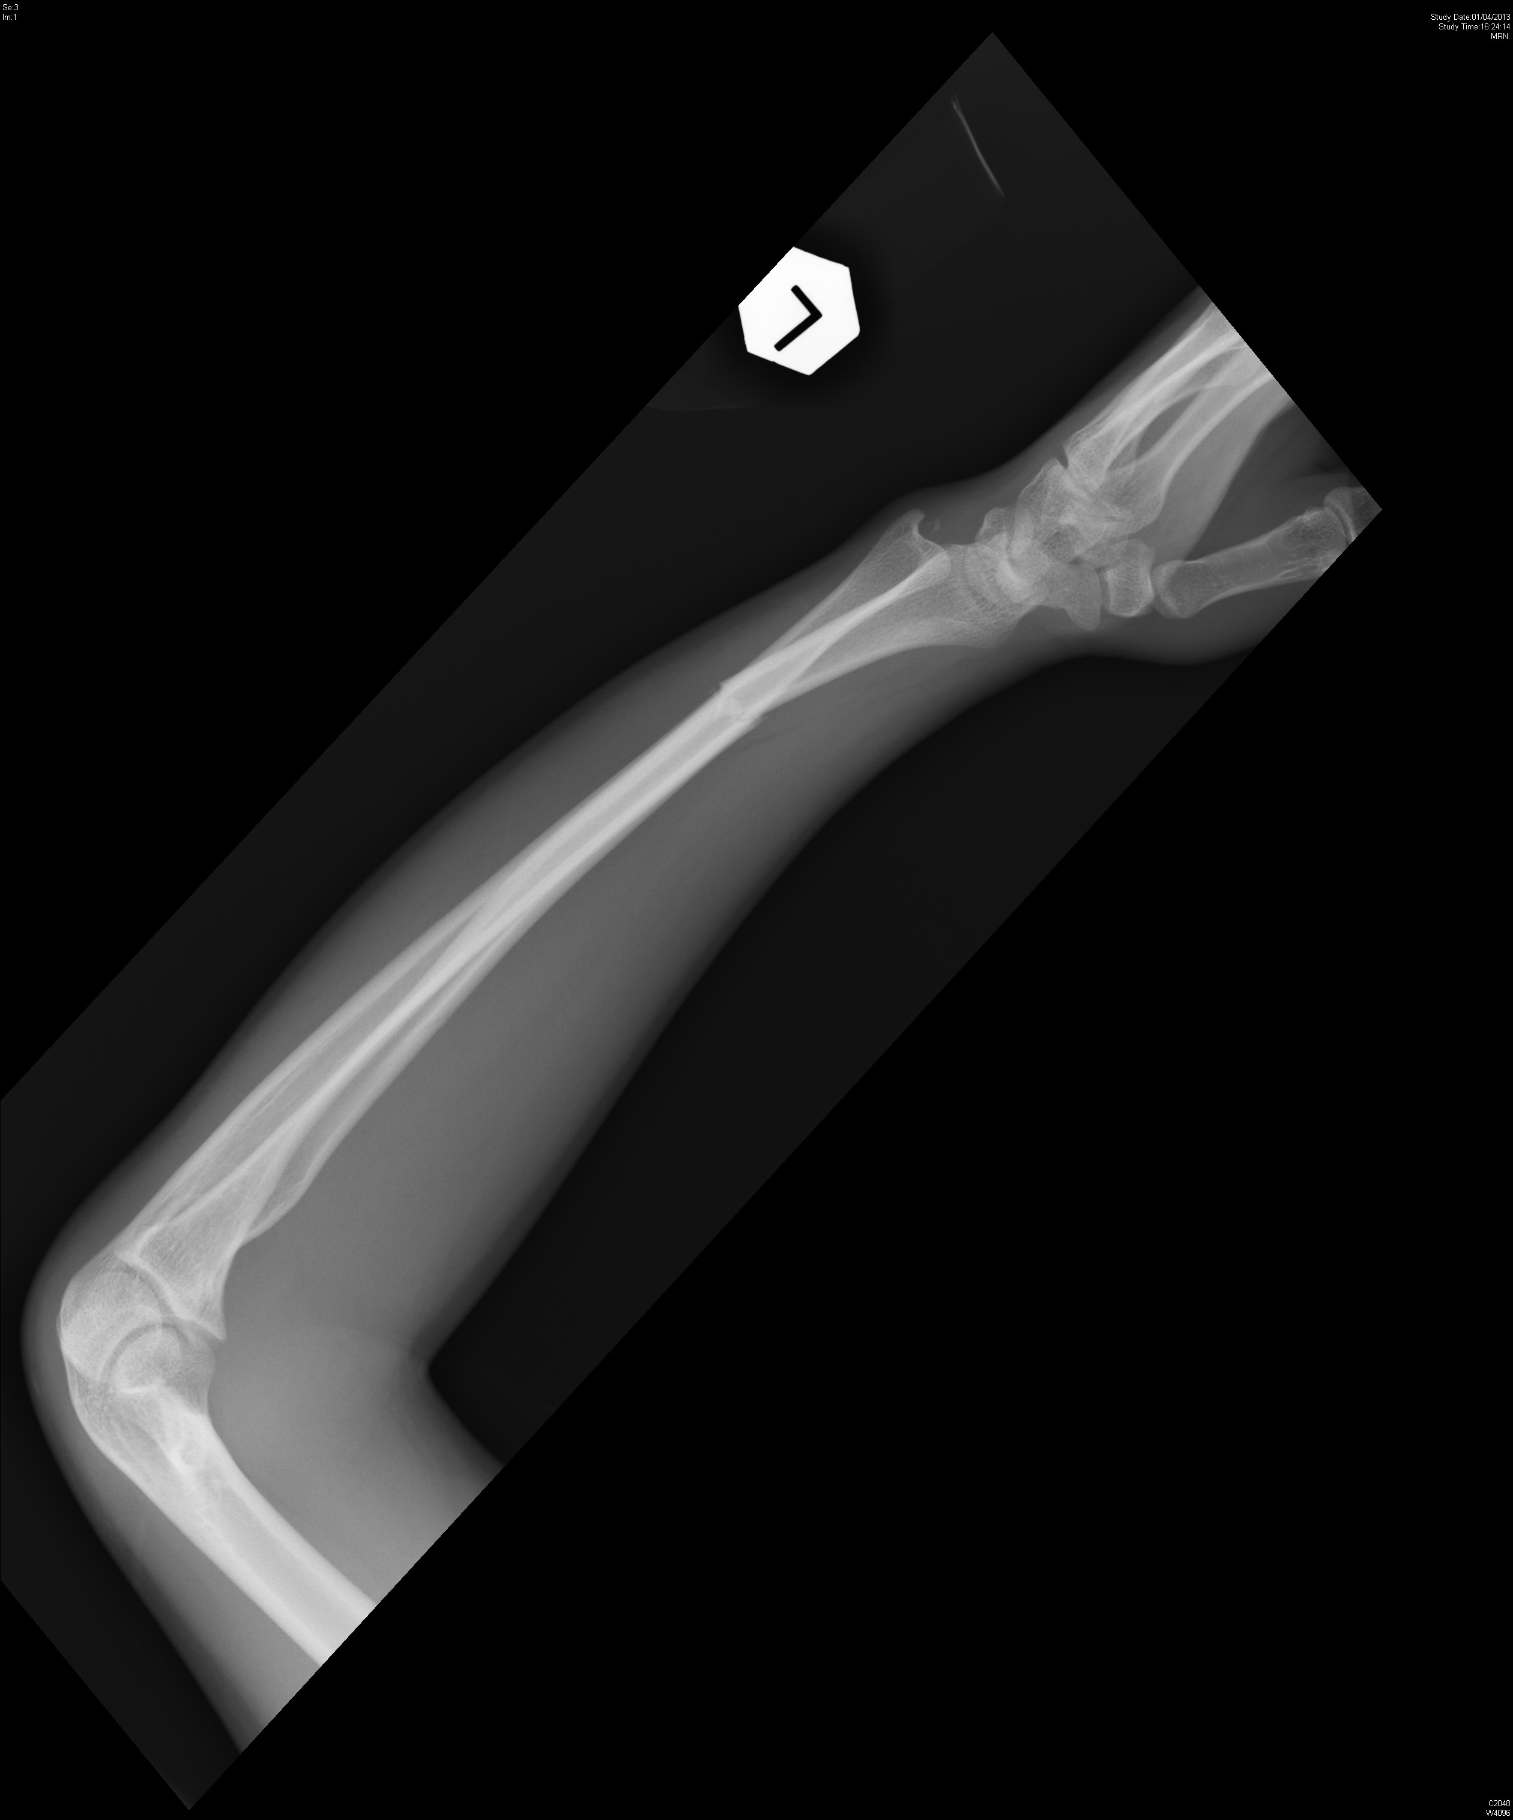
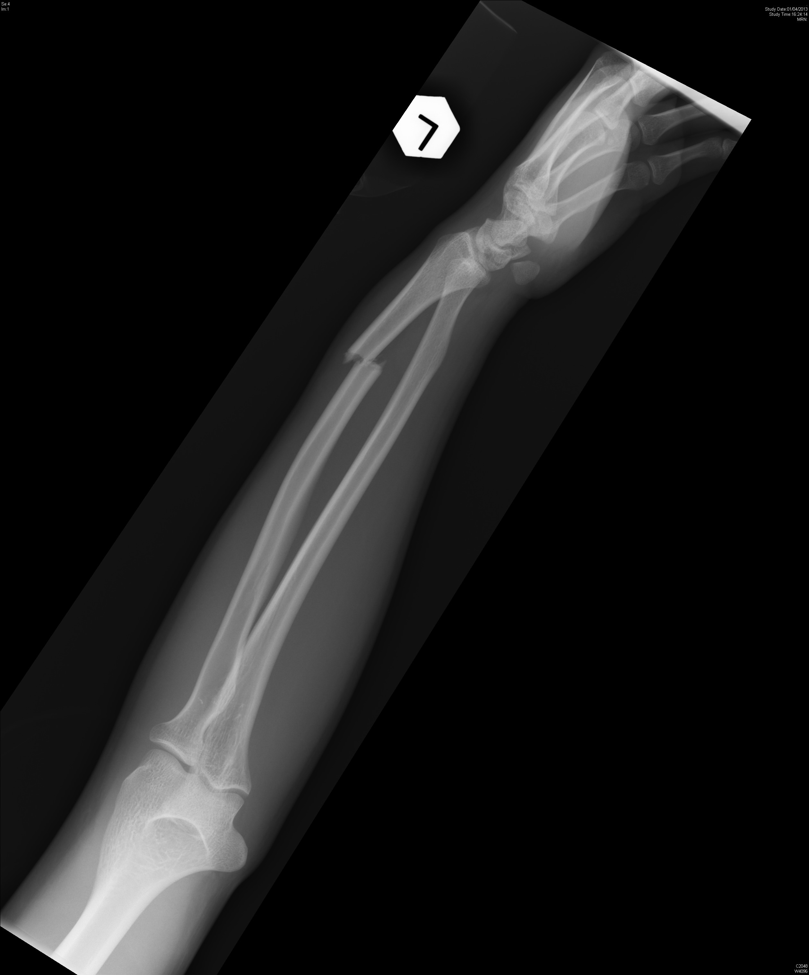
Question 5a. 20/M fell on left outstretched hand during football game. No external wound. What is the diagnosis and definitive management?
Displaced fracture at the junction of distal 1/3 and middle 1/3 of the radius
Dislocation of distal radioulnar joint
Dx is Galeazzi fracture-dislocation
Treatment is operative- ORIF

Slide 36
Question 5b.
31/M
Body building trainer. Tripped and fell with right hand hit onto ground
Right hand pain. Swelling over dorsum of right hand. No external wound
X-ray right hand taken. What is the diagnosis and definitive management?

Slide 37
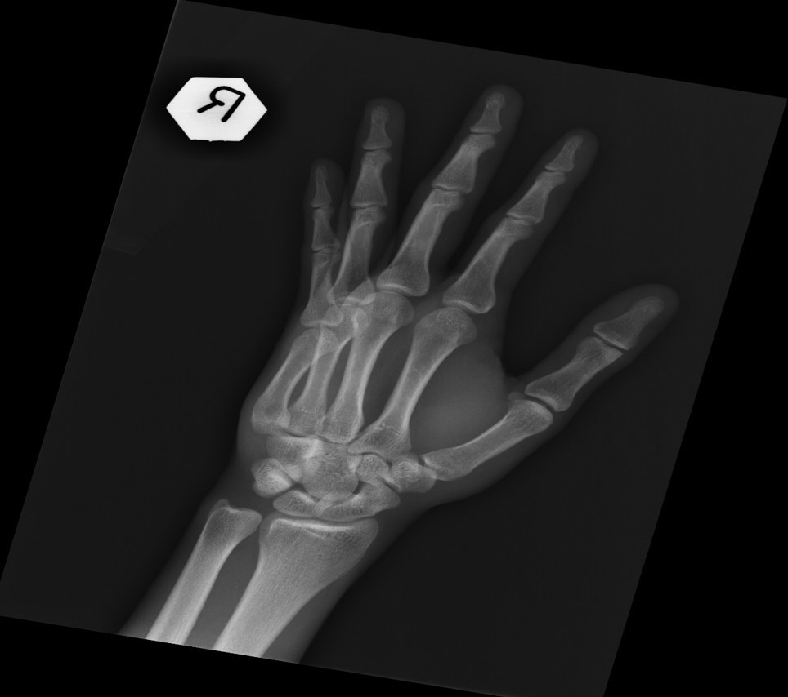

Slide 38
Diagnosis: right 5th carpometacarpal joint dorsal dislocation
(An easily missed diagnosis, a case series in UK reviewed 21 cases of dorsal dislocation of CMC joint, in 15 of them the diagnosis was missed when they first seen in an AED)
Henderson etc 1987 British Editorial Society of Bone and Joint Surgery
Treatment: This dislocation is usually unstable and often require operative K-wire fixation after close reduction

Slide 39
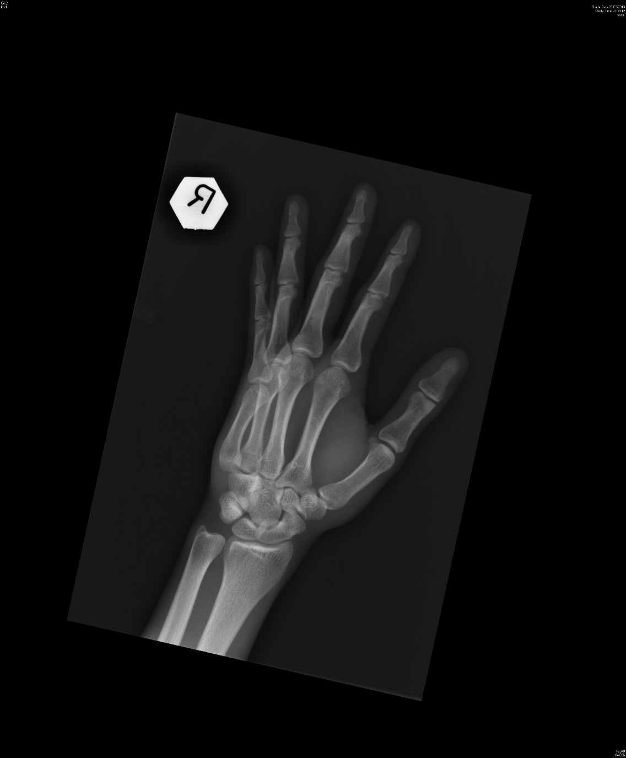
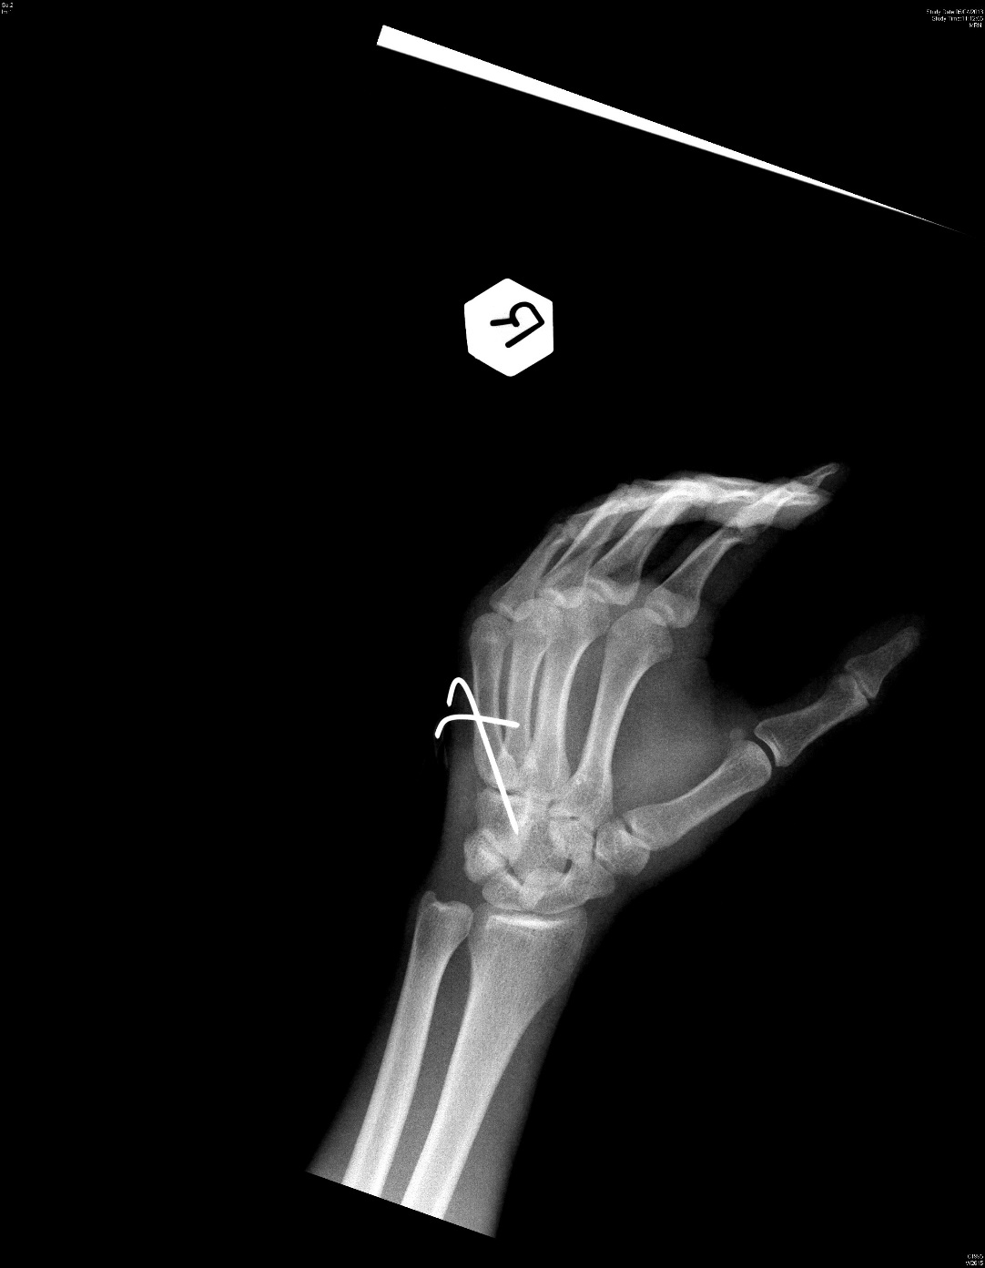
Pre-operative film Post-operative film

Slide 40
The End

