Slide 1
JCM - answer HKCEM
1/4/2015
TKOHAED
CY Lee
Hinson Li
Ludwig Tsoi

Slide 2
Case 1
M/18
Bicycle rider
Fell and smacked his right shoulder
o/e:
Right shoulder swollen, tender, unable to lift right arm above shoulder level

Slide 4
Questions
What is/are the radiological finding(s)? (3 marks)
What is the most appropriate management for this condition? (1 mark)
When will you instruct your patient to start upper limb pendulum exercise or other mobilization exercise? (1 mark)

Slide 5
Questions
His mother arrived and inquired the prognosis for this patient? (1 mark) Generally speaking, what are the poor prognostic factors? (3 marks)
An orthopedic surgeon popped in and asked about the “Neer classification”. What is “Neer classification” for? (1 mark)

Slide 6
What is/are the radiological finding(s)? (3 marks)
Simple non-displaced fracture of the surgical neck of right humerus
Without “surgical” – at most 1 mark
“anatomical” 0 mark
Cannot spot the humeral fracture 0 mark (e.g. “dislocation”)

Slide 7
What is the most appropriate management for this condition? (1 mark)
Board arm sling (or collar & cuff sling) for 4-6 weeks

Slide 8
When will you instruct your patient to start upper limb pendulum exercise (or other mobilization exercise)? (1 mark)
1-2 weeks (single answer or range acceptable)

Slide 9
His mother arrived and inquired the prognosis for this patient? (1 mark) Generally speaking, what are the poor prognostic factors? (3 marks)
Good (1 mark)
Poor prognostic factors:
Old age (1 mark)
Displaced fracture (1 mark)
And either one of the below: (1 mark)
3-part or 4-part fracture (Neer classification)
Type C (AO classification)
Court-Brown CM, McQueen MM, Tornetta P. Trauma. Lippincott Williams & Wilkins. (2005)

Slide 10
An orthopedic surgeon popped in and asked about the “Neer classification”. What is “Neer classification” for? (1 mark)
Neer classification of proximal humeral fracture – for fracture of proximal humerus

Slide 12
Case 2
F/65 non-smoker
Known case of hypertension on regular medication FU GOPC
c/o cough, and increasing shortness of breath for 2 days
She was seen by GP and Dx “asthma” and given Salbutamol syrup and inhaler

Slide 13
Case 2
BP 148/95 pulse 120
RR 24
SpO2 92% on 2L/min nasal canal O2
o/e: chest – bilateral wheezing
ECG – sinus tachycardia 120
Next - CXR

Slide 15
Questions
Describe the CXR findings. (3 marks)
Pulse rate was 90 before the GP’s drugs. A senior doctor saw the patient and Dx “cardiac asthma.” Do you agree? (1 mark)
List 3 pathophysiological changes of small airways in asthma. (3 marks)

Slide 16
Questions
“Salbutamol is not only useless, but can be detrimental in cardiac asthma.” Do you agree? (1 mark) Why? (2 mark)

Slide 17
Describe the CXR findings (3 marks)
Cardiomegaly
Upper lobe diversion
Increased lower lobe lung markings
Other reasonable negative findings: (allow one only)
E.g. No definitive consolidation / hyperinflation / pneumothorax / pleural effusion / SOL / oligemia

Slide 18
Pulse rate was 90 before the GP’s drugs. A senior doctor saw the patient and Dx “cardiac asthma.” Do you agree? (1 mark)
Yes

Slide 19
List 3 pathophysiological changes of small airways in asthma. (3 marks)
Smooth muscle constriction
Mucosal edema
Inflammation

Slide 20
“Salbutamol is not only useless, but can be detrimental to cardiac asthma.” Do you agree? (1 mark) Why? (2 mark)
Agree (1 mark)
Salbutamol will cause tachycardia, which in turn will worsen the heart failure

Slide 22
Case 3
M/34
Presented with “flu-like” symptoms for 3 months. No improvement with GP’s treatment.
c/o right nostril blockade for one day

Slide 24
Questions
Describe what you see in the photo. (1 mark)
What are the differential diagnoses? (4 marks)
An Xray was ordered. Describe the Xray findings. (see next slide) (2 marks)

Slide 26
Questions
The patient suddenly developed torrential anterior and posterior nasal bleeding. What are the methods to stop nasal bleeding? (3 marks)

Slide 27
Describe what you see in the photo. (1 mark)
A freshy growth in the right nostril 1-2 cm from the nostril

Slide 28
What are the differential diagnoses? (4 marks)
4 of the following:
Maxillary sinus carcinoma
Nasal polyp
Hemangioma
Cystic Fibrosis
Neuroblastoma
Neurofibromatosis
Rhabdomyosarcoma
Sinusitis
Any reasonable answer (*NPC not acceptable)

Slide 29
An Xray was ordered. Describe the Xray findings. (see next slide) (2 mark)
A homogenous mass lesion in the Rt maxillary antrum protruding thru the lower part of the medial wall of the antrum
Do not accept:
Fluid level
Retention change

Slide 30
The patient suddenly developed torrential anterior and posterior nasal bleeding. What are the methods to stop nasal bleeding? (3 marks)
Local pressure (pinching the soft part of the nose)
Sponge nasal packing (e.g. Ivalon)
Nasal epistat (double-ballon type catheter)
Foley catheter

Slide 32
Question 4
M/28 professional singer and artist
After a trivial head injury, he sought medical advice from a private hospital. CT scan brain was performed (see next 2 slides). At present he is totally asymptomatic and is performing as usual.

Slide 33
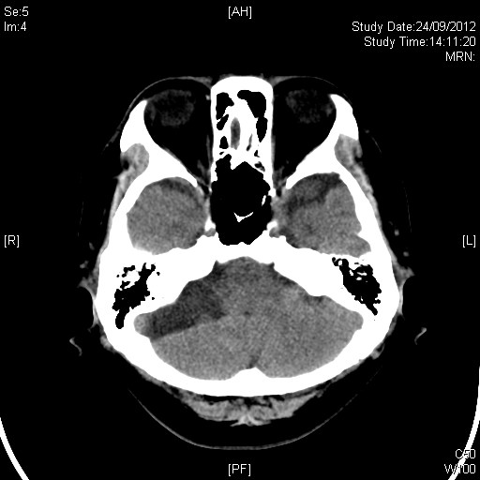

Slide 34
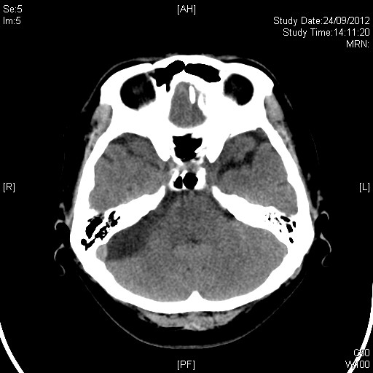

Slide 35
Questions
What radiological abnormalities do you see? (3 marks)
What is the likely diagnosis? (1 mark)
The private hospital persuaded patient to do an MRI for better delineation of the lesion. Do you agree? (1 mark) Why? (1 marks)

Slide 36
Questions
The patient said he fell from bed 2 weeks ago and bumped his occiput which resulted in a hematoma 4cm in diameter. He wants to know could this incident account for his CT lesion (1 mark), and why? (1 mark)
His mother popped up and asked, “What treatment(s) is/are necessary?” (1 marks) Why? (1 mark)

Slide 37
What radiological abnormalities do you see? (3 marks)
Well circumscribed hypodense lesion (of CSF quality) in the right posterior cranial fossa
Wrong side / fossa – no mark
Wrong pathology (e.g. bleeding) – no mark

Slide 38
What is the likely diagnosis? (1 mark)
Arachnoid cyst

Slide 39
The private hospital persuaded patient to do an MRI for better delineation of the lesion. Do you agree? (1 mark) Why? (1 marks)
Yes
Arachnoid cyst – Diagnosis is principally made by MRl.

Slide 40
The patient said he fell from bed 2 weeks ago and bumped his occiput which resulted in a hematoma 4cm in diameter. He wants to know could this incident account for his CT lesion (1 mark), and why? (1 mark)
No
It is congenital

Slide 41
His mother popped up and asked, “What treatment(s) is/are necessary?” (1 marks) Why? (1 mark)
No treatment is needed as long as the patient is asymptomatic.

Slide 43
Case 5
F/1
Uneventful delivery, normal developmental milestones
c/o cough for one week, seen by GP with no improvement
The triage nurse heard quirky breath sound and brought her to you

Slide 44
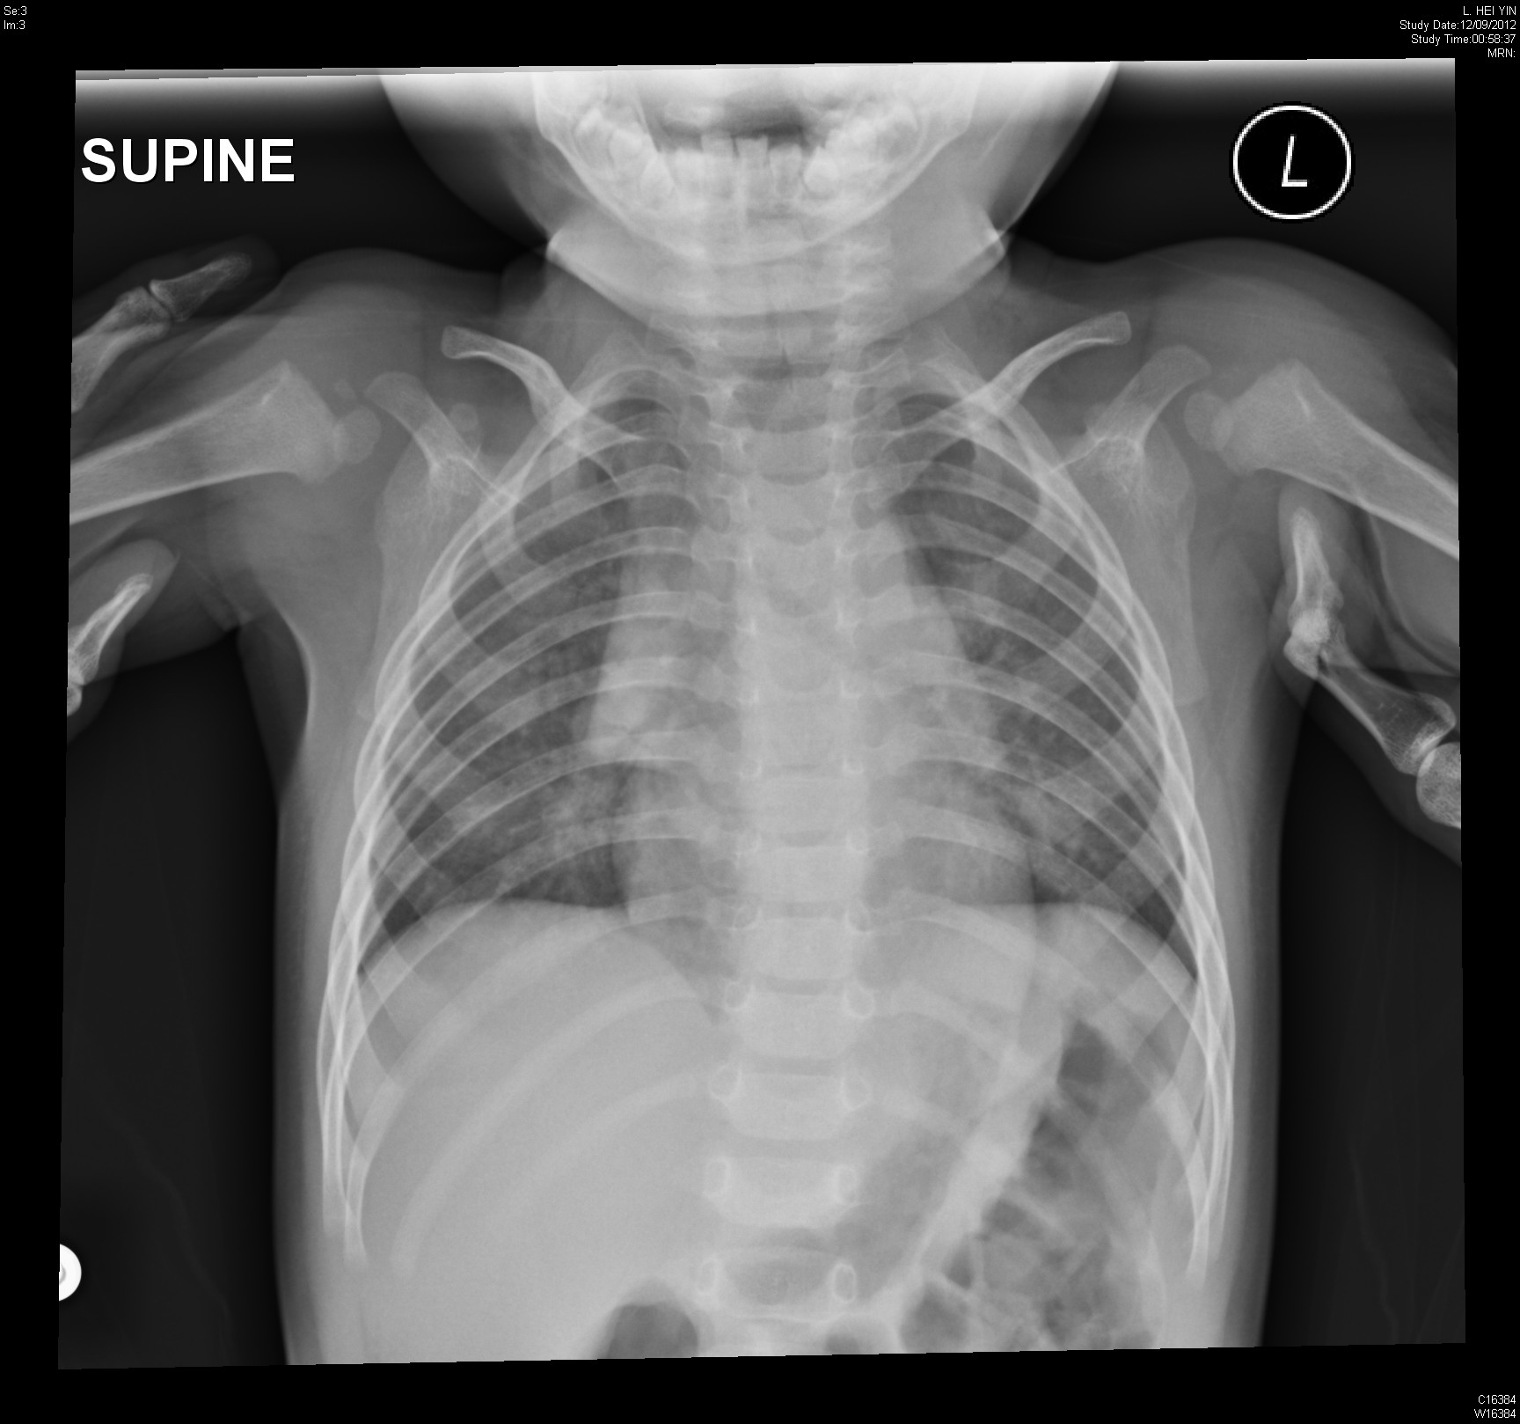

Slide 45
Questions
Describe the CXR findings. (3 marks)
What is the diagnosis? (2 marks)
What is the “quirky” sound in medical terms? (1 mark)
What specific treatments are indicated for this condition? (2 marks)
Her mother asked what is the likely etiological cause of the condition? (1 marks) Why? (1 mark)

Slide 46
Describe the CXR findings. (3 marks)
Steeple sign (=wine bottle sign)
Thymic shadow
Increase in bilateral lower lobe haziness
Other significant negative findings (allow one)

Slide 47
What is the diagnosis? (2 marks)
Laryngotracheobronchopneumonitis (2 marks)
Croup (=acute laryngotracheobronchitis)
Bronchopneumonia (o.5 mark)
Pneumonia (0.5 mark)
Croup in the broadest sense can also include Laryngotracheobronchopneumonitis

Slide 48
What is the “quirky” sound in medical terms? (1 mark)
Inspiratory stridor
Do not accept
Wheezing

Slide 49
What specific treatments are indicated for this condition? (2 marks)
Adrenaline nebulizer
Steroid (dexamethasone)
Do not accept
Nebulized salbutamol

Slide 50
Her mother asked what is the likely etiological cause of the condition? (1 marks) Why? (1 mark)
Bacterial and viral causes can lead to croup
More likely bacterial here
Involvement of “bronchopneumonia” on top of croup
Cherry JD (2008). "Clinical practice. Croup". N. Engl. J. Med. 358 (4): 384–91.

Slide 51
End
Thank you

