Slide 1
JCM - question HKCEM
1/4/2015
TKOHAED
CY Lee
Hinson Li
Ludwig Tsoi

Slide 2
Case 1
M/18
Bicycle rider
Fell and smacked his right shoulder
o/e:
Right shoulder swollen, tender, unable to lift right arm above shoulder level

Slide 4
Questions
What is/are the radiological finding(s)? (3 marks)
What is the most appropriate management for this condition? (1 mark)
When will you instruct your patient to start upper limb pendulum exercise (or other mobilization exercise)? (1 mark)

Slide 5
Questions
His mother arrived and inquired the prognosis for this patient? (1 mark) Generally speaking, what are the poor prognostic factors? (3 marks)
An orthopedic surgeon popped in and asked about the “Neer classification”. What is “Neer classification” for? (1 mark)

Slide 6
Case 2
F/65 non-smoker
Known case of hypertension on regular medication FU GOPC
c/o cough, and increasing shortness of breath for 2 days
She was seen by GP and Dx “asthma” and given Salbutamol syrup and inhaler

Slide 7
Case 2
BP 148/95 pulse 120
RR 24
SpO2 92% on 2L/min nasal canal O2
o/e: chest – bilateral wheezing
ECG – sinus tachycardia 120
Next - CXR

Slide 9
Questions
Describe the CXR findings. (2 marks)
Pulse rate was 90 before the GP’s drugs. What are the possible differential diagnoses in this patient? (2 marks)

Slide 10
Questions
List 3 pathophysiological changes of small airways in asthma. (3 marks)
A senior doctor commented that this is a case of cardiac asthma. What do you understand by term “cardiac asthma”? (1 mark)
“Salbutamol is not only useless, but can be detrimental in cardiac asthma.” Do you agree? (1 mark) Why? (1 mark)

Slide 11
Case 3
M/34
Presented with “flu-like” symptoms for 3 months. No improvement with GP’s treatment.
c/o right nostril blockade for one day

Slide 13
Questions
Describe what you see in the photo. (1 mark)
What are the differential diagnoses? (4 marks)
An Xray was ordered. Describe the Xray findings. (see next slide) (2 marks)

Slide 15
Questions
The patient suddenly developed torrential anterior and posterior nasal bleeding. What are the methods to stop nasal bleeding? (3 marks)

Slide 16
Question 4
M/28 professional singer and artist
After a trivial head injury, he sought medical advice from a private hospital. CT scan brain was performed (see next 2 slides). At present he is totally asymptomatic and is performing as usual.

Slide 17
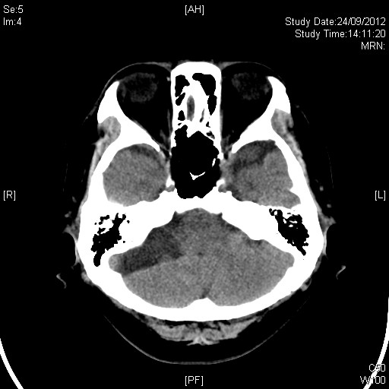

Slide 18
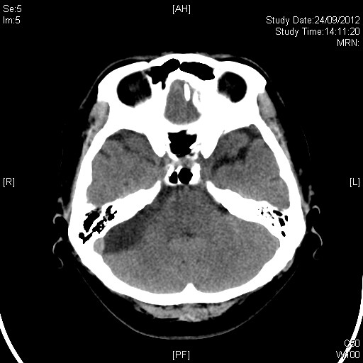

Slide 19
Questions
What radiological abnormalities do you see? (3 marks)
What is the likely diagnosis? (1 mark)
The private hospital persuaded patient to do an MRI for better delineation of the lesion. Do you agree? (1 mark) Why? (1 marks)

Slide 20
Questions
The patient said he fell from bed 2 weeks ago and bumped his occiput which resulted in a hematoma 4cm in diameter. He wants to know could this incident account for his CT lesion (1 mark), and why? (1 mark)
His mother popped up and asked, “What treatment(s) is/are necessary?” (1 marks) Why? (1 mark)

Slide 21
Case 5
F/1
Uneventful delivery, normal developmental milestones
c/o cough for one week, seen by GP with no improvement
The triage nurse heard quirky breath sound and brought her to you

Slide 22
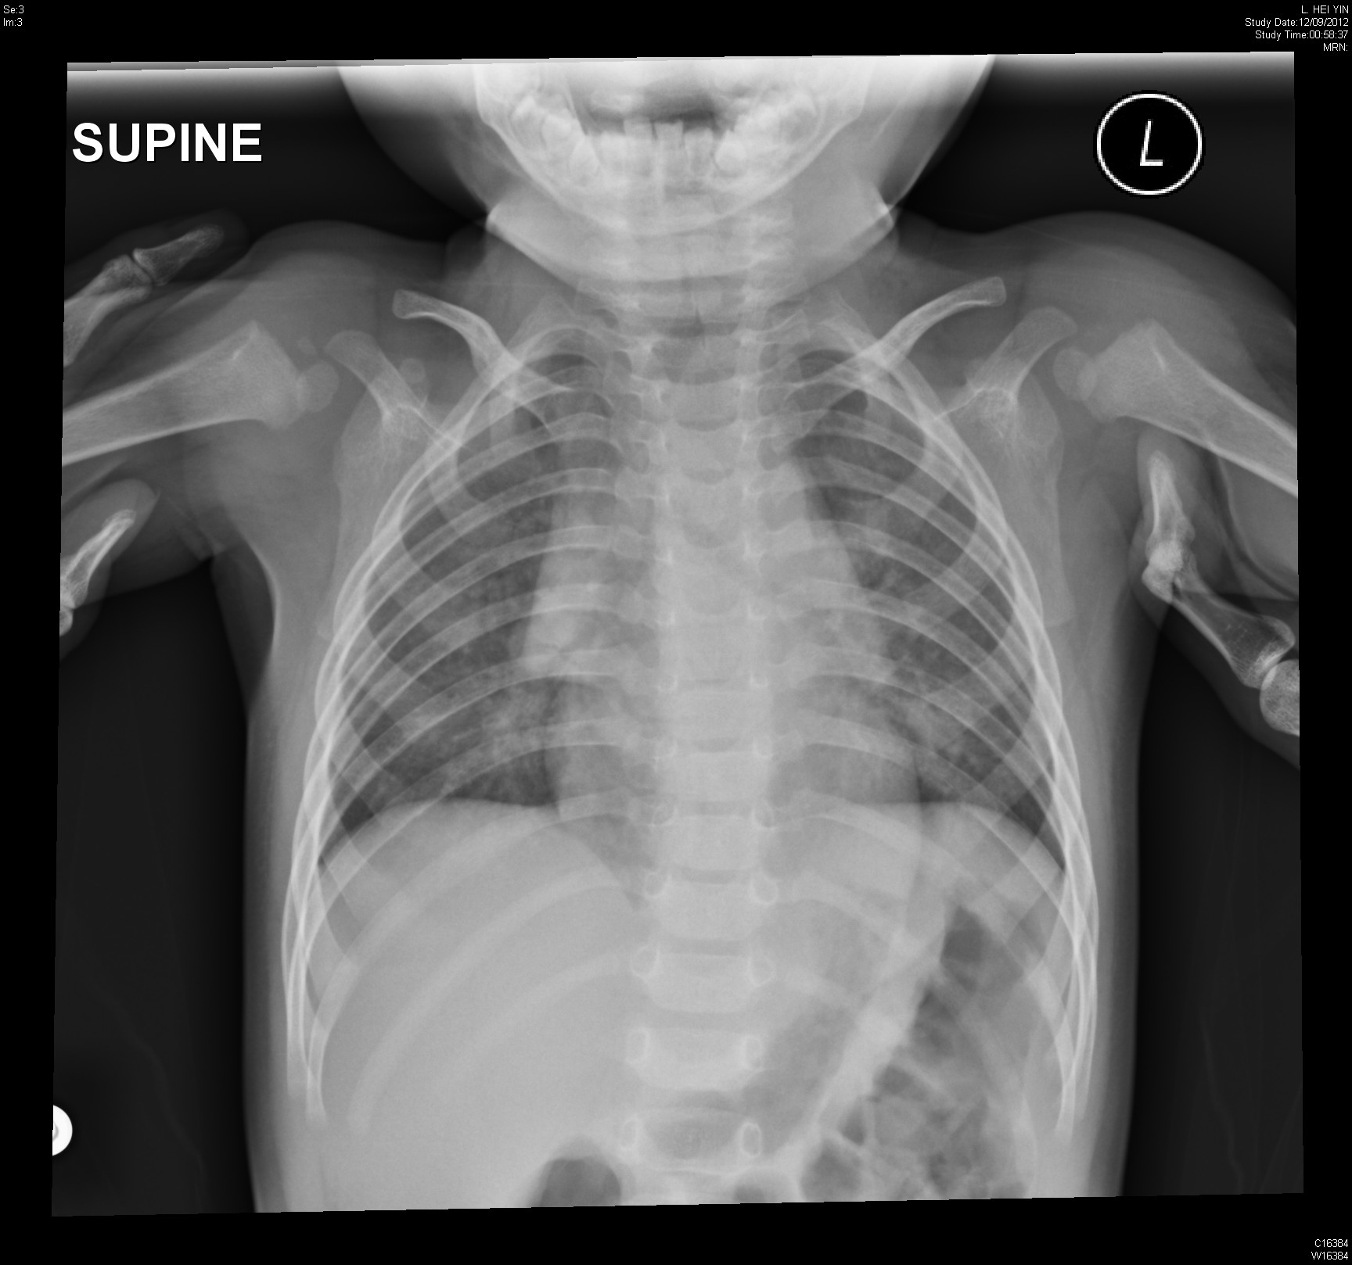

Slide 23
Questions
Describe the CXR findings. (3 marks)
What is the diagnosis? (2 marks)
What is the “quirky” sound in medical terms? (1 mark)
What specific treatments are indicated for this condition? (2 marks)
Her mother asked what is the likely etiological cause of the condition? (1 marks) Why do you think so? (1 mark)

