Slide 1
JCM OSCE Questions
AHNH AED
2/1/2019

Slide 2
Case 1
46/F,
Cough for 2/12
Sob on exertion for 2 days
Aferbile
BP:143/107mmHg, P:133/min, SaO2:97% on RA, temp: 36.8
PMHx: DM/HT/Hyperlipidaemia

Slide 3
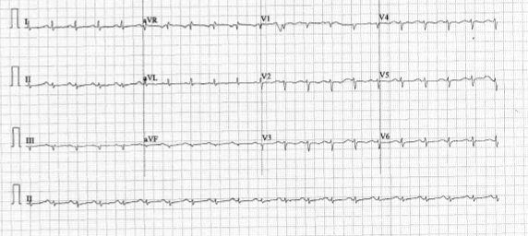
ECG

Slide 4
What abnormality can be seen on the ECG?

Slide 5
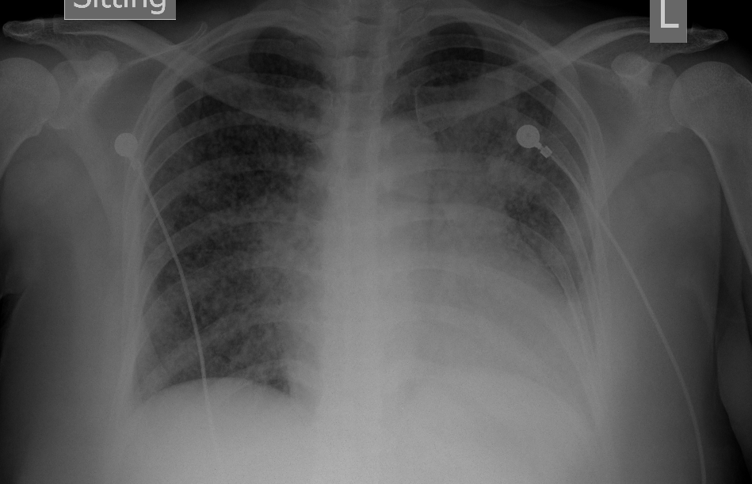
CXR

Slide 6
What abnormalities can be seen on the CXR?
What would you suspect base on ECG and CXR findings?
What bedside investigation would you perform to confirm the diagnosis and what important features would you look for?
What is the diagnosis and ddx for this case?

Slide 7
Case 2
48/M, smoker
Good past health
Sudden onset of back pain and chest pain for few hours after meal at restaurant
Associated with right leg numbness
BP:121/82mmHg, P:69/min, SaO2:96% on RA

Slide 8
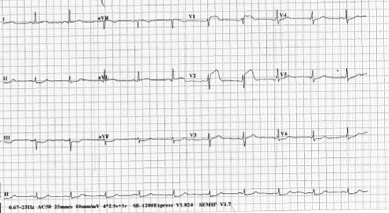
ECG

Slide 9
What are the ECG findings?

Slide 10
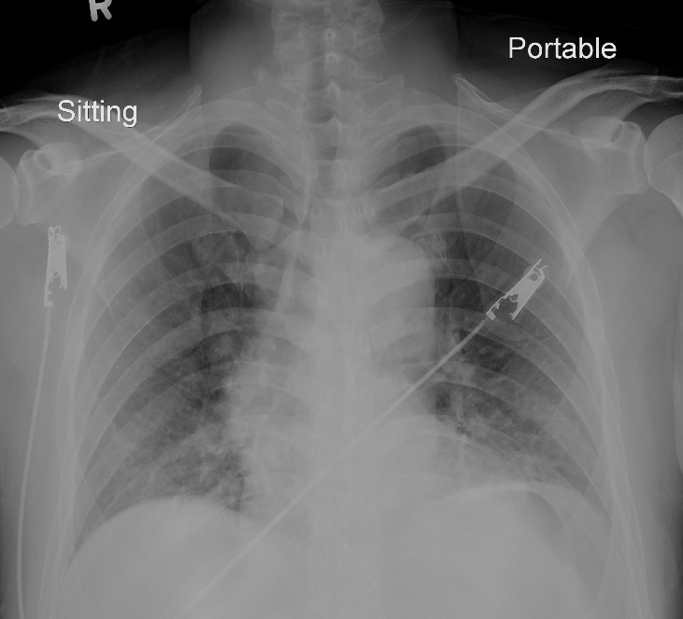
CXR

Slide 11
What are the CXR findings?
What is the diagnosis and DDX?
What further physical examinations and investigations would you like to do for the above patient?

Slide 12
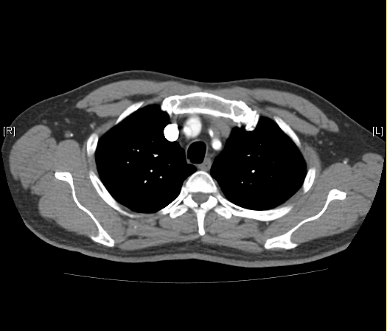
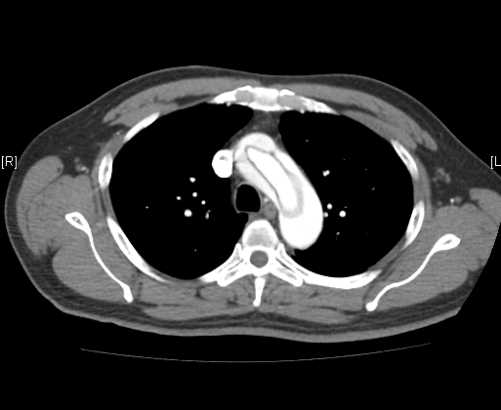
CT thorax with contrast

Slide 13
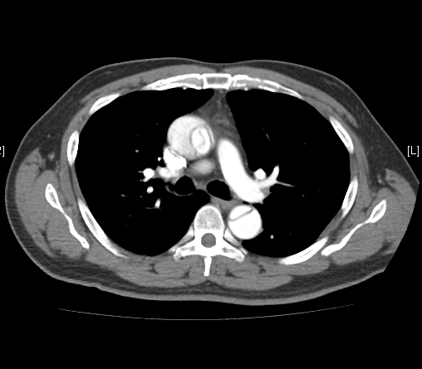
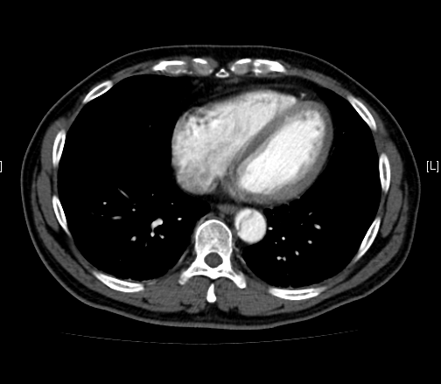

Slide 14
What abnormalities can be seen on the CT?
What is the diagnosis?
What are the classifications for the above diagnosis?
What are the target management in AED for the above condition?

Slide 15
Case 3
85/M, OAHR,
PMHx: HT/Dementia/HCV cirrhosis
Found sitting on the ground beside the bed with abrasion wound over the vertex of scalp
GCS: 14/15 (E4V4M6)
BP:150/58mmHg, P: 60/min
CT brain was done

Slide 16
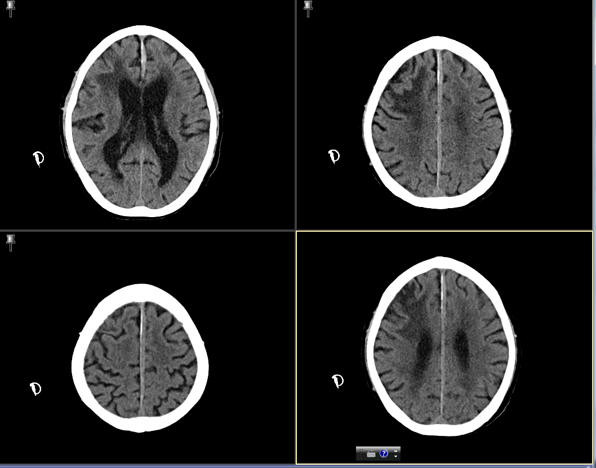

Slide 17
What abnormalities can be seen on the CT?
What is the diagnosis?
What further information and investigations would you consider for this case?
What are the risk factors for the above condition?

Slide 18
Case 4
23/M, good past health.
Sob and chest pain while performing running exercise
LOC for 1 min.
Recent travel history from France to HK 3 days ago
BP:125/80mmHg, P: 140/min, SaO2:94% on RA

Slide 19
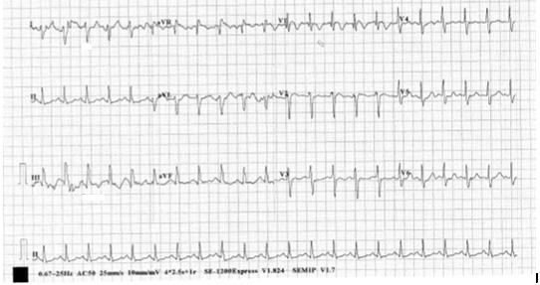
ECG

Slide 20
What abnormalities can be seen on the ECG?
What would you suspect base on ECG findings and history?
What would you look for on physical examination?
What further investigations would you like to order?

Slide 21
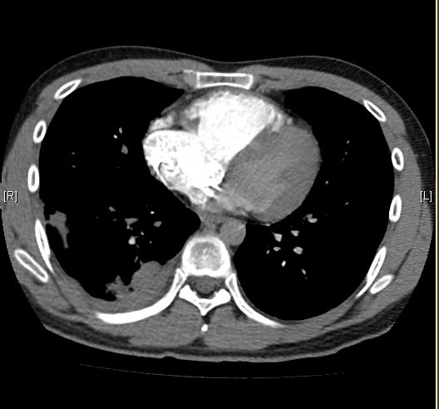
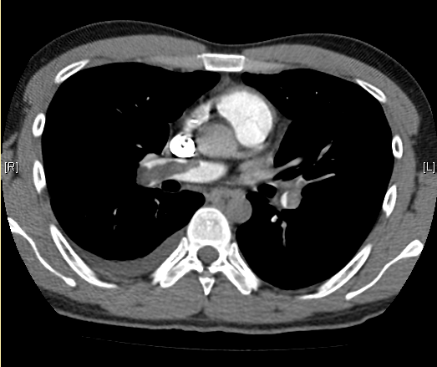
CT Thorax with contrast

Slide 22
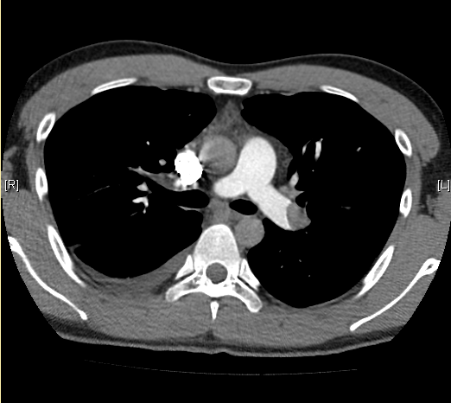
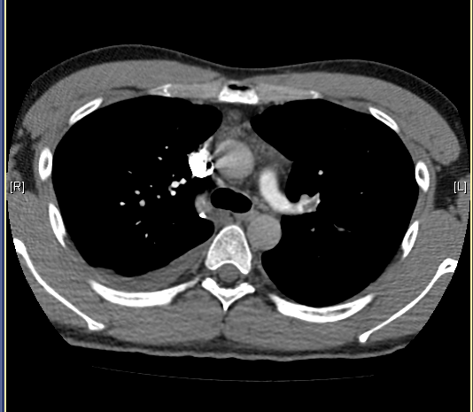

Slide 23
What abnormalities can be seen on the CT?
What is the diagnosis?

Slide 24
Case 5
35/M, good past health
Left eye was hit by shuttlecock when playing badminton.
Left eye pain and decreased vision after the injury.

Slide 25
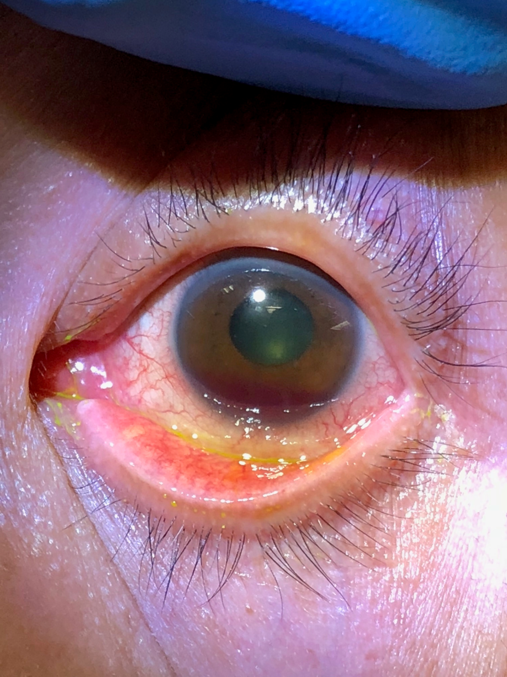
Examination with fluorescein eye stain

Slide 26
What are the abnormal physical findings?
What is the diagnosis?
What else do you need to check?
What is your management?
What are the long term complications?

