Slide 1
JCM OSCE Questions AHNH AED 2/1/2019

Slide 2
Case 1
46/F,
Cough for 2/12
Sob on exertion for 2 days
Aferbile
BP:143/107mmHg, P:133/min, SaO2:97% on RA, temp: 36.8
PMHx: DM/HT/Hyperlipidaemia

Slide 3
ECG

Slide 4
What abnormality can be seen on the ECG?
Diffuse low voltage

Slide 5
CXR
Cardiomegaly, globular-shaped heart
Multiple reticulonodular lesions over the both lung fields
LUZ mass

Slide 6
What would you suspect base on ECG and CXR findings?
Pericardial effusion
What bedside investigation would you perform to confirm the diagnosis and what important features would you look for?
Echocardiogram
Look for features of cardiac tamponade
right atrial collapse
right ventricular diastolic collapse
assessment of the IVC (dilated and unreactive in tamponade)

Slide 7
What is the diagnosis and ddx for this case?
Lymphangitic carcinomatosis complicate with pericardial effusion
Breast, lung, stomach, pancreas, and prostate cancers are the most common tumors that result in lymphangitis.
80% are adenocarcinomas
Miliary TB

Slide 8
Case 2
48/M, smoker
Good past health
Sudden onset of back pain and chest pain for few hours after meal at restaurant
Associated with right leg numbness
BP:121/82mmHg, P:69/min, SaO2:96% on RA

Slide 9
ECG

Slide 10
What are the ECG findings?
ST depression in II, III, aVF
ST elevation in V1 and V2

Slide 11
CXR

Slide 12
What are the CXR findings?
Widen mediastinum
Increase infiltration of bilateral lower lung fields
What is the diagnosis and DDX?
STEMI
Aortic dissection

Slide 13
What further physical examinations and investigations would you like to do for the above patient?
Check for any pulse delay
BP on both arms
Bld tests: CBP, R/LFT, CK, INR, Hstnt
Bedside usg/echocardiogram: any pericardial effusion, ventricular contraction, aortic root dilatation
CT thorax with iv contrast

Slide 14
CT thorax with contrast

Slide 16
What abnormalities can be seen on the CT?
Aortic dissection is noted extending from the aortic root down to descending aorta
What is the diagnosis?
Type A aortic dissection
What are the classifications for the above diagnosis?
Two major anatomic classification schemes for aortic dissection are the DeBakey and the Stanford systems
The most widely used system is the Stanford classification in type A (involving the ascending aorta) and type B (dissection limited to the aorta distal to the left subclavian artery).[

Slide 17
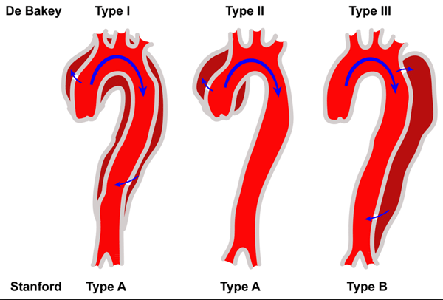

Slide 18
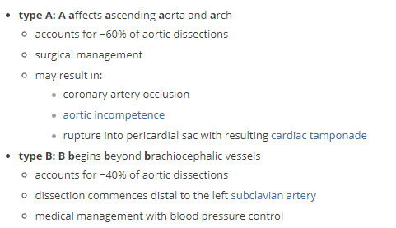

Slide 19
What are the target management in AED for the above condition?
ABC
Pain control
BP control
CTS consultation

Slide 20
Case 3
85/M, OAHR,
PMHx: HT/Dementia/HCV cirrhosis
Found sitting on the ground beside the bed with abrasion wound over the vertex of scalp
GCS: 14/15 (E4V4M6)
BP:150/58mmHg, P: 60/min
CT brain was done

Slide 22
What abnormalities can be seen on the CT?
What is the diagnosis?
What further information and investigations would you consider for this case?
What are the risk factors for the above condition?

Slide 23
Thin layer of acute SDH over anterior and posterior para-sagittal falx
Hypodense areas noted in rt frontal and left frontal lobesl

Slide 24
What is the diagnosis?
Acute SDH
What further information and investigations would you consider for this case?
Drug history e.g any aspirin, anticoagulant
History of alcohol intake
Blood tests: platelet, LFT, INR

Slide 25
What are the risk factors for the above condition?
Very young or very old age
As the brain shrinks with age, the subdural space enlarges and the veins that traverse the space must travel over a wider distance, more vulnerable to tears
Infants, too, have larger subdural spaces and are more predisposed to subdural bleeds than are young adults
Taking blood thinners (anticoagulants)
Long-term alcohol abuse

Slide 26
Case 4
23/M, good past health.
Sob and chest pain while performing running exercise
LOC for 1 min.
Recent travel history from France to HK 3 days ago
BP:125/80mmHg, P: 140/min, SaO2:94% on RA

Slide 27
ECG

Slide 28
What abnormalities can be seen on the ECG?
Sinus tachycardia
S1Q3T3
What would you suspect base on ECG findings and history?
PE(pulmonary embolization)
What would you look for on physical examination?
Any lower limb swelling

Slide 29
What further investigations would you like to order?
Blood: CBP, R/LFT, Tnt, INR, D-Dimer
CXR
Echocardiogram: ?dilated rt atrium/ventricle?
thrombus in pulmonary artery
4. Usg look for any DVT
5. CT thorax with contrast

Slide 30
CT Thorax with contrast

Slide 32
What abnormalities can be seen on the CT?

Slide 33
Eccentric intraluminal filling defects within both main pulmonary arteries extending to their bifurcation
Right pleural effusion
Right atrium and right ventricle seem prominent reflect rt heart strain

Slide 35
What is the diagnosis?
Pulmonary embolism

Slide 36
Case 5
35/M, good past health
Left eye was hit by shuttlecock when playing badminton.
Left eye pain and decreased vision after the injury.

Slide 37
Examination with fluorescein eye stain

Slide 38
What are the abnormal physical findings?
Blood in lower anterior chamber
Semi-dilated pupil
Cloudy cornea
What is the diagnosis?
Traumatic hyphema
What else do you need to check?
VA
IOP
What is your management?
Eye shield
Pain control
Urgent eye consultation
Limited eye movement (this means no reading)
Head elevated at least 40 degrees when sleeping (to help body absorb blood)

Slide 39
What are the long term complications?
Increased intraocular pressure
Cause glaucoma and atrophy of the optic nerve
Staining of the cornea with blood

