Slide 1
JCM OSCE 02/2019
Tuen Mun Hospital

Slide 2
Q 1
A 39 years old gentleman presented to AED due to pleuritic chest pain and SOB for 4 days. He enjoyed good past health. The vital signs were stable. ECG was performed.

Slide 4
1. ECG abnormality
Sinus tachycardia
STE over lead 1-3
Diffuse PR depression
PR elevation aVR
2. Diagnosis
Acute pericarditis
3. Sign to look for
Auscultate for the pericardial friction rubs
Usually loudest over the left sternal border

Slide 5
4. ECG different between pericarditis and AMI
5. Pharmacology treatment
Anti-inflammatory dose NSAID (e.g. Aspirin 600mg-1000mg tds PO) x 1-2/52
Colchicine 0.5mg BD PO x 3/12

Slide 6
Classical 4 stages of ECG evolution of acute pericarditis
Stage I: diffuse ST elevation with PR depression Stage II: normalization of ST and PR segments Stage III: diffuse deep T-wave inversions Stage IV: normalization of the ECG

Slide 7
More ECG examples

Slide 8
More ECG examples

Slide 9
Q 2
A 55 years old gentleman presented to AED due to fall with out stretched left hand. He complained left wrist pain and decreased range of movement over the left wrist. Physical examination showed tenderness along the ulnar border of the left wrist. X-ray of the left wrist was taken.

Slide 10
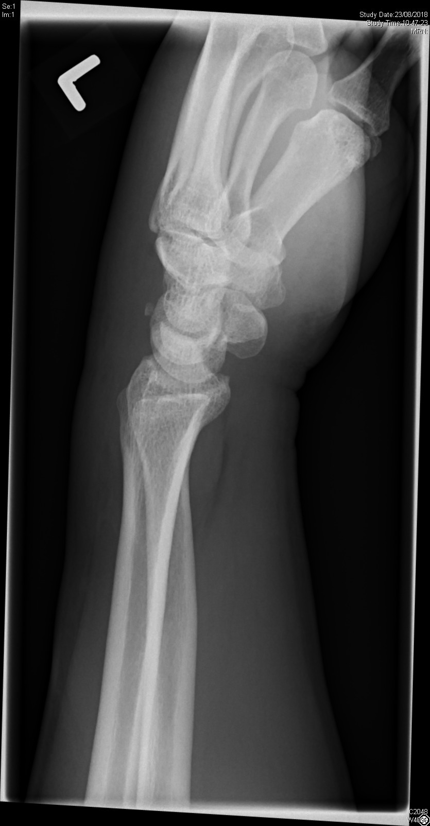

Slide 11
What is the x-ray finding? And what is the diagnosis?
What is the mechanism of injury?
What is the indication for surgical intervention? Give 4.
What is the non-surgical management?

Slide 12
Carpal bones
Sam Likes To Push The Toy Car Hard
She Looks Too Pretty Try To Catch Her
Sally Left The Party To Take Cathy Home
S: scaphoid
L: lunate
T: triquetrum
P: pisiform
T: trapezium
T: trapezoid
C: capitate
H: hamate

Slide 13
Avulsion fracture of triquetrum
Lateral view of the wrist x-ray
Small radiodense fragment just dorsal to the proximal row of carpal bones
Mechanism of injury
Typically occur from a fall onto an outstretched arm with the wrist in extension and ulnar deviation, or in extreme flexion
Avulsion fracture, usually off the dorsal radial surface account up to 93% of triquetrum #
Indication for surgery
Open #
Comminuted #
Asso. nerve injury (ulnar n.)
Asso. vascular injury
Non-surgical management
Immobilization with short arm cast with the wrist placed in slight extension and the MCP joints free for 3-6/52

Slide 14
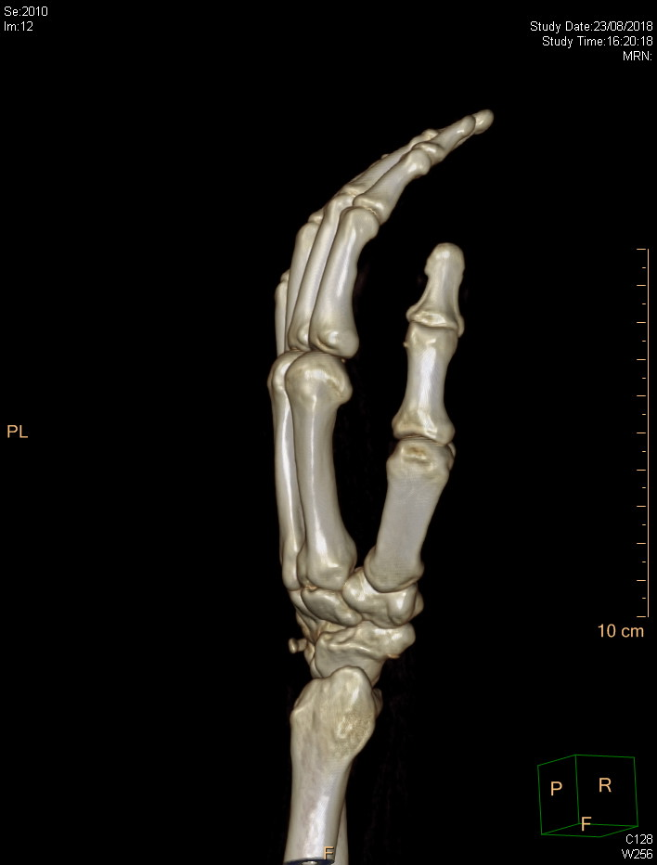

Slide 15
Q 3 STEMI equivalent

Slide 16
Left main coronary artery (LMCA) occlusion
Widespread horizontal ST depression, most prominent in leads I, II and V4-6
ST elevation in aVR ≥ 1mm
ST elevation in aVR ≥ V1

Slide 17
Possible cause of STE in aVR
LMCA occlusion
Proximal left anterior descending artery (LAD) occlusion
Severe triple-vessel disease
Diffuse subendocardial ischaemia

Slide 18
Management of AMI
Initial stabilization
Oxygen/ IV access/ cardiac monitor/ resuscitation
Antiplatelet agents
Aspirin 160mg-320mg chewed p.o.
Clopidogrel 300mg p.o. (thrombolytic therapy)
Ticagrelor 180mg p.o. (PCI)

Slide 19
Management of AMI
Anticoagulant
Enoxaparin (1mg/kg SC Q12H)
Enoxaparin 30mg IV bolus if given TNK
Unfractionated heparin 4000IU IV if PCI
Analgesic
Morphine
Nitrate infusion
Reperfusion therapy
Percutaneous coronary intervention
Thrombolytic therapy

Slide 20
STEMI equivalent

Slide 21
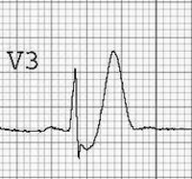
De Winter’s T wave
Tall, prominent, symmetric T waves in the precordial leads
Upsloping ST segment depression >1mm at the J-point in the precordial leads
Absence of ST elevation in the precordial leads
ST segment elevation (0.5mm-1mm) in aVR

Slide 22
De Winter’s T wave
The de Winter ECG pattern is an anterior STEMI equivalent that presents without obvious ST segment elevation.
Key diagnostic features include ST depression and peaked T waves in the precordial leads.
The de Winter pattern is seen in ~2% of acute LAD occlusions

Slide 23
STEMI equivalent

Slide 24
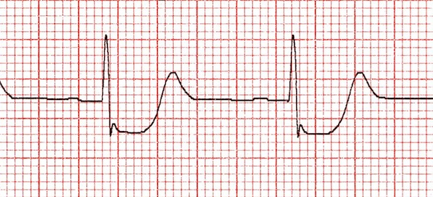
Posterior MI
Posterior MI is suggested by the following changes in V1-3:
Horizontal ST depression
Tall, broad R waves (>30ms)
Upright T waves
Dominant R wave (R/S ratio > 1) in V2

Slide 25
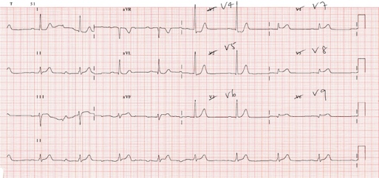
Posterior MI
The degree of ST elevation seen in V7-9 is typically modest – note that only 0.5 mm of ST elevation is required to make the diagnosis of posterior MI

Slide 26
Q 4
70 years old lady with history of DM, presented to AED with fever, malaise and abdominal pain.
BP 80/40mmHg, P 120 bpm, Temp 39C. AXR was performed.

Slide 27
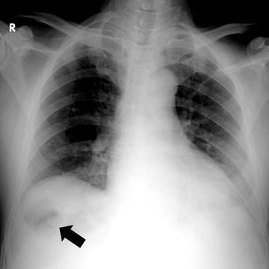
Emphysematous liver abscess
- Gas density over right subphrenic space

Slide 28
Diagnosis
Gas forming pyogenic liver abscess
Pathogens
Klebsiella pneumoniae
Escherichia coli
Salmonella
Clostridium species

Slide 29
Complications
K. pneumoniae pyogenic liver abscess and bacteremia are associated with metastatic infections.
Central nervous system (CNS), eyes, and lung are the most common sites involved.
Diabetic patients are particularly at high risk of developing septic endophthalmitis.

Slide 30
Management
Resuscitation and sepsis control
Fluid resuscitation
Blood culture
Broad spectrum antibiotic
Source control
Percutaneous drainage of the abscess under image guidance
Surgical intervention

