Slide 1
Case 1
A 22 year-old man hit a football pole with his occiput during a football game
He complained of posterior neck pain
There was diffuse tenderness over his posterior C-spine with no neurological deficit

Slide 2
Case 1
Please commend on the C-spine X-ray, what is the abnormal finding?
What will be your initial management?
CT C-spine was done later, what is the CT finding?
What is the diagnosis?

Slide 3
Case 1 X-ray C-spine

Slide 4
Case 1 X-ray C-spine

Slide 5
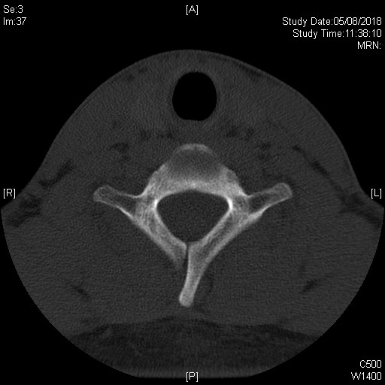
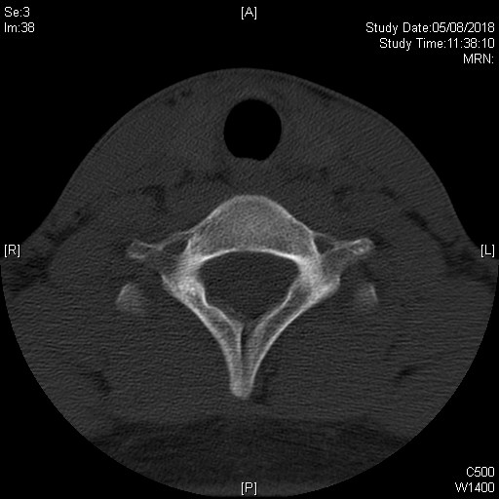
Case 1 CT C-spine

Slide 6
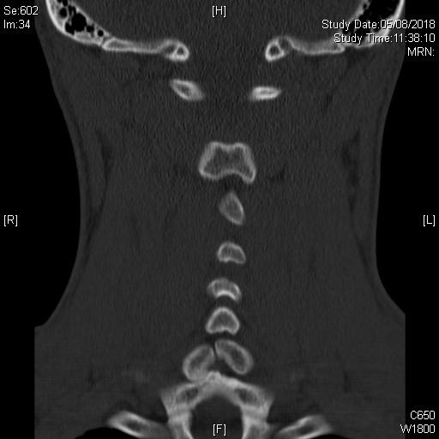
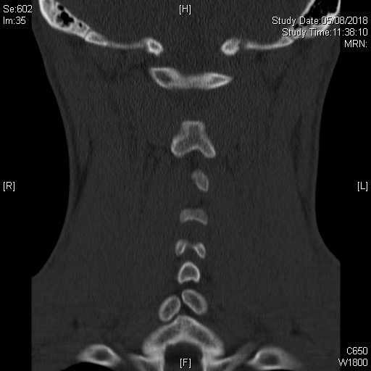
Case 1 CT C-spine

Slide 7
Case 2
A 42 year-old Filipino domestic helper presented with collapse and transient convulsion in the ambulance
She was drowsy on arrival, BP 80/50, pulse 142/min., SpO2 99% on 2L NC
ECG was done.

Slide 8
Case 2
What are the ECG findings?
What investigation will you do next and what are you looking for?
After stabilization, a CT pulmonary angiogram was done. What are the abnormalities?
What is the diagnosis and what therapy should be considered?

Slide 9
Case 2 ECG

Slide 10
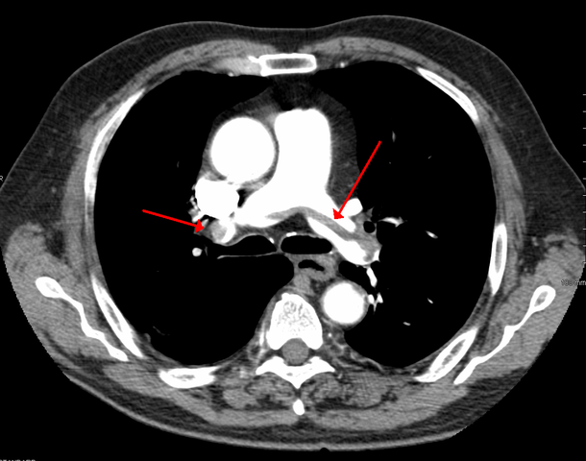
Case 2 CT pulmonary angiogram

Slide 11
Case 2 CT pulmonary angiogram

Slide 12
Case 3a
A 76 man was knocked down by a taxi
He complained of left knee pain
What is the X-ray finding?
What will you do next?

Slide 13
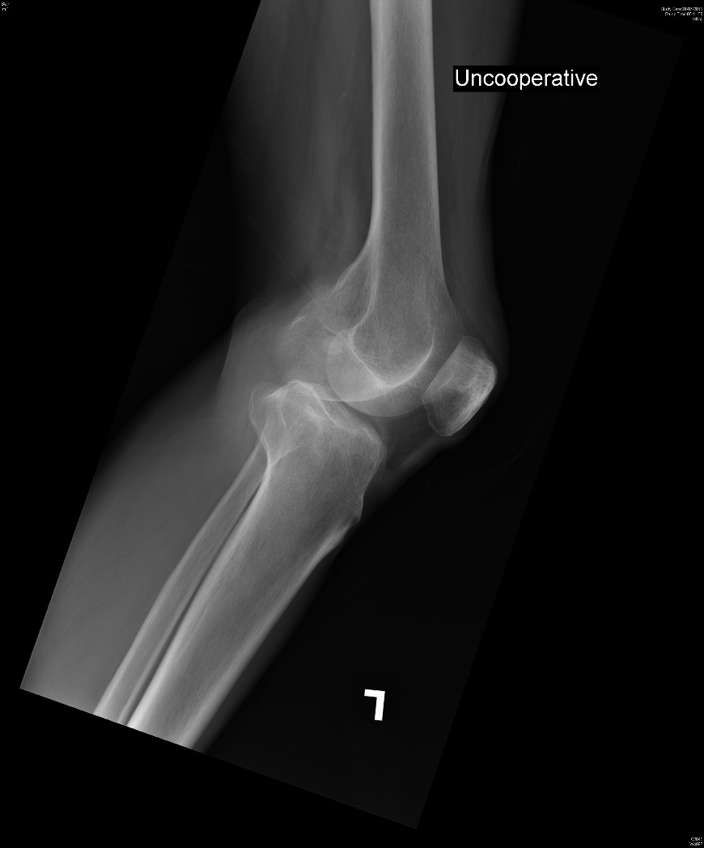
Case 3a

Slide 14
Case 3b
A 72 year-old woman presented with left hip contusion
What is the X-ray finding?
What will be your management?

Slide 15
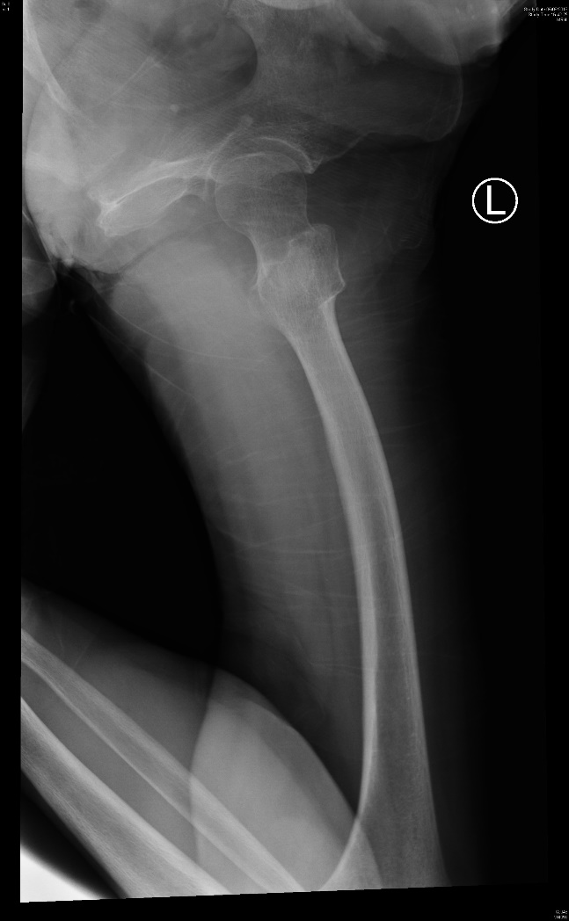
Case 3b

Slide 16
Case 4
Answer the following questions with reference to the CT brain shown:
Is the CT brain a contrast or non-contrast scan?
What are the CT abnormalities?

Slide 17
Case 4
What is your diagnosis and what is the name of the specific CT brain sign?
What is the implication?
What is the specific treatment of choice?
What could give similar appearance over the left MCA?

Slide 18
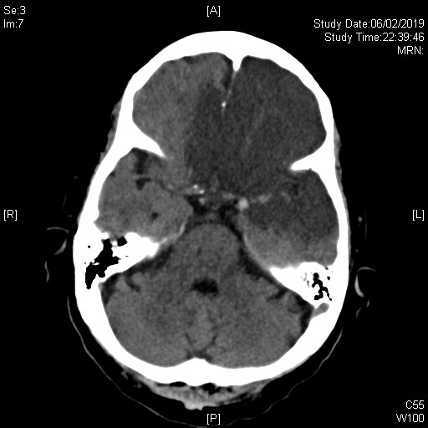
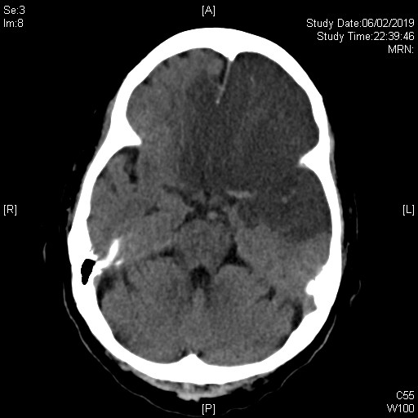
Case 4 – CT brain

Slide 19
Case 5
A 31 year-old man presented with left eye injury by metal chip flying off a nail when hammering against the wall.
Describe the clinical finding in picture 1.:
What radiological modality is shown in picture 2.:

Slide 20
Case 5
What are layer A, and structures B and C:
What is the abnormality shown in picture 2.?
What other beside examination/test you will do?
What is the emergency management?

Slide 21
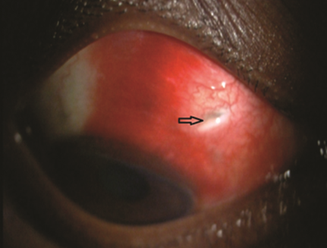
Case 5
Picture 1.
Picture 2.

Slide 22
Case 6
A 42 year-old man has injury on duty.
He suffered from blunt chest injury when inflating a van tie which explosed.
The is his lung ultrasound:

Slide 23
Case 6
What is the name of lung ultrasound sign showed in his right lung?
What is the name of lung ultrasound sign showed in his left upper lung zone and what is the implication?
What is the abnormality showed in his left lower Lung ultrasound?

Slide 24
Case 6
What is your next immediate action if patient has increasing respiratory distress and hypotension, and in what surface anatomical landmark?
What is the indication of urgent thoracotomy?

Slide 25
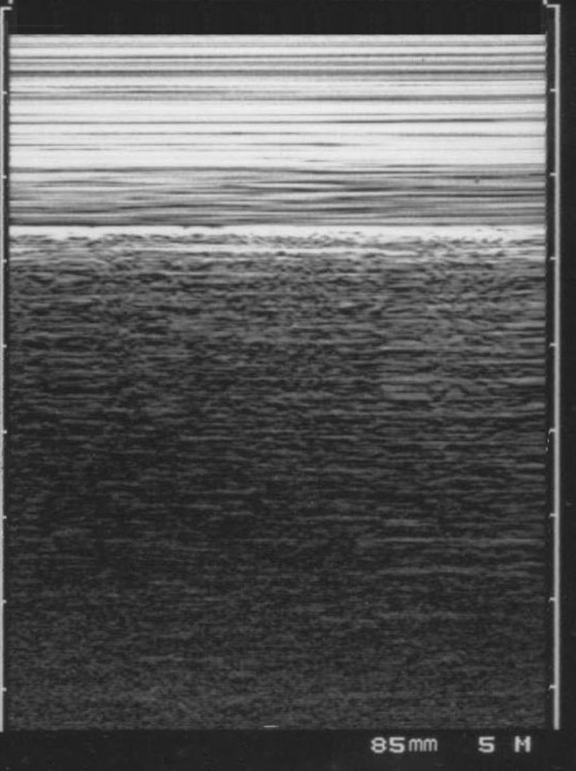
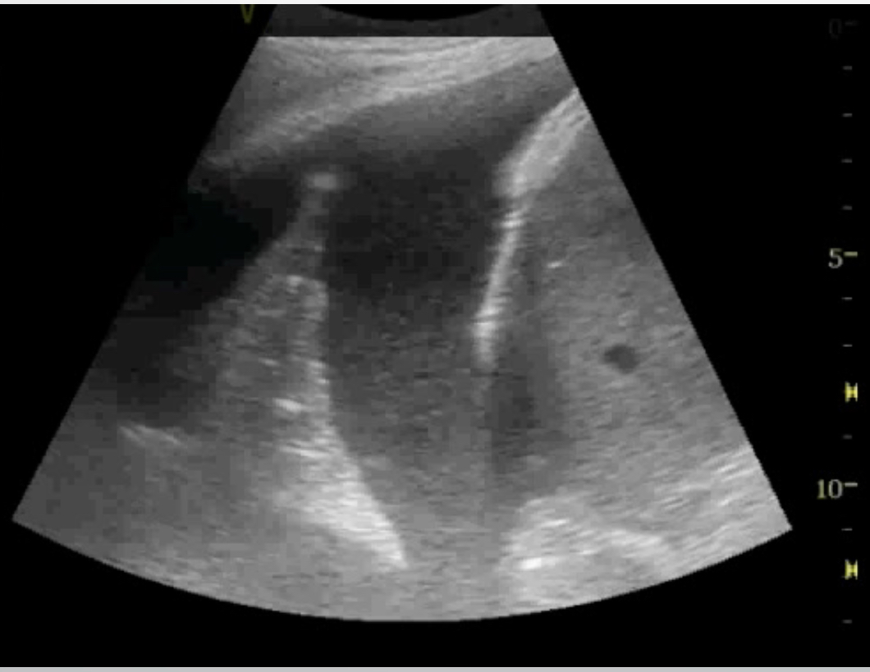
Case 6
Right upper lung
Left upper lung
Right lower lung
Left lower lung

