Slide 1
2019 May Joint Clinical Meeting OSCE
Dr TT Chan and Dr YT Pe
A&E Department
Queen Mary Hospital

Slide 2
Case 1
M/73, PMH IHD, anemia, anxiety, arrhythmia not on pacemaker
C/O chest discomfort x 1/7
Non-exertional
Increase on lying flat
Mild palpitation
PE vitals stable, chest clear, HSN no murmur, LL edema –
ECG was ordered

Slide 4
Case 1
Q1. What is the ECG sign?

Slide 5
Case 1
Q2. What are the types of above ECG sign?

Slide 6
Case 1
Q3. How do we diagnose the above-named syndrome and what are the implications?

Slide 7
Case 2
51/M, good past health
C/O retrosternal chest discomfort for 1.5 hours radiating to jaw and back, sweating and SOB +
PE vitals stable, chest clear, HSN no murmur, LL edema –
2 ECGs were ordered

Slide 8
Case 2: 1st ECG

Slide 9
Case 2: 2nd ECG

Slide 10
Case 2
Q1. What are the abnormalities and dynamic changes?

Slide 11
Case 2
Q2. What is the ECG sign called?

Slide 12
Case 2
Q3. What does this ECG configuration signify?

Slide 13
Case 3
67/M, PMH PVC, glaucoma
C/O stung by insect over left index finger when washing a sort of mushroom
PE: mild swelling over distal phalanx of left index finger
No systemic symptom

Slide 14
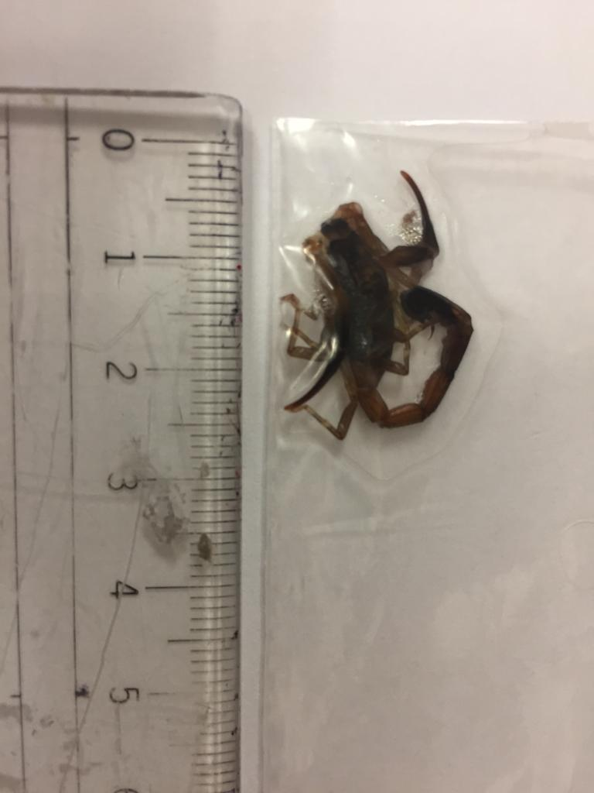
Case 3 – Q1. What is this?

Slide 15
Case 3 – Q2. What sort of plant can it be?

Slide 16
Case 3 – Q3. How do we manage the patient?

Slide 17
Case 4
64/F, good past health
C/O burning sensation over throat and stomach after ingestion of some leaves

Slide 18
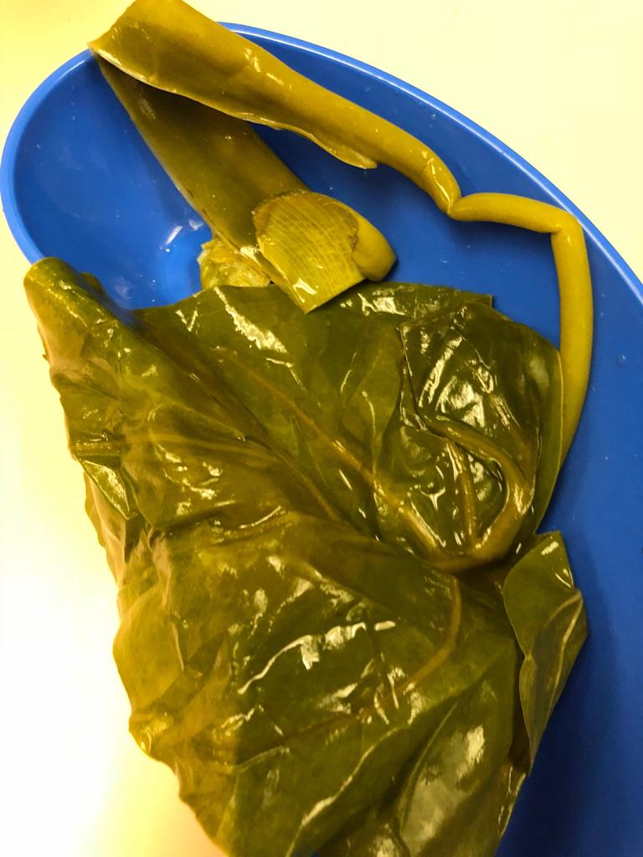
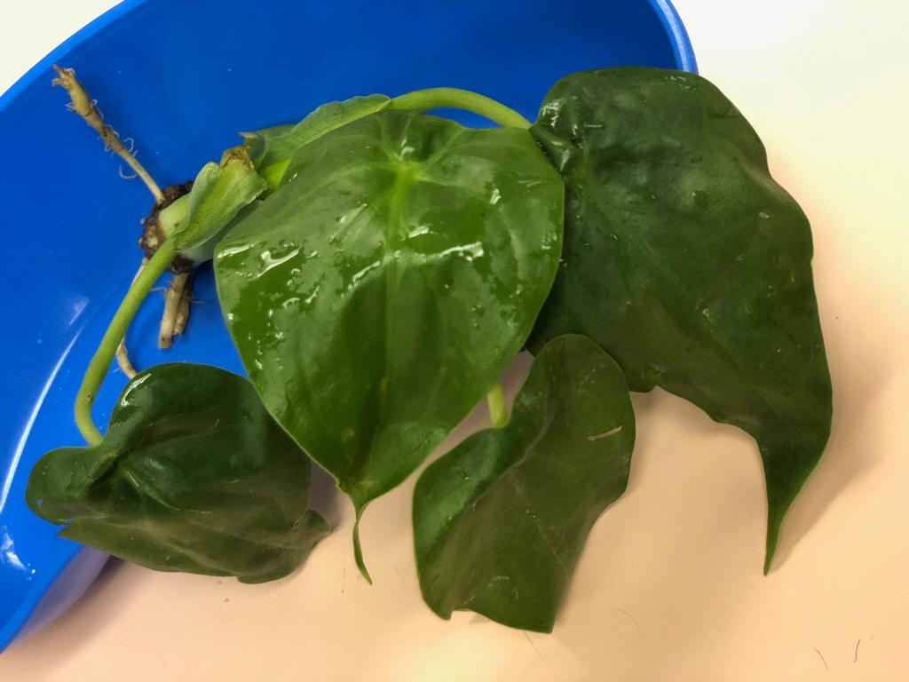
Case 4 – Q1. What is this plant?

Slide 19
Case 4
Q2. What is the cause of the burning sensation?

Slide 20
Case 4
Q3. How do we manage such cases?

Slide 21
Case 5
20/M, PMH croup
C/O right foot ? inversion injury during handball game
PE: vitals stable, pain and deformity + over right ankle, loss of ROM
No other injury noted
XR right tibia, fibula, ankle and foot requested

Slide 22
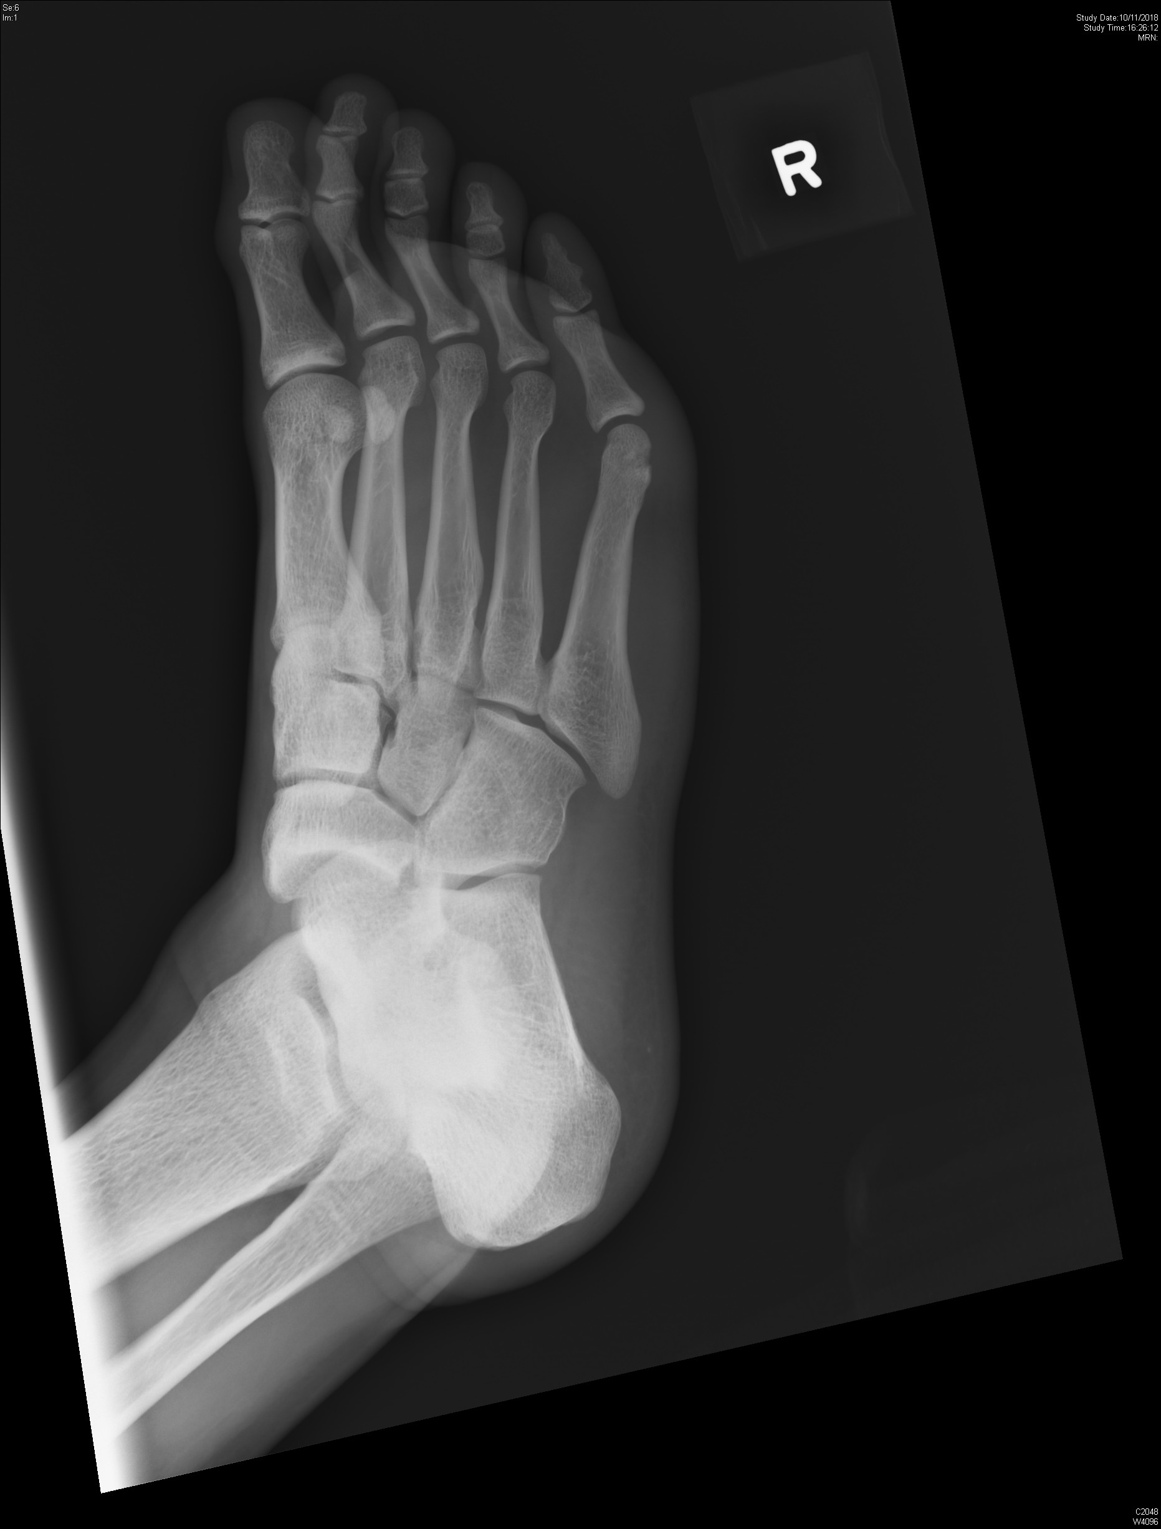
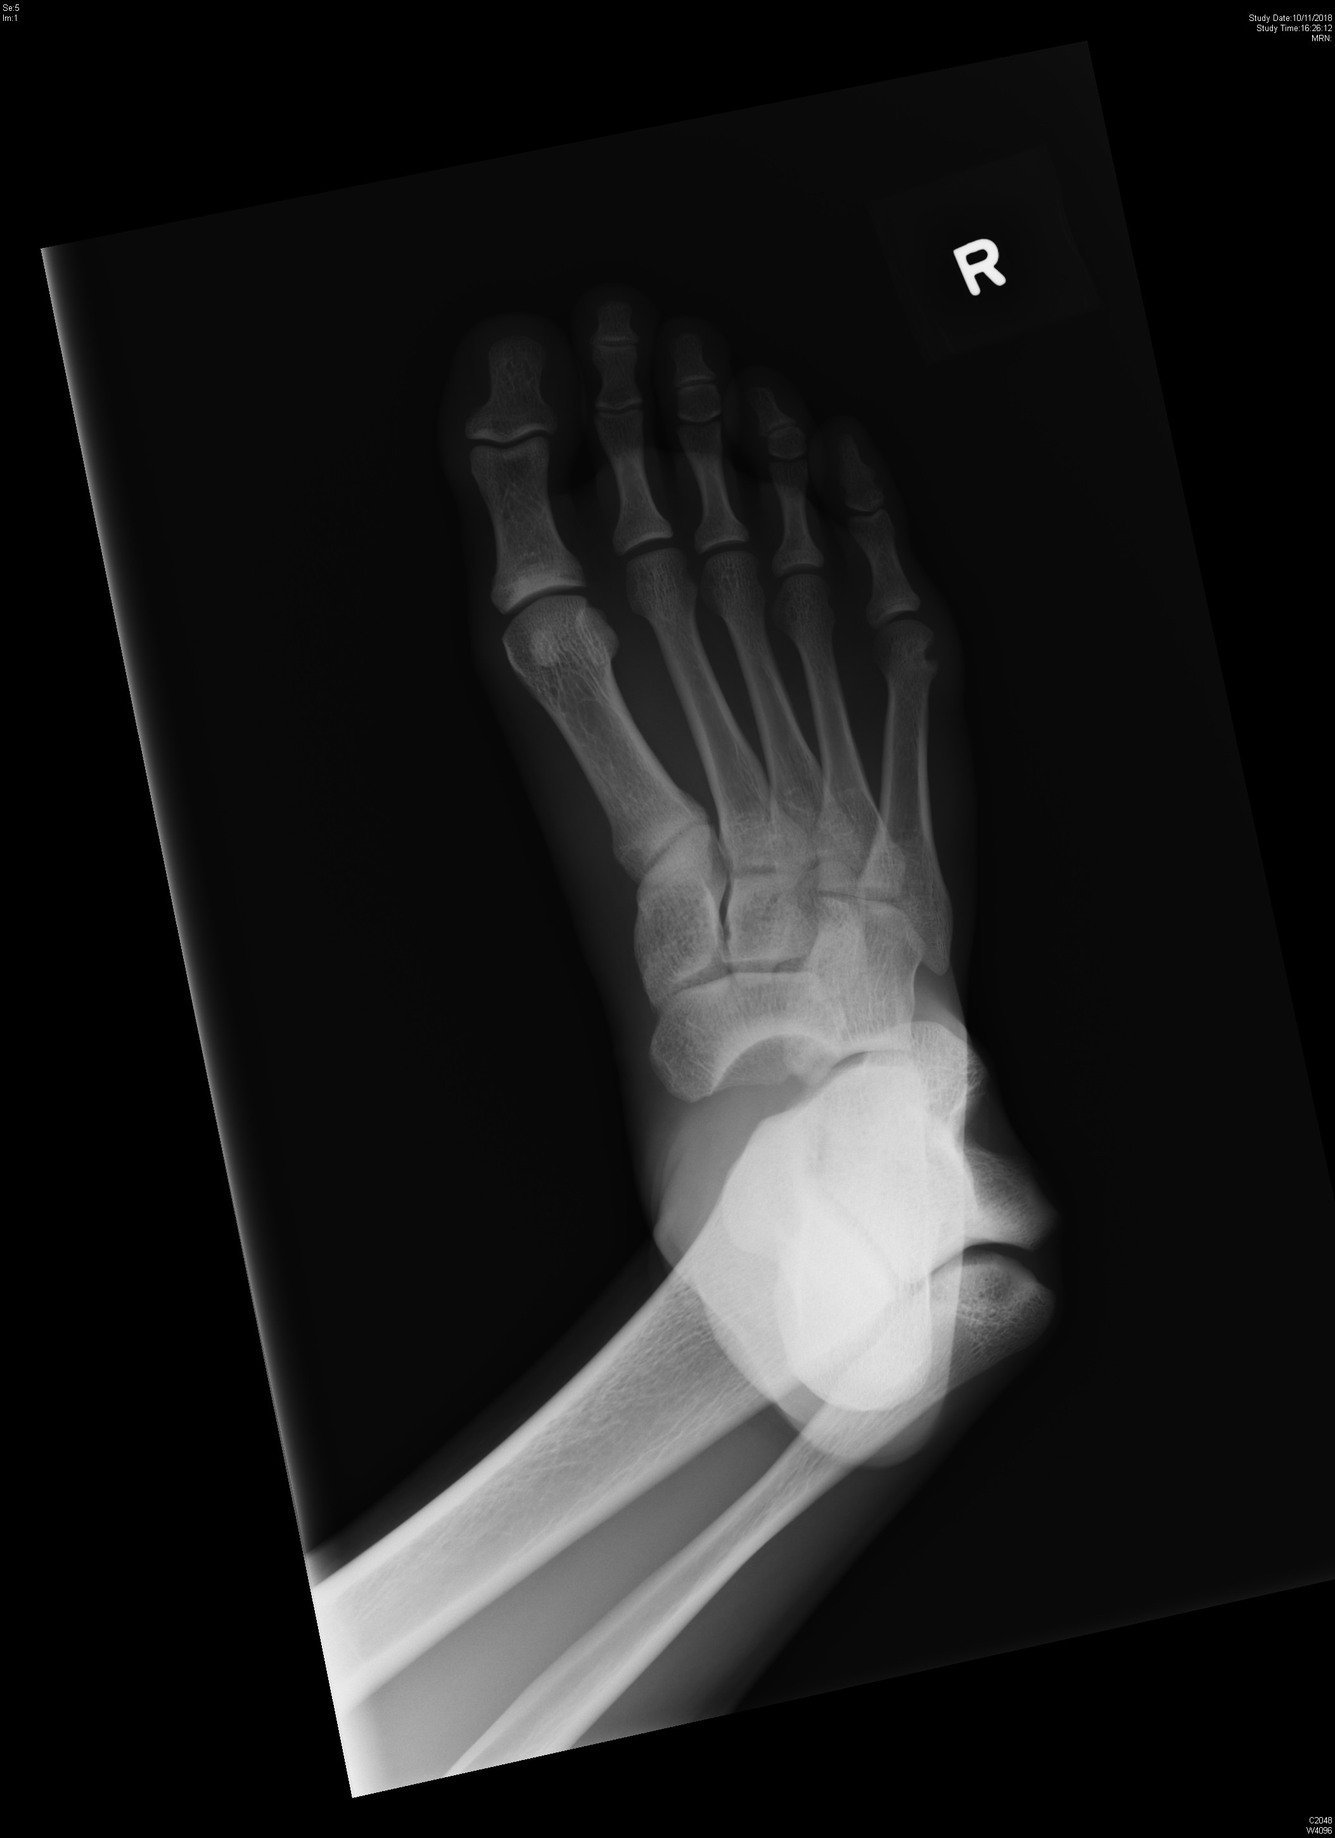

Slide 23
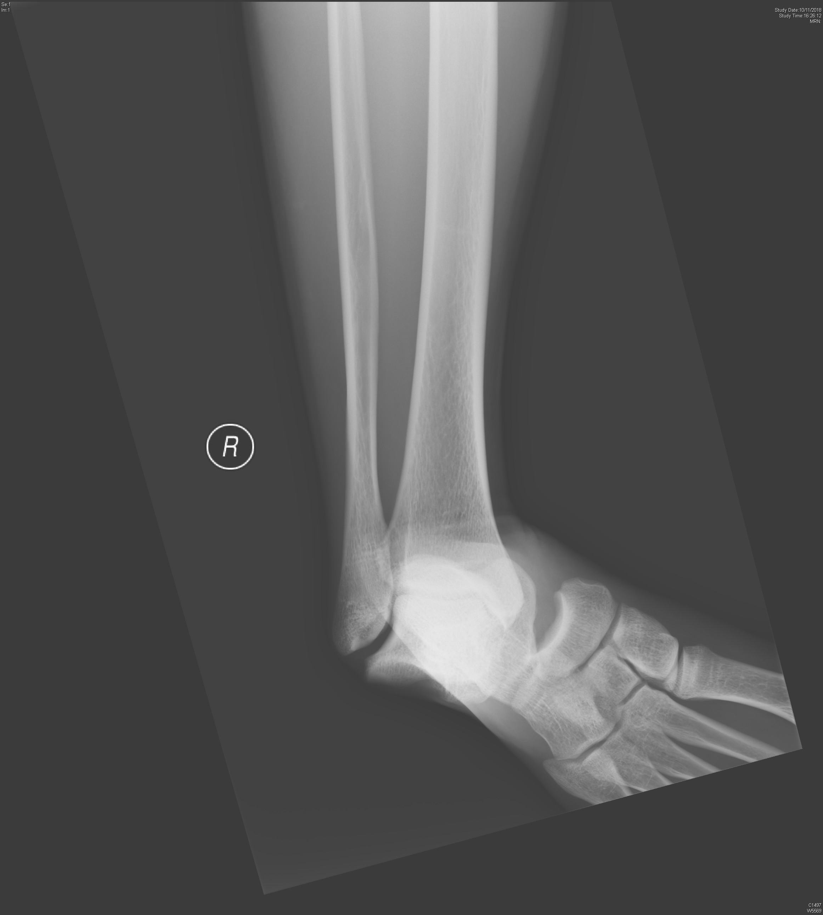

Slide 24
Case 5
Q1. What is the abnormality on XR?

Slide 25
Case 5
Q2. What are the types of above dislocation?

Slide 26
Case 5
Q3. How should we manage the patient?

Slide 27
Case 6
27/F, good past health
C/O left pelvic pain after fall from bed, landing on left side of body
Walk unaided
PE: vitals stable, pain generalized over left pelvis, ? most pain over pubic tubercle; left groin abrasion +, mild tenderness over neck
XR C spine, pelvis and left hip were requested

Slide 28
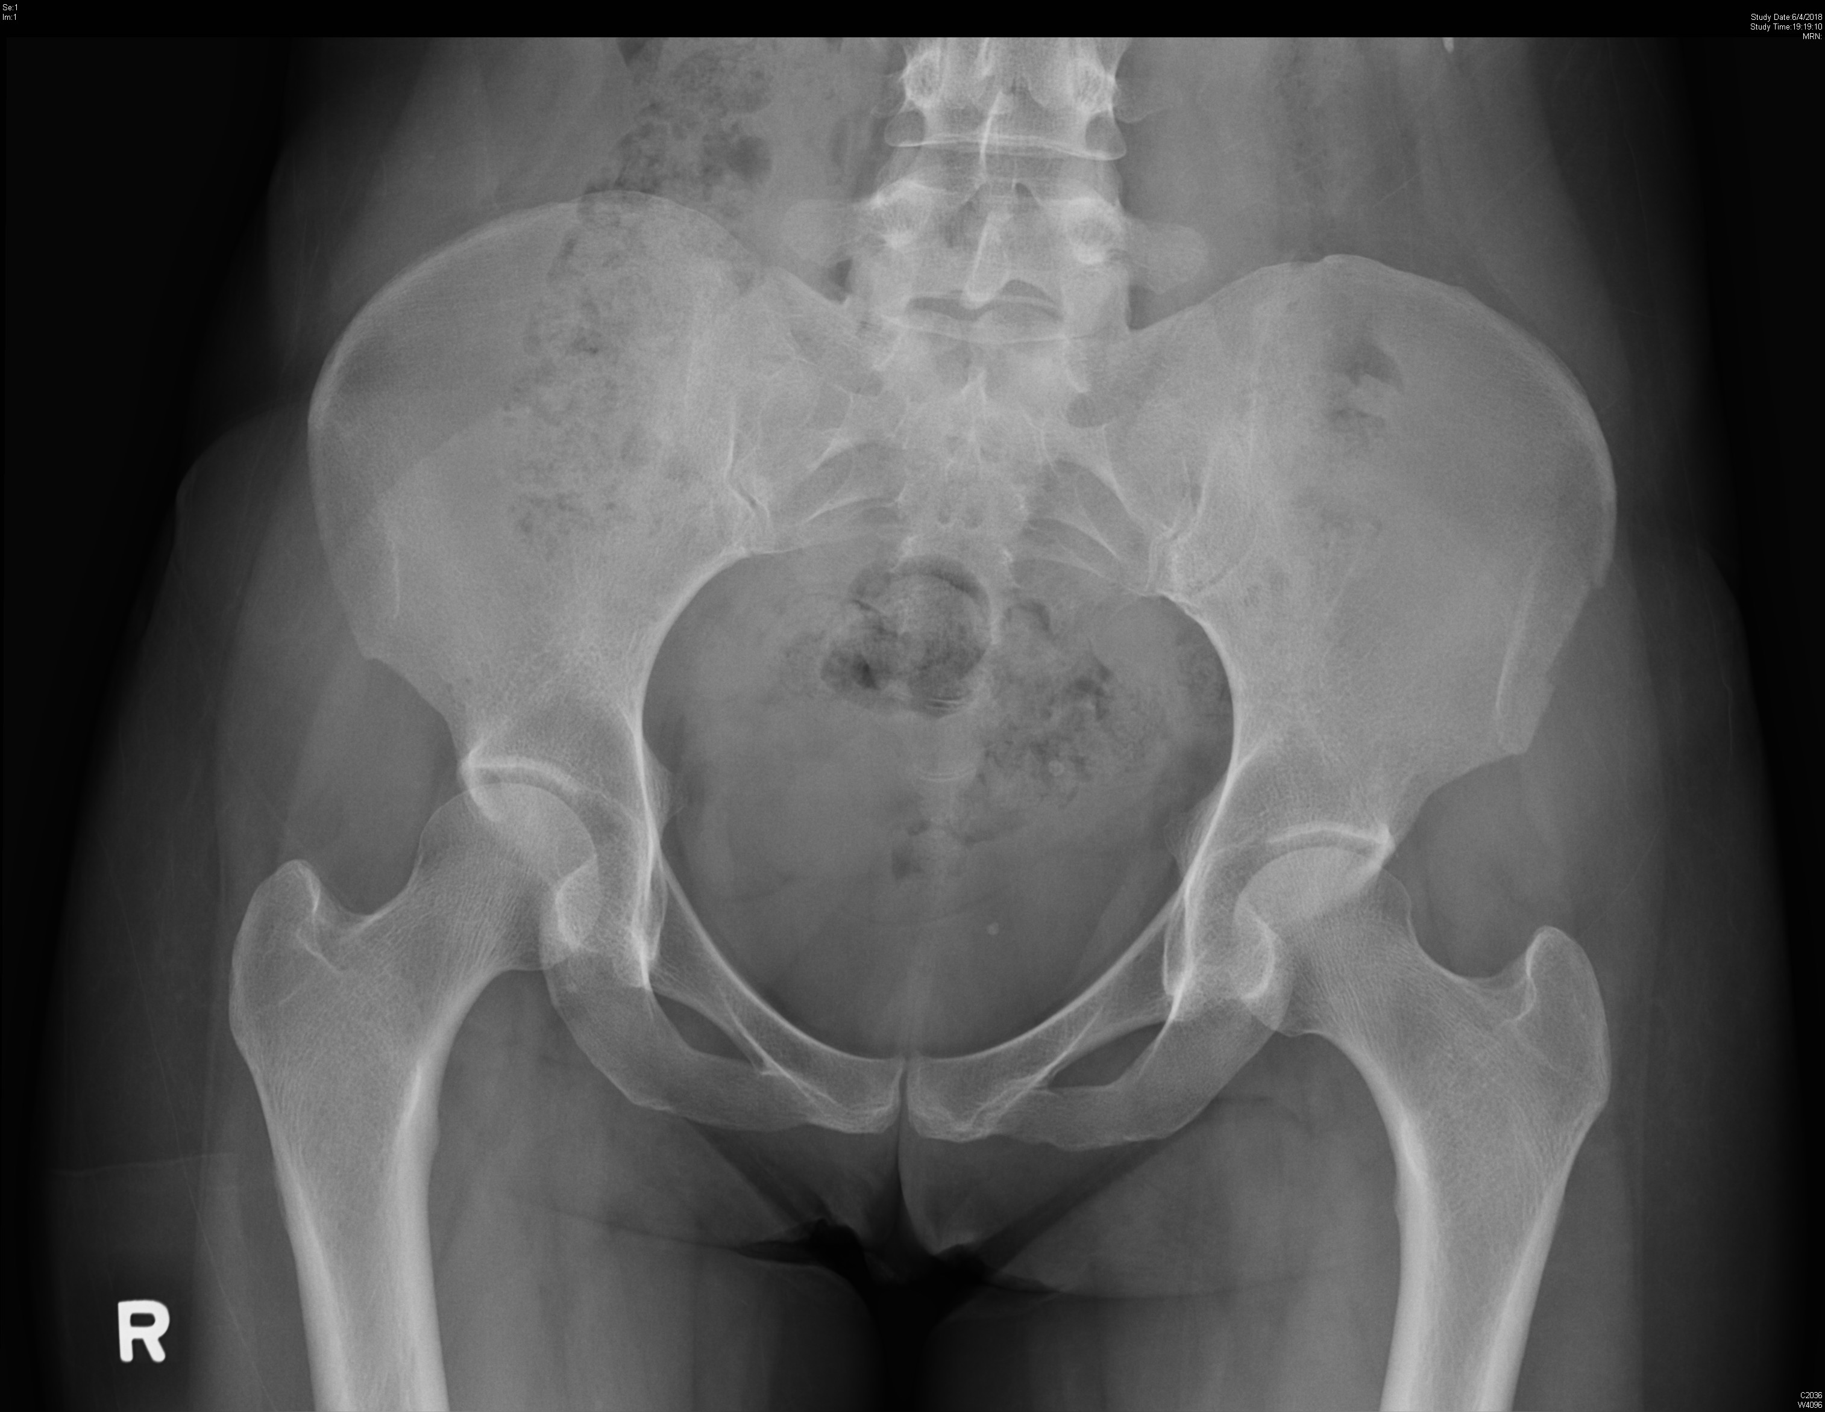
Case 6

Slide 29
Case 6
Q1. What is the abnormality on XR?

Slide 30
Case 6
Q2. How do we manage such case?

Slide 31
References
Guidelines for the diagnosis and management of Brugada Syndrome. The Cardiac Society of Australia and New Zealand. 2011.
Thabouillot O, Bouvier F, Roche NC. De Winter's wave. Emerg Med J. 2017 Dec;34(12):830.
Verouden NJ, Koch KT, Peters RJ, Henriques JP, Baan J, van der Schaaf RJ, Vis MM, Tijssen JG, Piek JJ, Wellens HJ, Wilde AA, de Winter RJ. Persistent precordial "hyperacute" T-waves signify proximal leftanterior descending artery occlusion. Heart. 2009 Oct;95(20):1701-6.
de Winter RW, Adams R, Verouden NJ, de Winter RJ. Precordial junctional ST-segment depression with tall symmetric T-waves signifying proximal LAD occlusion, case reports of STEMI equivalence. J Electrocardiol. 2016 Jan-Feb;49(1):76-80.
Ng VC, Lit AC, Wong OF, Tse ML, Fung HT. Injuries and envenomation by exotic pets in Hong Kong. Hong Kong Med J. 2018 Feb;24(1):48-55.
Bradbury JH, Nixon RW. The acridity of raphides from the edible aroids. Journal of the Science of Food and Agriculture, Volume 76, Issue 4. 26 March 1999.
Moon JM, Lee BK, Chun BJ. Toxicities of raw Alocasia odora. Hum Exp Toxicol. 2011 Oct;30(10):1720-3.
https://www.chp.gov.hk/
Wikipedia
https://www.webmd.com/

