Slide 1
OSCE April 2019
TKOH

Slide 2
Case 1
7 months old baby girl, normal birth history
On bottle feeding
Brought in by mother, complains of 3 weeks of coughing, rhinorrhea without fever
Recent 3 days mother noticed that the baby had SOB , exacerbated by feeding
Appetite decreased from 6 oz to 4 oz per feed, similar time to consume a bottle as before.
Birth weight 2.9 kg, now Body weight 6.5kg

Slide 3
P/E:
Temp 37.3, HR 107, RR 30 , Sao2 100%
Pink
Hydration and peripheral perfusion good
No use of accessory muscle, no intercostal insucking
Chest clear, bilaterally equal, no added sound

Slide 5
Q1. What is the CXR finding?

Slide 6
Q1. What is the CXR finding?
Left posterior 6th and 7th ribs fracture with callus formation

Slide 7
Q1. What is the CXR finding?
Left posterior 6th and 7th ribs fracture with callus formation
Q2. What are the differential diagnosis?

Slide 8
Q1. What is the CXR finding?
Left posterior 6th and 7th ribs fracture with callus formation
Q2. What are the differential diagnosis?
Non-accidental injury
Osteogenesis imperfecta
Pathological fracture secondary to
Rickets
Neoplasms

Slide 9
Q3. How many types of child abuse are there?

Slide 10
Q3. How many types of child abuse are there?
Physical
Neglect
Sexual
Psychological/ emotional

Slide 11
Q4. What are the risk factors for child abuse? Name 4.

Slide 12
Q4. What are the risk factors for child abuse? Name 4.
Child:
Premature babies
Unwanted/ illegitimate
Disabled
Special need e.g. ADHD
Family/ Parents:
Parents with history of domestic violence/ child abuse
Young parents
History of substance abuse
History of mental health problems
Chronic parental stress
Society/ Environment:
Poor social support

Slide 13
Q5. What are the salient history that would suggest element of child abuse?

Slide 14
Q5. What are the salient history that would suggest element of child abuse?
Vague/ incompatible description of mechanism of injury
Delayed presentation
Inconsistency in histories between care givers

Slide 15
Q5. What are the salient history that would suggest element of child abuse?
Vague/ incompatible description of mechanism of injury
Delayed presentation
Inconsistency in histories between care givers
Q6. Name 4 physical signs highly suggestive of NAI

Slide 16
Q5. What are the salient history that would suggest element of child abuse?
Vague/ incompatible description of mechanism of injury
Delayed presentation
Inconsistency in histories between care givers
Q6. Name 4 physical signs highly suggestive of NAI
Glove and stock pattern of scald injury
Cigarettes burns
Retinal hemorrhage
Bruises of different ages
Bruises with pattern reflecting offending objects

Slide 17
Q7. What are the common radiological features of fracture in NAI? (Name 4)

Slide 18
Q7. What are the common radiological features of fracture in NAI? (Name 4)
Multiple fractures in different stages
Spiral fracture
Metaphyseal injuries
Shaft thickening

Slide 19
Q8. The mother now refuses admission and wants to go home with the child. What is the best course of action?
Notes:
A local review of child abuse in Hong Kong: From the perspective of emergency physicians HKJEM 2018
Underreported, underacknowledged: child abuse can no longer be ignored HKMJ 2005

Slide 20
Q8. The mother now refuses admission and wants to go home with the child. What is the best course of action?
Inform medical social worker
Inform police to enforce Protection of Children and Juvenile Ordinance (Cap 213)
Notes:
A local review of child abuse in Hong Kong: From the perspective of emergency physicians HKJEM 2018
Underreported, underacknowledged: child abuse can no longer be ignored HKMJ 2005

Slide 21
Case 2
6 years old autism boy
Referred from GP: torticollis for 5 days
Doubtful history of neck sprain by head turning.
PE: GC satisfactory, T: 36.9C,
Neck: torticollis to right side,
decreased range of movement
Cervical spine mild tenderness, no stepping
4 Limbs spontaneous movement, normal power and reflex

Slide 22
Q1. Name 4 life-threatening causes of acquired torticollis in children (2 marks)

Slide 23
Q1. Name 4 life-threatening causes of acquired torticollis in children (2 marks)
1. Retropharyngeal abscess (0.5)
2. Suppurative jugular thrombophlebitis (Lemierre syndrome) (0.5)
3. Cervical spine injury (0.5)
4. Spinal epidural hematoma (0.5)
5. Central nervous system tumor (0.5)
(answer from 4 out of the above 5)

Slide 24
Cervical Spine X ray
Q2. Describe 2 abnormal X ray findings.(2 marks)

Slide 25
Cervical Spine X ray
Q2. Describe 2 abnormal X ray findings.(2 marks)
1. Disruption of anterior and posterior vertebral line (0.5) over C2/ C3 (0.5)
2. Swelling of pre-vertebral soft tissue (0.5) from C2 to C4 (0.5)

Slide 26
Q3. Give 2 Differential diagnosis (1 mark)

Slide 27
Q3. Give 2 Differential diagnosis (1 mark)
1. C2/ C3 subluxation (0.5)
2. Retropharyngeal abscess (0.5)

Slide 28
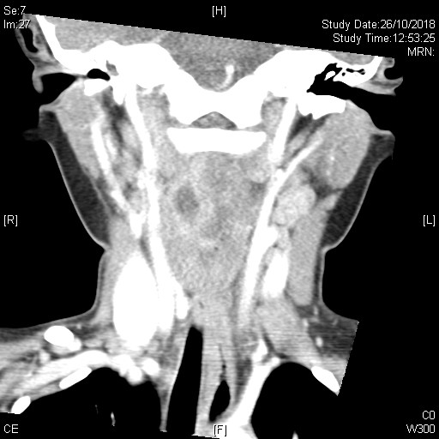
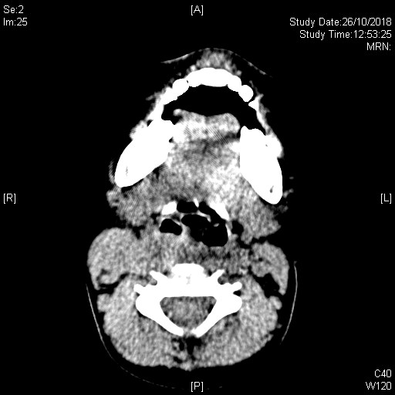
CT Cervical Spine with Contrast
Q4. Describe 4 significant CT findings? (2 marks)

Slide 29
CT Cervical Spine with Contrast
Q4. Describe 4 significant CT findings? (2 marks)
1. Fluid collection at the right retropharyngeal space (0.5)
2. Suggestive of abscess formation (0.5)
3. It extends from C2 to C4 level (0.5)
4. No dislocation or subluxation of cervical spine (0.5)

Slide 30
Q6. How to manage if the boy seems anxious and leaning forward with head in sniffing position ? (2 marks)

Slide 31
Q6. How to manage if the boy seems anxious and leaning forward with head in sniffing position ? (2 marks)
1. Address airway obstruction (0.5)
2. Emergently call for anaesthesiologist and ENT surgeon to assist with securing the airway (0.5)
3. Surgical drainage in the operating theatre (0.5)
4. Empiric IV antibiotics (0.5)

Slide 32
Case 3
2 years old boy, unremarkable past health, presented with on and off abdominal pain and decreased feeding x 1/7
Vomited undigested food x 1.
No diarrhea
No blood in stool noted
PE:
Lethragic, crying
Temp 36.2
HR 150, RR 20
Abdomen soft, non tender; ?mass felt
No hernia

Slide 33
1. Name 3 differential diagnosis

Slide 34
1. Name 3 differential diagnosis
Gastroenteritis
Intussusception
Malrotation with midgut volvulus
Appendicitis
Incarcerated Hernia

Slide 35
Describe the AXR. What is the diagnosis?

Slide 36
Crescent Sign = a crescent-shaped lucency usually in the left upper quadrant with a soft tissue mass

Slide 37
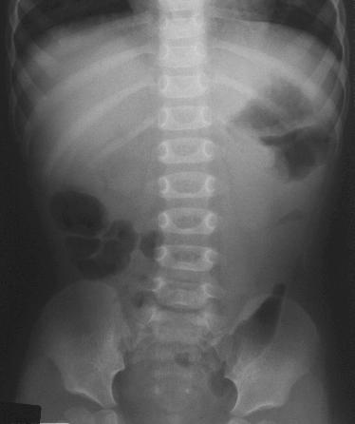
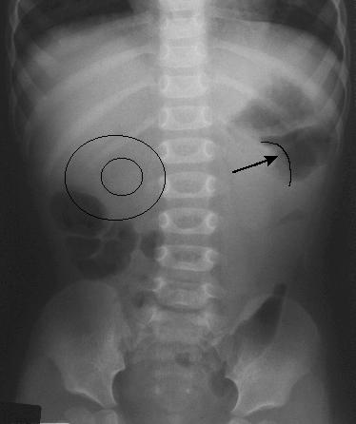
2. What are other possible signs on AXR?
Notes:
https://www.hawaii.edu/medicine/pediatrics/pemxray/v7c18.html

Slide 38
2. What are other possible signs on AXR?
Target sign
Signs of intestinal obstruction (fluid levels, dilated small bowel)
Notes:
https://www.hawaii.edu/medicine/pediatrics/pemxray/v7c18.html

Slide 39
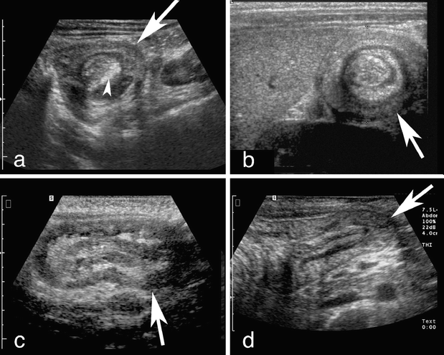
She was admitted for Paediatric surgical unit. A bedside USG was done to confirm the diagnosis.
3. What are the possible signs in USG?

Slide 40
She was admitted for Paediatric surgical unit. A bedside USG was done to confirm the diagnosis.
3. What are the possible signs in USG?
Target sign
Pseudokidney sign

Slide 41
4. What is the definitive treatment for stable patients?

Slide 42
4. What is the definitive treatment for stable patients?
Pneumatic/ hydrostatic enema reduction

Slide 43
4. What is the definitive treatment for stable patients?
Pneumatic/ hydrostatic enema reduction
5. If the patient also presented with generalized rash, what is the associated condition?

Slide 44
4. What is the definitive treatment for stable patients?
Pneumatic/ hydrostatic enema reduction
5. If the patient also presented with generalized rash, what is the associated condition?
Henoch-Schonlein purpura

Slide 45
Case 4
A 53 year-old gentleman attended emergency department for palpitation, chest discomfort and dizziness while jogging in a park tonight.
PE:
- BP 118/101, P 190, SpO2 100% RA
- Afebrile
- GCS 15/15
- Unremarkable physical exam
An ECG was recorded:

Slide 46
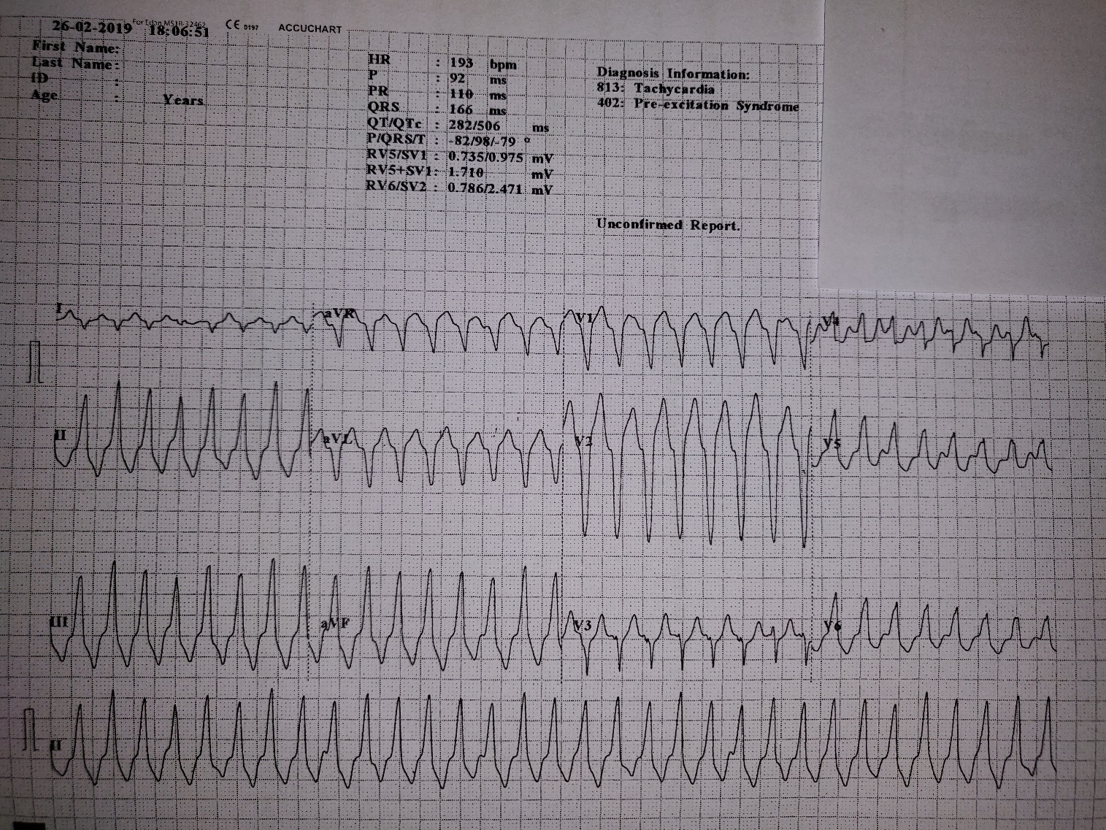
Is this rhythm supraventricular or ventricular in origin? Give 2 supportive features according to the ECG.
Ventricular rhythm
(any 2 of the following)
AV dissociation (P and QRS complexes at different rates)
Capture beat (V3)
Very broad complexes (>160ms)
Absence of typical LBBB morphology

Slide 47
Is this rhythm supraventricular or ventricular in origin? Give 2 supportive features according to the ECG.
Ventricular rhythm
(any 2 of the following)
AV dissociation (P and QRS complexes at different rates)
Capture beat (V3)
Very broad complexes (>160ms)

Slide 48
What is the diagnosis? List 2 specific diagnostic features on the ECG.

Slide 49
What is the diagnosis? List 2 specific diagnostic features on the ECG.
Diagnosis: Right ventricular outflow tract tachycardia
Inferior axis
LBBB-like morphology

Slide 50
What is the diagnosis? List 2 specific diagnostic features on the ECG.
Diagnosis: Right ventricular outflow tract tachycardia
Inferior axis
LBBB-like morphology
List 2 differential diagnoses

Slide 51
What is the diagnosis? List 2 specific diagnostic features on the ECG.
Diagnosis: Right ventricular outflow tract tachycardia
Inferior axis
LBBB-like morphology
List 2 differential diagnoses
SVT with aberrant conduction
pre-excited SVT/antidromic AVRT

Slide 52
What is the initial treatment?

Slide 53
What is the initial treatment?
Vagal maneuver
IV adenosine/ATP
IV verapamil

Slide 54
What is the initial treatment?
Vagal maneuver
IV adenosine/ATP
IV verapamil
Despite the initial treatment, the patient becomes very drowsy and BP drops to 67/55 mmHg. The rhythm on cardiac monitor is the same. What is your immediate treatment? Please state the dosage as well.

Slide 55
What is the initial treatment?
Vagal maneuver
IV adenosine/ATP
IV verapamil
Despite the initial treatment, the patient becomes very drowsy and BP drops to 67/55 mmHg. The rhythm on cardiac monitor is the same. What is your immediate treatment? Please state the dosage as well.
Synchronized cardioversion, 100J

Slide 56
Finally the patient is stabilized and transferred to CCU for further observation. What is the definitive management for his condition? (1)

Slide 57
Finally the patient is stabilized and transferred to CCU for further observation. What is the definitive management for his condition? (1)
Radiofrequency ablation

Slide 58
Case 5
A 55-year-old lady with history of asthma and being treated for URI symptoms for 1 week, presents with chest tightness, shortness of breath and a brief syncopal episode which has made her son call the ambulance. Her vital signs are as follows:
PE:
BP 75/40 P 95, SpO2 85% RA
Temperature 35 °C
GCS E4V5M6, breathless when talking

Slide 59
1. List 2 immediate actions you would do in the resuscitation room.

Slide 60
1. List 2 immediate actions you would do in the resuscitation room.
High flow oxygen
IV fluid resuscitation

Slide 61
2. ECG is done as follows:
List 2 ECG abnormalities.

Slide 62
2. ECG is done as follows:
List 2 ECG abnormalities.
- Q waves in III
- Inverted T waves in III

Slide 63
3. Chest auscultation is clear. Name 1 BEDSIDE test you can do to aid your diagnosis. Name 2 abnormalities you would expect to see in this test.

Slide 64
3. Chest auscultation is clear. Name 1 BEDSIDE test you can do to aid your diagnosis. Name 2 abnormalities you would expect to see in this test.
Bedside Test: echocardiography
Abnormalities (any 2):
Increased right ventricle (RV) size
Decreased RV function (systolic)
Tricuspid regurgitation
Abnormal septal wall motion (D-shaped LV suggestive of RV strain)
McConnell sign (akinesia of mid free wall sparing the apex)
Dilated IVC with lack of respiratory collapse
RV thrombus
Pulmonary hypertension

Slide 65
Echo in PE
https://youtu.be/rToL0yz6N7E?t=7s

Slide 66
McConell’s sign
Right ventricular free wall akinesis with sparing of the apex
Not very sensitive (~ 77%) [UpToDate]
Video: https://youtu.be/f_QgPo4c6XU

Slide 67
Contrast CT thorax is done after hemodynamic stability is restored:
Multiple filling defects in bilateral pulmonary arteries

Slide 68
Dilated main pulmonary artery (~ 3.6 cm)

Slide 69
5. What is the overall diagnosis of this lady?

Slide 70
5. What is the overall diagnosis of this lady?
Massive pulmonary embolism (or hemodynamically unstable PE, not necessarily related to the size of the PE)

Slide 71
5. What is the overall diagnosis of this lady?
Massive pulmonary embolism (or hemodynamically unstable PE, not necessarily related to the size of the PE)
6. What is the initial treatment of choice?

Slide 72
5. What is the overall diagnosis of this lady?
Massive pulmonary embolism (or hemodynamically unstable PE, not necessarily related to the size of the PE)
6. What is the initial treatment of choice?
r-TPA (alterplase)

Slide 73
7. Name 3 risk factors for this condition.

Slide 74
7. Name 3 risk factors for this condition.
Photo source: UpToDate

Slide 75
Case 6
A 76-year-old woman presented with sudden onset of chest pain radiating to the back, with dizziness and vomiting.
On arrival, she is disoriented, sweating, and in pain. Her blood pressure is 71/47 mmHg, pulse 75/min, SaO2 97% on 100% O2.
After initial resuscitation, physical examination revealed a soft abdomen with epigastric tenderness, and PR yielded brownish stool.
She had a history of pAF with left atrial appendage occlusion (LAAO) done 2 months ago.

Slide 76
1. Please comment on the ECG and CXR.

Slide 77
1. Please comment on the ECG and CXR.
ECG: SR, mild ST depression over precordial leads

Slide 79
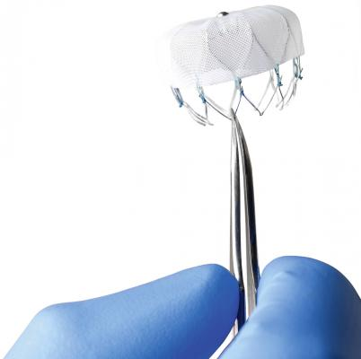
CXR: cardiomegaly, widened mediastinum, LAAO present

Slide 80
2. What is your working diagnosis?

Slide 81
2. What is your working diagnosis?
Aortic dissection
NSTEMI
LAAO complicated with cardiac perforation

Slide 82
3. What specific bedside investigation would you do next? What would you look for?

Slide 83
3. What specific bedside investigation would you do next? What would you look for?
Bedside echocardiogram:
pericardial effusion/ tamponade
aortic regurgitation
intimal flap
regional wall motion abnormality
color flow doppler showing true and false lumens

Slide 84
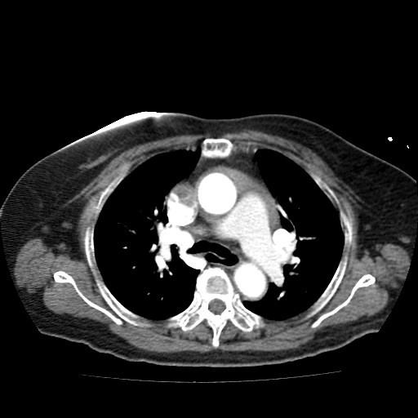
An urgent CT aortogram was ordered. Please comment on the images.

Slide 85
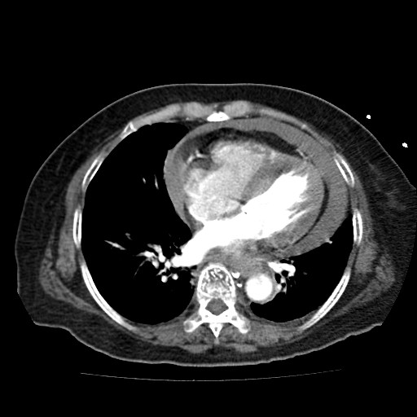

Slide 86
CT findings:
1. no evidence of aortic dissection
2 .pericardial effusion
3. LAAO present, suspected migration

Slide 87
4. What is your final diagnosis? What is the immediate bedside treatment and how would you perform it?

Slide 88
4. What is your final diagnosis? What is the immediate bedside treatment and how would you perform it?
Haemopericardium causing cardiac tamponade with shock, possibly due to complication of intracardiac device
Bedside pericardiocentesis:
subxiphoid approach
long 18-22 G needle attached to syringe
insertion: between xiphisternum and left costal margin
direct towards the left shoulder at 40 degree angle to skin
continual aspiration as needle approaches RV
once pericardial fluid aspirated, can insert cannula into pericardial space
attach a 3 way tap and remove fluid until improvement in haemodynamics

Slide 89
5. After the emergency procedure was performed, the patient’s BP rose to 90/50 mmHg. The chest and back pain also subsided. What will you do now?

Slide 90
5. After the emergency procedure was performed, the patient’s BP rose to 90/50 mmHg. The chest and back pain also subsided. What will you do now?
Consult cardiothoracic surgeon and ICU
For surgical exploration + repair of pericardium

Slide 91
Thank you!

